Slide 1
HARDWARE ACCELERATED AUTHENTICATION FOR VEHICULAR NETWORKS
ATTILA A. YAVUZ (OREGON STATE UNIVERSITY)
IOANNIS PAPAPANAGIOTOU, PHD
ANAND MUDGERIKAR, ANKUSH SINGLA (PURDUE UNIVERSITY)
Notes:
1

Slide 2
Outline
Vehicular Networks: Authentication and Scalability Challenges
Limitations of Existing Authentication Methods
Contribution: Hardware Accelerated Authentication
Cryptographic Algorithm: Rapid Authentication (RA)
Hardware Acceleration (HAA)
Realization Details and Performance Analysis
Implementation Results
Priority Queue and Dynamic Scheduler
Conclusion & future work

Slide 3
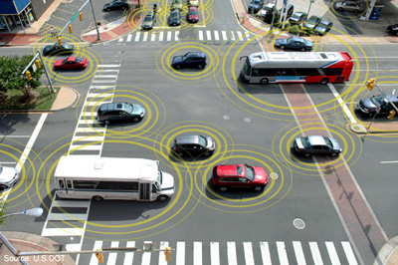
Vehicular Networks
Vehicles are equipped with advanced sensing, communication technologies
Growing at an annual rate of almost 35% [1]
Vehicular networks play a key role in tactical military systems by providing mobile and ad-hoc communication in battlefields
Connect to surrounding entities
IoV (Internet of Vehicles) will be crucial part of the Internet of Things (IoT)
“ The Connected Car Market to Surpass US$ 131.9 Billion by 2019” - Transparency Market Research
Notes:
3
Add reference for the 35% and put it in the notes
[1] – Transparency Market Research published new report titled “Connected Car Market – Global Industry Analysis, Size, Share, Growth, Trends, and Forecast, 2013 – 2019.”
https://tmrreports.files.wordpress.com/2014/06/connected-car-market-global-industry-analysis-size-share-growth-trends-and-forecast-2013-2019.pdf

Slide 4
Autonomous Vehicle Systems
As an autonomous vehicle, it is capable of sensing its environment and navigating without human input.
Autonomous vehicles can be safer, faster and more efficient than human driven cars.
“You can't have a person driving a two-ton death machine" - Elon Musk, CEO TESLA
“Self-driving cars could account for 9% of global auto sales in 2035, hitting 11.8 million units” - IHS Automotive
Google’s self-driving fleet has clocked over 1.8 million miles with only 12 minor collisions
Notes:
4
References:

Slide 5
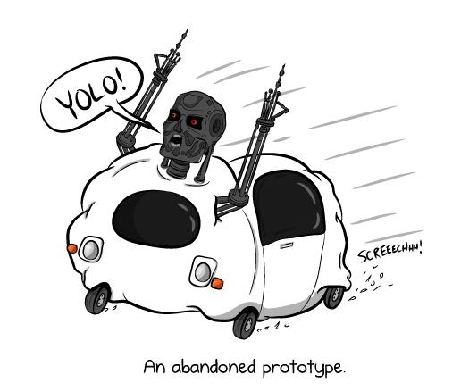
Security Problems
The key issue:
Authentication: Prevent an attacker from injecting or manipulating messages
“Car Hacked in 60 minutes” - Researchers at DARPA were able to take control of many of the car's functions, including the braking and acceleration [2].
Recently, a senate report [3] by Ed Markey, a US Senator from Massachusetts, discussed the security aspects of vehicles
Notes:
5
[2] – News Report by CBS , Car hacked on 60 Minutes, http://www.cbsnews.com/news/car-hacked-on-60-minutes/
[3] - Tracking and Hacking: Security and Privacy Gaps Put American Drivers at Risk, Ed Markey, Senate Report 2015
Add references to the notes
Add more companies
Use the first paragraph from the proposal to get some motivational expressions
Who is Ed?
We have not discussed privacy in our paper. But

Slide 6
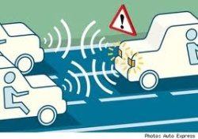
Challenges
Vehicular networks require high message throughput, thousands of messages per second (NHTSA, August 2014) [12].
To ensure reliable operation, the security must be guaranteed in
(i) Real-time: A few msec end-to-end crypto delay [13]
(ii) Scalable: Millions of cars in an ad-hoc manner.
The computational and transmission overhead introduced by the crypto method should not impact the safety of IoVs.
Existing crypto mechanisms introduce significant computation and bandwidth overhead, which creates critical safety problems.
ECDSA impact break distance negatively [4,14].
Standard digital signatures are too slow [12,13].
Notes:
6

Slide 7
Limitations of existing approaches
Symmetric crypto (e.g., MACs only): unscalable, no public verifiability
Delayed Seed Disclosure: TESLA variants [7], delay issues and time sync.
Standard signatures (e.g., ECDSA, RSA) are too slow [4,12,13,14].
One-time signatures: Very fast but very large signatures (5KB) [11].
Offline/online signatures [4,8,9,10]: Pre-compute tokens offline, use them for efficient signing online
RAPID AUTHENTICATION (RA) [4] very fast but:
Offline/online methods deplete tokens on high throughput applications
HW-acceleration has not been investigated for RA in specific and offline/online signature in general.

Slide 8
Solution: Hardware Accelerated Authentication
Developed a comprehensive cryptographic hardware-acceleration framework Hardware-Accelerated Authentication (HAA)
Exploits existing structures in the vehicular communication messages to enable pre-computation for signature schemes like RSA.
It is based on an online/offline signature scheme known as Rapid Authentication.
HAA offers significant performance improvements over standard signatures (e.g., ECDSA,RSA) for high throughput applications.
Scheme | End-End Crypto Delay per-msg (msec)
RSA (2048) | 4
ECDSA (256) | 1.18
RA (2048) | 0.69
HAA (2048) (4096 token) | 0.21
Notes:
8
- All the end-end delay values are for server systems. RSA and ECDSA on CPU and HAA using GPU.
- RSA is one of the first practical public-key cryptosystems and is widely used for secure data transmission
- ECDSA The Elliptic Curve Digital Signature Algorithm is the elliptic curve analogue of the Digital Signature Algorithm (DSA). It was accepted in 1999 as an ANSI standard, and was accepted in 2000 as IEEE and NIST standards.

Slide 9
Crypto Algorithm: Rapid Authentication [4]
Observation: Aggregation of some signatures is a magnitude of times faster than their signature generation (e.g., RSA).
IDEA: Leverage structures in messages to pre-compute RSA signatures offline, then combine them with aggregation online.
Each message is divided into certain fixed sub-messages (pre-structured)
Offline phase: Pre-compute and store an RSA signature on each of the sub-messages.
Online Phase: The signer combines individual RSA signatures of relevant sub-messages via Condensed-RSA to sign a message.
The verification is also efficient, as it requires a standard RSA signature verification plus a few modular multiplications.
Notes:
9
Can add maths to it
Add citation for condensed-RSA

Slide 10
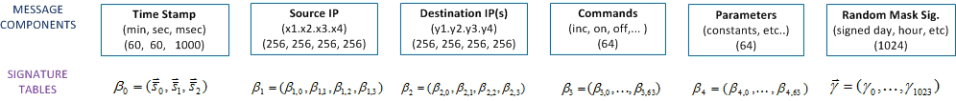
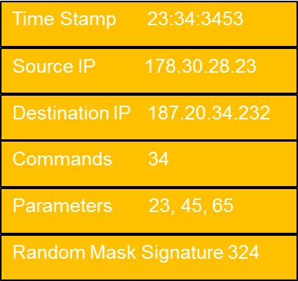

S_{23,34,34533453}
β_{1,4}
β_{2,3}
Β_{3,64}
Β_{4,43}
Υ₃₂₄
Verifier
Time Stamp 23:34:3453
Source IP 178.30.28.23
Destination IP 187.20.34.232
Signature
Commands 34
Parameters 23, 45, 65
Random Mask Signature 324

Slide 11
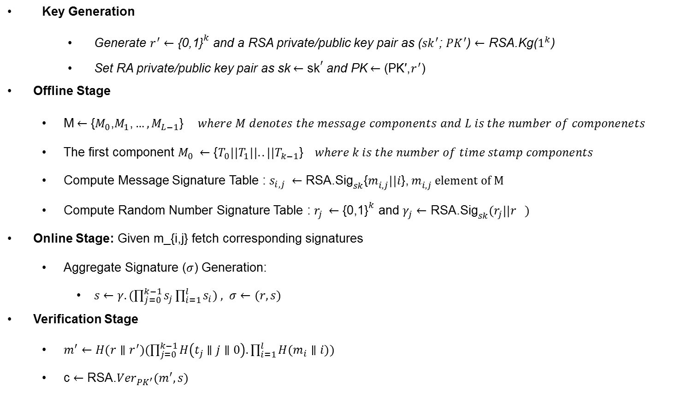
Rapid Authentication Details
Key Generation
Generate $r^{′}←{\text{\{0,1\}}}^{k}$ and a RSA private/public key pair as (${sk}^{′}$; ${PK}^{′}$) $←$ RSA.Kg($1^{k}$)
Set RA private/public key pair as sk$←{\text{sk}}^{′}$ and PK$←{\text{(}\text{PK}\text{′,}r^{′}\text{)}}^{}$
Offline Stage
M$←{\text{\{}M_{0}\text{,}M_{1}\text{,}…,M_{L−1}\text{\}}}^{} where M denotes the message components and L is the number of componenets$
The first component $M_{0} ←{\text{\{}T_{0}\text{||}T_{1}||..||T_{k−1}\text{\}}}^{} where k is the number of time stamp components$
Compute Message Signature Table : $s_{i,j} ←{{\text{RSA}\text{.}\text{Sig}}_{sk}\text{\{}m_{i,j}^{}||i\text{\}}\text{,}{ m}_{i,j}^{} element of M}^{}$
Compute Random Number Signature Table : $r_{j} ←{\text{\{0,1\}}}^{k}$ and $γ_{j}←{\text{RSA}\text{.}\text{Sig}}_{sk}(r_{j}||r_{})$
Online Stage: Given m_{i,j} fetch corresponding signatures
Aggregate Signature ($σ$) Generation:
$s←γ.(\prod_{j=0}^{k−1}{s_{j}}\prod_{i=1}^{l}{s_{i}) , σ←(r,s)}$
Verification Stage
$m^{′}←H(r∥r^{′})(\prod_{j=0}^{k−1}{H\left(t_{j}∥j∥0\right).}\prod_{i=1}^{l}{{H(m}_{i}∥i)) }$
c $←{\text{RSA}\text{.}Ver}_{PK^{′}}(m^{′},s)$

Slide 12
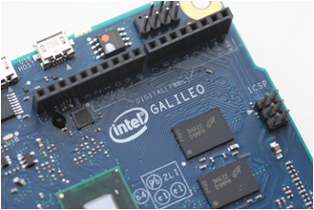

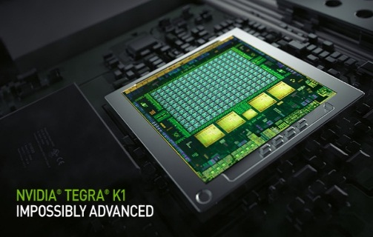
System on Chips (SoC)
A system on a chip (SoC) is an integrated circuit (IC) that integrates all components of a computer into a single chip
Embedded SoCs are used by major car manufacturers (e.g., Audi, BMW, Ford, Mercedes and Tesla) for their infotainment and communication systems
Already available source of high performance computing in vehicles
Come with high-bandwidth peripherals, sensors, network interfaces
They include embedded GPUs

Slide 13
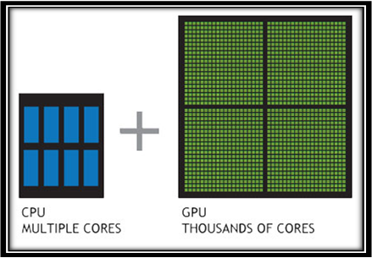
Graphic Processing Units (GPU)
CPU: A few cores optimized for sequential serial processing.
GPU: Massively parallel architecture consisting of thousands of smaller, more efficient cores designed for handling multiple tasks simultaneously.
Offload compute-intensive portions of the application to the GPU, while the remainder of the code still runs on the CPU.

Slide 14
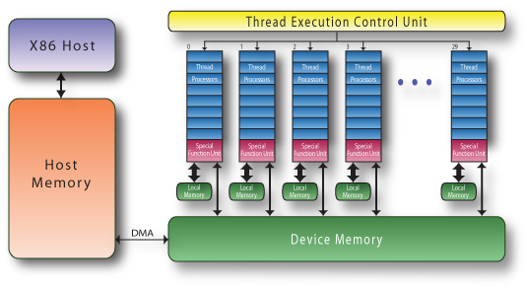
Hardware Acceleration
We implement RA scheme [4] on GPUs
We utilize the thousands of cores that GPUs have to process parallel workloads efficiently
We have made several optimizations to the algorithm to parallelize the individual steps of the Crypto algorithms.
We also used optimizations specific to the architecture of the GPU to realize the full potential of the available cores.
Notes:
14

Slide 15
Specific Techniques used
Algorithm optimizations :
CRT (Chinese Remainder Theorem)
Montgomery Reduction
Hardware optimizations
Batch Processing
Breakup of components into words
GPU warp size utilization
Memory latency vs GPU Occupancy
Constant Length Non-zero Window Technique
Notes:
15
Batch processing- Message components are processed in batches. That is, the crypto operations for multiple messages are performed concurrently in the GPU.
Breakup of components into words- each message component is divided into words of size 32/64 bit and each operation being run on a single thread is run over words rather than entire message components.
GPU warp size utilization- Warps are set of threads (generally 32) that are considered as one single execution unit inside a CUDA block. We aim to attain the maximum number of active warps per streaming multiprocessor which is 64 in our case.
Memory latency vs GPU Occupancy- We attain an optimum balance between the SM occupancy and the Global memory read/write latency through testing various permutations of memory allocations among the shared and global memory.
Constant Length Non-zero Window Technique- We scan the bits of the exponent from the least significant to the most significant. At each step, we compute a zero window or a non-zero window.

Slide 16
Token Regeneration and Online Signing
Offline (depleted tokens, online) phase: Pre-compute and store an RSA signature on each of the sub-messages during the offline phase.
GPUs are highly effective to replenish tokens
Massive parallel token generation minimizes the impact on online-phase
Online Phase: The signer combines individual RSA signatures of relevant sub-messages via Condensed-RSA to sign a message.
Aggregation hashes and optimized multiplications with GPUs
Majority of this process is parallelizable
Notes:
16

Slide 17
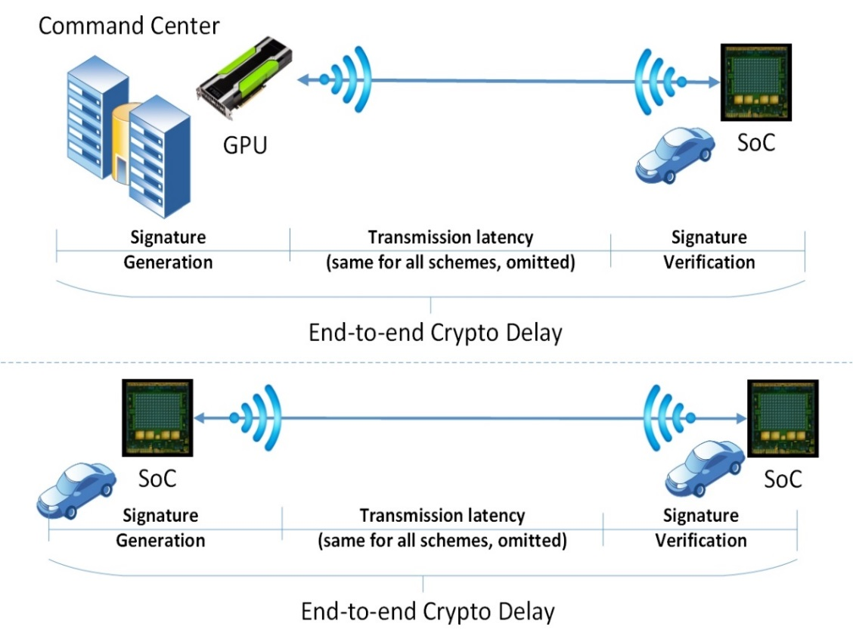
Implementation
System model: Two entities:
Central entities such as static C&C centers or satellites, which are resourceful and equipped with GPUs
Mobile entities such as vehicles which are equipped with SoC
Implementaion on server GPUs and SoCs.
i7-5930K CPU
Nvidia Tesla K40c GPU with 2880 computing cores.
Nvidia Tegra K1 SoC with an embedded GPU of 192 cores.
Notes:
17
- Add diagram from the paper

Slide 18
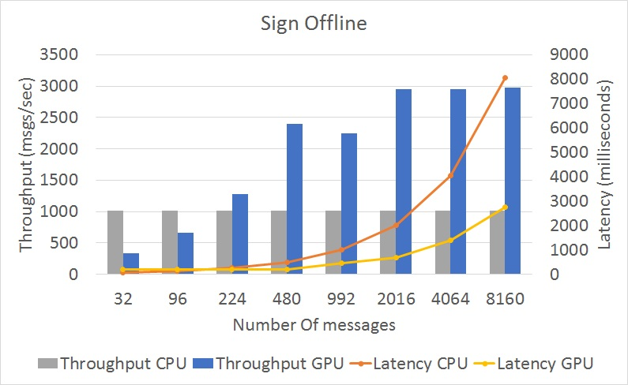
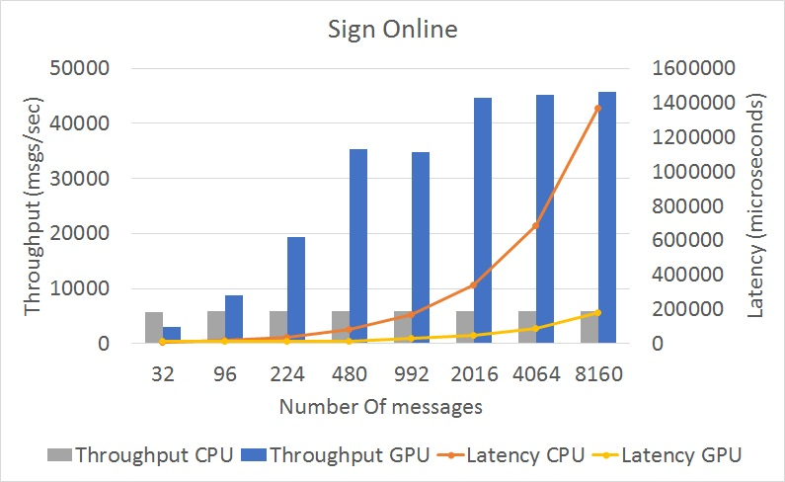
Performance Analysis (Server Side)
i7-5930K CPU and a Nvidia Tesla K40c GPU with 2880 computing cores and 12GB RAM
Up to 8160 messages,
Offline sign stage:
x3 times more throughput with our GPU optimizations compared to CPU only.
Online sign stage: Gains up to x7 times.
The verify stage, the gain is around x1.3
Notes:
18

Slide 19
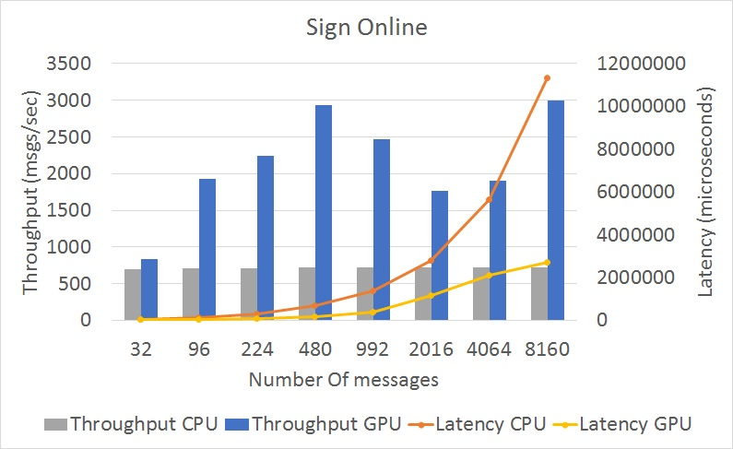
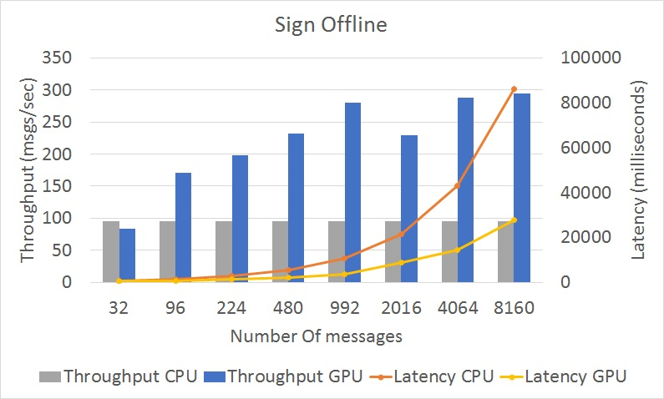
Performance Analysis (SoC)
Nvidia Tegra K1 SoC with an embedded GPU of 192 cores
Offline sign stage:
x3.1 more throughput with GPU compared to CPU only.
Online sign stage:
gains upto x4.1 times.
The verify stage: GPU~=CPU
Notes:
19
Why verify stage is slower in SoC ?
-

Slide 20
Observations on GPU Behavior
The throughput increases as the number of messages increases, BUT:
Saturation point: Throughput does not increase beyond a point and even fluctuates
The reason for this is exhaustion of shared memory of the GPU
The total shared memory available is limiting factor for the overall throughput
Memory Utilization in Server and SoC

Slide 21
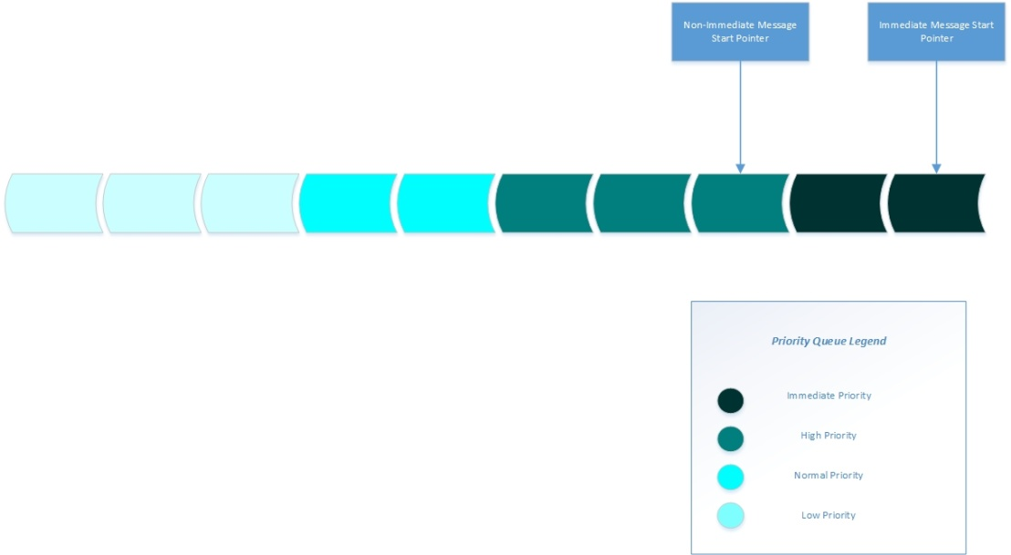
Priority-Based Scheduling
CANT’ WAIT: Immediate Messages (the highest priority), vehicle crashes, losing steering control, break failure cannot afford buffered and require immediate processing.
A priority queue (FIFO data structure) : Messages are authenticated according to their priority level.
The incoming messages inserted at their respective positions in the queue according to their priority.
Notes:
As and when the messages are generated the system will look for the suitable location to insert the message. The messages will be inserted after the messages of priority equal to its own but before the messages having priority lesser than it. This will allow non-pre-emptive preferential processing of the messages according to their urgency and critical nature.
21

Slide 22
Dynamic Scheduler
The dynamic scheduler decides which processor CPU/GPU will process the messages in the queue and the amount of messages to be fed to the GPU.
Threshold value: Min. # of messages, for which GPU outperforms CPU.
If # messages > threshold, the scheduler will hand over all of these messages to the GPU in batch.
Check is performed: A non-immediate message is inserted or GPU is idle
The immediate messages (high priority) always processed by the CPU.
Notes:
We assume that the immediate messages, for e.g., vehicle crash, losing steering control, break failure will be a rare occurrence and never exceed the /tau value at one time even under extreme circumstances. So, not a big factor in affecting the performance.
22

Slide 23
Conclusion
Our experimental results demonstrate the potential of HAA:
speedup of x18, x6 and x3 than the corresponding RSA, ECDSA and RA, respectively.
leverages the CPU and GPU capabilities on Systems-on-chip(SoC)
has dynamic scheduling to maximize throughput
performs prioritized processing of messages based on urgency and criticality
employs a unique offline/online signature division strategy
Notes:
23

Slide 24
Future (&Current) Work:
We eliminate “structured message requirement”
Structure-free Compact RA (SCRA)
Applicable to any vehicular scenario
Instantiated with different crypto schemes
NTRU and BLS for compactness
Incorporate SCRA into HW-acceleration
We obtain several magnitude of times faster results over std. Signatures
Road tests are being planned
Explore the potential of SCRA on drone networks, smart-grids,... and

Slide 25



Slide 26
References
[1] Car Market - Global Industry Analysis, Size, Share, Growth, Trends, and Forecast, 2013 - 2019.
[2] News Report by CBS , Car hacked on 60 Minutes, http://www.cbsnews.com/news/car-hacked-on-60-minutes/
[3] Tracking and Hacking: Security and Privacy Gaps Put American Drivers at Risk, Ed Markey, Senate Report 2015
[4] Attila A. Yavuz. An efficient real-time broadcast authentication scheme for command and control messages. IEEE Transactions on Information Forensics and Security, 9(10):1733–1742, Oct 2014.
[5] R.L. Rivest, A. Shamir, and L.A. Adleman. A method for obtaining digital signatures and public-key cryptosystems. Communications of the ACM, 21(2):120–126, 1978
[6] American Bankers Association. ANSI X9.62-1998: Public Key Cryptography for the Financial Services Industry: The Elliptic Curve Digital Signature Algorithm (ECDSA), 1999
[7] Perrig, R. Canetti, D. Song, and D. Tygar. Efficient authentication and signing of multicast streams over lossy channels. In Proceedings of the IEEE Symposium on Security and Privacy, May 2000
[8] D. Naccache, D. M’Raïhi, S. Vaudenay, and D. Raphaeli. Can D.S.A. be improved? Complexity trade-offs with the digital signature standard. In Proceedings of the 13th International Conference on the Theory and Application of Cryptographic Techniques (EUROCRYPT ’94), pages 77–85, 1994
[9] D. Catalano, M. D. Raimondo, D. Fiore, and R. Gennaro. Off-line/on-line signatures: Theoretical aspects and experimental
results. Public Key Cryptography (PKC), pages 101–120. Springer-Verlag, 2008
[10] A. Shamir and Y. Tauman. Improved online/offline signature schemes. In Proceedings of the 21st Annual International Cryptology Conference on Advances in Cryptology, CRYPTO ’01, pages 355–367, London, UK, 2001
[11] L. Reyzin and N. Reyzin. Better than BiBa: Short one-time signatures with fast signing and verifying. In Proceedings of the 7th
Australian Conference on Information Security and Privacy (ACIPS ’02), pages 144–153. Springer-Verlag, 2002.

Slide 27
References (Cont’)
[12] John Harding, Gregory Powell, Rebecca Yoon, Joshua Fikentscher, Charlene Doyle, Dana Sade, Mike Lukuc, Jim Simons, and Jing Wang. Vehicle-to-Vehicle Communications: Readiness of V2V Technology for Application. U.S. Department of Transportation National Highway Traffic Safety Administration (NHTSA), August 2014.
[13] IEEE guide for wireless access in vehicular environments (WAVE) - architecture. IEEE Std 1609.0-2013, pages 1–78, March 2014.
[14] S. S. Manvi, M. S. Kakkasageri, and D. G. Adiga. Message authentication in vehicular ad hoc networks: ECDSA based approach. In Proceedings of the 2009 International Conference on Future Computer and Communication, ICFCC ’09, pages 16–20, Washington, DC, USA, 2009. IEEE Computer Society

