Slide 1
Chapter 2:
Beginning the Problem-Solving Process

Slide 2
Chapter Objectives
Explain the problem-solving process used to create a computer program
Analyze a problem
Complete an IPO chart
Plan an algorithm using pseudocode and flowcharts
Desk-check an algorithm
An Introduction to Programming with C++, Eighth Edition

Slide 3
Problem Solving
People solve hundreds of simple problems every day without thinking about how they do it
Understanding the thought process involved can help in solving more complex problems
You can also use a similar process to design a computer solution to a problem (computer program)
An Introduction to Programming with C++, Eighth Edition

Slide 4
Solving Everyday Problems
First step in solving a problem: analyze it
  Example: paying and mailing a bill
Next, you plan, review, implement, and evaluate the solution
After this, it may be necessary to modify the solution
An Introduction to Programming with C++, Eighth Edition

Slide 5
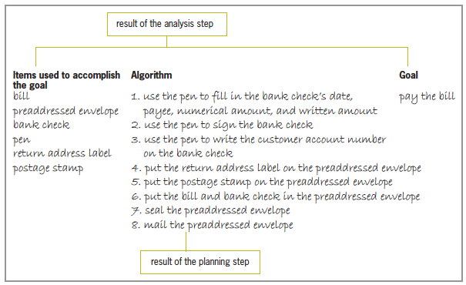
Solving Everyday Problems (cont’d.)
Figure 2-1 Summary of the analysis and planning steps for the bill paying problem
An Introduction to Programming with C++, Eighth Edition

Slide 6
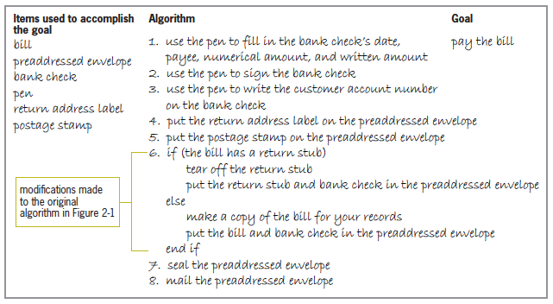
Solving Everyday Problems (cont’d.)
Figure 2-2 Modified algorithm for the bill paying problem
An Introduction to Programming with C++, Eighth Edition

Slide 7
Creating Computer Solutions to Problems
A similar process to everyday problem solving is used to create computer programs
A computer program is a solution implemented on a computer
There are six steps to creating a computer solution to a problem
An Introduction to Programming with C++, Eighth Edition

Slide 8
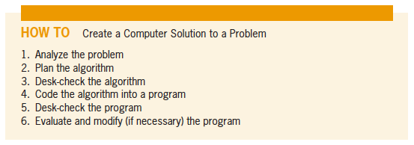
Creating Computer Solutions to Problems (cont’d.)
Figure 2-3 How to create a computer solution to a problem
An Introduction to Programming with C++, Eighth Edition

Slide 9
Step 1−Analyzing the Problem
It is essential to understand a problem before creating a solution to it
Analyze a problem to:
  Determine the goal of solving it (Output)
  Determine the items needed to achieve that goal (Input)
Always search first for the output
An Introduction to Programming with C++, Eighth Edition

Slide 10
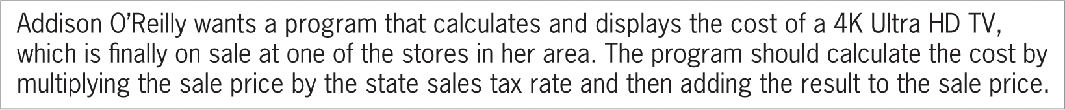
Step 1−Analyzing the Problem (cont’d.)
Figure 2-4 Problem specification for Addison O’Reilly
An Introduction to Programming with C++, Eighth Edition

Slide 11
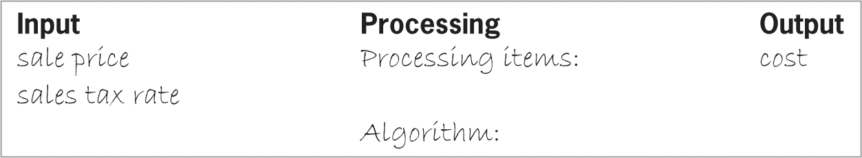
Step 1−Analyzing the Problem (cont’d.)
Some programmers use an IPO chart to organize and summarize the results of a problem analysis
  IPO: Input, processing, and output
Figure 2-5 Partially completed IPO chart
showing the input and output items
An Introduction to Programming with C++, Eighth Edition

Slide 12
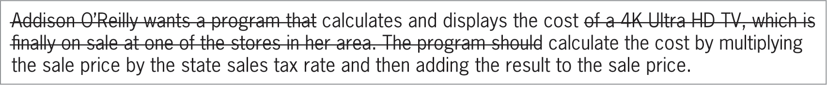
Hints for Analyzing Problems
Several readings of the problem may be necessary to fully understand the problem
Cross out irrelevant information in the problem description
Figure 2-6 Problem specification with
unimportant information crossed out
An Introduction to Programming with C++, Eighth Edition

Slide 13
Hints for Analyzing Problems (cont’d.)
Some problem specifications contain incomplete information
Figure 2-7 Problem specification that does
not contain enough information
An Introduction to Programming with C++, Eighth Edition

Slide 14
Hints for Analyzing Problems (cont’d.)
Distinguish between information that is missing and information that is implied
Figure 2-8 Problem specification in
which the input is not explicitly stated
An Introduction to Programming with C++, Eighth Edition

Slide 15
Step 2−Planning the Algorithm
Algorithm: set of instructions that will transform the problem’s input into its output
  Record in the Processing column of the IPO chart
  Can be written as pseudocode or a flowchart
Pseudocode: tool programmers use to help plan an algorithm
  Short English statements
  Not standardized
  Not understandable by a computer
An Introduction to Programming with C++, Eighth Edition

Slide 16
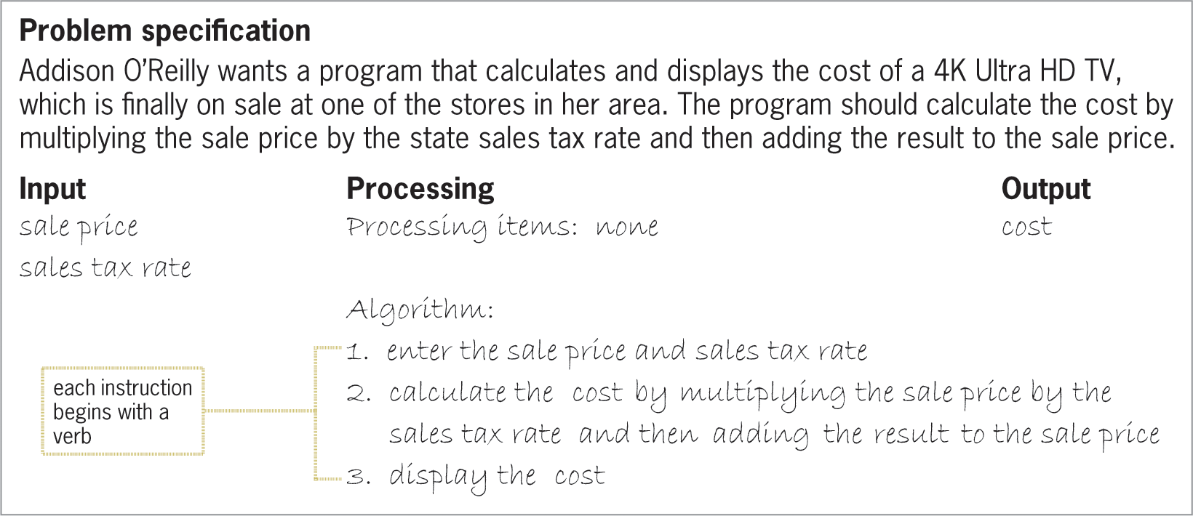
Step 2−Planning the Algorithm (cont’d.)
Figure 2-9 Problem specification and IPO
chart for the Addison O’Reilly problem
An Introduction to Programming with C++, Eighth Edition

Slide 17
Step 2−Planning the Algorithm (cont’d.)
Flowcharts are also used to plan an algorithm
  Use standardized symbols
  Symbols connected with flowlines
  Oval: start/stop symbol
    Represents beginning and end of algorithm
  Rectangle: process symbol
    Represents tasks such as calculations
  Parallelogram: input/output symbol
    Represents I/O tasks
An Introduction to Programming with C++, Eighth Edition

Slide 18
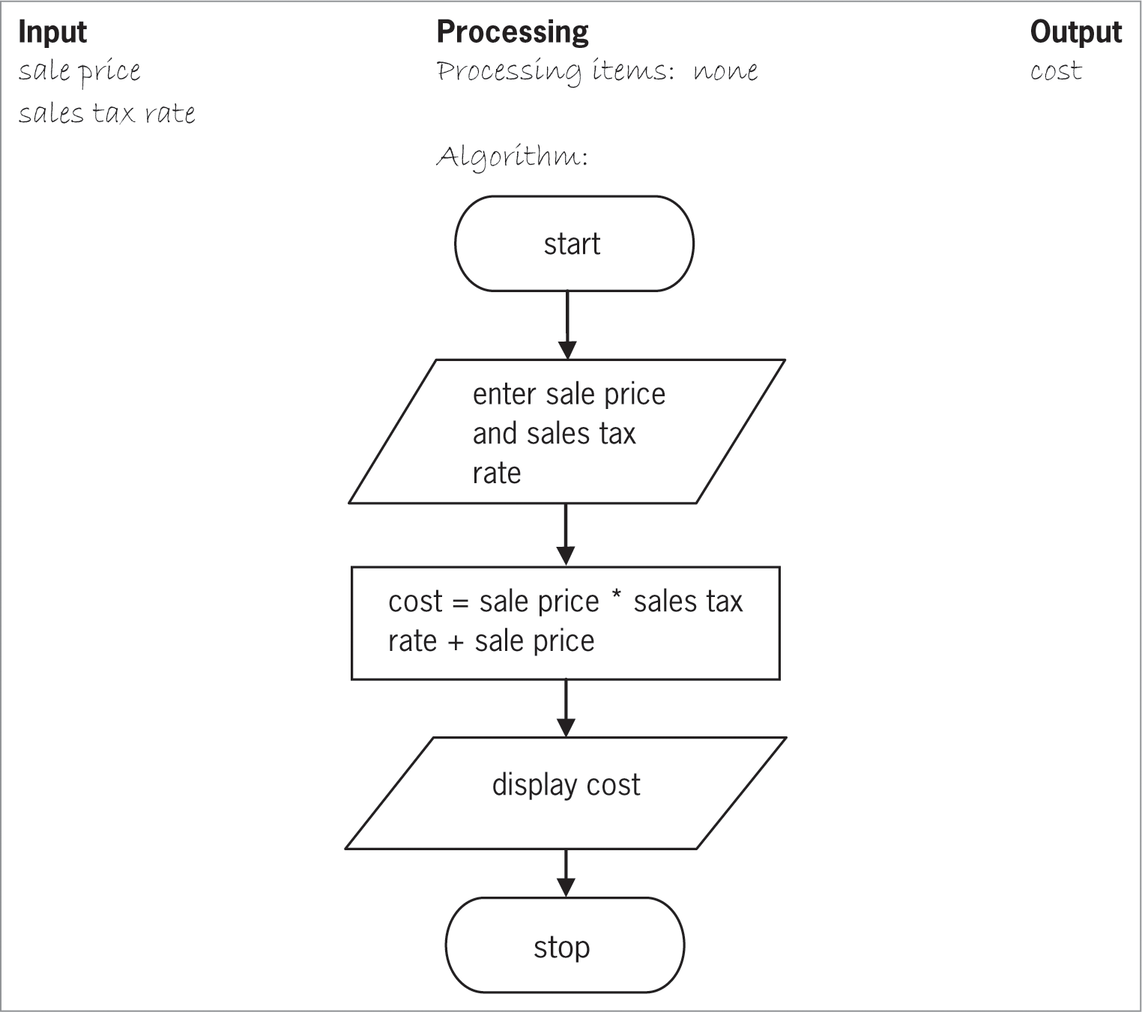
Step 2−Planning the Algorithm (cont’d.)
Figure 2-10 Figure 2-9’s algorithm in flowchart form
An Introduction to Programming with C++, Eighth Edition

Slide 19
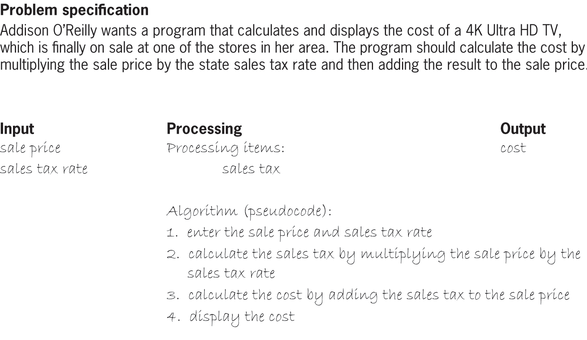
Step 2−Planning the Algorithm (cont’d.)
Figure 2-11 A different solution to the
Addison O’Reilly problem (pseudocode)
An Introduction to Programming with C++, Eighth Edition

Slide 20
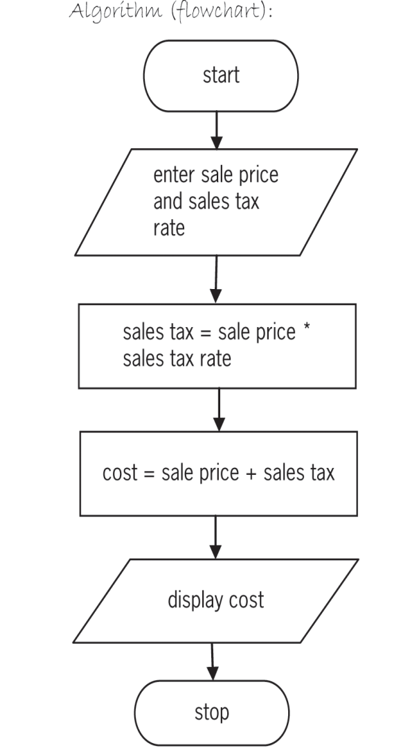
Step 2−Planning the Algorithm (cont’d.)
Processing item: an intermediate value (neither input nor output) the algorithm uses to transform input into output
Figure 2-11 A different solution to the Addison O’Reilly problem (flowchart)
An Introduction to Programming with C++, Eighth Edition

Slide 21
Step 3−Desk-Checking the Algorithm
Desk-checking an algorithm verifies that it is correct
  Refers to checking an algorithm by hand, rather than with a computer
  Also called hand-tracing
Choose sample data and manually compute the expected output value
Creating a desk-check table can be helpful
An Introduction to Programming with C++, Eighth Edition

Slide 22
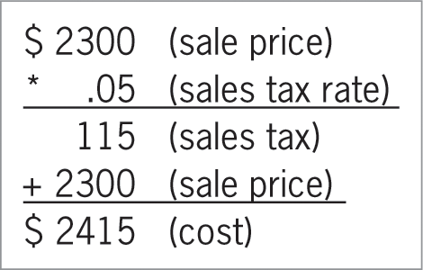
Step 3−Desk-Checking the Algorithm (cont’d.)
Figure 2-12 Manual cost calculation for the first desk-check
An Introduction to Programming with C++, Eighth Edition

Slide 23
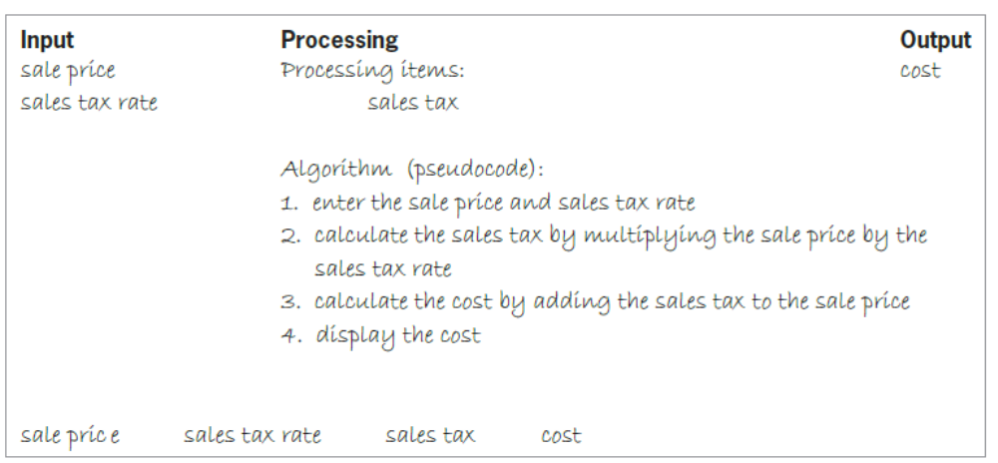
Step 3−Desk-Checking the Algorithm (cont’d.)
Figure 2-13 Addison O’Reilly solution and
partially completed desk-check table
An Introduction to Programming with C++, Eighth Edition

Slide 24
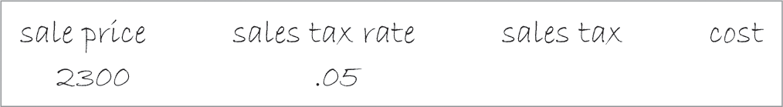
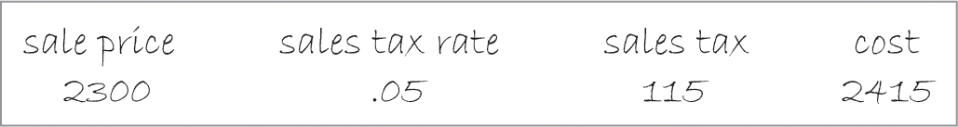
Step 3−Desk-Checking the Algorithm (cont’d.)
Figure 2-14 Input values entered in the desk-check table
Figure 2-16 Output value entered in the desk-check table
An Introduction to Programming with C++, Eighth Edition

Slide 25
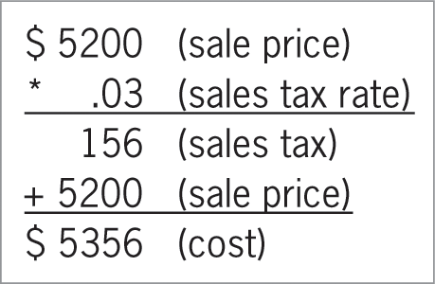
Step 3−Desk-Checking the Algorithm (cont’d.)
Figure 2-17 Manual cost calculation for
the second desk-check
An Introduction to Programming with C++, Eighth Edition

Slide 26
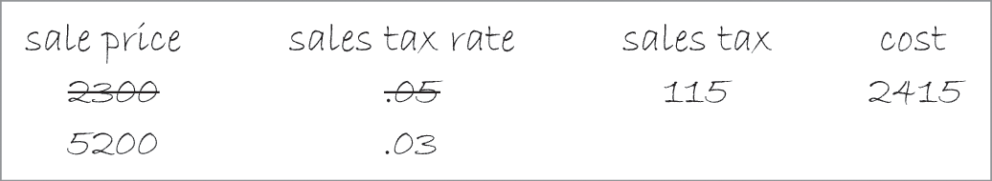
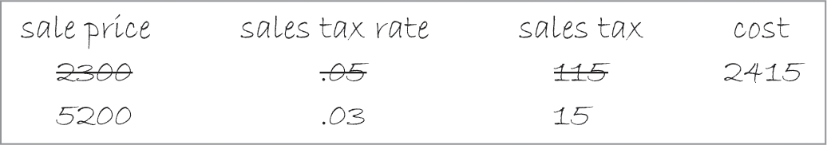
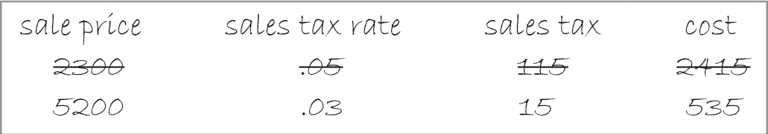
Step 3−Desk-Checking the Algorithm (cont’d.)
Figure 2-18 Second set of input values
entered in the desk-check table
Figure 2-19 Value of the second desk-check’s
processing item entered in the desk-check table
Figure 2-20 Value of the second desk-check’s
output item entered in the desk-check table
An Introduction to Programming with C++, Eighth Edition

Slide 27
Step 3−Desk-Checking the Algorithm (cont’d.)
Valid data: data that the algorithm is expecting the user to enter
Invalid data: data that the algorithm is not expecting the user to enter
You should test an algorithm with invalid data
  Users may make mistakes when entering data
An Introduction to Programming with C++, Eighth Edition

Slide 28
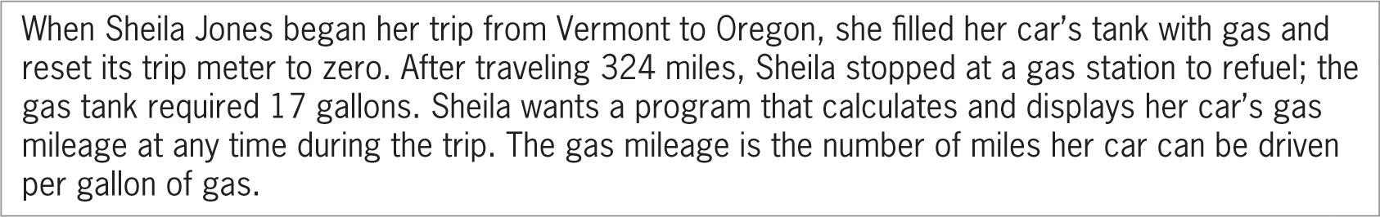
The Gas Mileage Problem
Figure 2-21 Problem specification for the gas mileage problem
An Introduction to Programming with C++, Eighth Edition

Slide 29
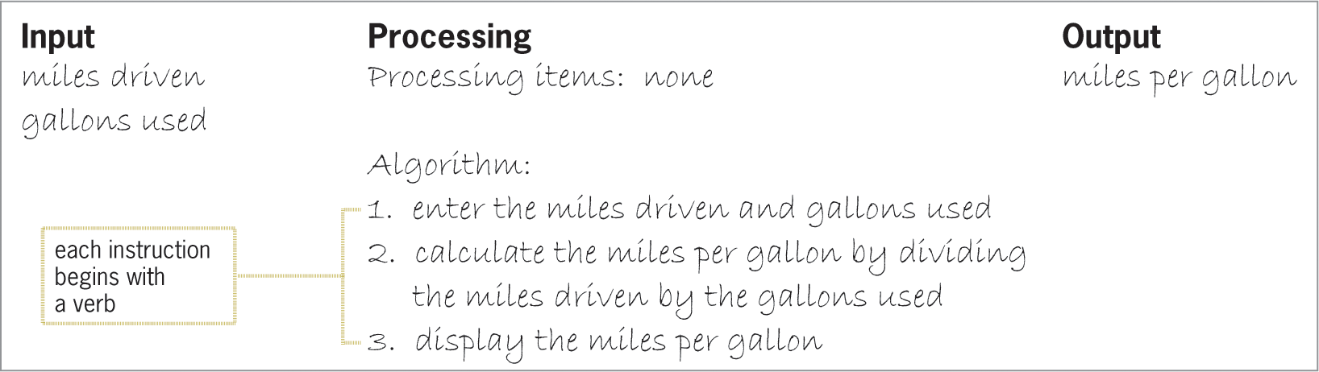
The Gas Mileage Problem (cont’d.)
Plan the algorithm with an IPO chart
Figure 2-22 IPO chart for the gas mileage problem
An Introduction to Programming with C++, Eighth Edition

Slide 30
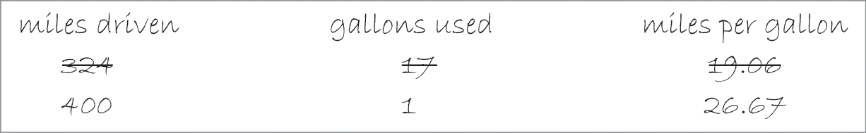
The Gas Mileage Problem (cont’d.)
Then desk-check the algorithm
Figure 2-23 Desk-check table for the gas mileage problem
An Introduction to Programming with C++, Eighth Edition

Slide 31
Summary
Problem solving typically involves analyzing the problem and then planning, reviewing, implementing, evaluating, and modifying (if necessary) the solution
Programmers use tools (IPO charts, pseudocode, flowcharts) to help them analyze problems and develop algorithms
The first step in problem solving is to analyze the problem
  First determine the output and then the input
An Introduction to Programming with C++, Eighth Edition

Slide 32
Summary (cont’d.)
The second step is to plan the algorithm
  Write the steps that will transform the input into the output
  Most algorithms begin with entering input data, then processing the data, then displaying the output
The third step is to desk-check the algorithm
  Choose sample data and manually compute the expected output
  Create a desk-check table to fill in values step by step
An Introduction to Programming with C++, Eighth Edition

Slide 33
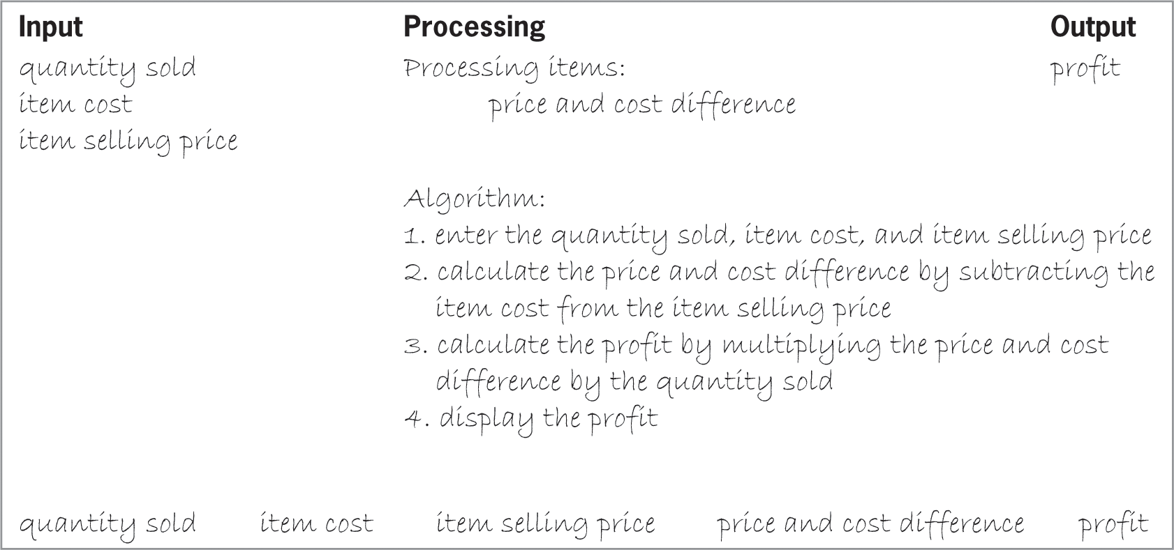
Lab 2-1: Stop and Analyze
Study the IPO chart shown in Figure 2-26 and then answer the questions.
Figure 2-26 IPO chart for Lab 2-1
An Introduction to Programming with C++, Eighth Edition

Slide 34
Lab 2-1: Stop and Analyze (cont’d.)
Complete the desk-check table using two sets of input values. First, use 100, 5, and 8 as the quantity sold, item cost, and item selling price, respectively. The use 650, 2.50, and 3.75. What will the algorithm display using the first set of input values? What will the algorithm display using the second set of input values?
How would you modify the IPO chart to also display the difference between the item cost and item selling price?
How would you modify the IPO chart and desk-check table to eliminate the use of a processing item?
An Introduction to Programming with C++, Eighth Edition

Slide 35
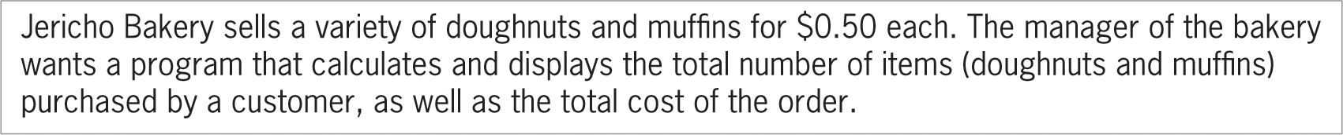
Lab 2-2: Plan and Create
Create an algorithm for the manager of the Jericho Bakery
Figure 2-27 Problem Specification for Lab 2-2
An Introduction to Programming with C++, Eighth Edition

Slide 36
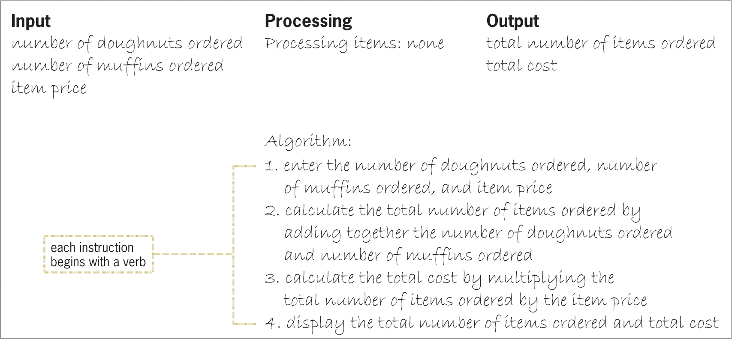
Lab 2-2: Plan and Create (cont’d.)
Figure 2-29 Completed IPO Chart for Lab 2-2
An Introduction to Programming with C++, Eighth Edition

Slide 37
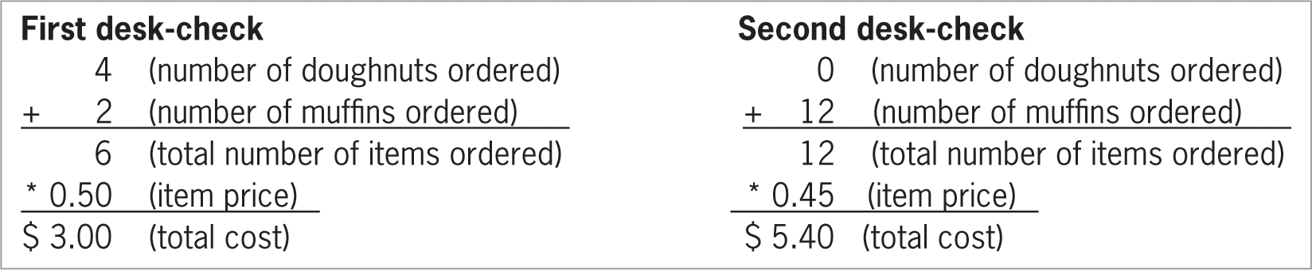
Lab 2-2: Plan and Create (cont’d.)
Figure 2-30 Manual calculations for the two desk-checks
An Introduction to Programming with C++, Eighth Edition

Slide 38
Lab 2-3: Modify
Jericho Bakery has raised the price of its muffins from $0.50 to $0.55.
Make the appropriate modifications to the IPO chart shown earlier in Figure 2-29.
Desk-check the algorithm twice.
For the first desk-check, use 4, 2, 0.50, and 0.55 as the number of doughnuts ordered, number of muffins ordered, doughnut price, and muffin price, respectively.
For the second desk-check, use 0, 12, 0.60, and 0.70.
An Introduction to Programming with C++, Eighth Edition

Slide 39
Lab 2-4: What’s Missing?
A local club sells boxes of three types of cookies: shortbread, pecan sandies, and chocolate mint. The club leader wants a program that displays the percentage that each of the cookie types contributes to the total cookie sales. Figure 2-34 contains a list of items and instructions that you can use for this lab. Fill in the IPO chart and determine whether any items are missing from the list. Next, put the instructions in the proper order and determine the one or more missing instructions.
An Introduction to Programming with C++, Eighth Edition

Slide 40
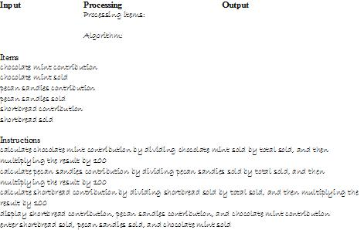
Lab 2-4: What’s Missing? (cont’d.)
An Introduction to Programming with C++, Eighth Edition

Slide 41
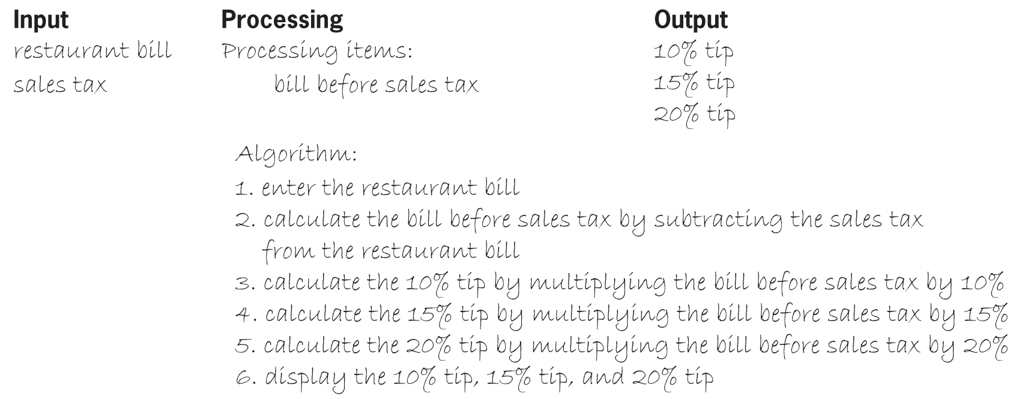
Lab 2-5: Desk-Check
The algorithm in Figure 2-35 displays three suggested amounts to tip a waiter. Desk-check the algorithm twice. First, use $102.50 and $5.80 as the bill amount and sales tax, respectively. Then, use $56.78 and $2.18.
Figure 2-35 IPO chart for Lab 2-5
An Introduction to Programming with C++, Eighth Edition

Slide 42
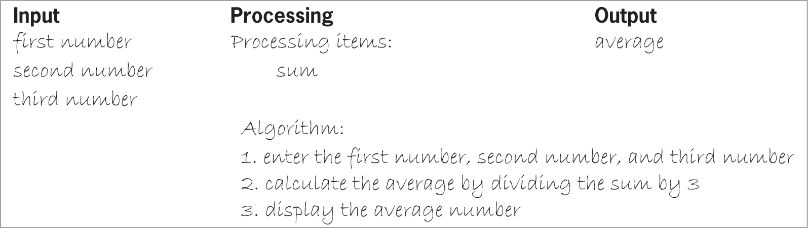
Lab 2-6: Debug
The algorithm below should calculate and display the average of three numbers, but it is not working properly. In this lab, you will find and correct the errors in the algorithm.
Figure 2-36 IPO chart for Lab 2-6
An Introduction to Programming with C++, Eighth Edition

