Slide 1
Chapter 6:
More on the Selection Structure

Slide 2
Objectives
Include a nested selection structure in pseudocode and in a flowchart
Code a nested selection structure
Recognize common logic errors in selection structures
Include a multiple-alternative selection structure in pseudocode and in a flowchart
Code a multiple-alternative selection structure in C++
An Introduction to Programming with C++, Eighth Edition

Slide 3
Nested Selection Structures
True and false paths of a selection structure can contain other selection structures
Inner selection structures are referred to as nested selection structures; contained (nested) within an outer selection structure
Nested selection structures are used when more than one decision needs to be made before choosing an instruction
Inner (nested) selection structures are indented within their outer selection structures
An Introduction to Programming with C++, Eighth Edition

Slide 4
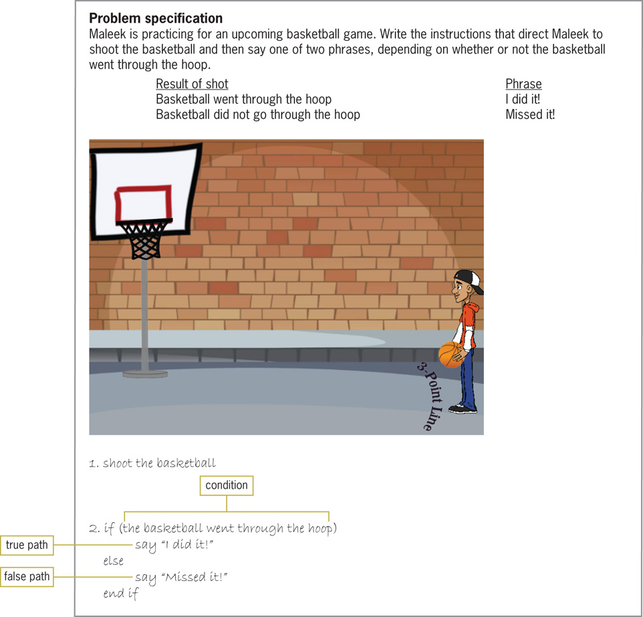
Nested Selection Structures (cont’d.)
Figure 6-1 Problem that requires a selection structure
An Introduction to Programming with C++, Eighth Edition

Slide 5
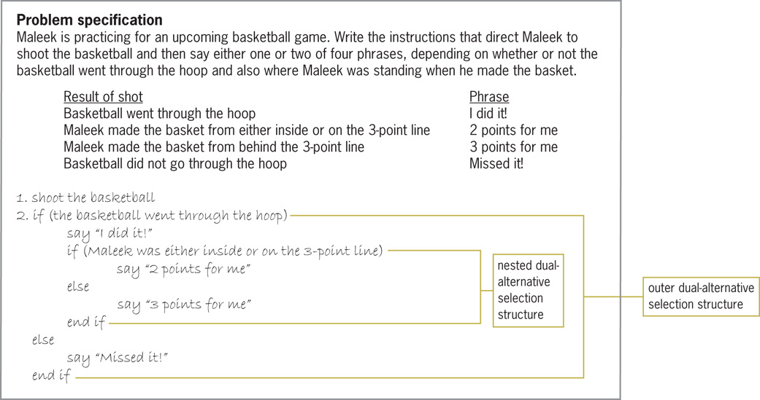
Nested Selection Structures (cont’d.)
Figure 6-2 Problem that requires a nested selection structure
An Introduction to Programming with C++, Eighth Edition

Slide 6
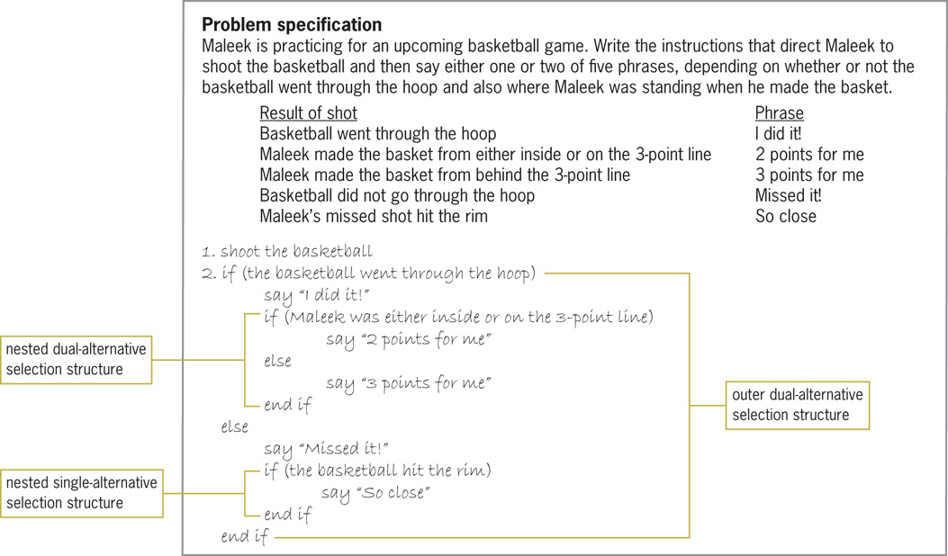
Nested Selection Structures (cont’d.)
Figure 6-3 Problem that requires two nested selection structures
An Introduction to Programming with C++, Eighth Edition

Slide 7
Flowcharting a Nested Selection Structure
Outer and inner selection structures can be thought of as making primary and secondary decisions, respectively
Secondary decision is called such because whether it needs to be made depends on the result of a primary decision
An Introduction to Programming with C++, Eighth Edition

Slide 8
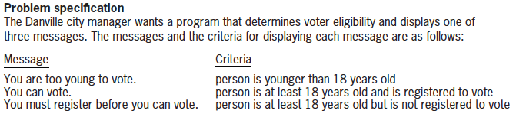
Flowcharting a Nested Selection Structure (cont’d.)
Figure 6-5 Problem specification for voter eligibility problem
An Introduction to Programming with C++, Eighth Edition

Slide 9
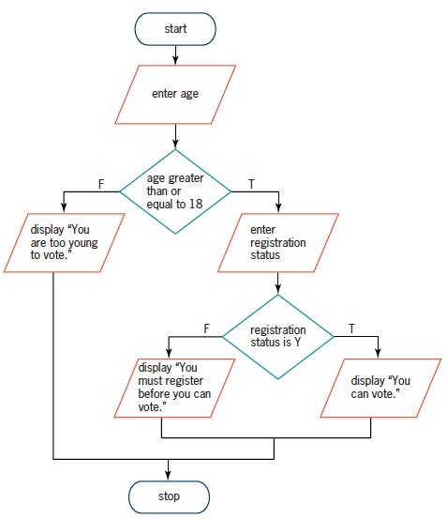
Flowcharting a Nested Selection Structure (cont’d.)
Figure 6-5 A correct solution to the voter eligibility problem
An Introduction to Programming with C++, Eighth Edition

Slide 10
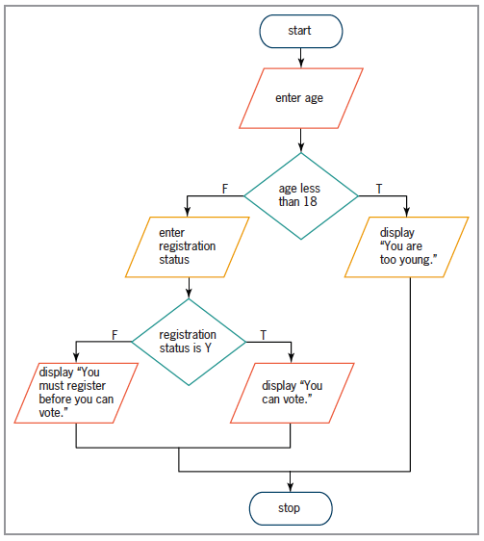
Flowcharting a Nested Selection Structure (cont’d.)
Figure 6-6 Another correct solution to the voter eligibility problem
An Introduction to Programming with C++, Eighth Edition

Slide 11
Coding a Nested Selection Structure
Code for nested selection structures uses the if and else statements
Nested selection structures can be placed in either if or else statement blocks
Correct tabbing makes code easier to read
An Introduction to Programming with C++, Eighth Edition

Slide 12
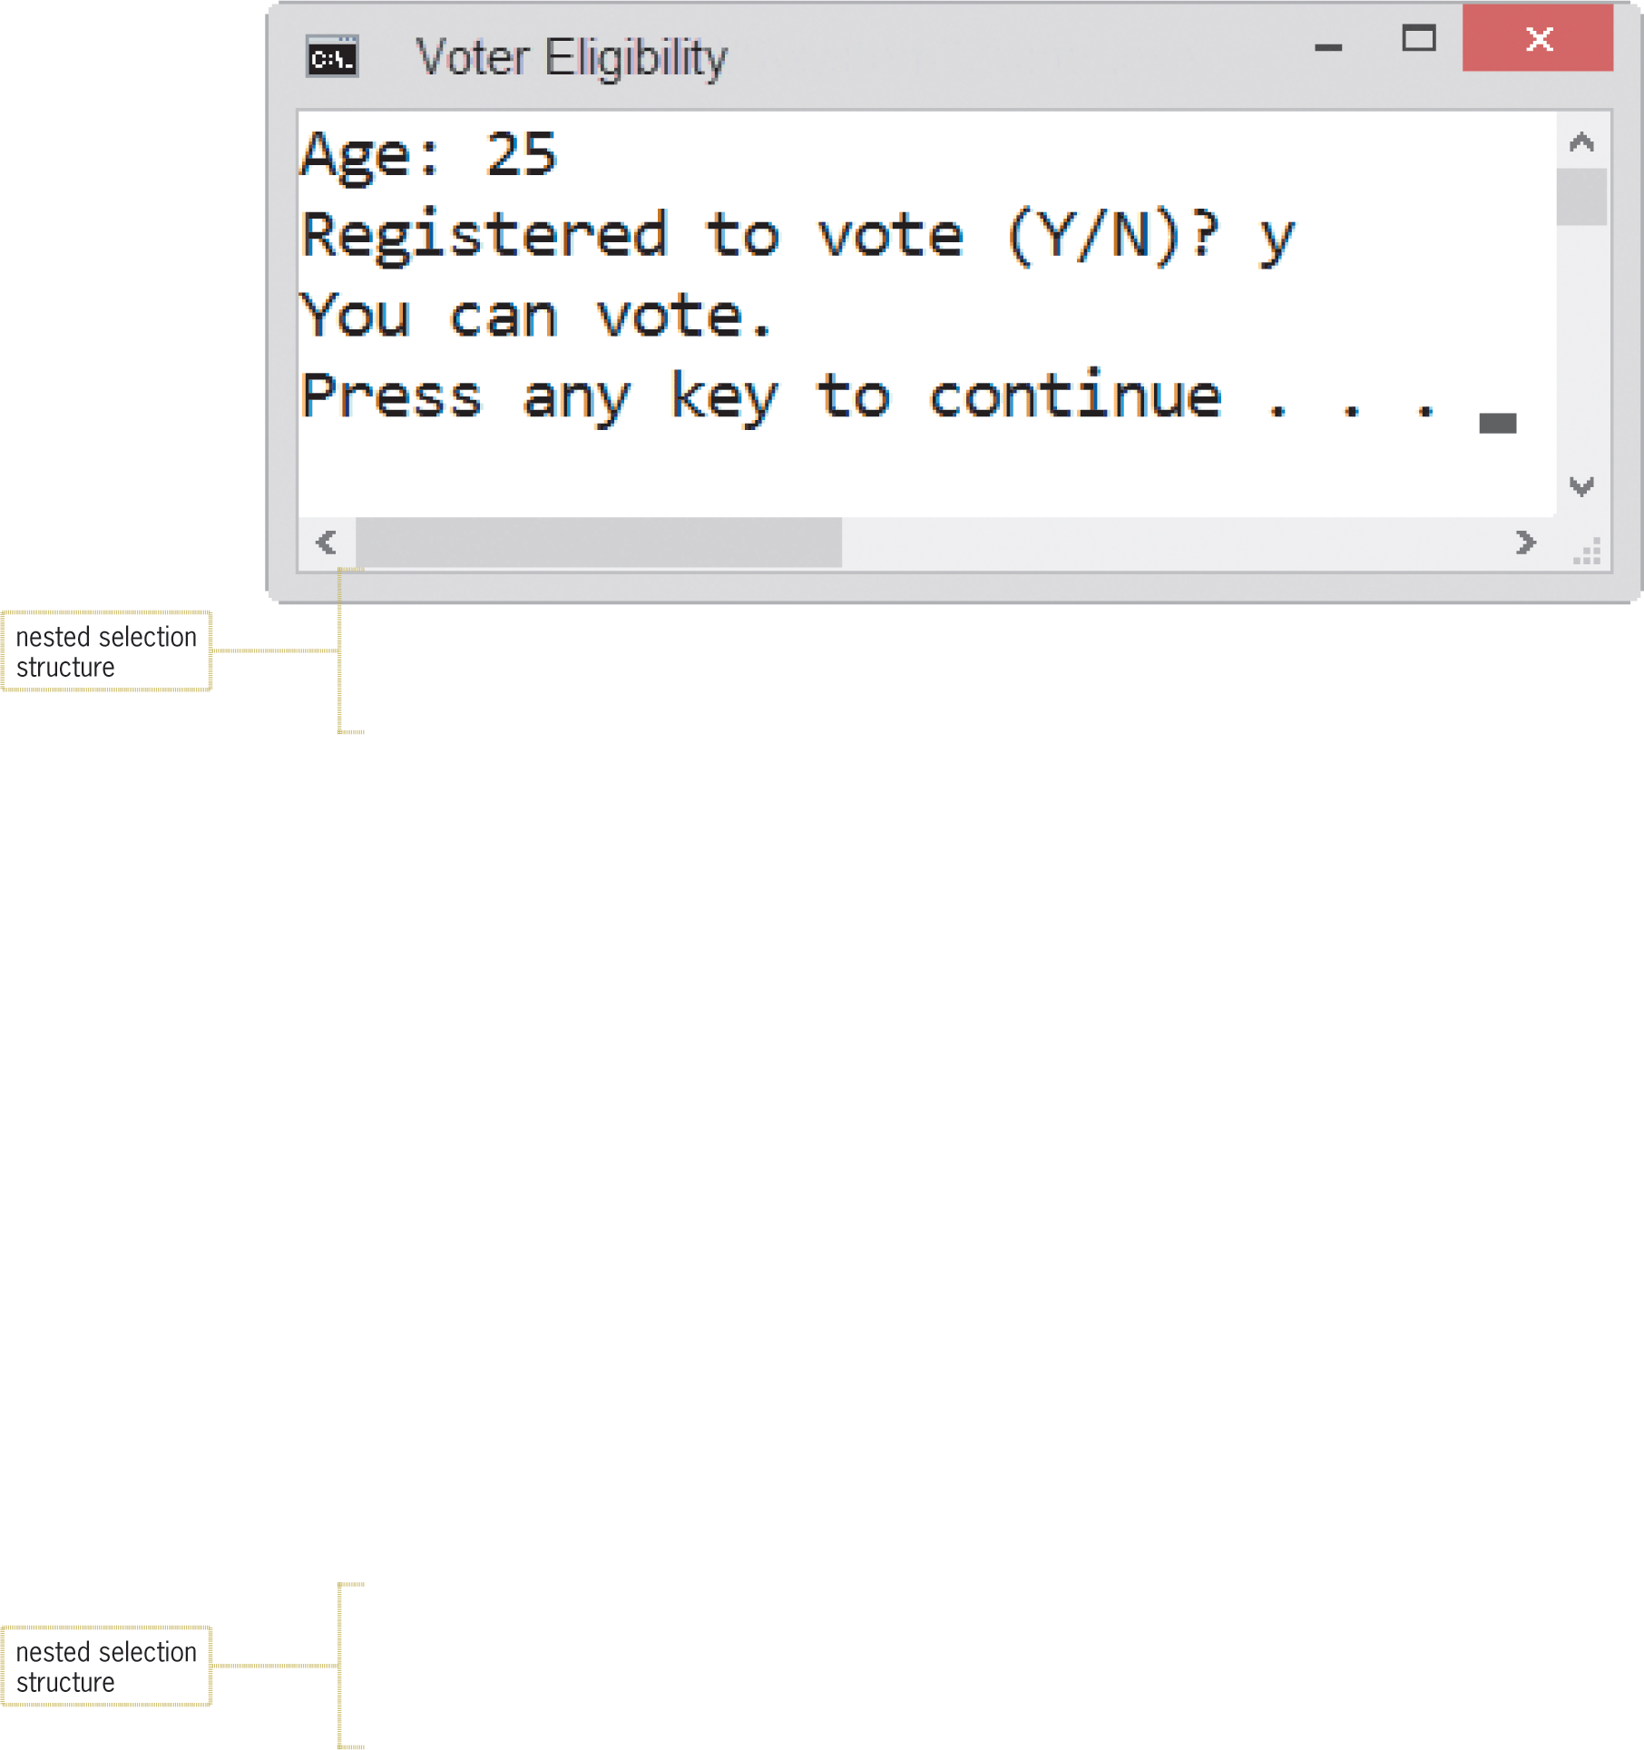
Coding a Nested Selection Structure (cont’d.)
Figure 6-7 Code and sample run of the voter eligibility program
An Introduction to Programming with C++, Eighth Edition

Slide 13
Logic Errors in Selection Structures
Four common logic errors made when writing selection structures
  Using a compound condition rather than a nested selection structure
  Reversing the outer and nested decisions
  Using an unnecessary nested selection structure
  Including an unnecessary comparison in a condition
An Introduction to Programming with C++, Eighth Edition

Slide 14
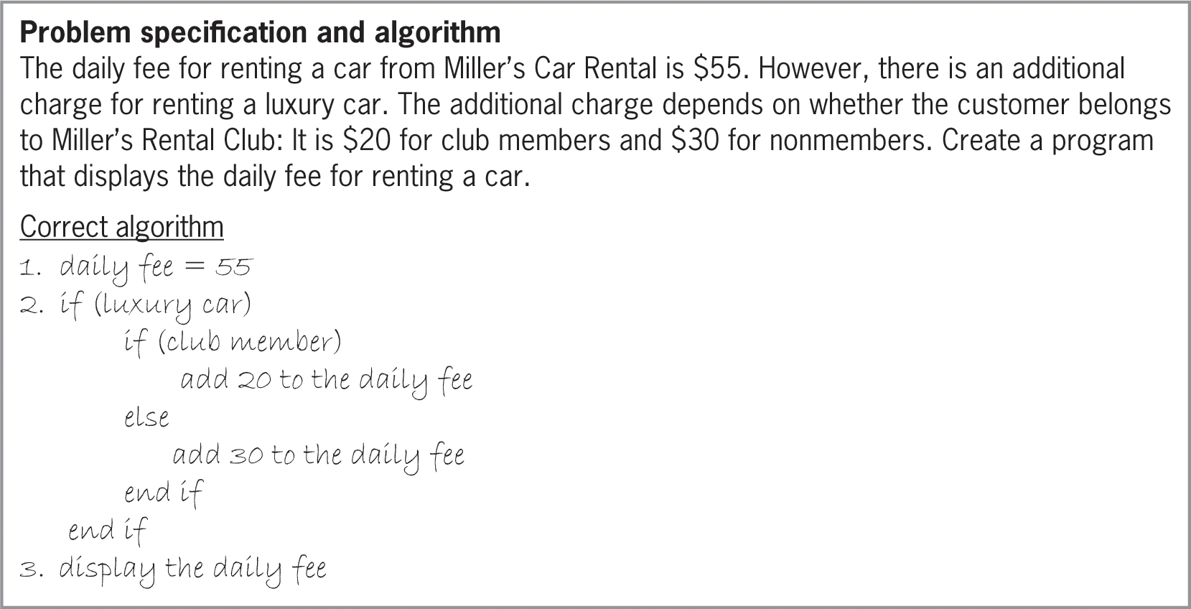
Logic Errors in Selection Structures (cont’d.)
Figure 6-8 Problem specification and a correct algorithm for the Miller’s Car Rental
An Introduction to Programming with C++, Eighth Edition

Slide 15
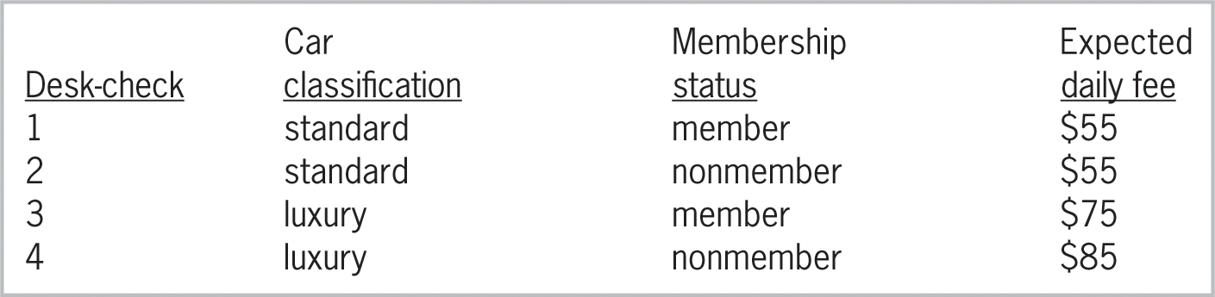
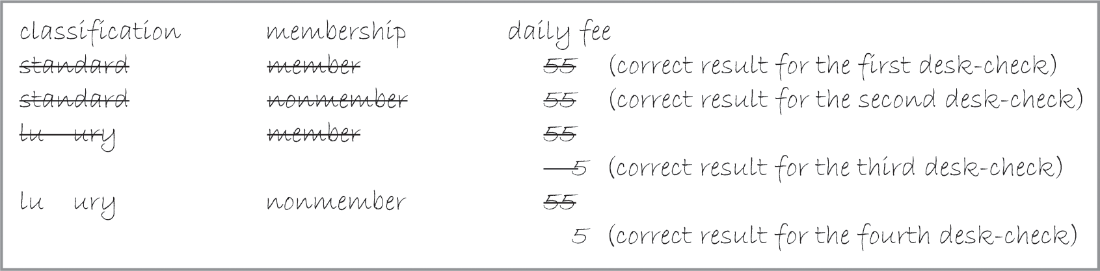
Logic Errors in Selection Structures (cont’d.)
Figure 6-9 Sample data and expected results for the algorithm shown in Figure 6-8
Figure 6-10 Result of desk-checking the correct algorithm
An Introduction to Programming with C++, Eighth Edition

Slide 16
First Logic Error
Using a compound condition rather than a nested selection structure
Ignores the hierarchy between two sub-conditions – One applies only if the other is a certain value
An Introduction to Programming with C++, Eighth Edition

Slide 17
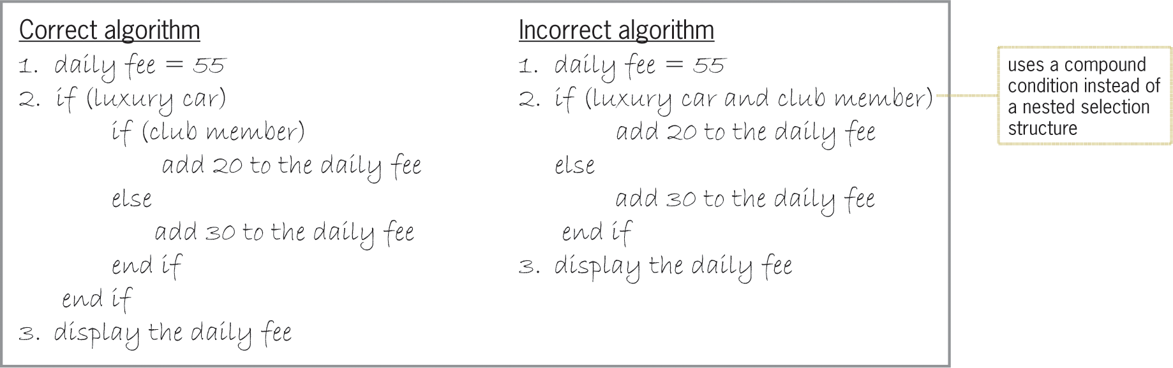
First Logic Error (cont’d.)
Figure 6-11 Correct algorithm and incorrect algorithm containing the first logic error
An Introduction to Programming with C++, Eighth Edition

Slide 18
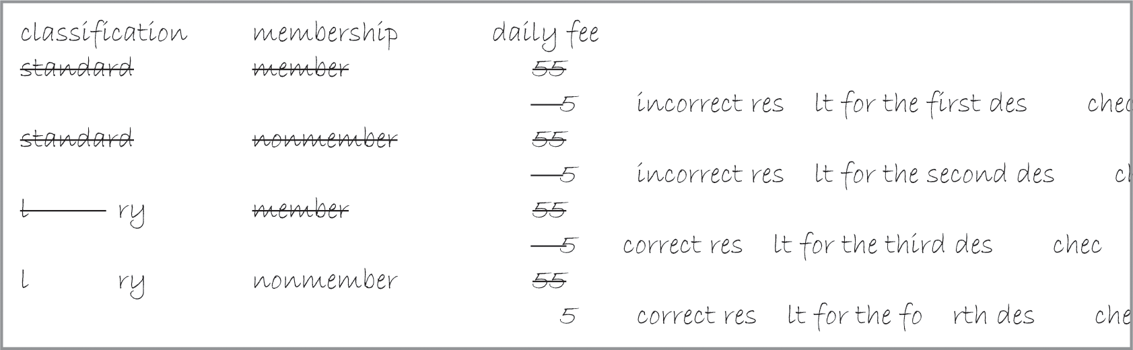
First Logic Error (cont’d.)
Figure 6-12 Results of desk-checking the incorrect algorithm from Figure 6-11
An Introduction to Programming with C++, Eighth Edition

Slide 19
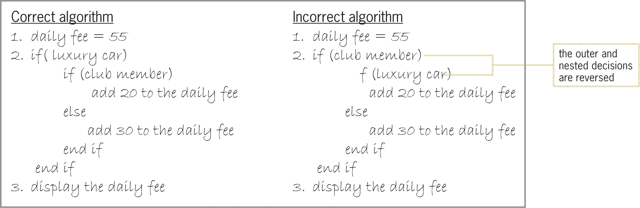
Second Logic Error
Reversing outer and nested selection structures
Figure 6-13 Correct algorithm and an incorrect
algorithm containing the second logic error
An Introduction to Programming with C++, Eighth Edition

Slide 20
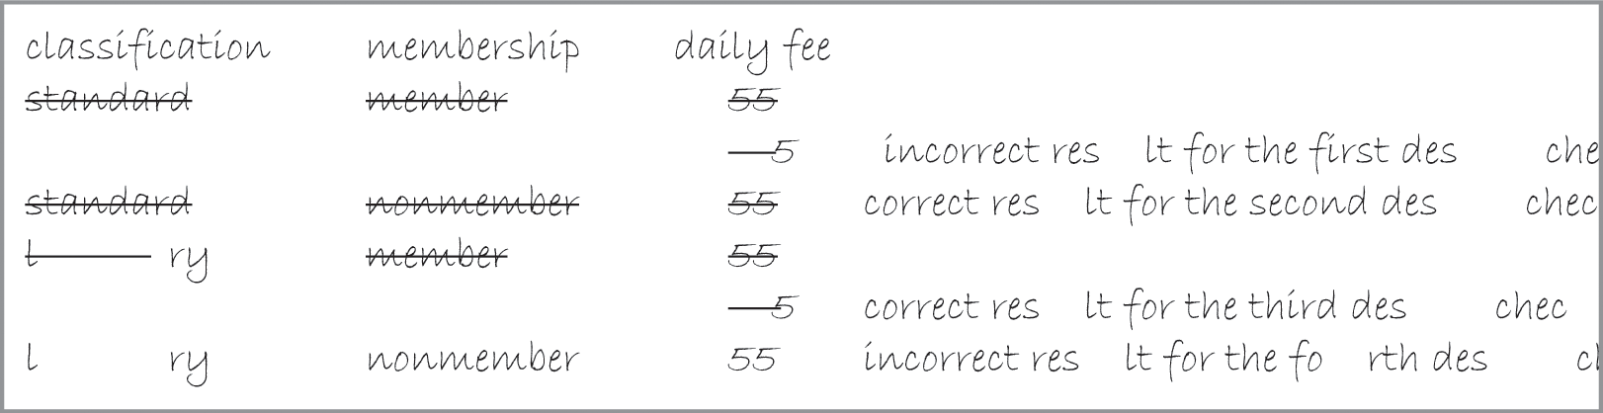
Second Logic Error (cont’d.)
Figure 6-14 Results of desk-checking the incorrect algorithm in Figure 6-13
An Introduction to Programming with C++, Eighth Edition

Slide 21
Third Logic Error
Using an unnecessary nested selection structure
Often will produce the correct result, but will be inefficient
An Introduction to Programming with C++, Eighth Edition

Slide 22
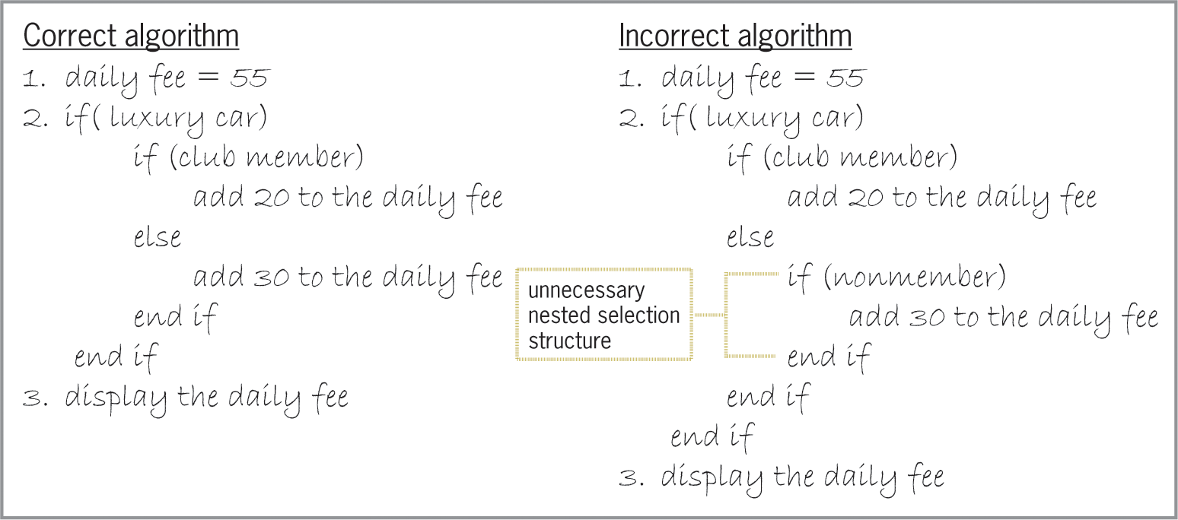
Third Logic Error (cont’d.)
Figure 6-15 Correct algorithm and inefficient algorithm containing the third logic error
An Introduction to Programming with C++, Eighth Edition

Slide 23
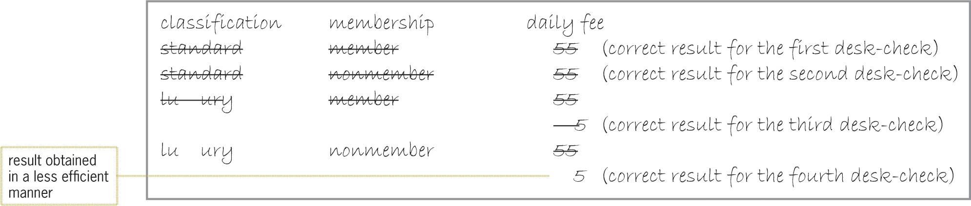
Third Logic Error (cont’d.)
Figure 6-16 Results of desk-checking the inefficient algorithm from Figure 6-15
An Introduction to Programming with C++, Eighth Edition

Slide 24
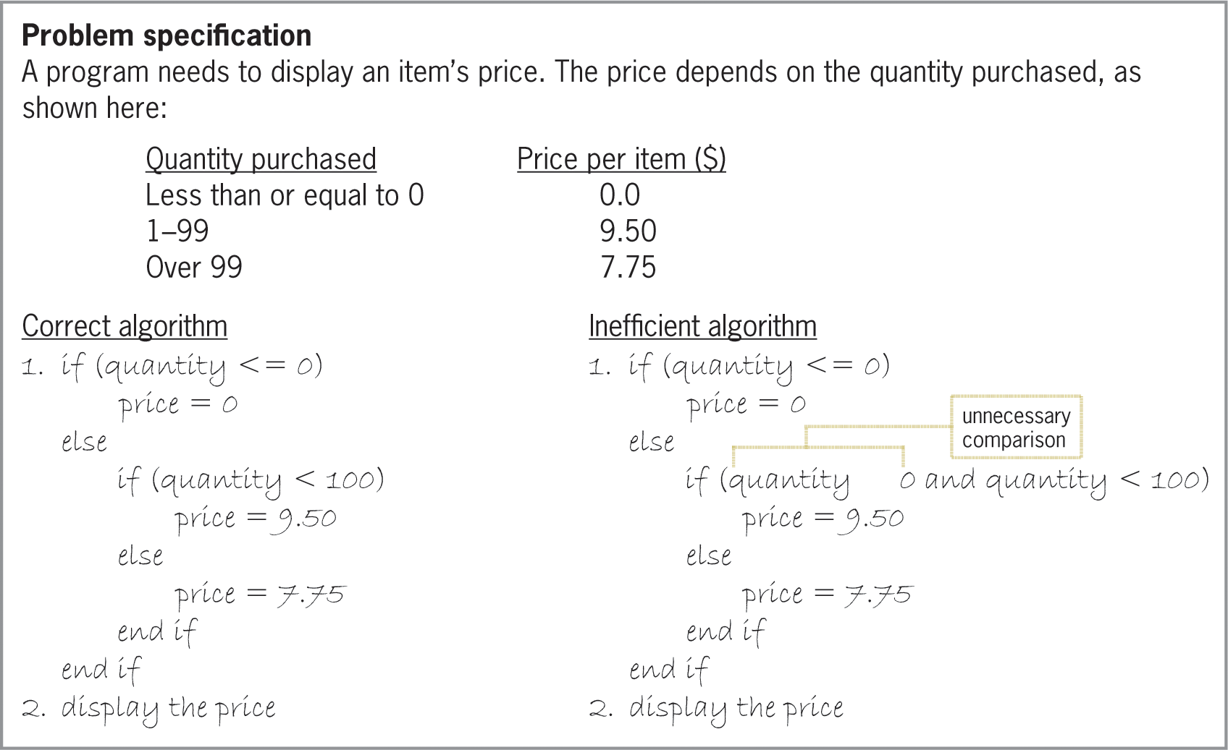
Fourth Logic Error
Including an unnecessary comparison in a condition
Figure 6-17 Problem specification, a correct algorithm, and an inefficient algorithm
An Introduction to Programming with C++, Eighth Edition

Slide 25
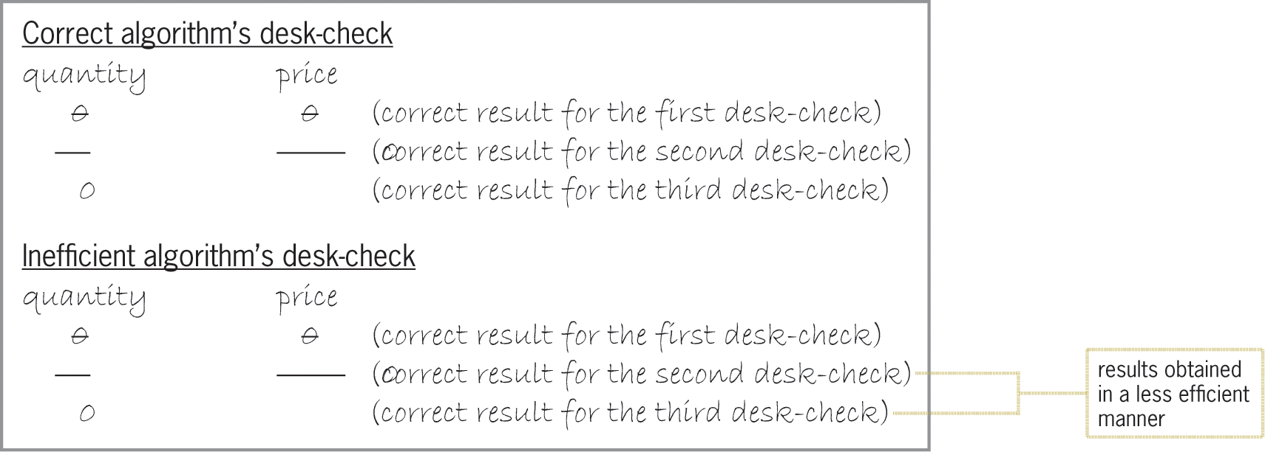
Fourth Logic Error (cont’d.)
Figure 6-18 Results of desk-checking the algorithms from Figure 6-17
An Introduction to Programming with C++, Eighth Edition

Slide 26
Multiple-Alternative Selection Structures
Sometimes problems require a selection structure that chooses between several alternatives
Called multiple-alternative selection structures or extended selection structures
In a flowchart, diamond symbol is used; has multiple flowlines leading out, not just two
Each flowline represents a possible path, marked with the value that represents that path
if/else statements can be used to implement it; uses multiple if else clauses
An Introduction to Programming with C++, Eighth Edition

Slide 27
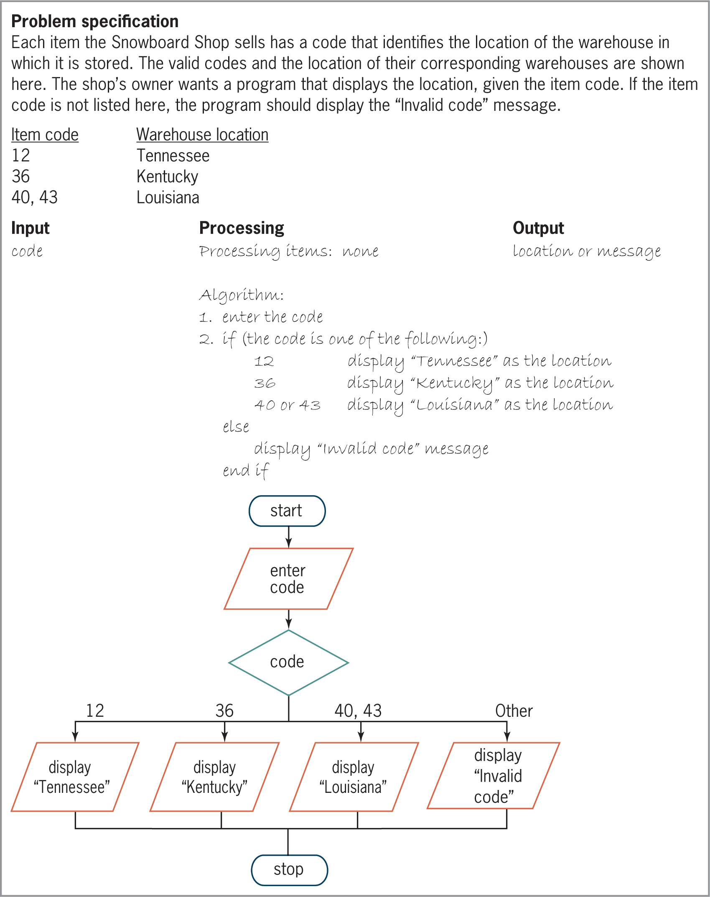
Multiple-Alternative Selection Structures (cont’d.)
Figure 6-20 Problem specification and IPO chart for the Snowboard Shop problem
An Introduction to Programming with C++, Eighth Edition

Slide 28
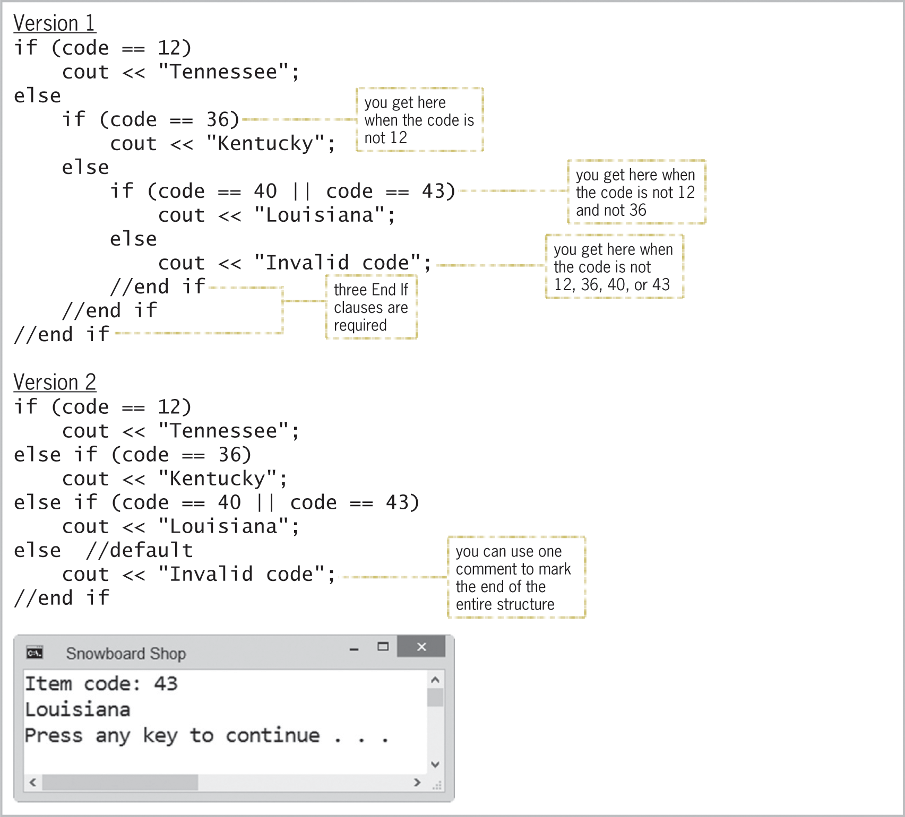
Multiple-Alternative Selection Structures (cont’d.)
Figure 6-21 Two ways of coding the multiple-alternative selection structure from Figure 6-20
An Introduction to Programming with C++, Eighth Edition

Slide 29
The switch Statement
Can sometimes use the switch statement to code a multiple-alternative selection structure
Statement begins with switch keyword followed by a selector expression in parentheses
Selector expression can contain any combination of variables, constants, functions, and operators
Must result in a data type that is bool, char, short, int, or long
Between opening and closing braces (after selector expression), there are one or more case clauses
An Introduction to Programming with C++, Eighth Edition

Slide 30
The switch Statement (cont’d.)
Each case clause represents a different alternative and contains a value followed by a colon
Can include as many case clauses as necessary
Value for each case clause can be a literal constant, named constant, or an expression composed of literal and named constants
Data type of the value should be the same data type as the selector expression
An Introduction to Programming with C++, Eighth Edition

Slide 31
The switch Statement (cont’d.)
Each case clause contains one or more statements processed when selector expression matches that case’s value
break statement tells computer to break out of switch at that point; must be the last statement of a case clause
Without a break statement, computer continues to process instructions in later case clauses
After processing break, computer processes next instruction after switch statement’s closing brace
An Introduction to Programming with C++, Eighth Edition

Slide 32
The switch Statement (cont’d.)
Good programming practice to document end of switch with a comment (//end switch)
Can also include one default clause; processed if selector expression does not match any values in case clauses
default clause can appear anywhere, but usually entered as last clause
  If it is the last clause, a break statement is not needed at its end
  Otherwise, a break statement is needed to prevent computer from processing later case clauses
An Introduction to Programming with C++, Eighth Edition

Slide 33
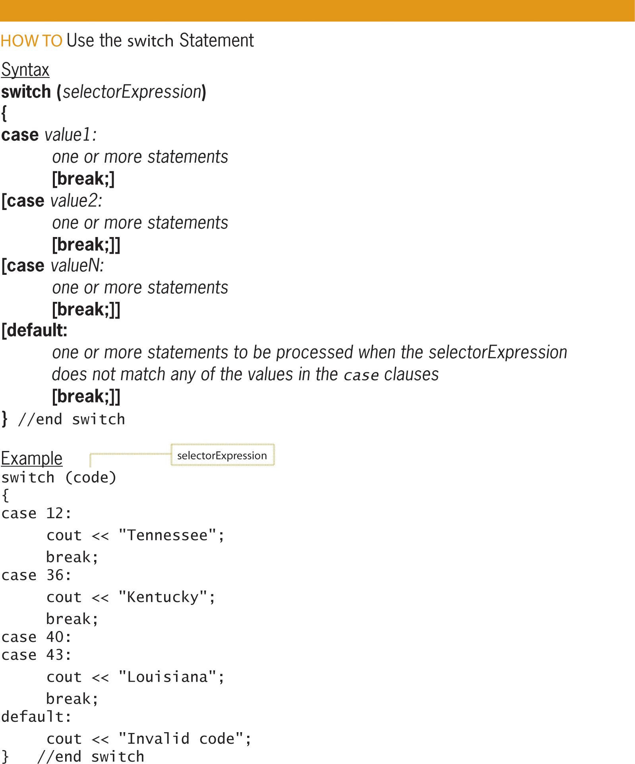
The switch Statement (cont’d.)
Figure 6-22 How to use the switch statement
An Introduction to Programming with C++, Eighth Edition

Slide 34
Summary
Can nest a selection structure within true or false path of another selection structure
Four common logic errors when writing selection structures
  Using a compound condition instead of a nested selection structure
  Reversing the inner and outer selection structures
  Using an unnecessary nested selection structure
  Including an unnecessary comparison in a condition
An Introduction to Programming with C++, Eighth Edition

Slide 35
Summary (cont’d.)
Some solutions require selection structures that choose from multiple alternatives; called multiple-alternative or extended selection structures
Can code these either with if/else statements or the switch statement
Diamond is used to represent multiple-alternative selection structures in a flowchart
Has multiple flowlines leading out; each representing a possible path and marked with appropriate values
An Introduction to Programming with C++, Eighth Edition

Slide 36
Summary (cont’d.)
In a switch statement, the data type of the value in each case clause must be compatible with data type of selector expression
Selector expression must evaluate to value of type bool, char, short, int, or long
Most case clauses contain a break statement; tells the computer to leave the switch statement
Good practice to mark end of switch statement with a comment (//end switch)
An Introduction to Programming with C++, Eighth Edition

Slide 37
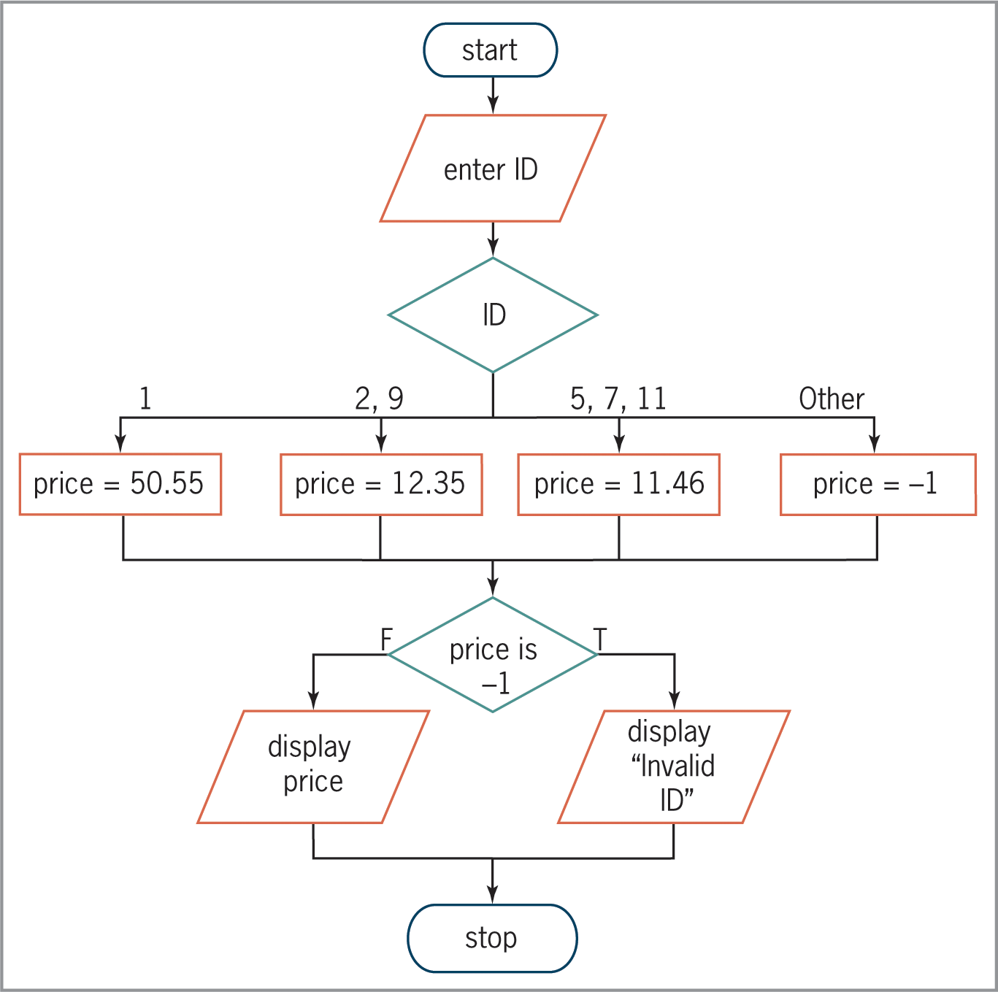
Lab 6-1: Stop and Analyze
Figure 6-23 Flowchart for Lab 6-1
An Introduction to Programming with C++, Eighth Edition

Slide 38
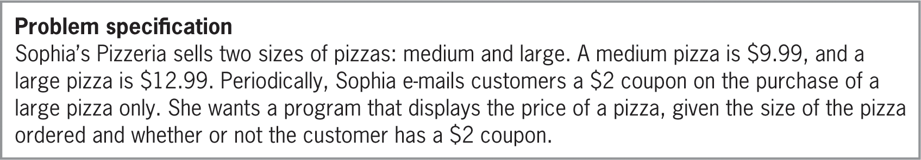
Lab 6-2: Plan and Create
Figure 6-24 Problem specification for Lab 6-2
An Introduction to Programming with C++, Eighth Edition

Slide 39
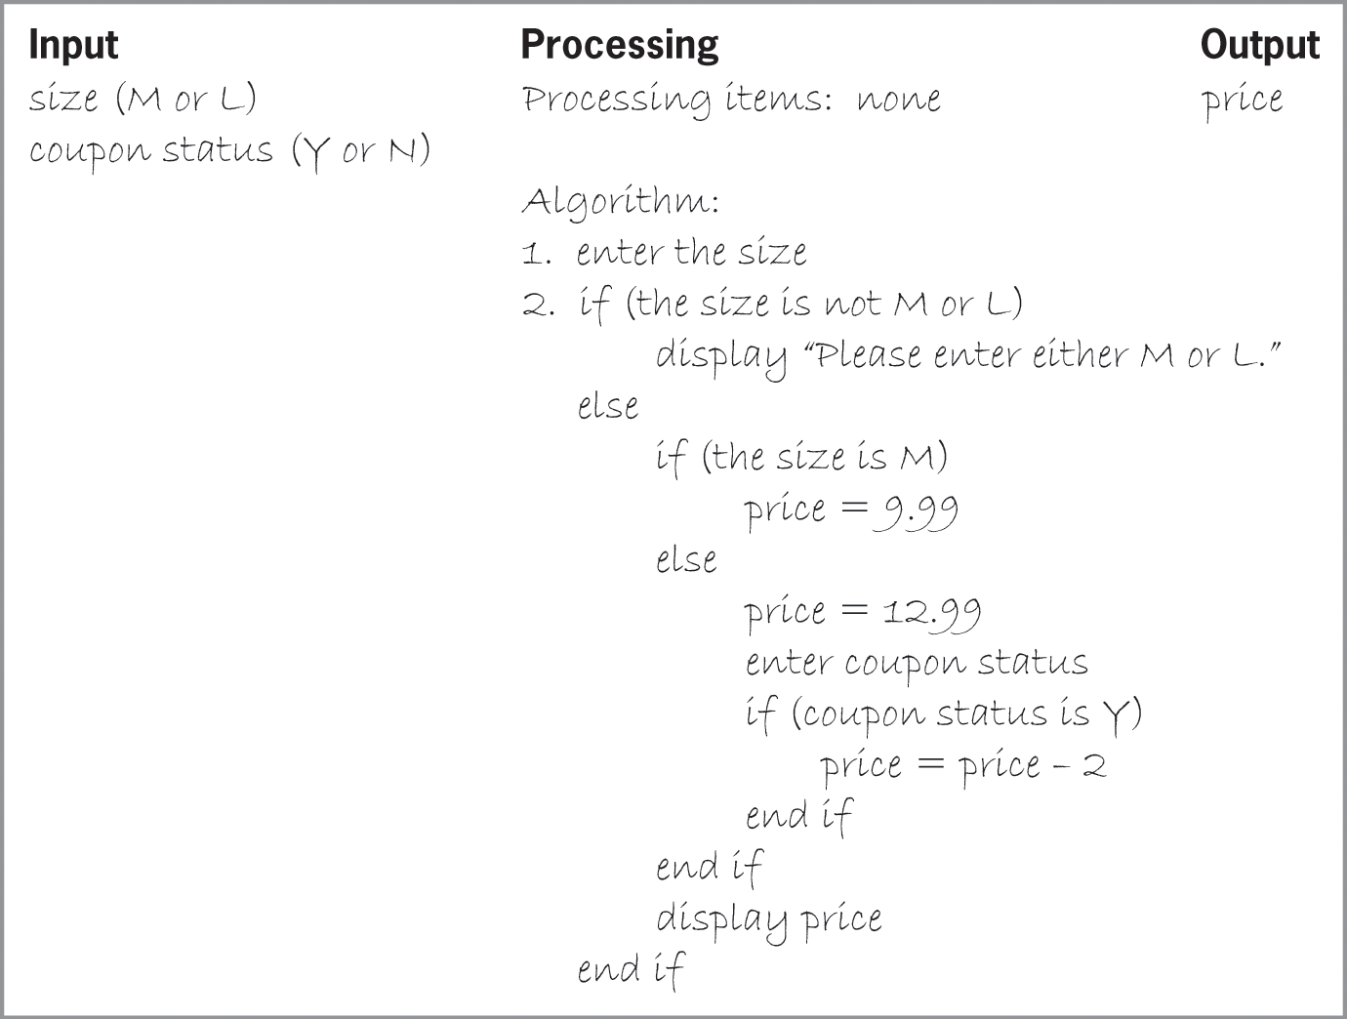
Lab 6-2: Plan and Create (cont’d.)
Figure 6-25 Completed IPO chart for Lab 6-2
An Introduction to Programming with C++, Eighth Edition

Slide 40
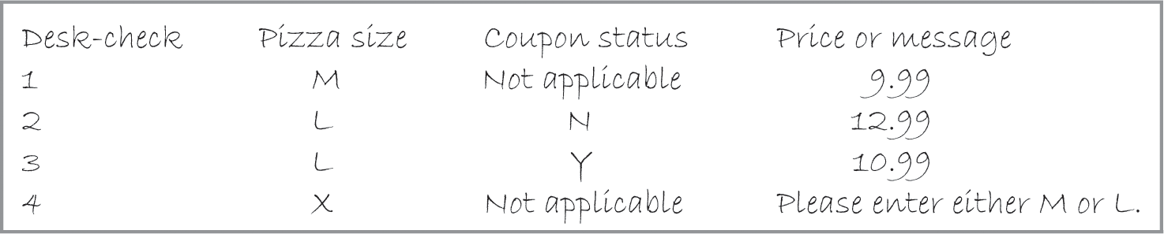

Lab 6-2: Plan and Create (cont’d.)
Figure 6-26 Test data and completed desk-check table for Lab 6-2’s algorithm
An Introduction to Programming with C++, Eighth Edition

Slide 41
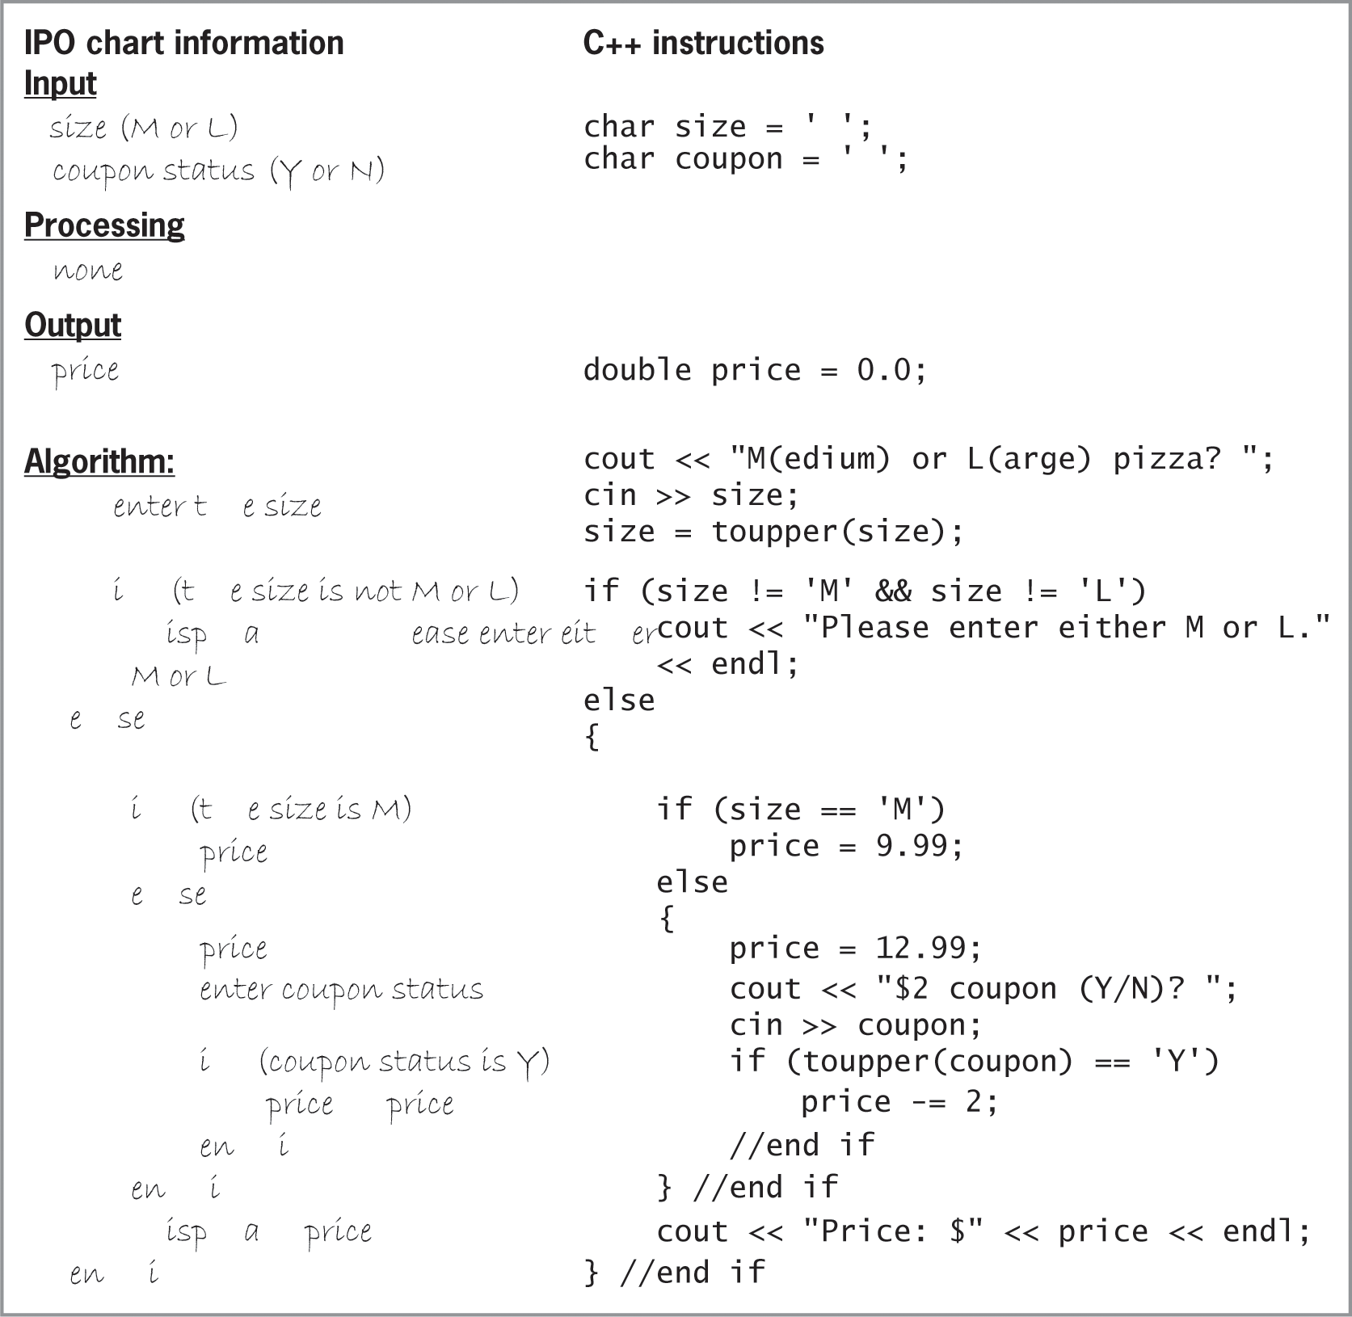
Lab 6-2: Plan and Create (cont’d.)
Figure 6-27 IPO chart information and C++ instructions for Lab 6-2
An Introduction to Programming with C++, Eighth Edition

Slide 42
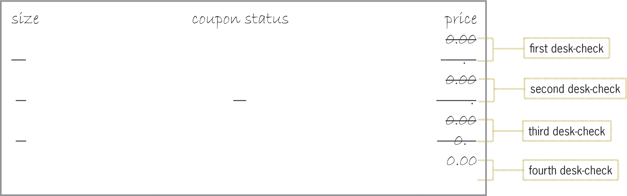
Lab 6-2: Plan and Create (cont’d.)
Figure 6-28 Completed desk-check table for Lab 6-2’s program
An Introduction to Programming with C++, Eighth Edition

Slide 43
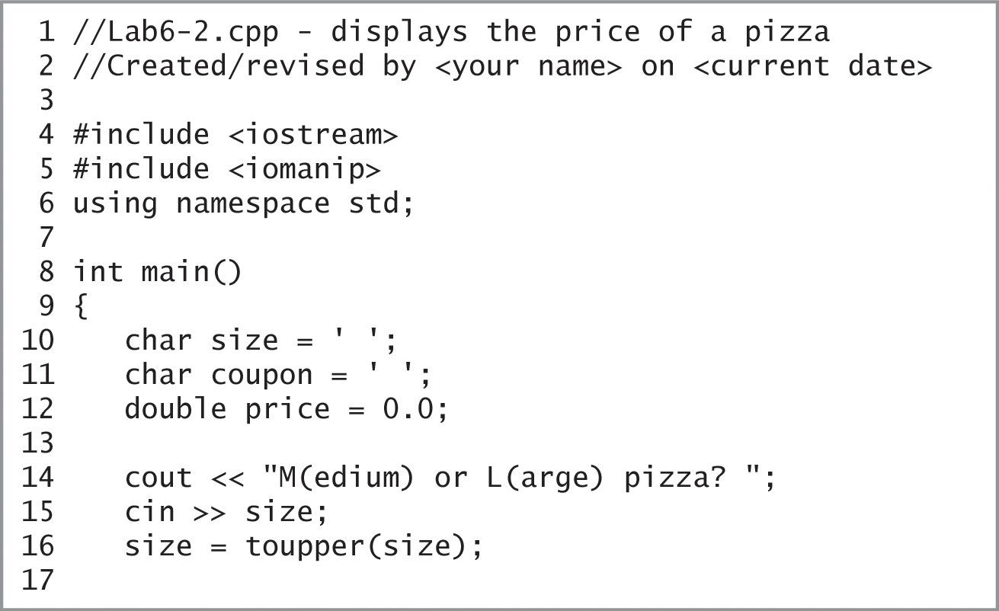
Lab 6-2: Plan and Create (cont’d.)
Figure 6-29 Sophia’s Pizzeria program
An Introduction to Programming with C++, Eighth Edition

Slide 44
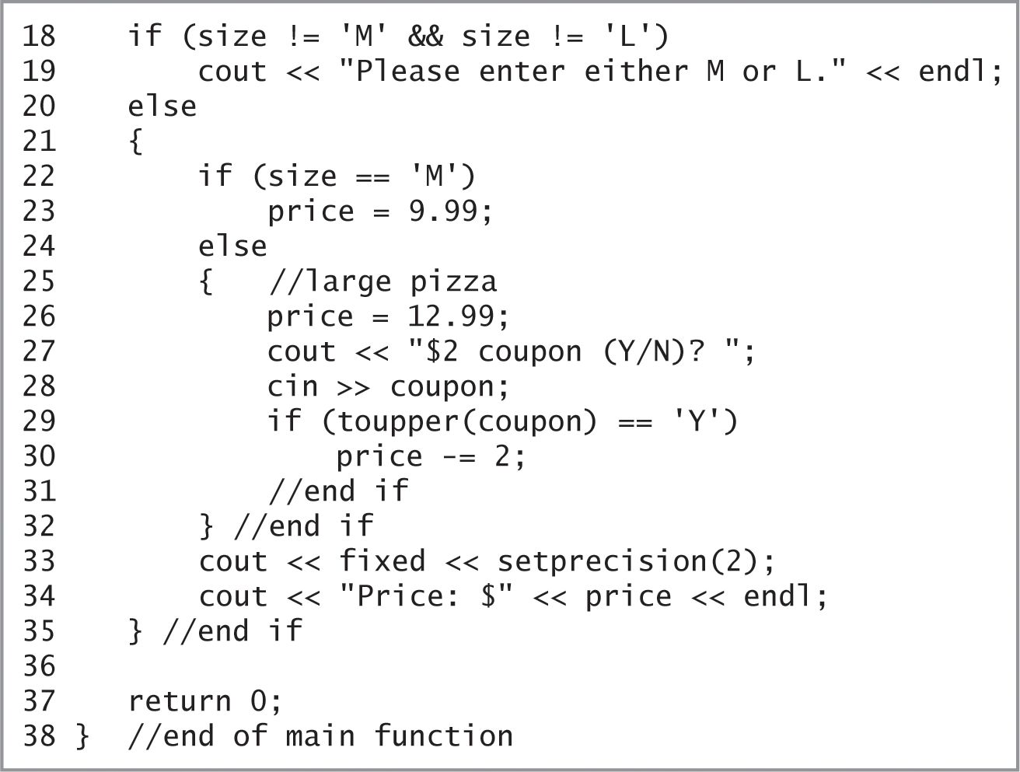
Lab 6-2: Plan and Create (cont’d.)
Figure 6-29 Sophia’s Pizzeria program (cont’d.)
An Introduction to Programming with C++, Eighth Edition

Slide 45
Lab 6-3: Modify
Modify the program in Lab 6-2 to allow customers to use a $2 coupon toward the purchase on any size pizza. Modify the program appropriately.
Test the program five times using the following test data: M and N, M and Y, L and N, L and Y, and X.
An Introduction to Programming with C++, Eighth Edition

Slide 46
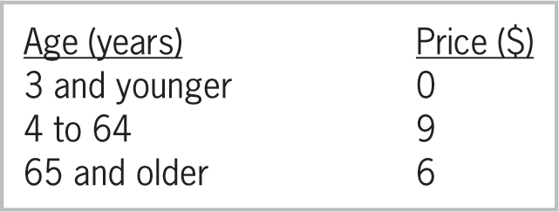
Lab 6-4: What’s Missing?
The program in this lab should display the price of a movie ticket. The price is based on the customer’s age, as shown in Figure 6-30. If the user enters a negative number, the program should display the “Invalid age” message.
Figure 6-30 Ticket information for Lab 6-4
An Introduction to Programming with C++, Eighth Edition

Slide 47
Lab 6-4: What’s Missing? (cont’d.)
Follow the instructions for starting C++ and opening the Lab6-4.cpp file.
Put the C++ instructions in the proper order, and then determine the one or more missing instructions.
Test the program seven times using the following data: 1, 3, 4, 64, 65, 70, and -3.
An Introduction to Programming with C++, Eighth Edition

Slide 48
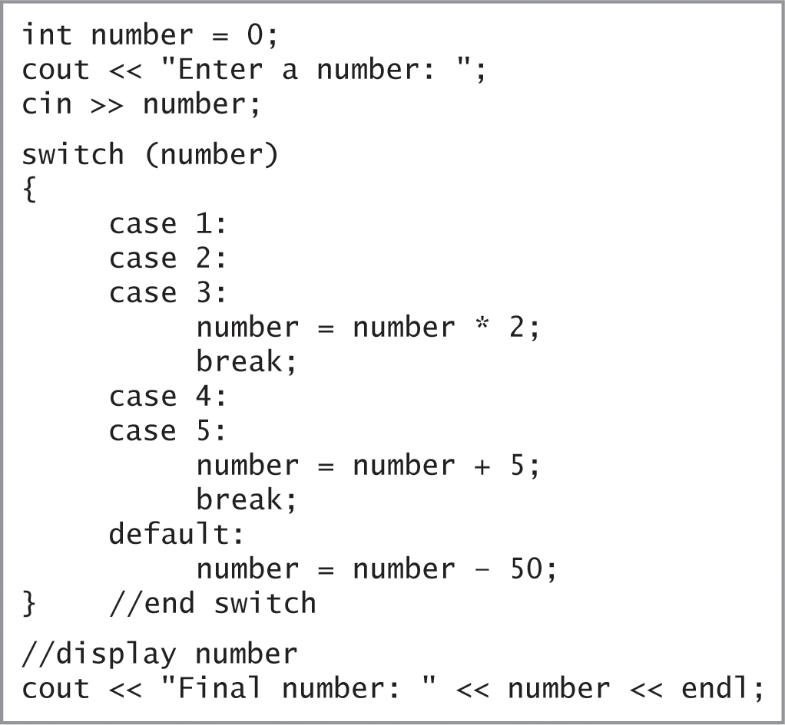
Lab 6-5: Desk-Check
Desk-check the code shown in Figure 6-31 three times, using the numbers 2, 5, and 100.
Figure 6-31 Code for Lab 6-5
An Introduction to Programming with C++, Eighth Edition

Slide 49
Lab 6-6: Debug
Follow the instructions for starting C++ and opening the Lab6-5.cpp file
Test the program using codes 1, 2, 3, 4, 5, 9, and -3
Debug the program
An Introduction to Programming with C++, Eighth Edition

