Slide 1
Chapter 14: Sequential Access Files

Slide 2
Objectives
Create file objects
Open a sequential access file
Determine whether a sequential access file was opened successfully
Write data to a sequential access file
Read data from a sequential access file
Test for the end of a sequential access file
Close a sequential access file
An Introduction to Programming with C++, Eighth Edition

Slide 3
File Types
In addition to getting data from the keyboard and sending data to the screen, a program also can get data from and send data to a file on a disk
Getting data from a file is referred to as “reading the file,” and sending data to a file is referred to as “writing to the file”
Files to which data is written are called output files, and files that are read by the computer are called input files
An Introduction to Programming with C++, Eighth Edition

Slide 4
File Types (cont’d.)
Most input and output files are composed of lines of text that are written and read sequentially (in consecutive order, one line at a time)
Such files are referred to as sequential access files (also text files, since they store text)
You can also create random access and binary access files, which let you access data in random order and according to their byte locations, respectively
An Introduction to Programming with C++, Eighth Edition

Slide 5

File Types (cont’d.)
Figure 14-1 Examples of text stored in sequential files
An Introduction to Programming with C++, Eighth Edition

Slide 6
Creating File Objects
The iostream file contains the definitions of the istream and ostream classes from which the cin and cout objects, respectively, are created
You do not have to create the cin and cout objects in a program because C++ creates the objects in the iostream file for you
Objects are also used to perform file input and output operations in C++, but they must be created by the programmer
An Introduction to Programming with C++, Eighth Edition

Slide 7
Creating File Objects (cont’d.)
To create a file object in a program, the program must contain the #include <fstream> directive
The fstream file contains the definitions of the ifstream (input file stream) and ofstream (output file stream) objects, which allow you to create input file objects and output file objects
Although not required, it is useful to begin input file object names with “in” and output file object names with “out”, so as to distinguish a program’s input file objects from its output file objects
An Introduction to Programming with C++, Eighth Edition

Slide 8
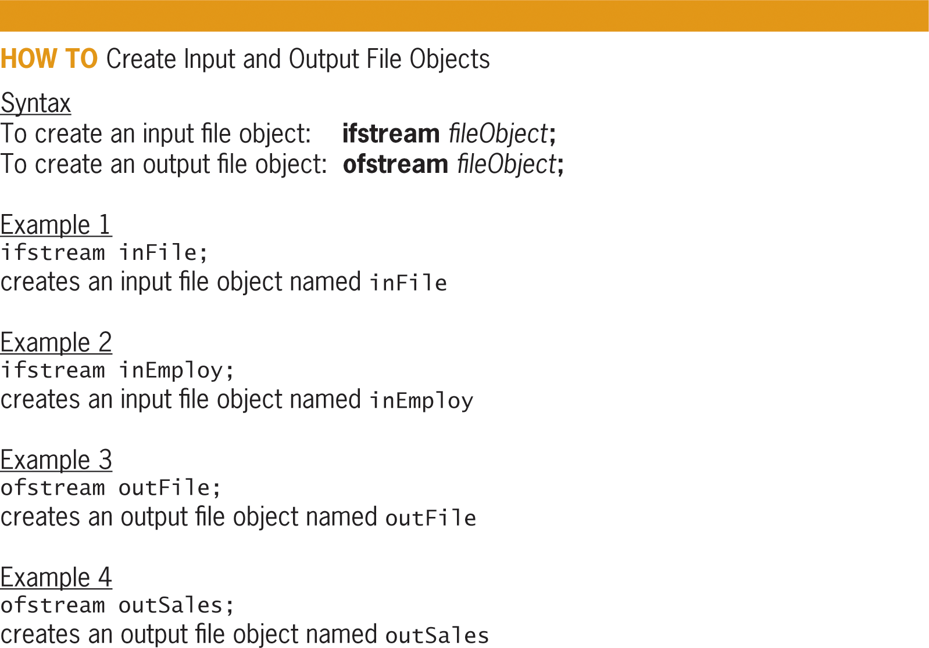
Creating File Objects (cont’d.)
Figure 14-2 How to create input and output file objects
An Introduction to Programming with C++, Eighth Edition

Slide 9
Opening a Sequential Access File
You use the open function to open actual files on your computer’s disk
Syntax is:
  fileObject.open(fileName[, mode]);
  fileObject: name of existing ifstream or ofstream file object
  fileName: name of file you want to open
Function opens file in fileName and associates it with fileObject variable
An Introduction to Programming with C++, Eighth Edition

Slide 10
Opening a Sequential Access File (cont’d.)
fileName argument may contain an optional path
If it does not contain a path, computer assumes the file is located in the same folder as program
Optional mode argument indicates how the file is to be opened
Use ios::in mode to open a file for input
Use ios::out and ios::app to open a file for output
An Introduction to Programming with C++, Eighth Edition

Slide 11
Opening a Sequential Access File (cont’d.)
Use ios::app mode (app stands for append) when you want to add data to the end of an existing file
  File is created if it does not exist
Use the ios::out mode to open a new, empty file
  File is erased if it already exists
Two colons (::) are called scope resolution operators and indicate that the keywords in, out, and app are defined in the ios class
An Introduction to Programming with C++, Eighth Edition

Slide 12
Opening a Sequential Access File (cont’d.)
ios::out is default mode for output file objects
Computer uses a file pointer to keep track of the next character to read or write from a file
When you open a file for input, the file pointer is positioned at beginning of file
When you open a file for output, the file pointer is positioned at beginning of an empty file
When you open a file for append, the file pointer is positioned immediately after last character in file
An Introduction to Programming with C++, Eighth Edition

Slide 13
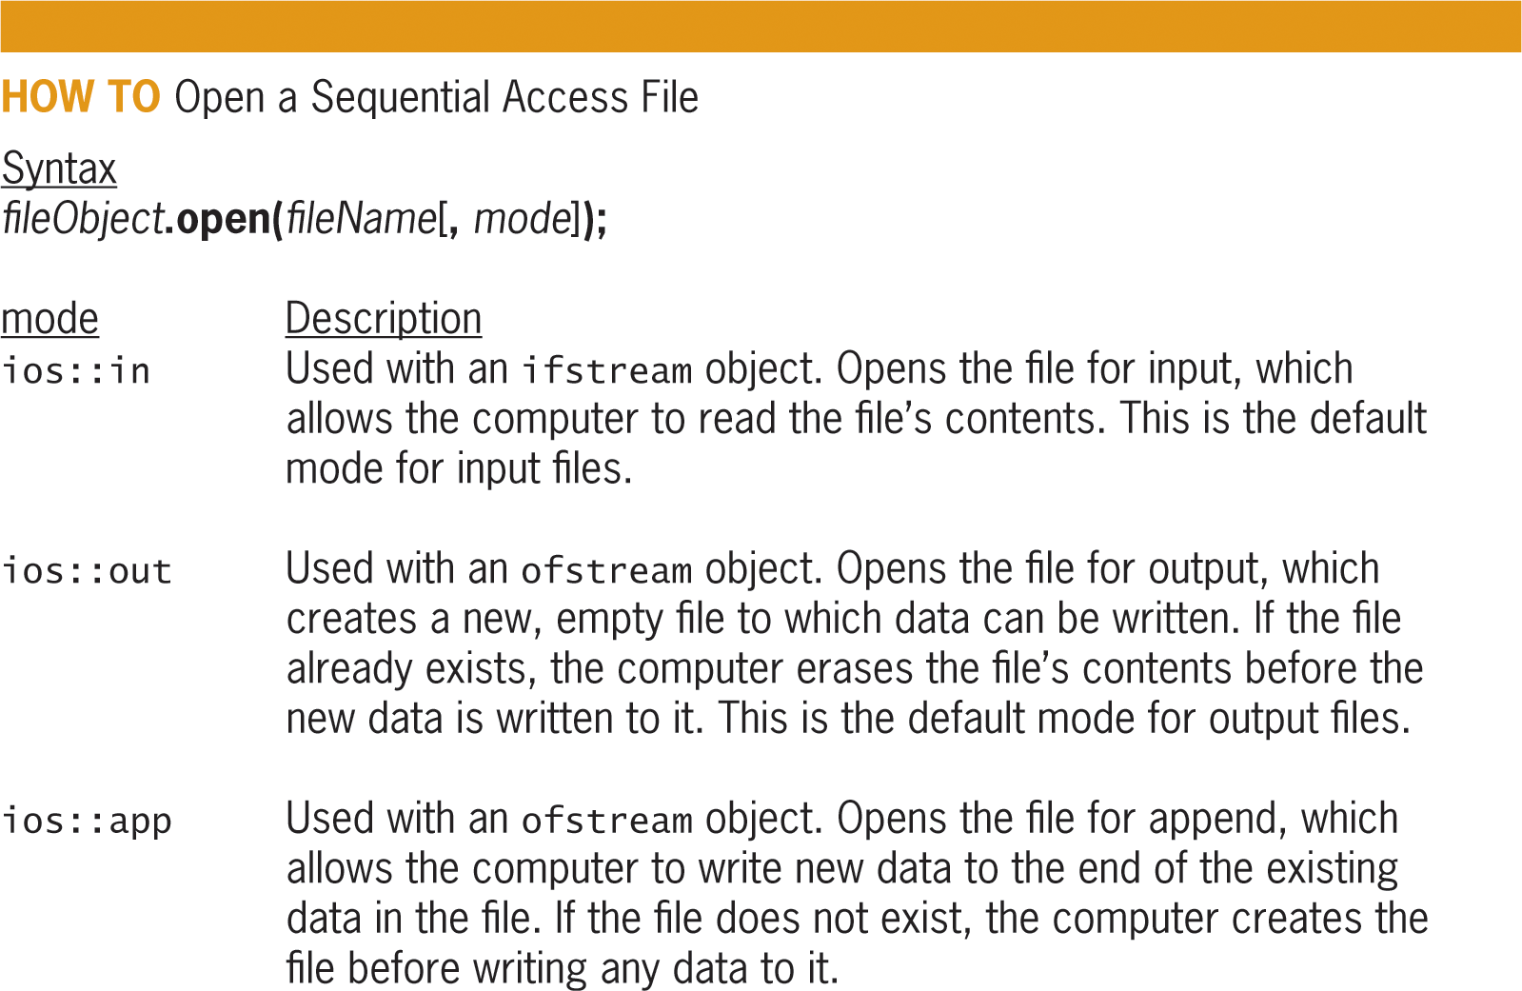
Opening a Sequential Access File (cont’d.)
Figure 14-3 How to open a sequential access file
An Introduction to Programming with C++, Eighth Edition

Slide 14
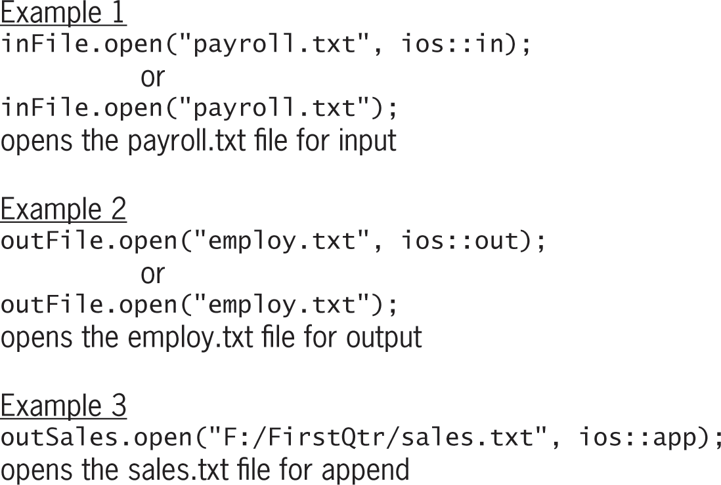
Opening a Sequential Access File (cont’d.)
Figure 14-3 How to open a sequential access file
An Introduction to Programming with C++, Eighth Edition

Slide 15
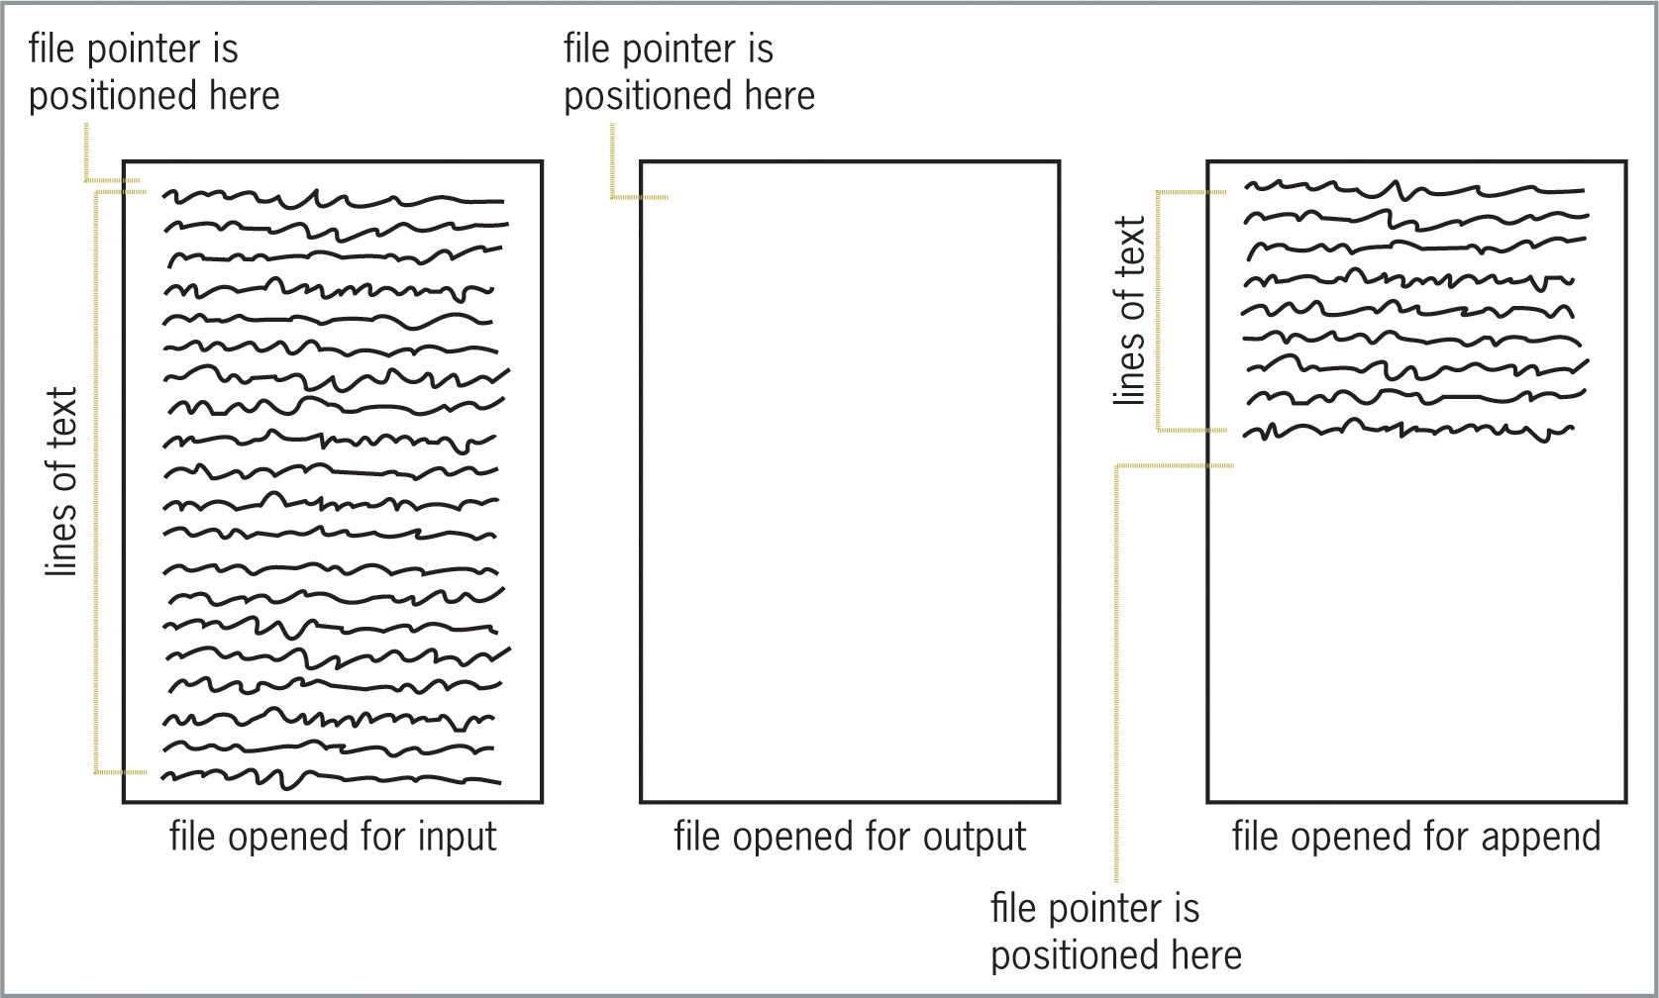
Opening a Sequential Access File (cont’d.)
Figure 14-4 Position of the file pointer when files are opened for input, output, and append
An Introduction to Programming with C++, Eighth Edition

Slide 16
Determining Whether a File Was Opened Successfully
open function can fail when attempting to open a file (e.g., path does not exist)
You use the is_open function to determine whether a file was opened successfully
  Returns Boolean value true if the open function was successful; false otherwise
  Syntax is fileObject.is_open()
  The ! is the Not logical operator, which is used to reverse the truth value of a Boolean expression
An Introduction to Programming with C++, Eighth Edition

Slide 17
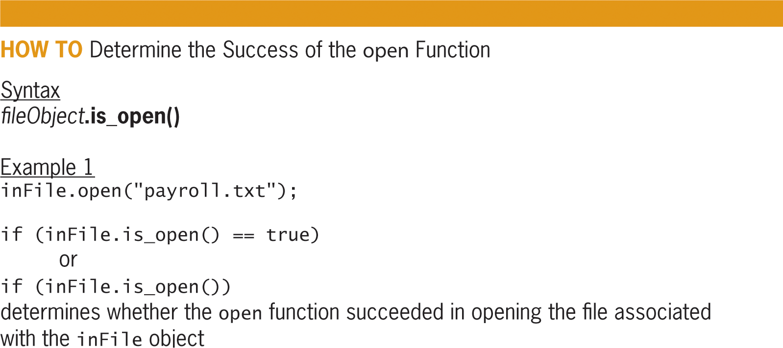
Determining Whether a File Was Opened Successfully (cont’d.)
Figure 14-5 How to determine success of open function
An Introduction to Programming with C++, Eighth Edition

Slide 18
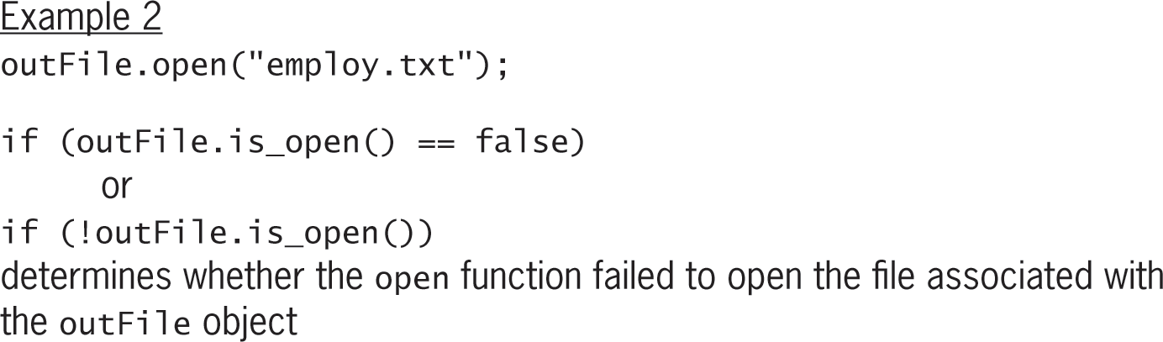
Determining Whether a File Was Opened Successfully (cont’d.)
Figure 14-5 How to determine success of open function
An Introduction to Programming with C++, Eighth Edition

Slide 19
Writing Data to a Sequential Access File
Syntax for writing data to a file is:
  fileObject << data
A field is a single item of information
A record is a collection of one or more related fields
To distinguish one record from another, you can write each record on a separate line by including the endl stream manipulator at the end of a statement that writes a record
You can separate multiple fields in a record with a character literal constant (e.g., ‘#’)
An Introduction to Programming with C++, Eighth Edition

Slide 20
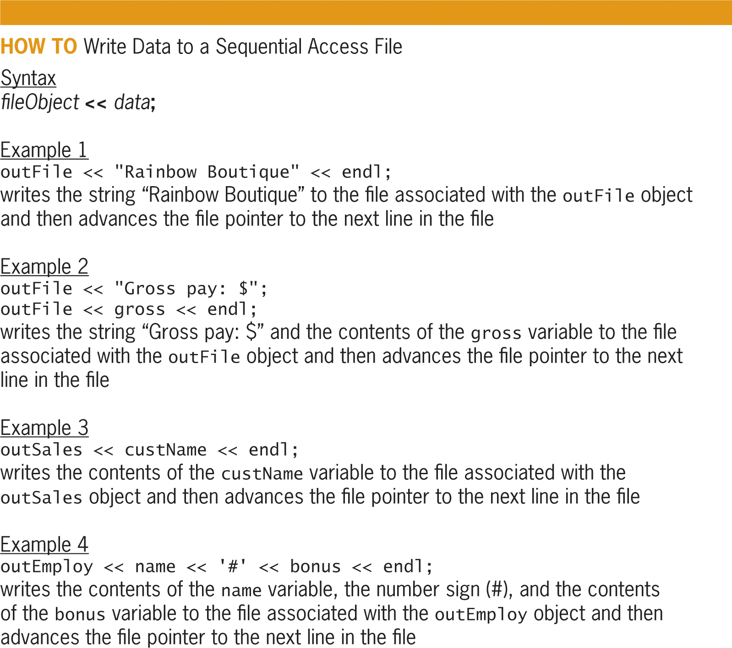
Writing Data to a Sequential Access File (cont’d.)
Figure 14-6 How to write data to a sequential access file
An Introduction to Programming with C++, Eighth Edition

Slide 21
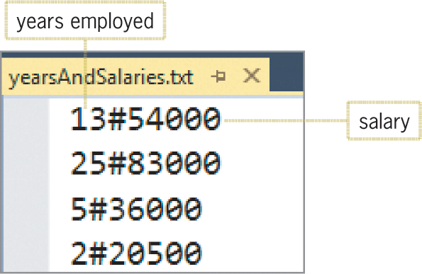
Writing Data to a Sequential Access File (cont’d.)
Figure 14-7 The yearsAndSalaries.txt sequential
access file opened in a text editor
An Introduction to Programming with C++, Eighth Edition

Slide 22
Reading Information from a Sequential Access File
Syntax for reading numeric and char data from a sequential access file is:
  fileObject >> variableName
For string data, you use:
  getline(fileObject, stringVariableName
  [, delimiterCharacter]);
An Introduction to Programming with C++, Eighth Edition

Slide 23
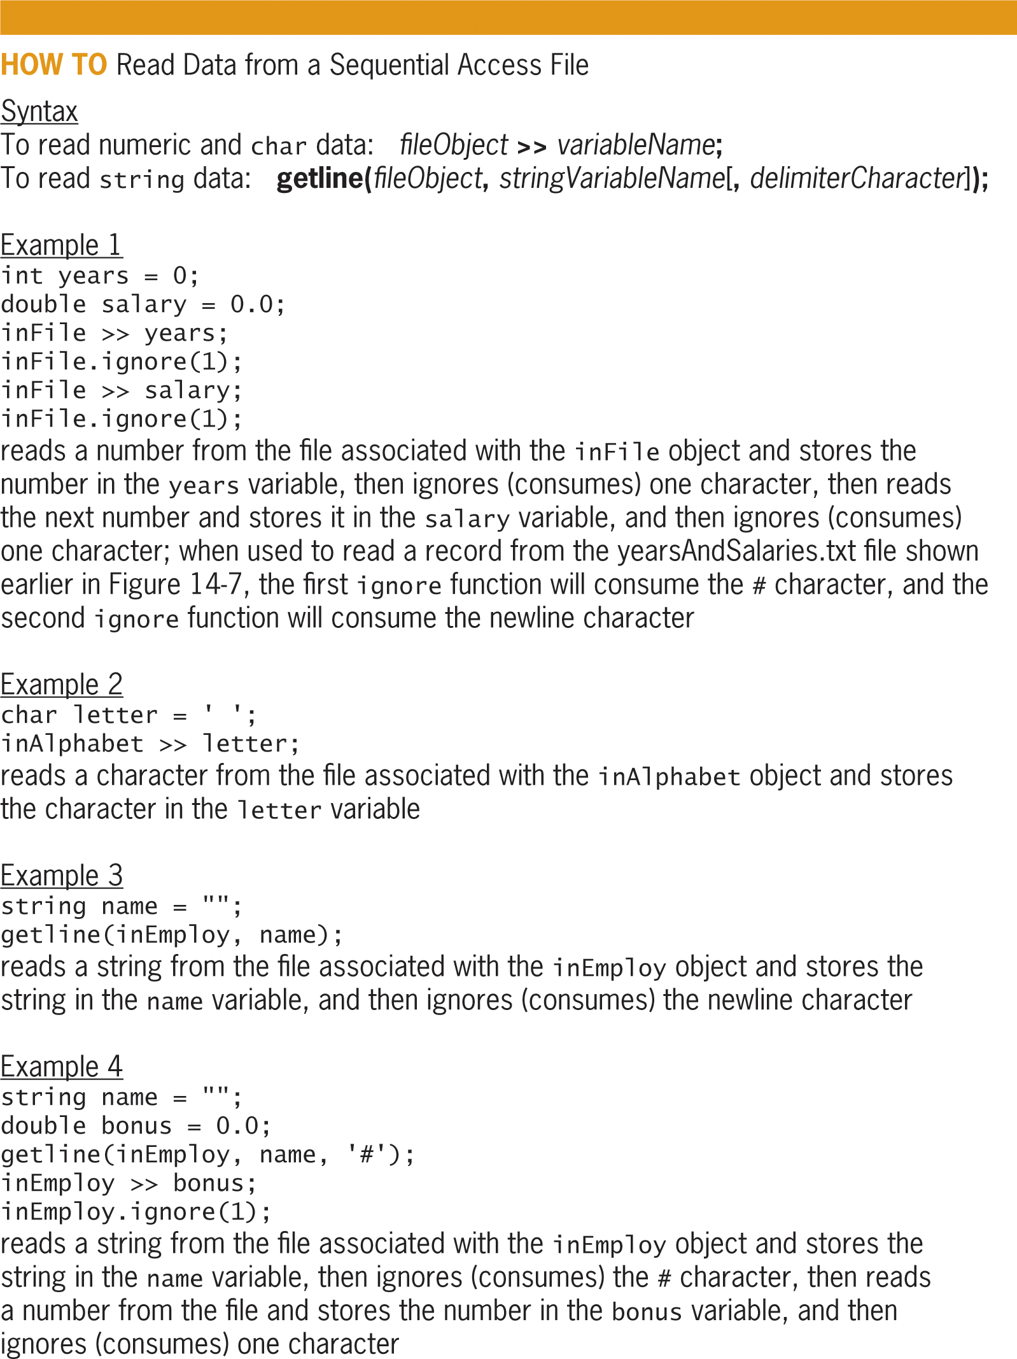
Reading Information from a Sequential Access File (cont’d.)
Figure 14-8 How to read data from a sequential access file
An Introduction to Programming with C++, Eighth Edition

Slide 24
Testing for the End of a Sequential Access File
Each time a character is read from a file, the file pointer is moved to the next character
When an entire line is read, the file pointer is moved to the next line of the file
The eof function determines whether the last character in a file has been readd
Returns true if file pointer is located at end of file; false otherwise
Syntax: fileObject.eof()
An Introduction to Programming with C++, Eighth Edition

Slide 25
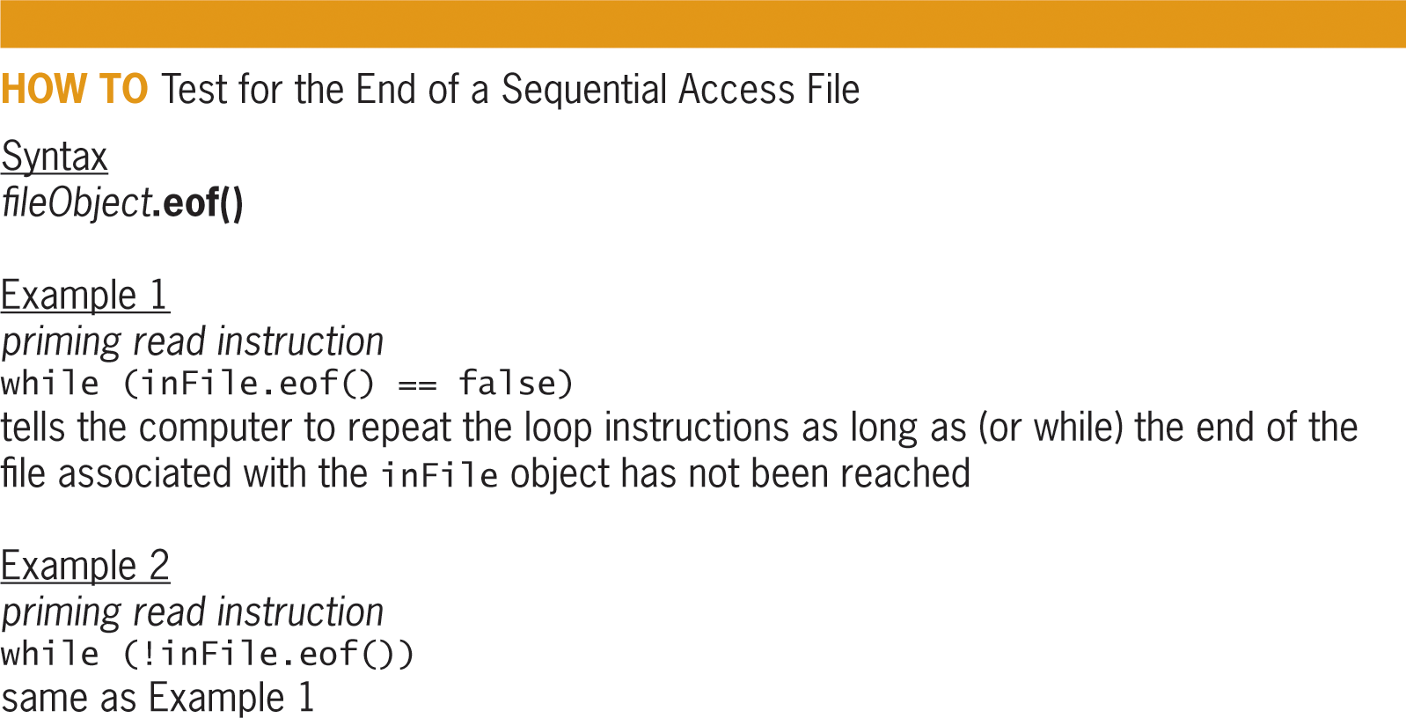
Testing for the End of a Sequential Access File (cont’d.)
Figure 14-9 How to test for the end of a sequential access file
An Introduction to Programming with C++, Eighth Edition

Slide 26
Closing a Sequential Access File
To prevent loss of data, you use the close function to close a sequential access file as soon as the program is finished using it
Syntax: fileObject.close()
Function closes the file associated with fileObject so that it can be accessed by other programs or file objects correctly
An Introduction to Programming with C++, Eighth Edition

Slide 27
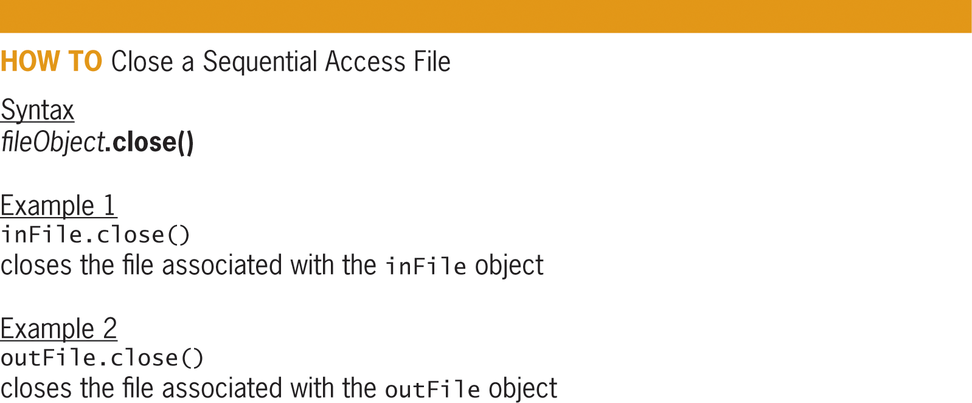
Closing a Sequential Access File (cont’d.)
Figure 14-10 How to close a sequential access file
An Introduction to Programming with C++, Eighth Edition

Slide 28
The eBook Collection Program
The eBook Collection Program will use the sequential file to save two items of information for each eBook: the title and the author’s name.
An Introduction to Programming with C++, Eighth Edition

Slide 29
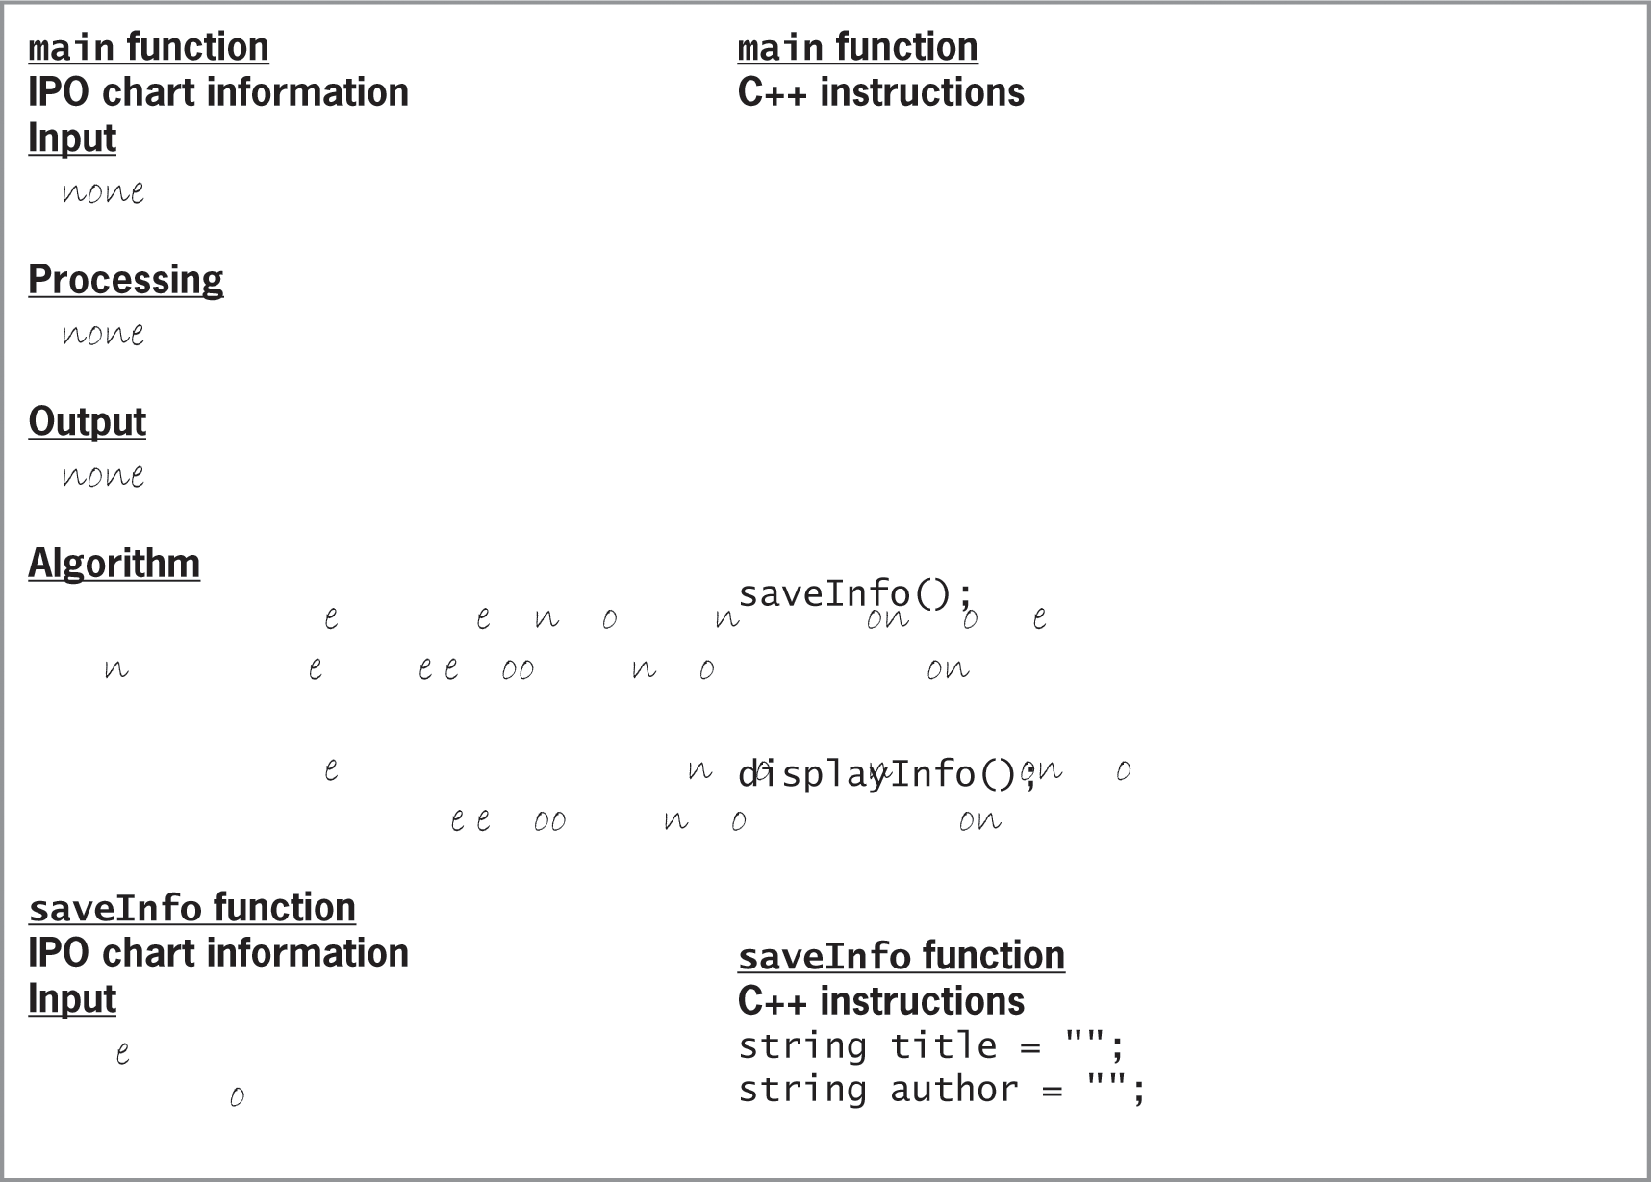
The eBook Collection Program (cont’d.)
Figure 14-11 IPO chart and C++ instructions for the eBook Collection Program
An Introduction to Programming with C++, Eighth Edition

Slide 30
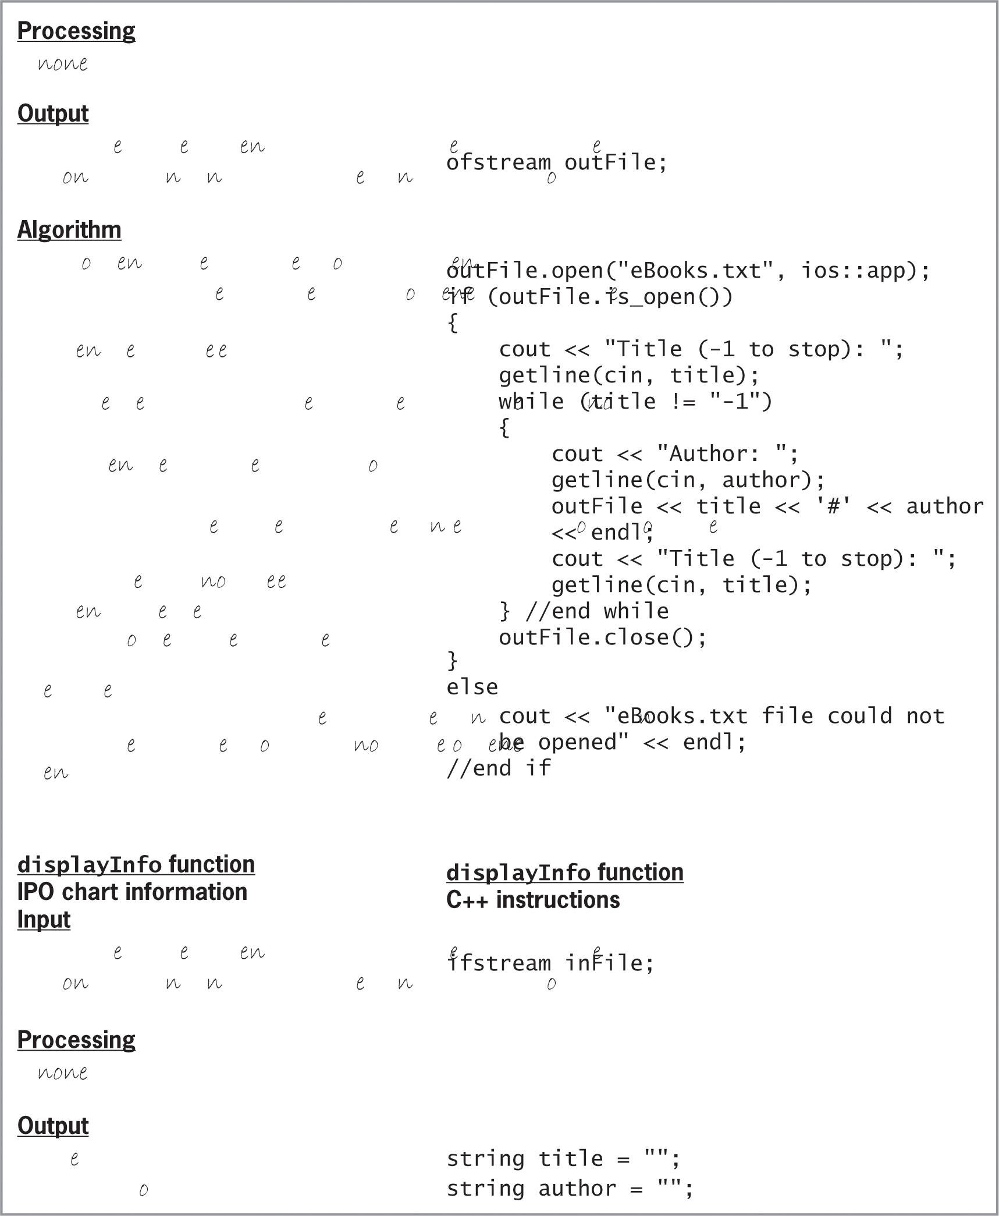
The eBook Collection Program (cont’d.)
Figure 14-11 IPO chart and C++ instructions for the eBook Collection Program
An Introduction to Programming with C++, Eighth Edition

Slide 31
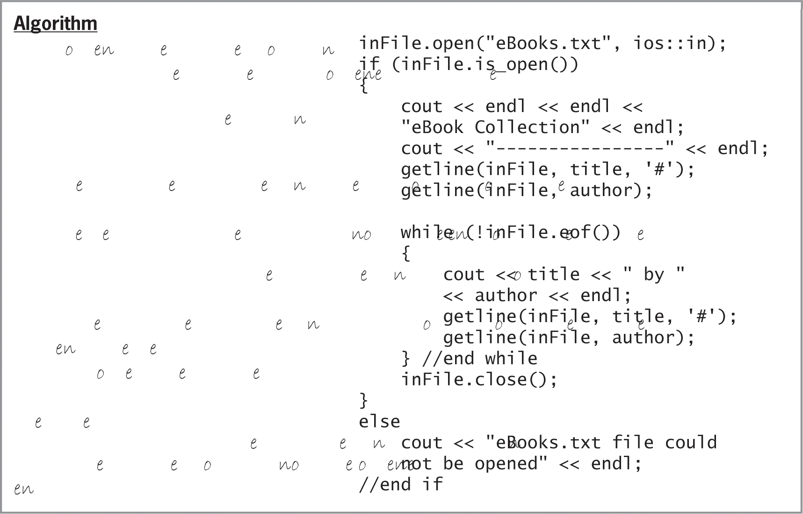
The eBook Collection Program (cont’d.)
Figure 14-11 IPO chart and C++ instructions for the eBook Collection Program
An Introduction to Programming with C++, Eighth Edition

Slide 32
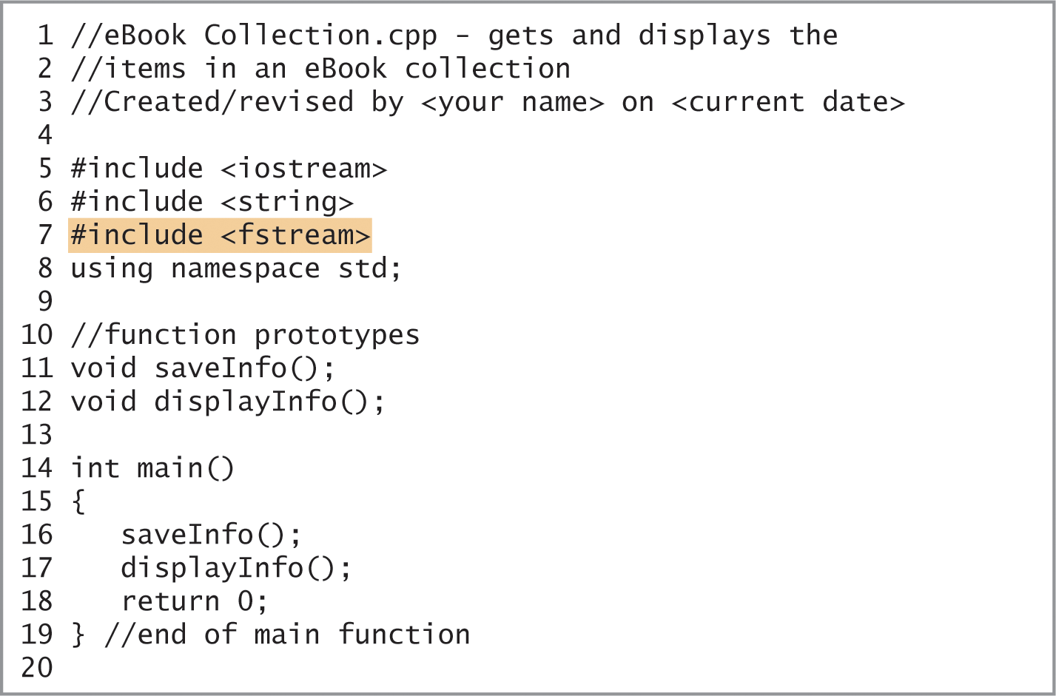
The eBook Collection Program (cont’d.)
Figure 14-12 Beginning of the eBook Collection Program
An Introduction to Programming with C++, Eighth Edition

Slide 33
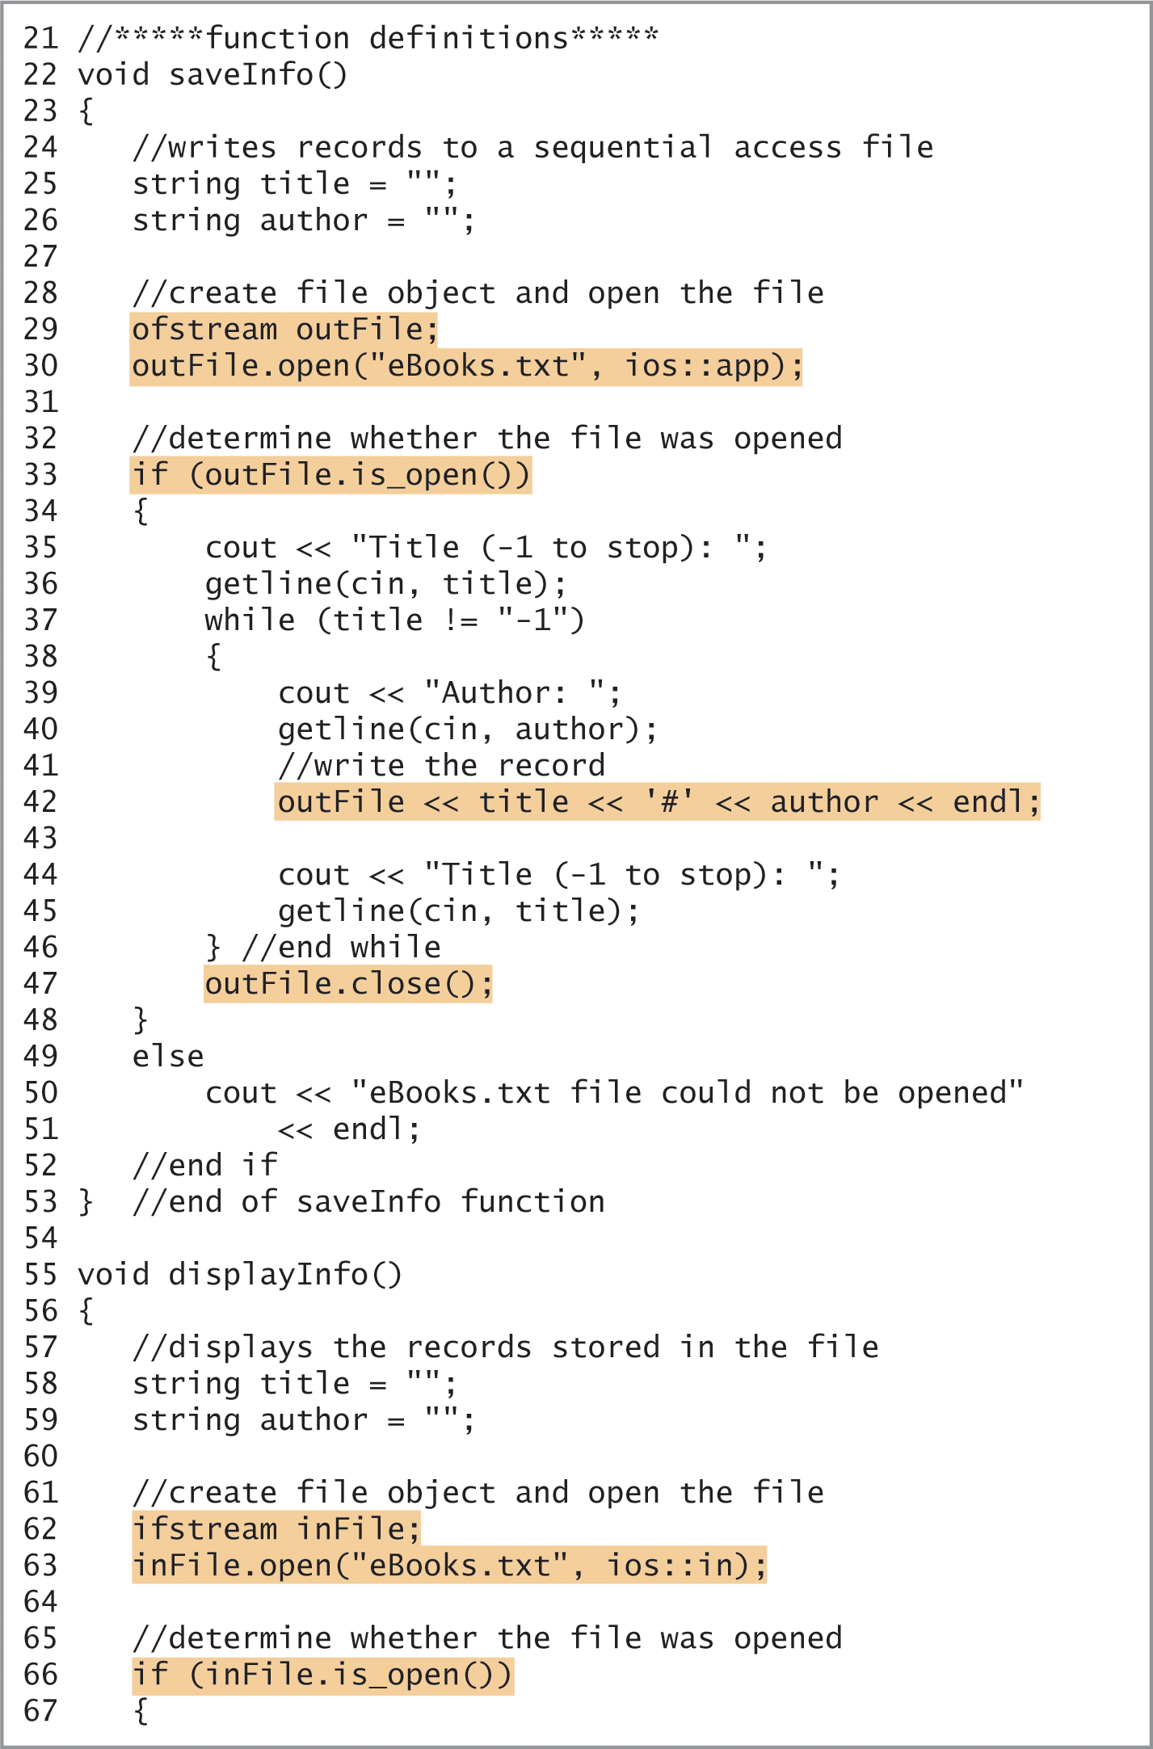
The eBook Collection Program (cont’d.)
Figure 14-12 Continuation of the eBook Collection Program
An Introduction to Programming with C++, Eighth Edition

Slide 34
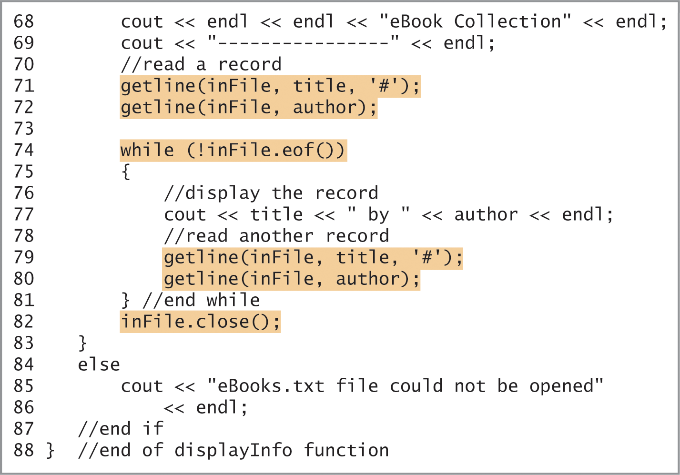
The eBook Collection Program (cont’d.)
Figure 14-12 Completion of the eBook Collection Program
An Introduction to Programming with C++, Eighth Edition

Slide 35
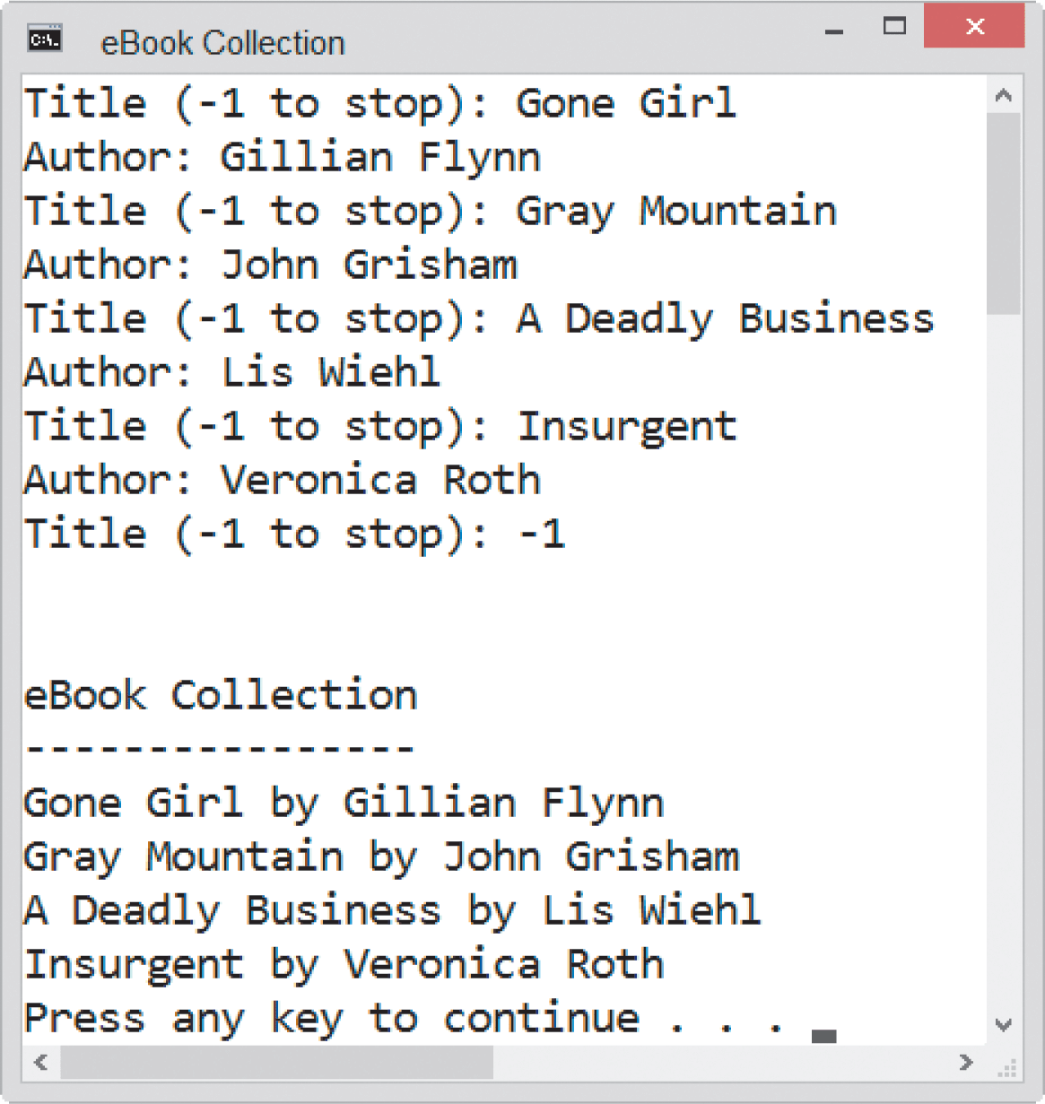
The eBook Collection Program (cont’d.)
Figure 14-13 Sample run of the eBook Collection Program
An Introduction to Programming with C++, Eighth Edition

Slide 36
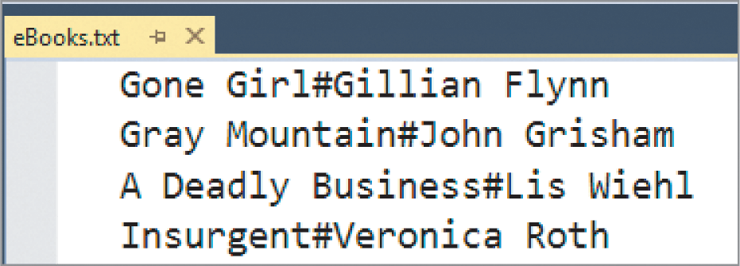
The eBook Collection Program (cont’d.)
Figure 14-13 Contents of the eBooks.txt file
An Introduction to Programming with C++, Eighth Edition

Slide 37
Summary
Sequential access files can be either input files or output files
Input files are files whose contents are read by a program
Output files are files to which a program writes data
To create a file object in a program, the program must contain the #include <fstream> directive
You use the ifstream and ofstream classes, which are defined in the fstream file, to create input and output file objects, respectively
An Introduction to Programming with C++, Eighth Edition

Slide 38
Summary (cont’d.)
The file objects are used to represent the actual files stored on your computer’s disk
After creating a file object, you then use the open function to open the file for input, output, or append
You can use the is_open function to determine whether the open function either succeeded or failed to open a sequential access file
The is_open function returns true if the open function was successful and false if it failed
An Introduction to Programming with C++, Eighth Edition

Slide 39
Summary (cont’d.)
You can write each record in a file on a separate line by including the endl stream manipulator at the end of each statement that writes a record
If the record contains more than one field, you can use a character (such as '#') to separate data in one field from data in another field
When reading data from a file, you use the eof function to determine whether the file pointer is at the end of the file
An Introduction to Programming with C++, Eighth Edition

Slide 40
Summary (cont’d.)
If the file pointer is located after the last character in the file, the eof function returns true; otherwise, it returns false
When a program is finished with a file, you should use the close function to close it
Failing to close an open file can result in loss of data
An Introduction to Programming with C++, Eighth Edition

Slide 41
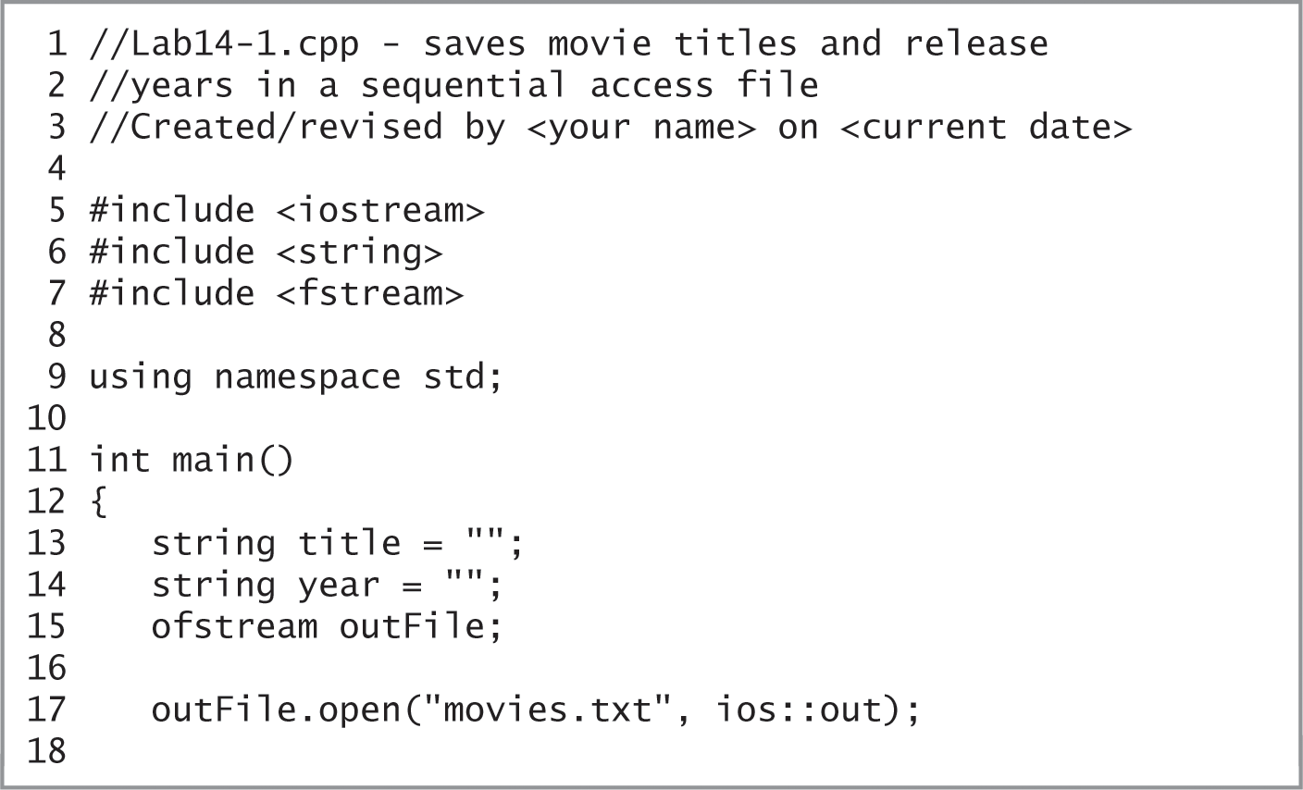
Lab 14-1: Stop and Analyze
Study the code in Figure 14-14 and then answer the questions.
Figure 14-14 Code for Lab 14-1
An Introduction to Programming with C++, Eighth Edition

Slide 42
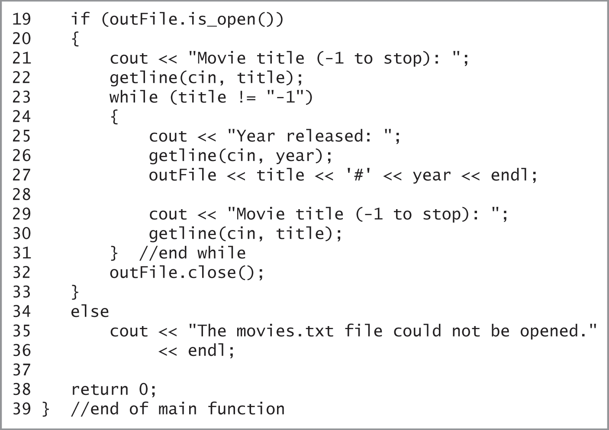
Lab 14-1: Stop and Analyze (cont’d.)
Figure 14-14 Code for Lab 14-1
An Introduction to Programming with C++, Eighth Edition

Slide 43
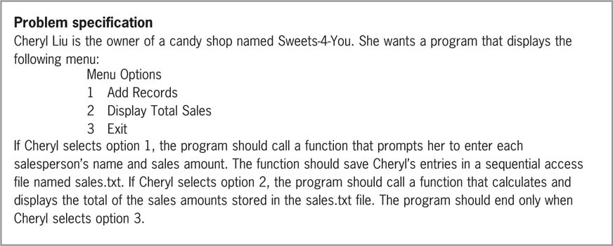
Lab 14-2: Plan and Create
Figure 14-15 Problem specification for Lab 14-2
An Introduction to Programming with C++, Eighth Edition

Slide 44
Lab 14-3: Modify
Modify the program in Lab14-2.cpp.
Modify the menu so that it contains five options: Add Records, Display Records, Display Total Sales, Display Average Sales, and Exit.
When Display Records is selected, call a function to display the contents of the sales.txt file on the screen.
When Display Average Sales is selected, call a function to calculate and display the average sales amount stored in the file.
Save the modified program as Lab14-3.cpp and test the program appropriately
An Introduction to Programming with C++, Eighth Edition

Slide 45
Lab 14-4: What’s Missing?
The program is this lab should read five records from and write five records to a sequential access file.
Follow the instructions for starting C++ and opening the Lab14-4.cpp file. Put the C++ instructions in the proper order, and then determine the one or more missing instructions.
Test the program appropriately.
An Introduction to Programming with C++, Eighth Edition

Slide 46
Lab 14-5: Desk-Check
Desk-check the code in Figure 14-20 using the Lab14-5.txt file shown in Figure 14-20.
What will the code display on the screen?
An Introduction to Programming with C++, Eighth Edition

Slide 47
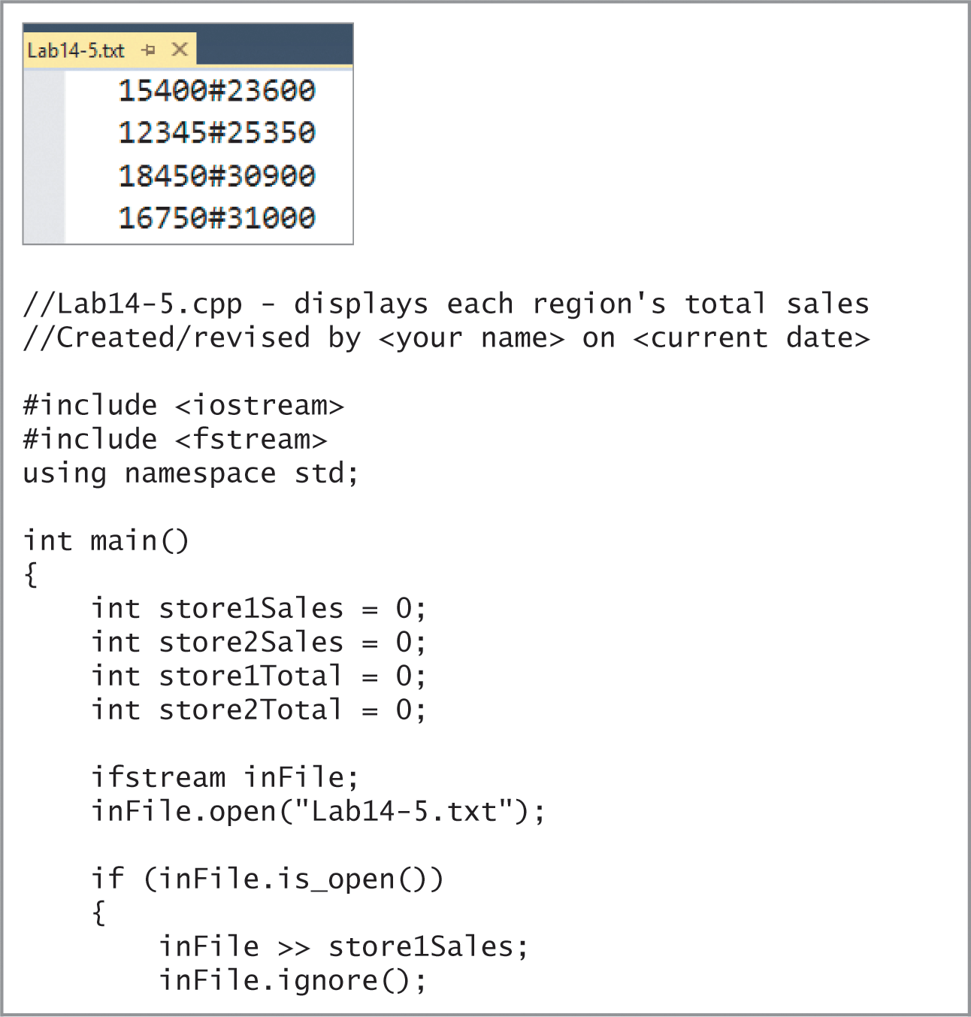
Lab 14-5: Desk-Check (cont’d.)
Figure 14-20 Information for Lab 14-5
An Introduction to Programming with C++, Eighth Edition

Slide 48
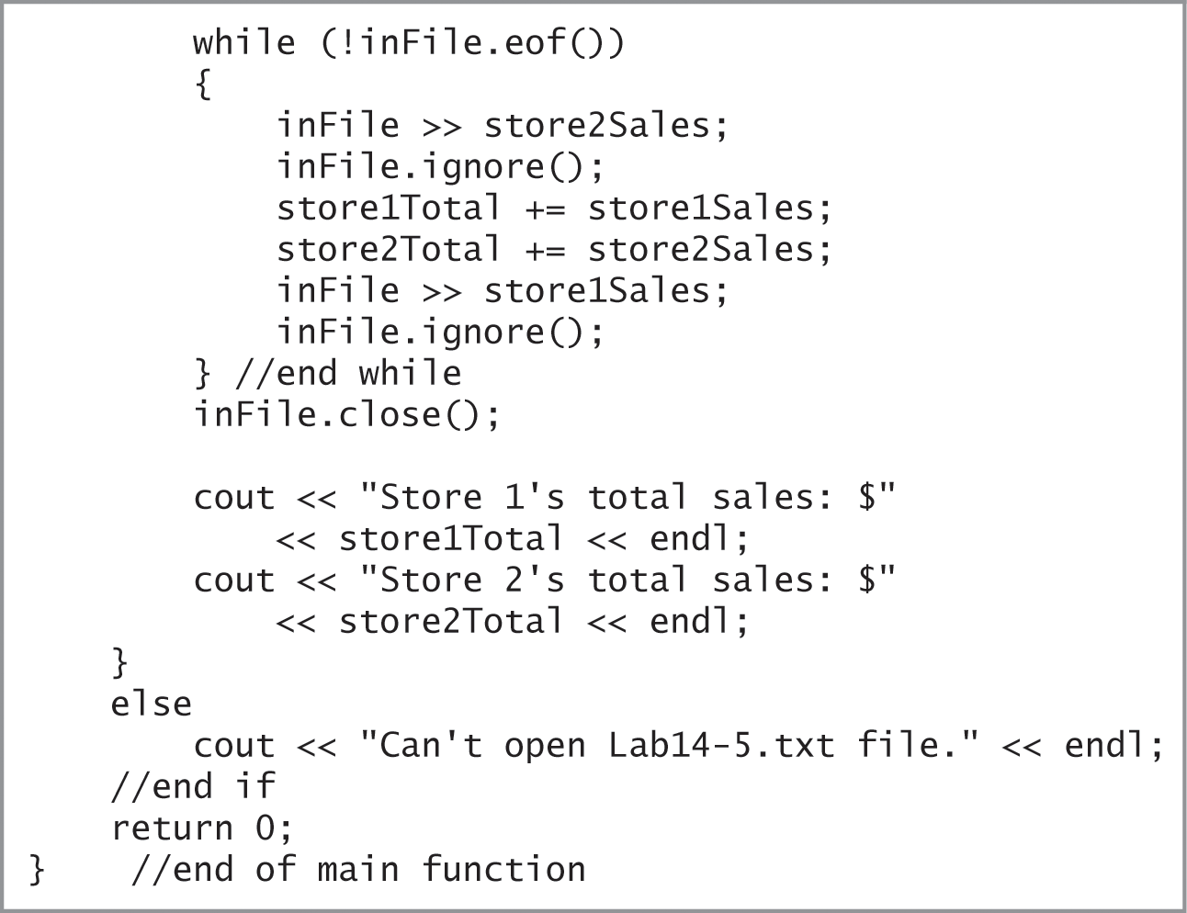
Lab 14-5: Desk-Check (cont’d.)
Figure 14-20 Information for Lab 14-5
An Introduction to Programming with C++, Eighth Edition

Slide 49
Lab 14-6: Debug
Run the program in the Lab14-6.cpp file.
The program should write records consisting of a name and two numbers to a sequential file named records.txt.
Run the program. Type your name and press Enter. Type 5000 and press Enter, then type 2000 and press Enter.
Notice the program is not working correctly.
Debug the program.
An Introduction to Programming with C++, Eighth Edition

