Slide 1
Chapter 15:
Classes and Objects

Slide 2
Objectives
Differentiate between procedure-oriented and object-oriented programming
Define the terms used in object-oriented programming
Create a class definition
Instantiate an object from a class that you define
Create a default constructor
Create a parameterized constructor
Include methods other than constructors in a class
Overload the methods in a class
An Introduction to Programming with C++, Eighth Edition

Slide 3
Object-Oriented Terminology
In a procedure-oriented program, the primary components are the tasks to accomplish
In an object-oriented program, the primary components are objects
  An object is anything that can be seen, touched, or used.
When writing an object-oriented program, the programmer focuses on the objects (rather than the tasks) that the program can use to accomplish its goal
An Introduction to Programming with C++, Eighth Edition

Slide 4
Object-Oriented Terminology (cont’d.)
Every object in an object-oriented program is created from a class, which is a pattern or blueprint that the computer uses to create the object
Using object-oriented programming (OOP) terminology, objects are instantiated (created) from a class, and each object is referred to as an instance of the class
Every object has attributes, which are characteristics that describe the object
An object’s behaviors are either actions that the object is capable of performing or actions to which the object can respond
An Introduction to Programming with C++, Eighth Edition

Slide 5
Object-Oriented Terminology (cont’d.)
A class contains, or encapsulates, all of the attributes and behaviors of the object it instantiates
Abstraction refers to the hiding of the internal details of an object from the user
Hiding the internal details helps prevent the user from making inadvertent changes to the object
Attributes and behaviors that are not hidden are considered to be exposed
Inheritance refers to the fact that you can create one class from another class
An Introduction to Programming with C++, Eighth Edition

Slide 6
Object-Oriented Terminology (cont’d.)
When you create one class from another class, the new class is said to be the derived class
The derived class inherits the attributes and behaviors of the original class, called the base class
Polymorphism is the object-oriented feature that allows the same instruction to be carried out differently depending upon the object
An Introduction to Programming with C++, Eighth Edition

Slide 7
Defining a Class in C++
Previously, you instantiated objects using existing classes, such as the string and ofstream classes
  You used the instantiated objects in a variety of ways in many different programs
In C++, you can also define you own classes and create instances (objects) from those classes
Use a class definition to specify the attributes and behaviors
An Introduction to Programming with C++, Eighth Edition

Slide 8
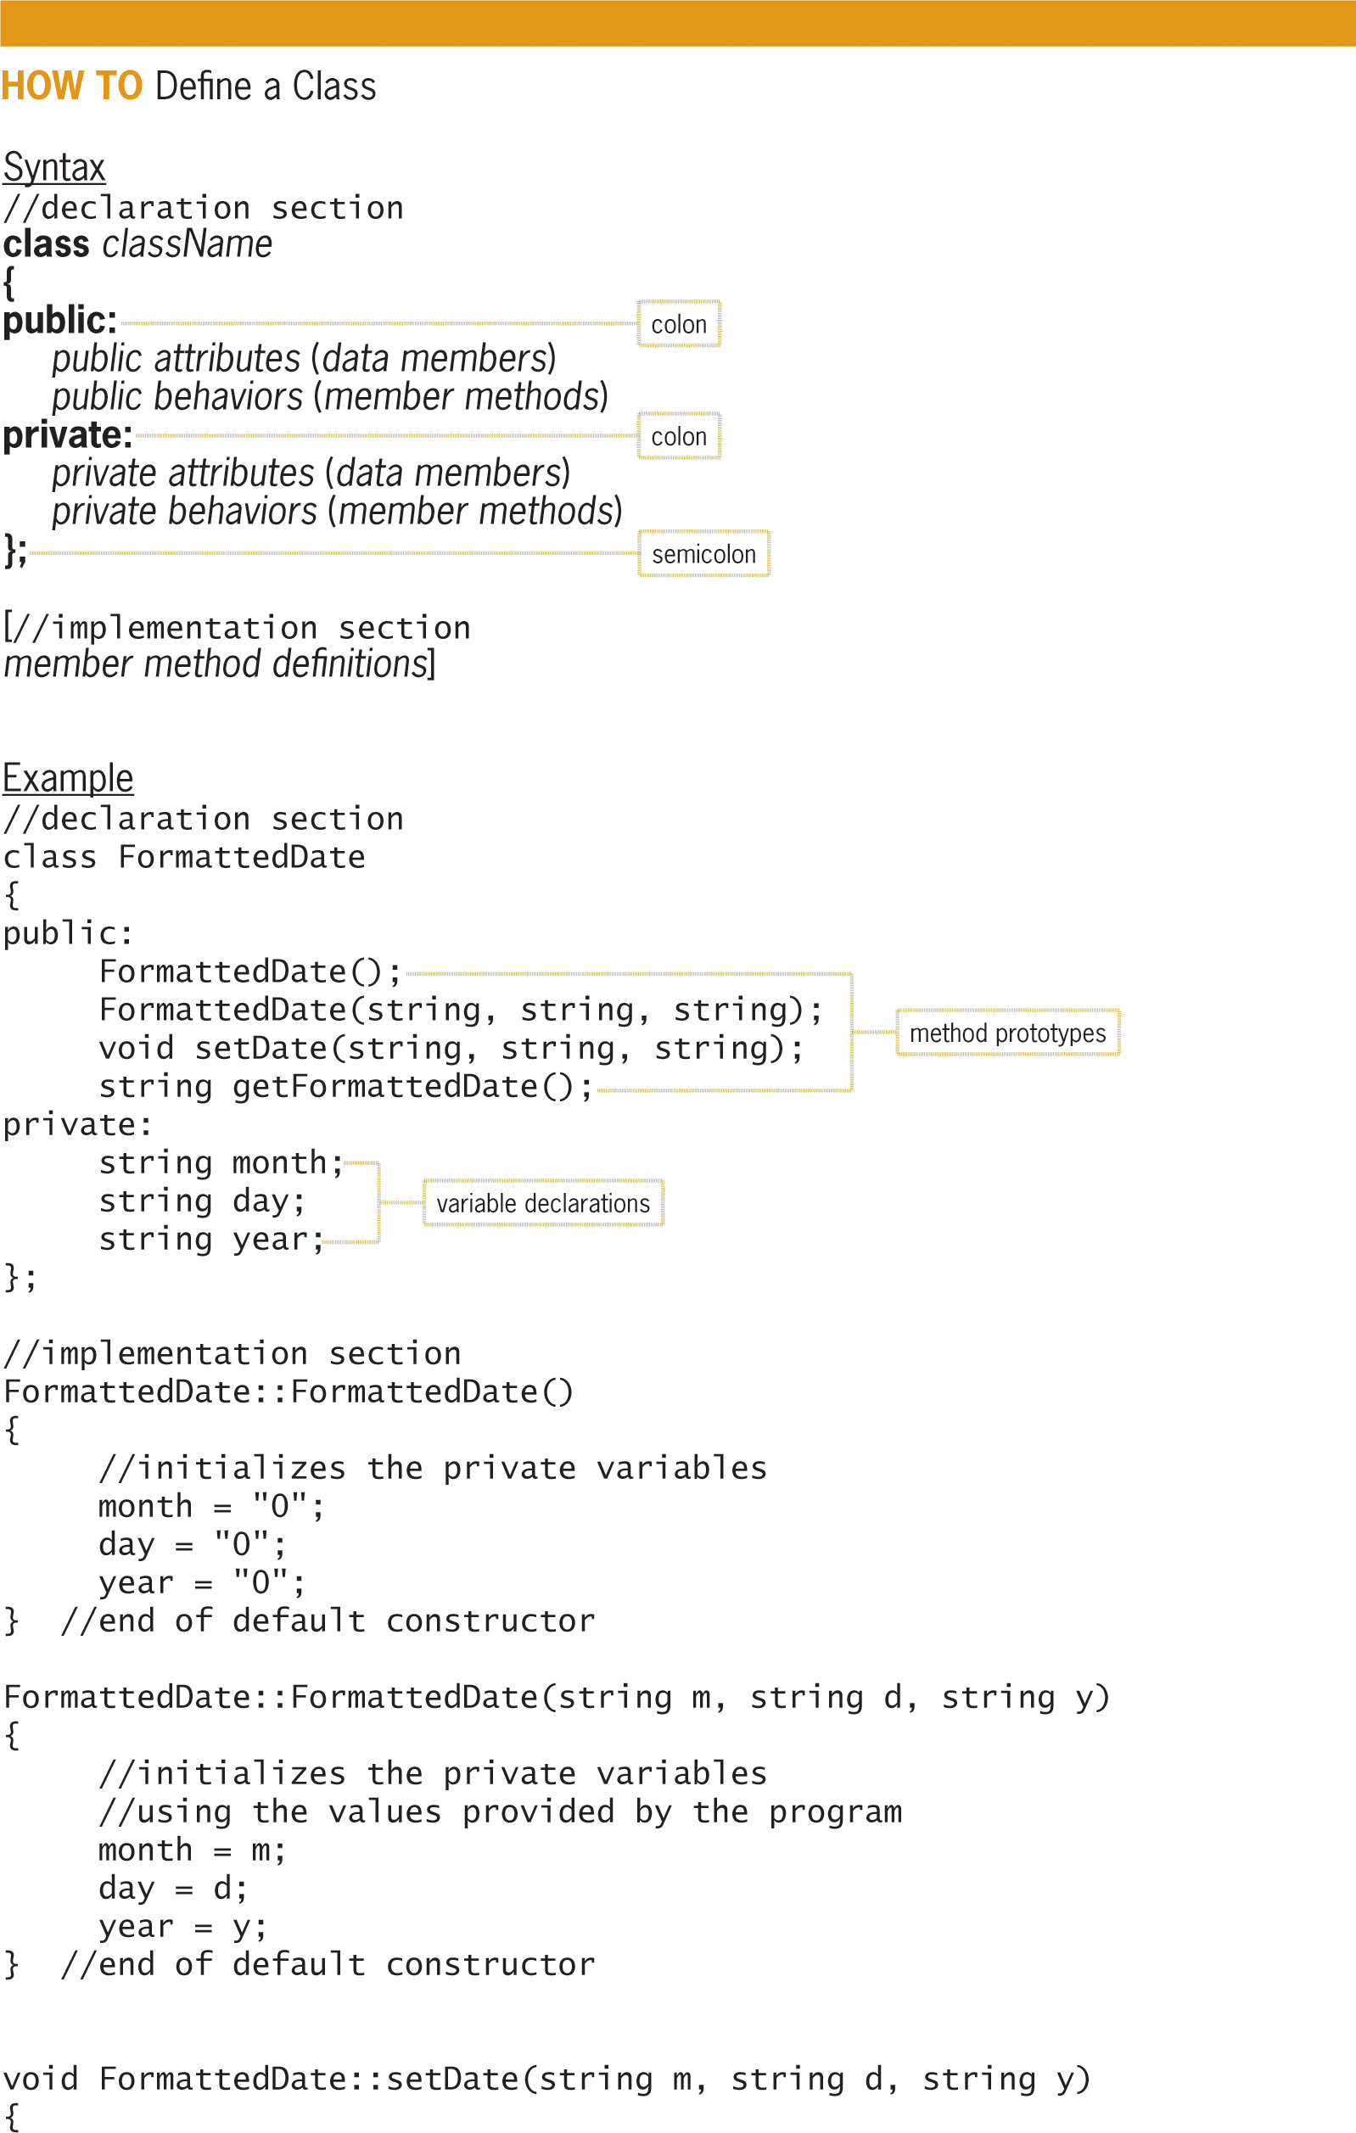
Defining a Class in C++ (cont’d.)
Figure 15-1 How to define a class
An Introduction to Programming with C++, Eighth Edition

Slide 9
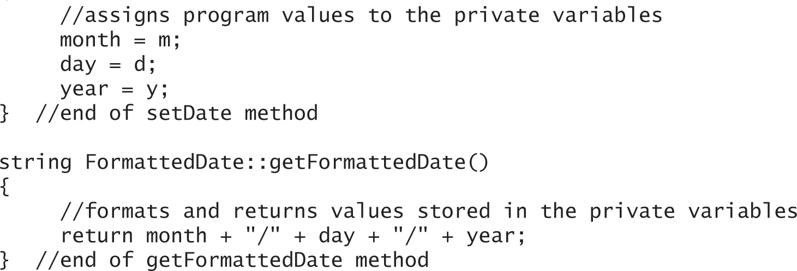
Defining a Class in C++ (cont’d.)
Figure 15-1 How to define a class
An Introduction to Programming with C++, Eighth Edition

Slide 10
Defining a Class in C++ (cont’d.)
The class definition contains two sections: a declaration section and an optional implementation section
The declaration section contains the C++ class statement
Within the class statement, list the attributes and behaviors of the objects that the class will create
An Introduction to Programming with C++, Eighth Edition

Slide 11
Defining a Class in C++ (cont’d.)
The implementation section contains one definition for each prototype listed in the declaration section
In most cases, the attributes (called data members) are represented by method prototypes
A method is simply a function that is defined in a class definition
An Introduction to Programming with C++, Eighth Edition

Slide 12
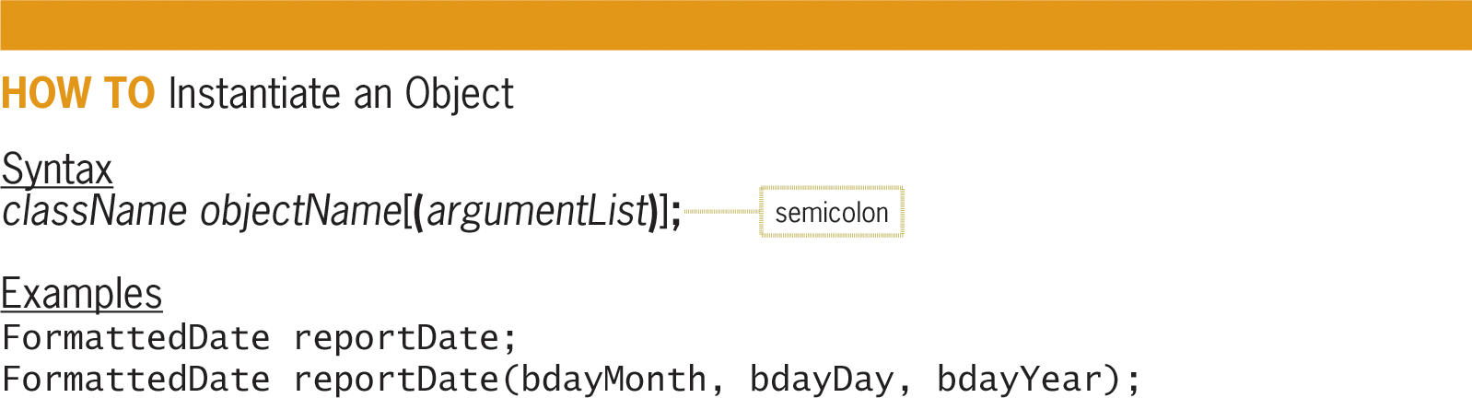
Instantiating an Object and Referring to a Public Member
Figure 15-2 How to instantiate an object
An Introduction to Programming with C++, Eighth Edition

Slide 13
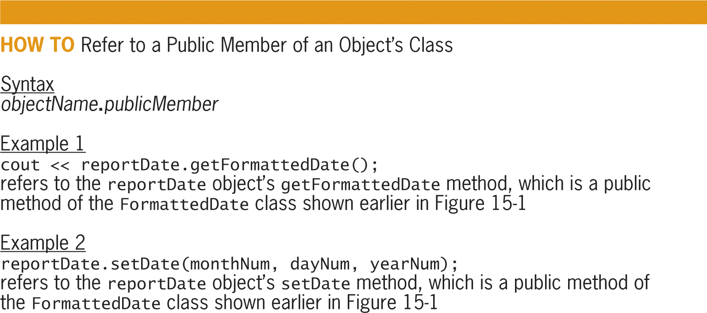
Instantiating an Object and Referring to a Public Member (cont’d.)
Figure 15-3 How to refer to a public member of an object’s class
An Introduction to Programming with C++, Eighth Edition

Slide 14
Example 1 – Private Data Member and Public Member Methods
The class definition contains private data members and public member methods
  Enables data security by regulating access to the data members through the member methods
The public member methods of a class define the tasks that an object can perform
An Introduction to Programming with C++, Eighth Edition

Slide 15
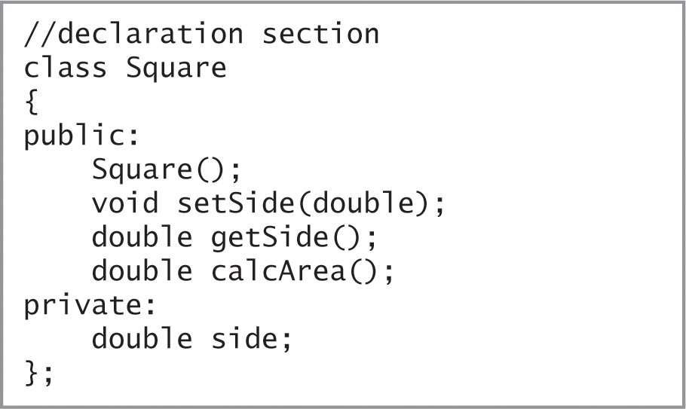
Example 1 – Private Data Member and Public Member Methods (cont’d.)
Figure 15-4 Beginning of Square class definition
An Introduction to Programming with C++, Eighth Edition

Slide 16
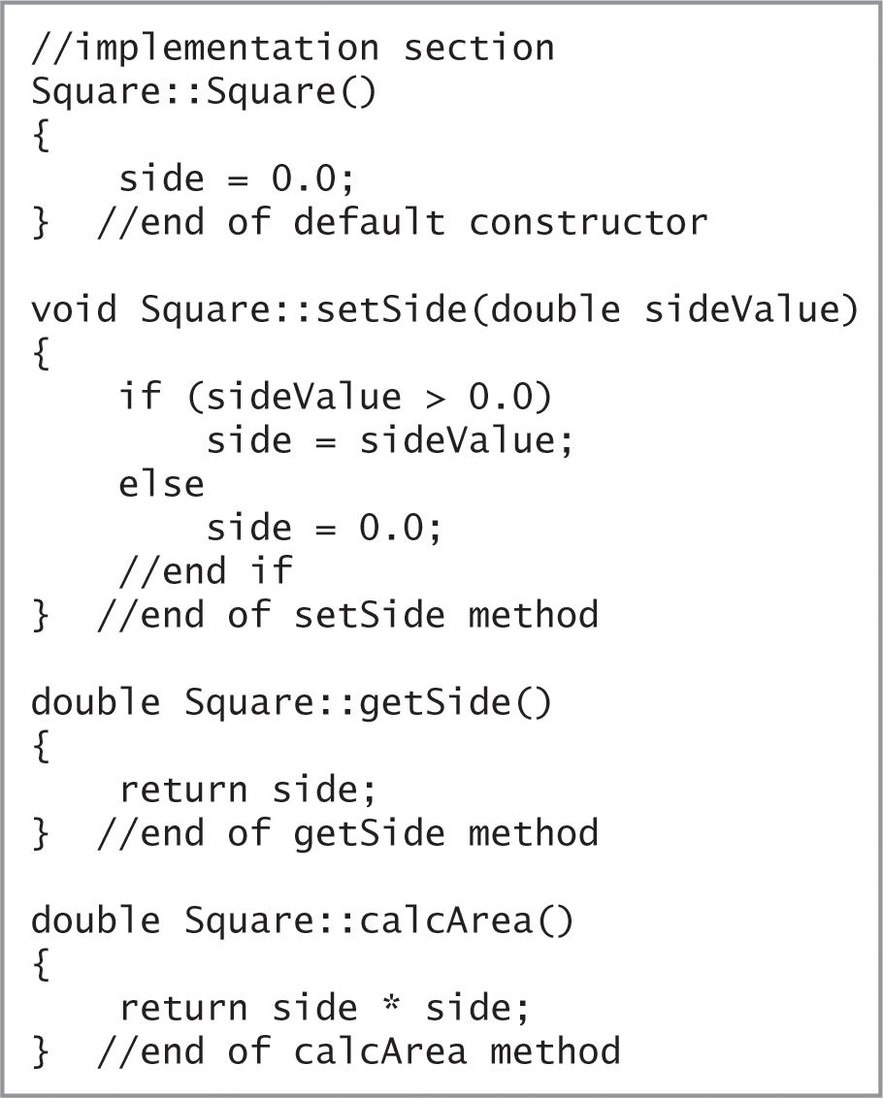
Example 1 – Private Data Member and Public Member Methods (cont’d.)
Figure 15-4 Completion of Square class definition
An Introduction to Programming with C++, Eighth Edition

Slide 17
Example 1 – Private Data Member and Public Member Methods (cont’d.)
A constructor is a class method whose instructions the computer automatically processes each time an object is instantiated from the class
Every class should have at least one constructor
A constructor that has no formal parameters is called the default constructor
A class can have only one default constructor
The sole purpose of a constructor is to initialize the class’s private variables
An Introduction to Programming with C++, Eighth Edition

Slide 18
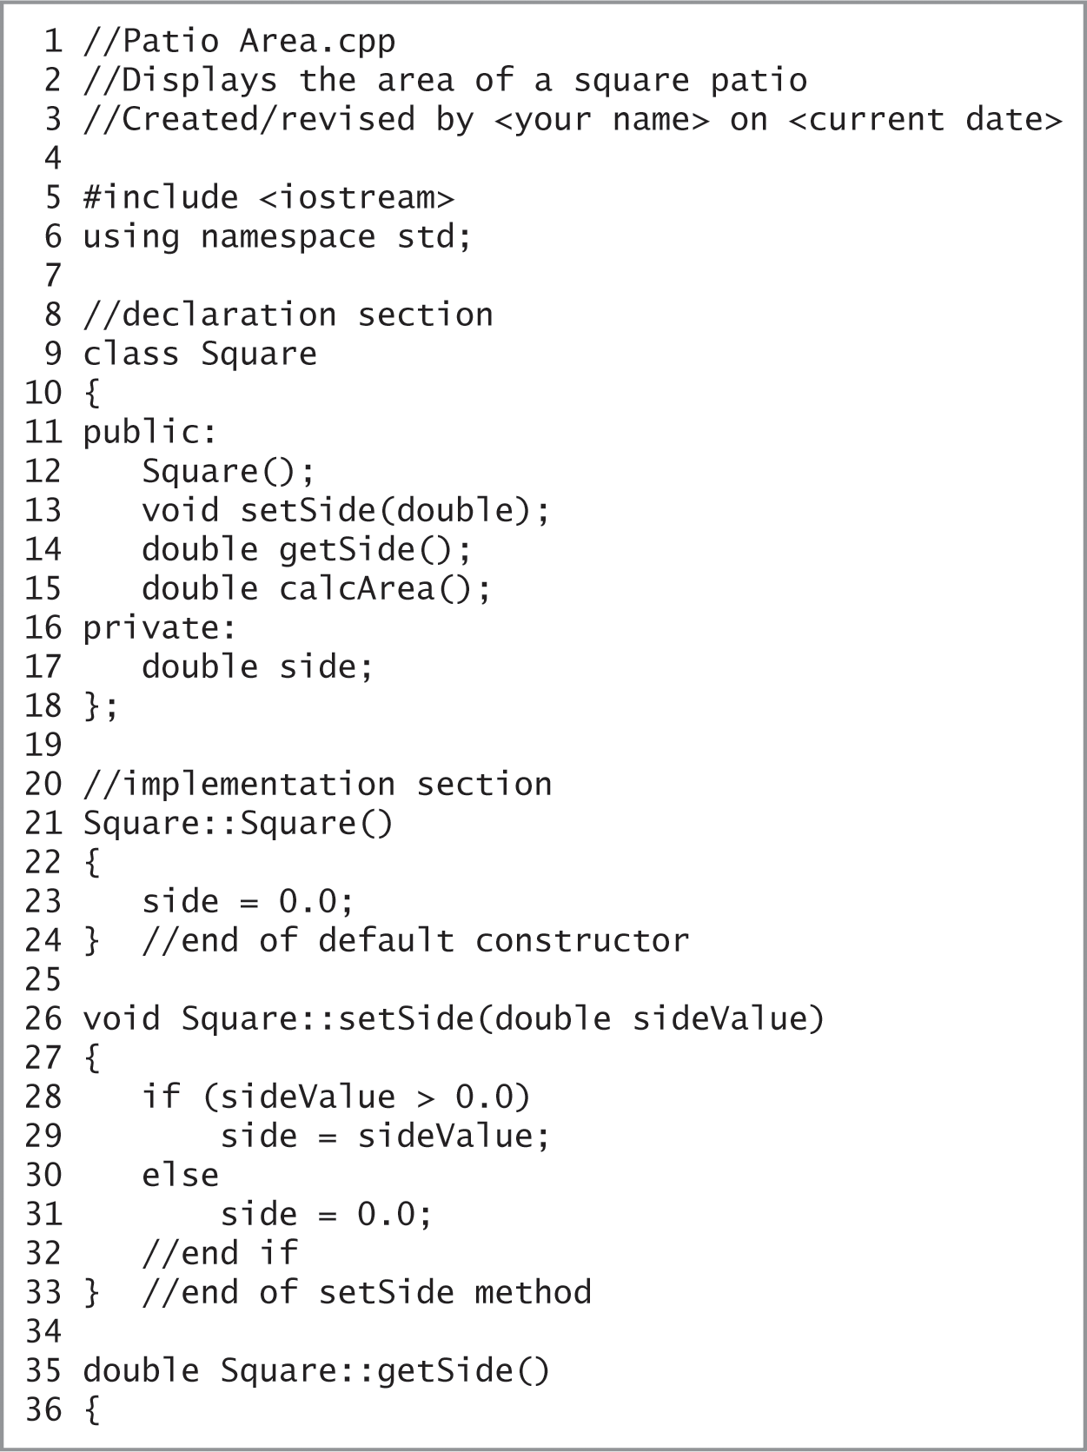
Example 1 – Private Data Member and Public Member Methods (cont’d.)
Figure 15-5 Beginning of Patio Area Program
An Introduction to Programming with C++, Eighth Edition

Slide 19
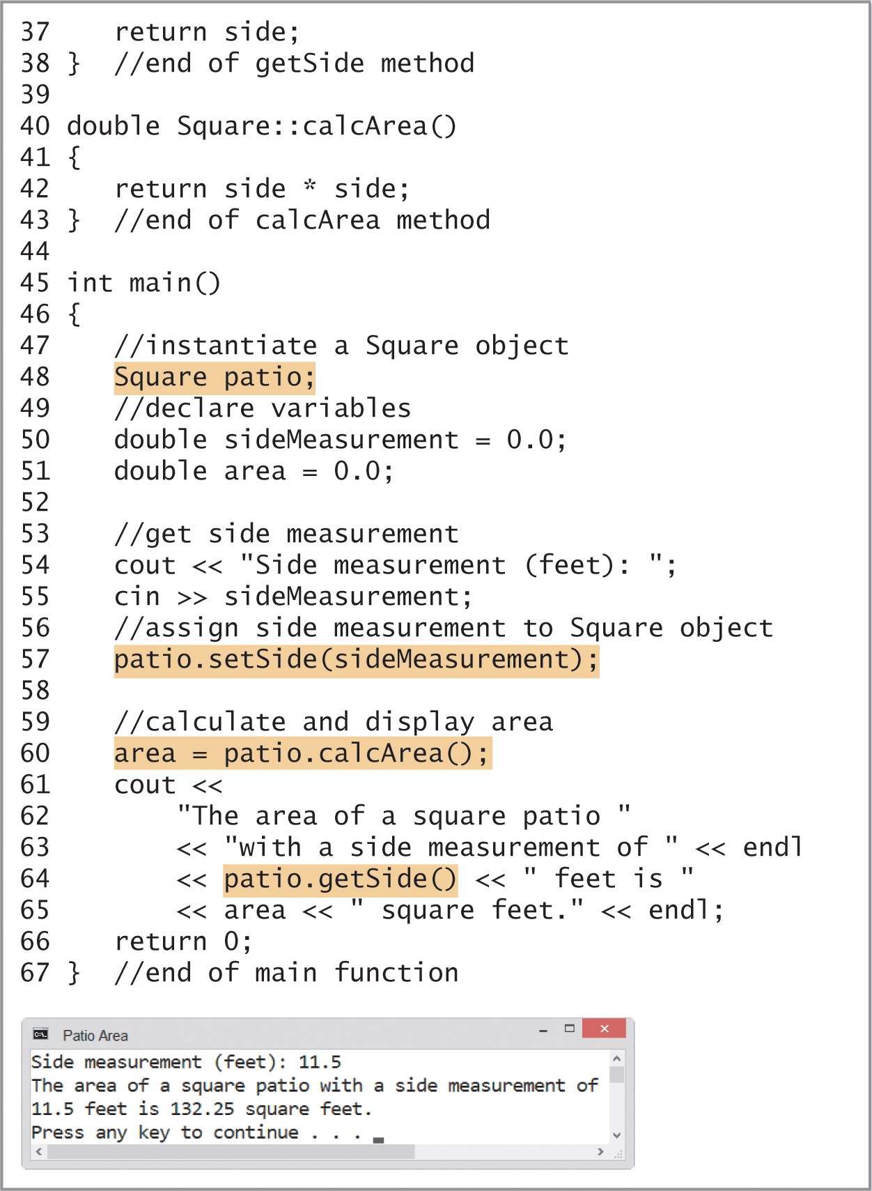
Example 1 – Private Data Member and Public Member Methods (cont’d.)
Figure 15-5 Completion of Patio Area Program and sample run
An Introduction to Programming with C++, Eighth Edition

Slide 20
Header Files
Although you can enter a class definition in the program that uses the class, most programmers enter a class definition in a separate text file called a header file
  Header filenames end with .h
  Use an #include directive to include the header file in a program
An Introduction to Programming with C++, Eighth Edition

Slide 21
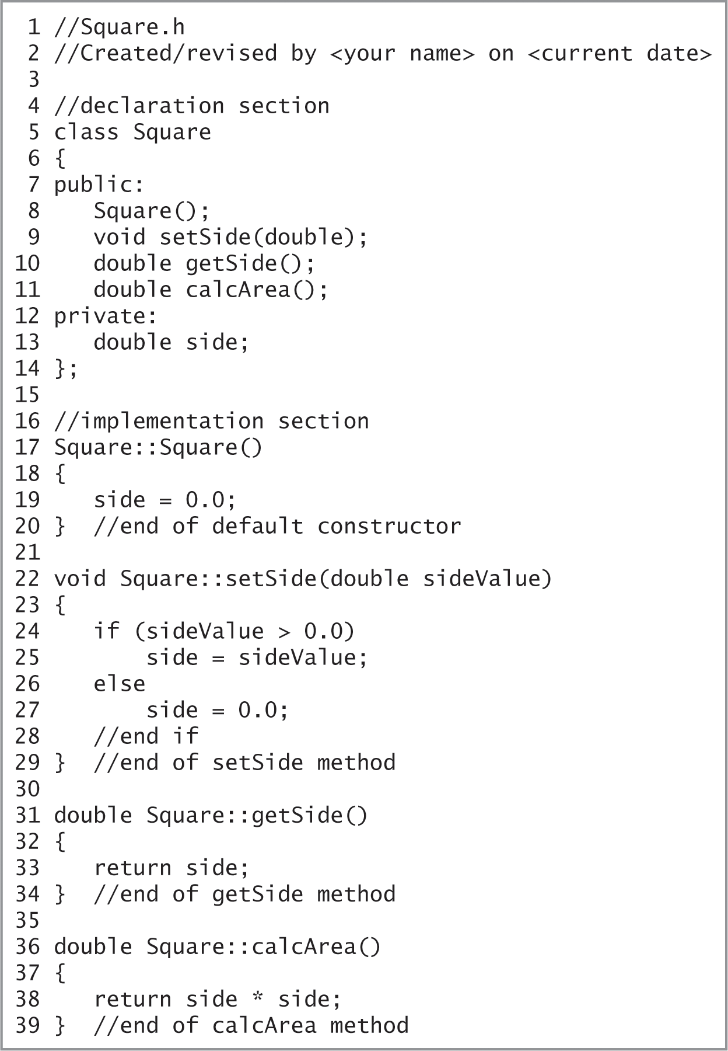
Header Files (cont’d.)
Figure 15-6 Square class definition entered in the Square.h header file
An Introduction to Programming with C++, Eighth Edition

Slide 22
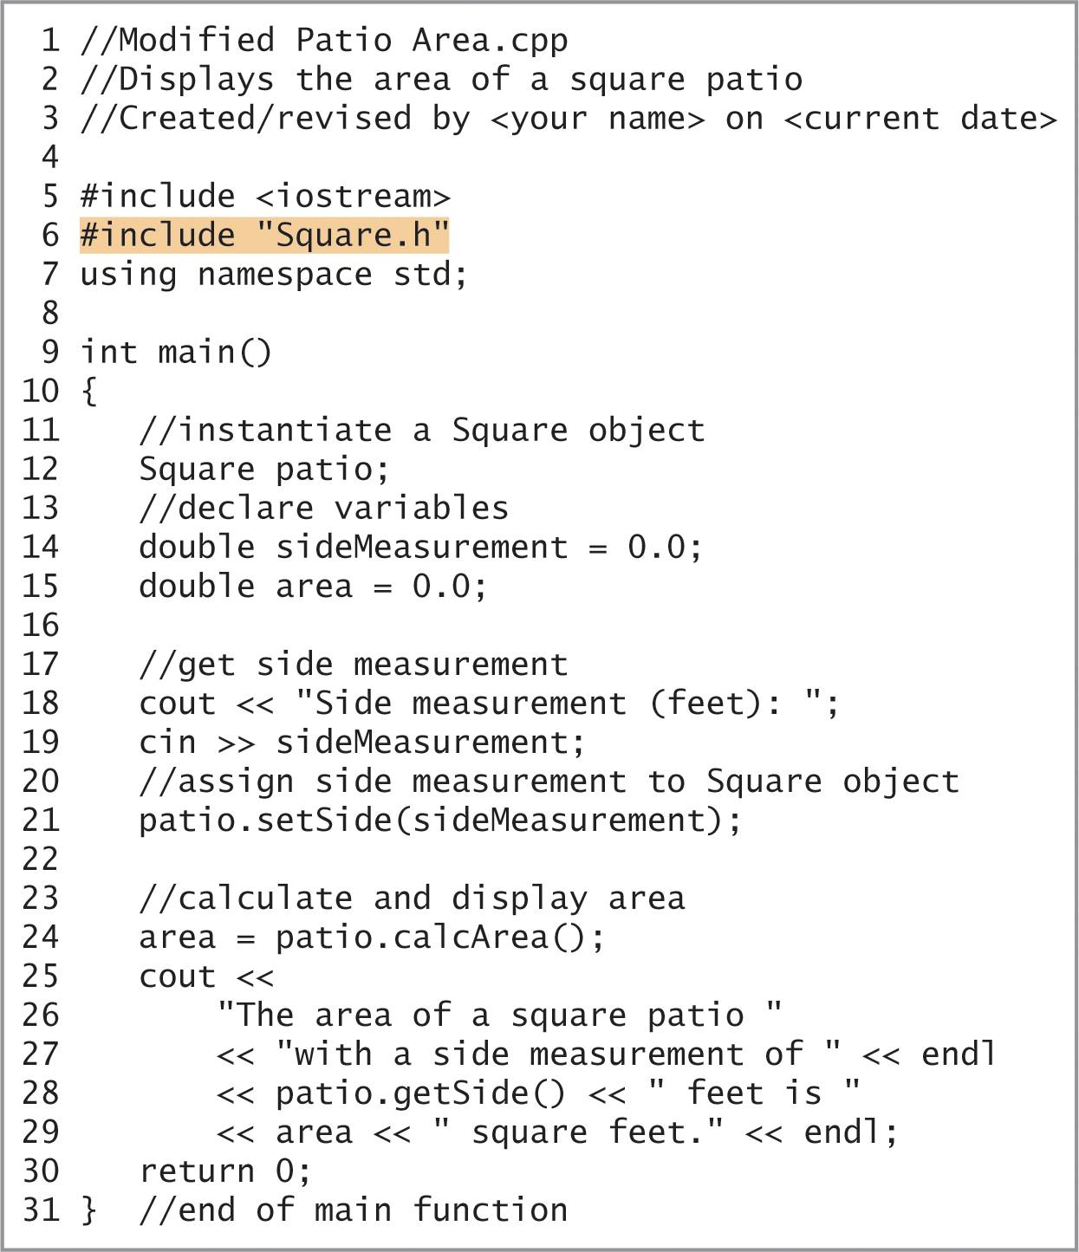
Header Files (cont’d.)
Figure 15-7 Modified Patio Area Program
An Introduction to Programming with C++, Eighth Edition

Slide 23
Example 2 – A Class that Contains a Parameterized Constructor
Constructors that contain at least one parameter are called parameterized constructors
A method’s name combined with its optional parameter list is called the method’s signature
An Introduction to Programming with C++, Eighth Edition

Slide 24
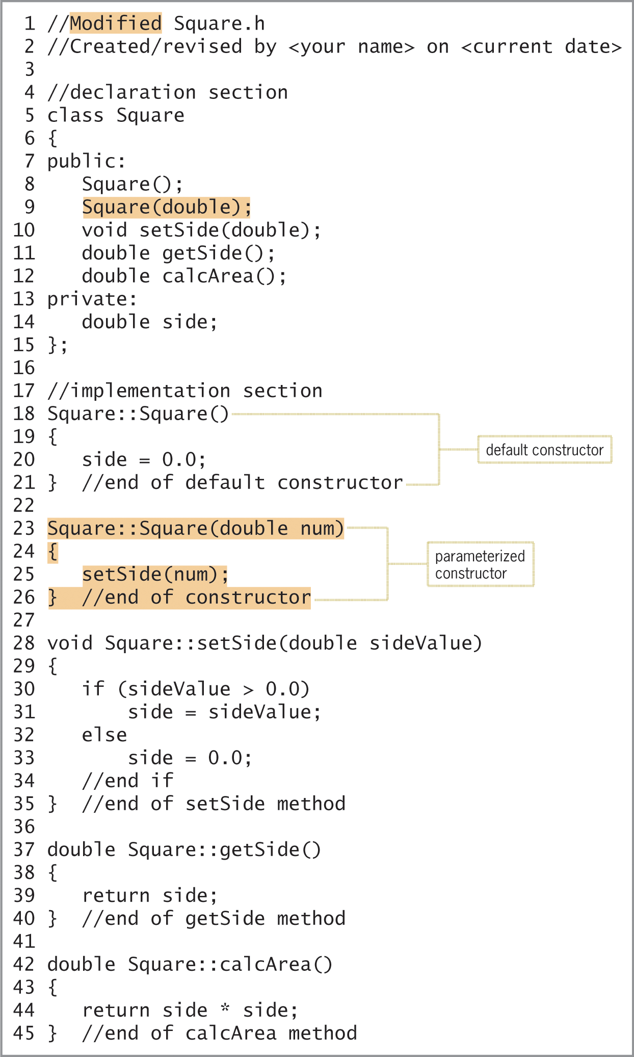
Example 2 – A Class that Contains a Parameterized Constructor (cont’d.)
Figure 15-8 Modified Square class definition entered in the Modified Square.h header file
An Introduction to Programming with C++, Eighth Edition

Slide 25
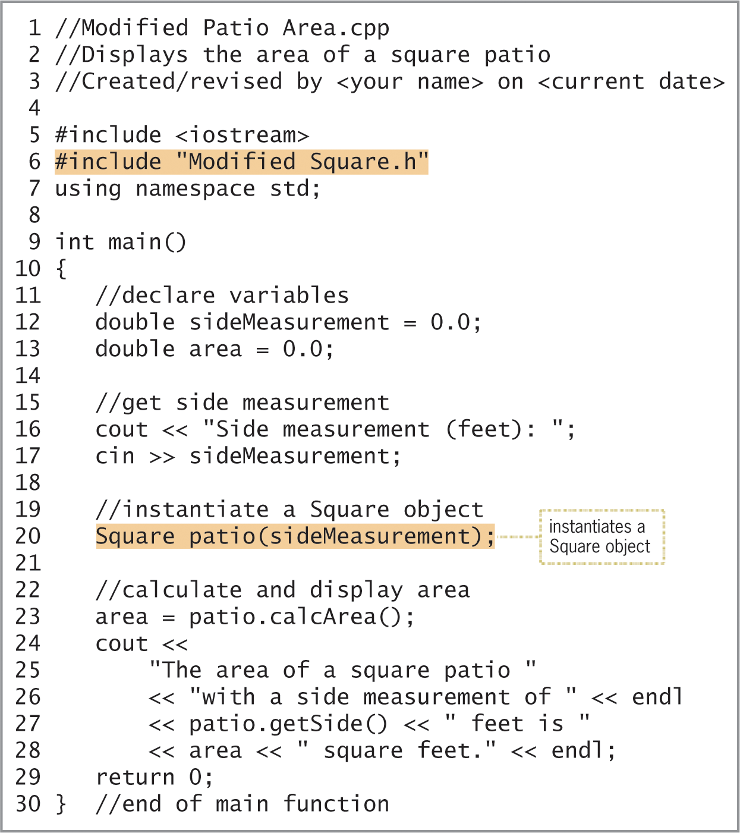
Example 2 – A Class that Contains a Parameterized Constructor (cont’d.)
Figure 15-9 Modified Patio Area Program using the parameterized constructor from Figure 15-8
An Introduction to Programming with C++, Eighth Edition

Slide 26
Example 3 – Reusing a Class
In examples 1 and 2, you used the Square class to create an object that represented a square patio.
In this example, use the Square class to create objects that represent a square pizza and a square pizza slice.
What are the advantages in using the Square class?
An Introduction to Programming with C++, Eighth Edition

Slide 27
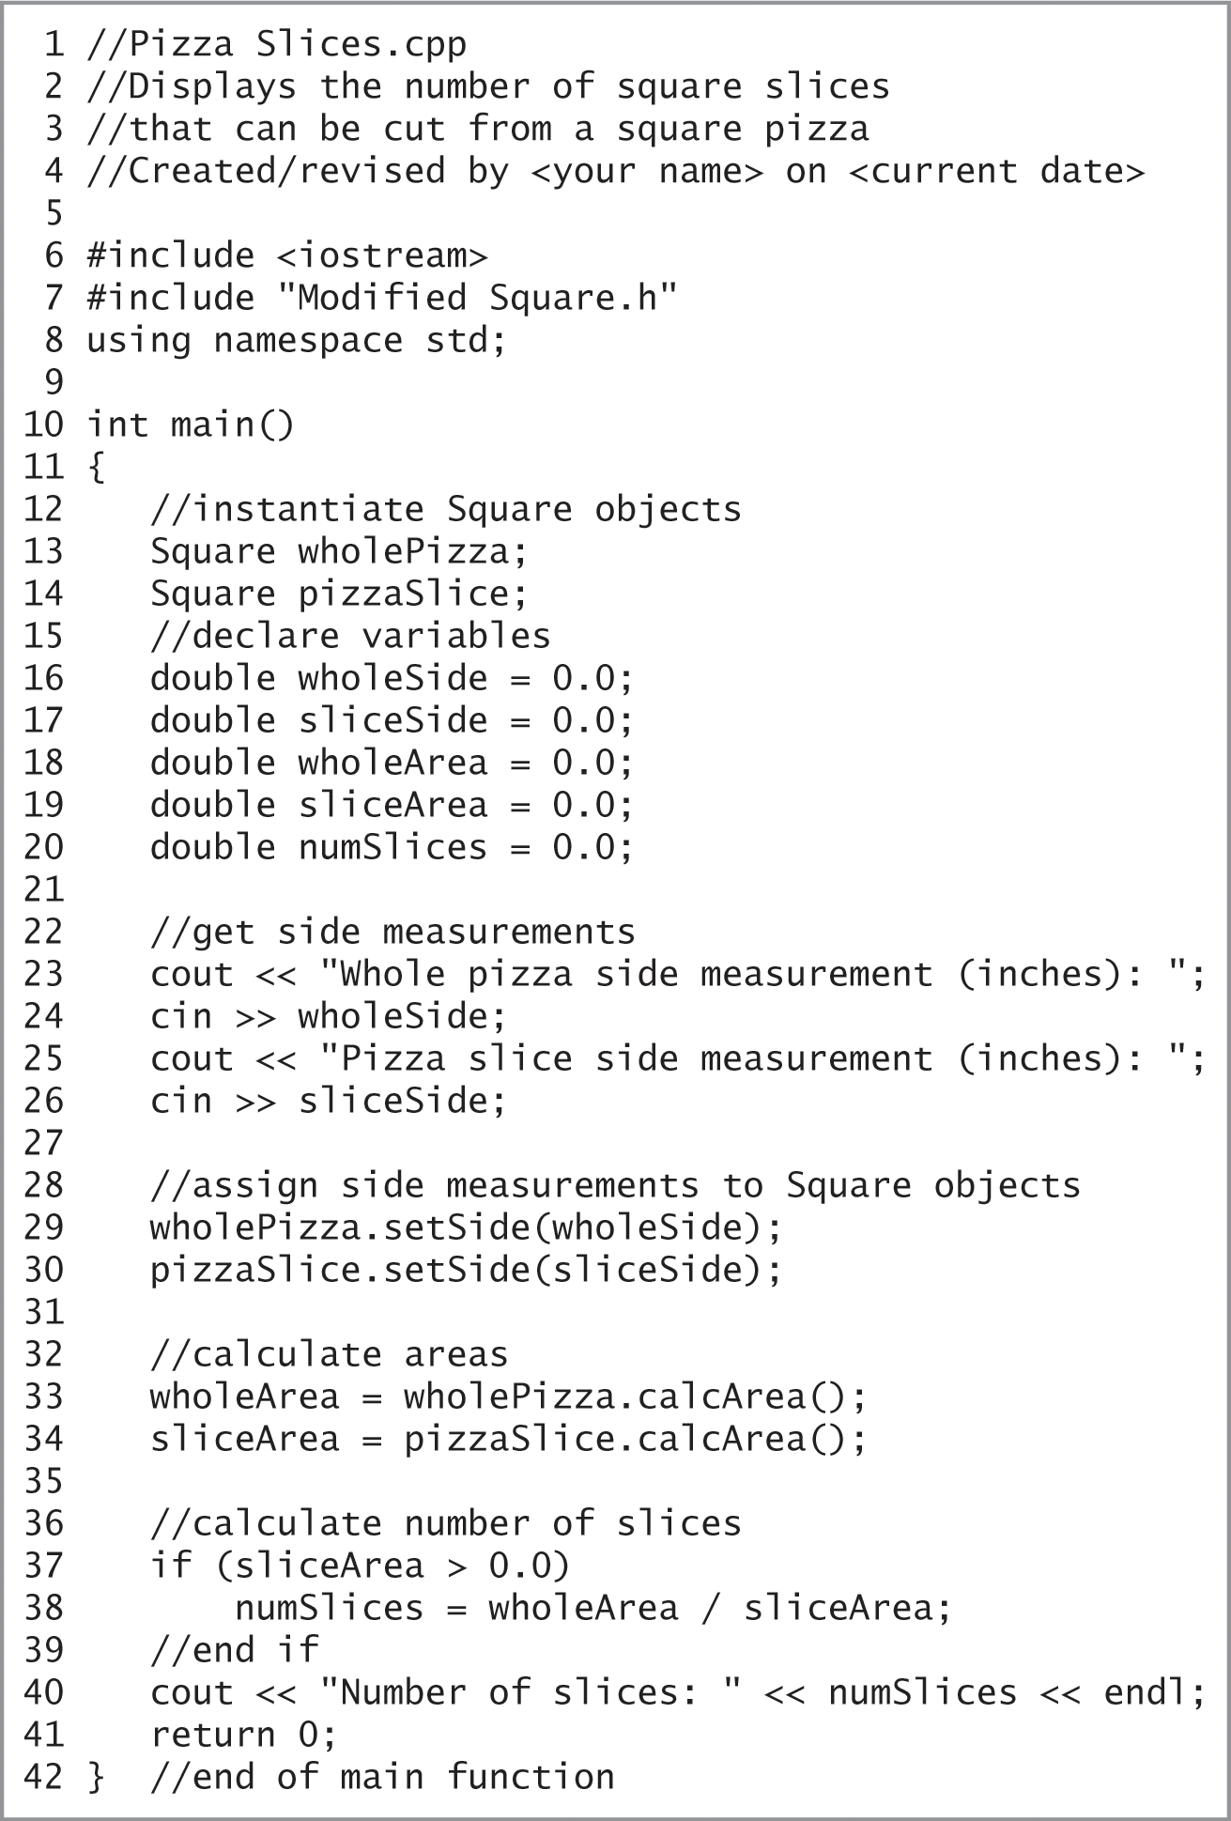
Example 3 – Reusing a Class (cont’d.)
Figure 15-10 Pizza Slices Program showing another use for the Square class
An Introduction to Programming with C++, Eighth Edition

Slide 28
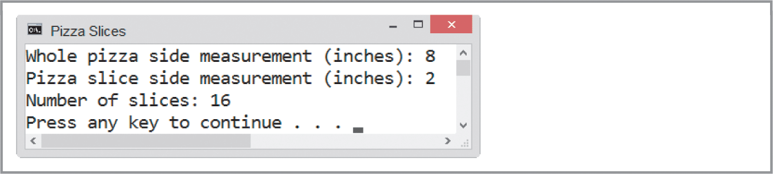
Example 3 – Reusing a Class (cont’d.)
Figure 15-10 Sample run of the Pizza Slices Program
An Introduction to Programming with C++, Eighth Edition

Slide 29
Example 4 – A Class that Contains Overloaded Methods
When two or more methods have the same name but different parameter lists, the methods are overloaded.
The two constructors in Figure 15-11 are overloaded methods because both have the same name but a different parameter list.
An Introduction to Programming with C++, Eighth Edition

Slide 30
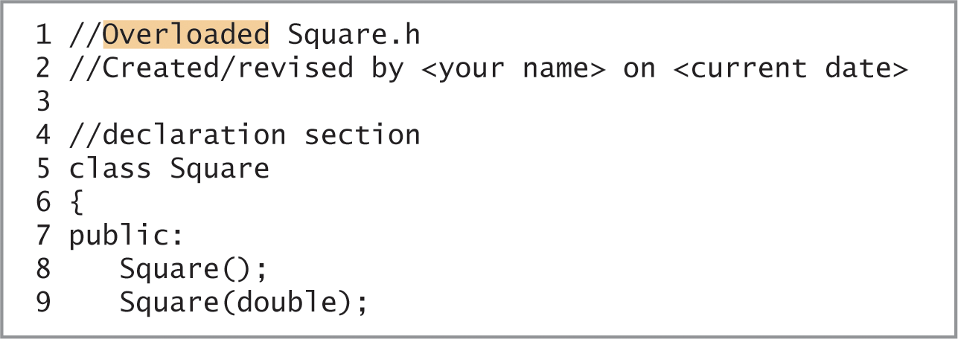
Example 4 – A Class that Contains Overloaded Methods (cont’d.)
Figure 15-11 Beginning of the Square class definition entered in the Overloaded Square.h file
An Introduction to Programming with C++, Eighth Edition

Slide 31
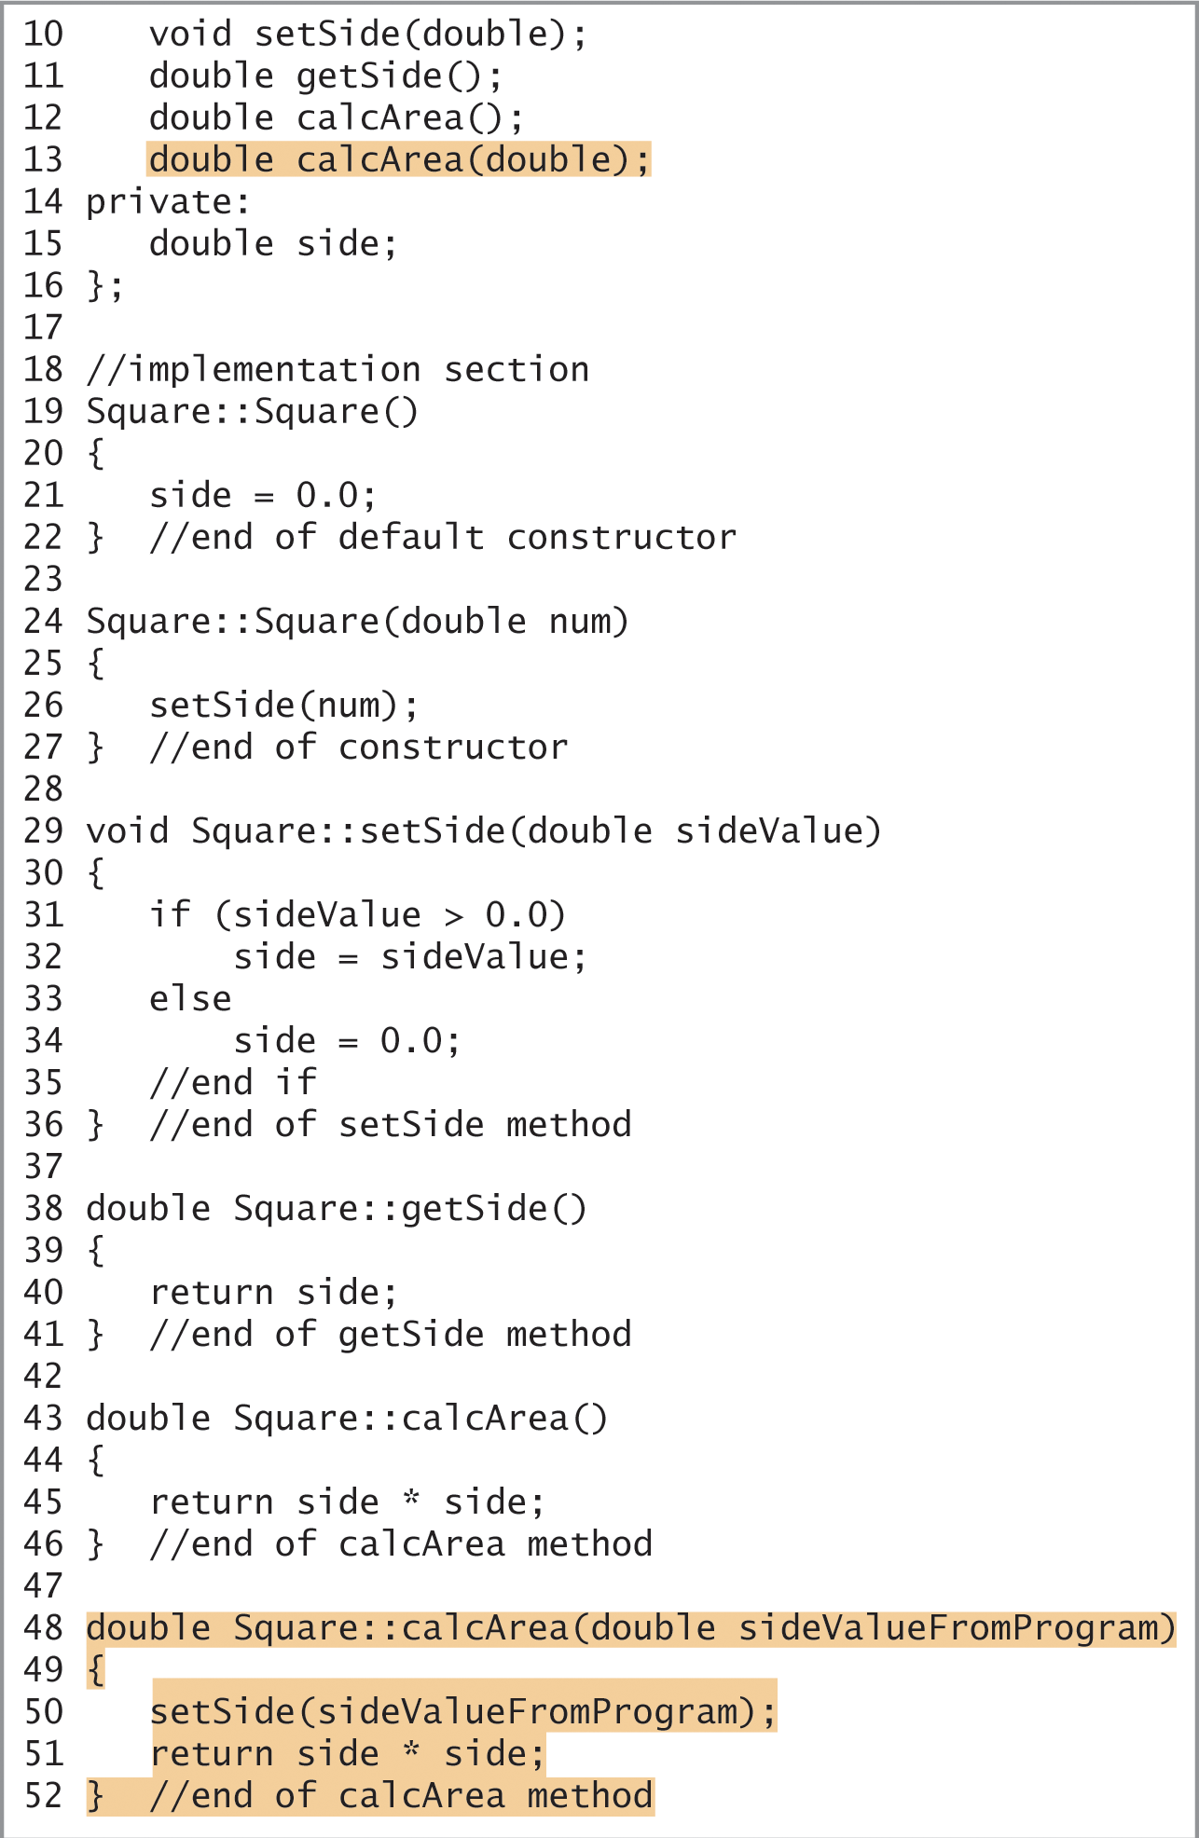
Example 4 – A Class that Contains Overloaded Methods (cont’d.)
Figure 15-11 Completion of the Square class definition entered in the Overloaded Square.h file
An Introduction to Programming with C++, Eighth Edition

Slide 32
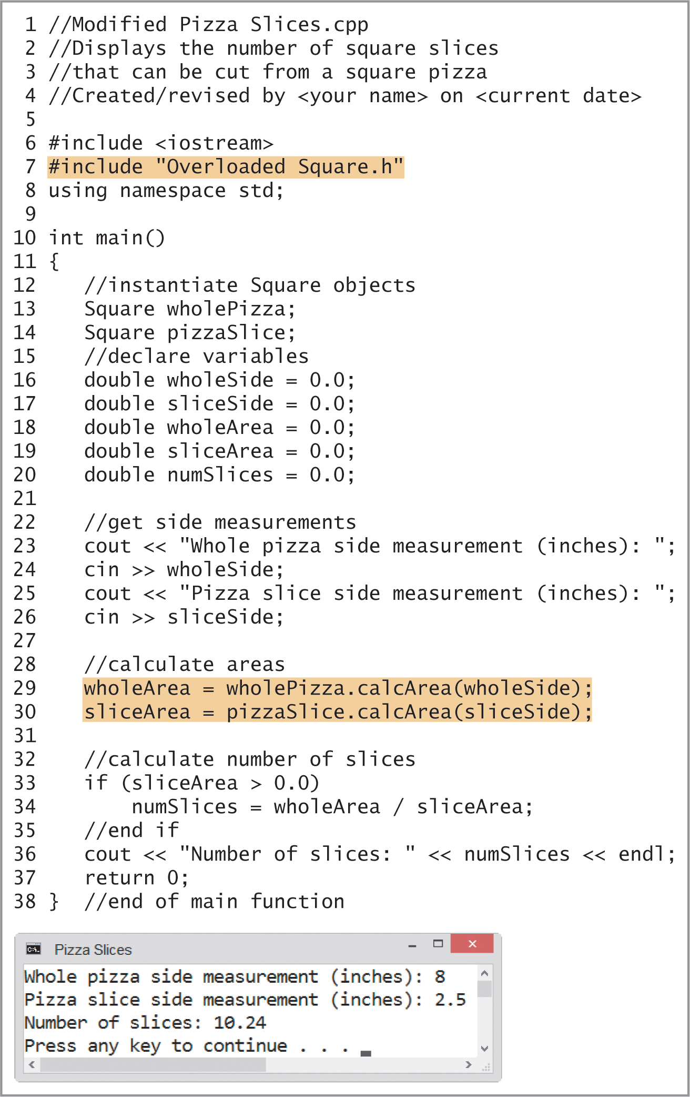
Example 4 – A Class that Contains Overloaded Methods (cont’d.)
Figure 15-12 Modified Pizza Slices Program and sample run
An Introduction to Programming with C++, Eighth Edition

Slide 33
Summary
A class encapsulates all of an object’s attributes and behaviors
  Attributes: the characteristics that describe the object
  Behaviors: the actions that the object can perform or to which the object can respond
Abstraction: the hiding of an object’s internal details from the user
  expose the user only to attributes and behaviors that are necessary to use the object; hide everything else to prevent the user from making inadvertent changes to the object
An Introduction to Programming with C++, Eighth Edition

Slide 34
Summary (cont’d.)
Polymorphism: the object-oriented feature that allows the same instruction to be carried out differently depending on the object
A class definition contains two sections: declaration and implementation
Another name for creating an object is instantiation
An Introduction to Programming with C++, Eighth Edition

Slide 35
Summary (cont’d.)
Most C++ programmers enter class definitions in header files, which have a file extension of .h
You can use a constructor to initialize the data members in a class when an object is instantiated
Each constructor in a class has the same name, but its formal parameters (if any) must be different from any other constructor in the class
A constructor does not have a data type, because it cannot return a value
You can overload the methods in a class
An Introduction to Programming with C++, Eighth Edition

Slide 36
Lab 15-1: Stop and Analyze
Study the code in Figure 15-13 and then answer the questions.
An Introduction to Programming with C++, Eighth Edition

Slide 37
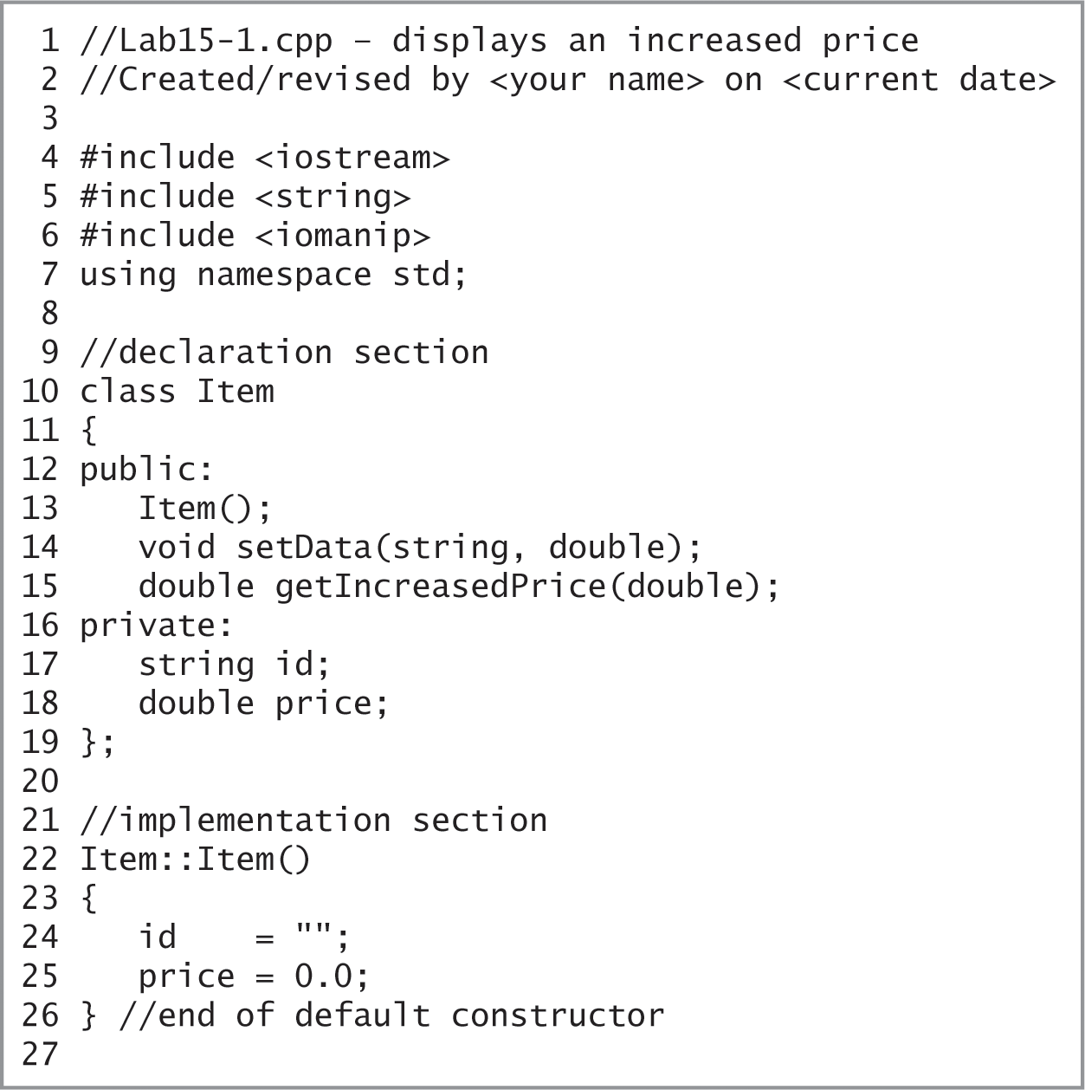
Lab 15-1: Stop and Analyze (cont’d.)
Figure 15-13 Beginning of code for Lab 15-1
An Introduction to Programming with C++, Eighth Edition

Slide 38
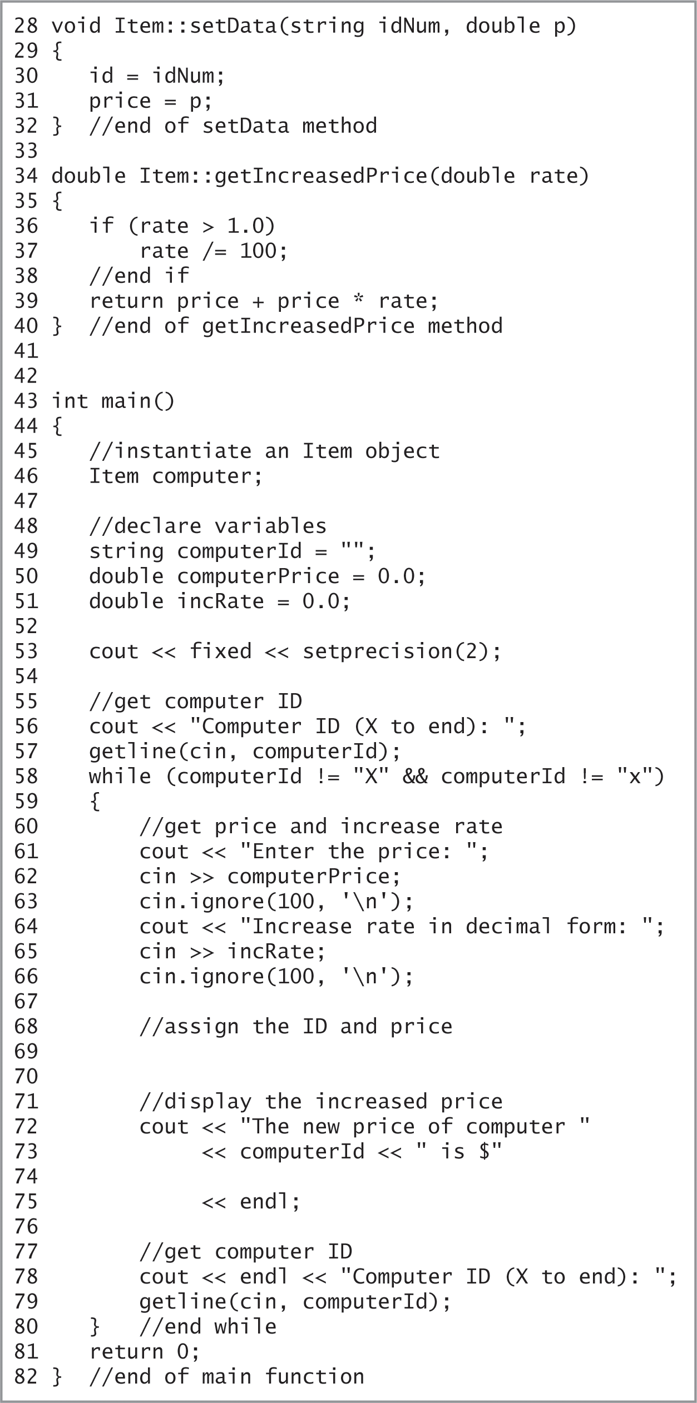
Lab 15-1: Stop and Analyze (cont’d.)
Figure 15-13 Remainder of code for Lab 15-1
An Introduction to Programming with C++, Eighth Edition

Slide 39
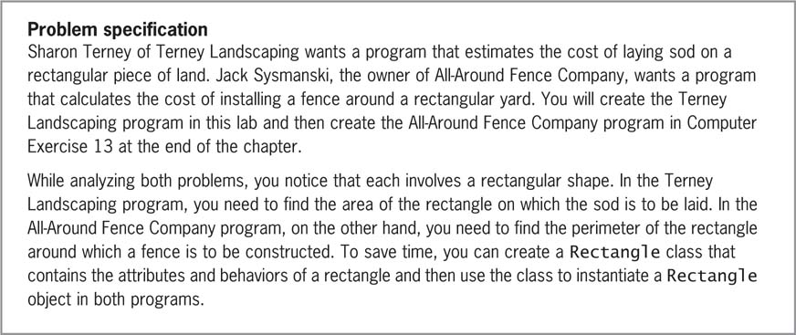
Lab 15-2: Plan and Create
Figure 15-14 Problem specification for Lab 15-2
An Introduction to Programming with C++, Eighth Edition

Slide 40
Lab 15-3: Modify
Make a copy of Lab 15-2 to modify.
Follow the modification instructions on page 576.
Save the modified program as Lab14-3.cpp and test the program appropriately.
An Introduction to Programming with C++, Eighth Edition

Slide 41
Lab 15-4: What’s Missing?
The program is this lab should display the area of a parking lot.
Follow the instructions for starting C++ and opening the Lab15-4.cpp file. Put the C++ instructions in the proper order, and then determine the one or more missing instructions.
Test the program appropriately.
An Introduction to Programming with C++, Eighth Edition

Slide 42
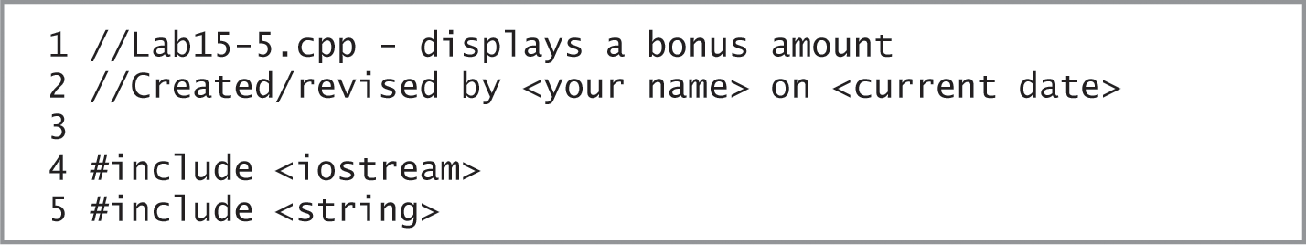
Lab 15-5: Desk-Check
Desk-check the code in Figure 15-20 using Carla Rensen and 123456.75 as the salesperson’s name and sales amount, respectively.
What will the code display on the screen?
Figure 15-20 Beginning of code for Lab 15-5
An Introduction to Programming with C++, Eighth Edition

Slide 43
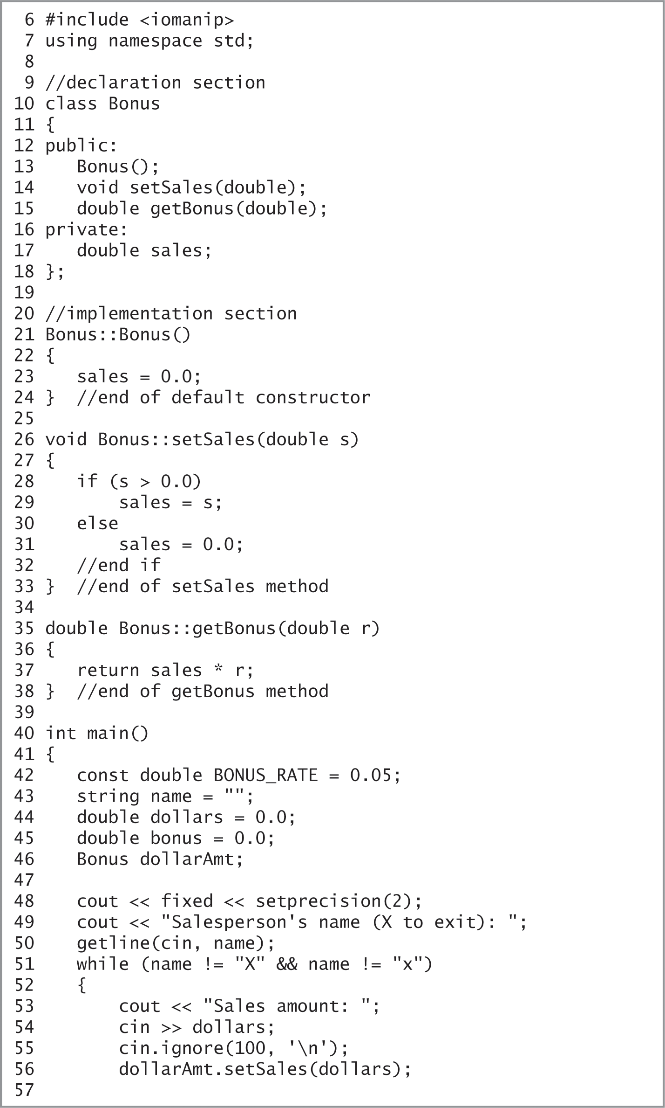
Lab 15-5: Desk-Check (cont’d.)
Figure 15-20 Continuation of code for Lab 15-5
An Introduction to Programming with C++, Eighth Edition

Slide 44
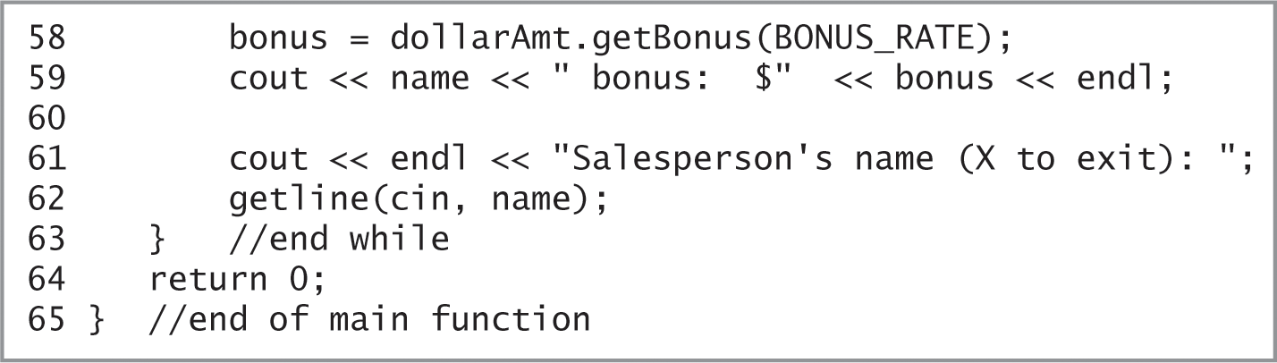
Lab 15-5: Desk-Check (cont’d.)
Figure 15-20 Remainder of code for Lab 15-5
An Introduction to Programming with C++, Eighth Edition

Slide 45
Lab 15-6: Debug
Run the program in the Lab15-6.cpp file.
The program should display the item number and inventory quantity entered by the user.
Notice the program is not working correctly.
Debug the program.
An Introduction to Programming with C++, Eighth Edition

