Slide 1
Assessing Comprehensibility of Children’s Read Speech
Dual Degree Stage 2 Presentation
Mithilesh Vaidya (17D070011)
Guide: Prof. Preeti Rao

Slide 2
Motivation
Reading - a fundamental skill in today’s world
Automatic assessment of reading skills:
Important for providing remedial measures to poor readers
Current methodology requires skilled teachers ⇒ not scalable, subjective
Can be judged by analysing read aloud speech [1]
Involves two stages of proficiency:
Word decoding - Recognizing words (Accuracy) at a reasonable (Rate)
Meaning construction - Incorporating Expression (Prosody) => Comprehending the text
Notes:
Poor readers ⇒ slow to absorb knowledge ⇒ suffer during school and later
Conduct exams - cognitive demand

Slide 3

Word decoding and Prosodic Fluency
First stage (Lexical fluency): Constructing words from characters
For good readers in grades 4-6, WCPM ~> 70 [3]
Poor WCPM ⇒ Poor word decoding ability ⇒ Poor reading comprehension BUT high WCPM ⇏ good readers e.g.
Aim of reading is comprehension
Comprehending while reading out reflected by modulating voice
Acoustically correlated with pitch, rhythm and intonation
Beyond certain word decoding ability, prosodic fluency gains importance
Notes:
Explain WCPM; how it can measure lexical fluency
No such single score for prosodic fluency

Slide 4
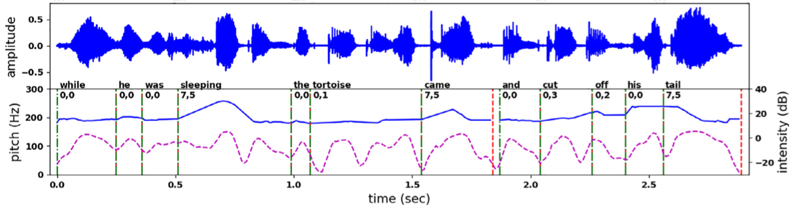
Prosodic events and their acoustic correlates
Two important components of prosodic fluency:
Phrasing
Group words together to convey syntactic structure such as commas and full stop
Relatively easy to predict from pauses
Prominence
Stress on certain words to convey linguistic focus or novel information
More subjective, with multiple acoustic patterns e.g. lengthening of word, pitch variation within word
Figure reproduced from [10]
Notes:
Sleeping is prominent: lengthening + pitch variation
Phrasing: obvious from text and punctuation
Prominence: more subjective and dependent on context

Slide 5
Example for correct expression
one day || three tortoises went for a picnic near a pond || they put down the basket of food they had brought at the shore || and went inside the pond || to enjoy a bath || when they came back || they found a fox eating their food || on being asked || the fox replied || anything lying on the ground is public property || so the basket and the food were also public property || and hence || i ate the food ||​
Notes:
Information structure: heuristics in literature
E.g. phrasing: for a long sentence without punctuation, long sentences need to be chunked
Prominence: default position is last content word of phrase, completely new word
Prosodic miscue

Slide 6
Rating rubric (Comprehension/Comprehensibility)​
Expert-rated for comprehensibility using NAEP rubric [4]
Note the focus on phrasing and prominence
Rating level | Interpretation
0 | random grouping, pauses in wrong places, incomprehensible to the listener
1 | poor grouping by and large with glimpse of good grouping in one or two places. The underlying reason could be word difficulty.
2 | better grouping but still not perfect in all places.
3 | grouping is good but stresses are wrong.
4 | basically a good reader, some local slips that may be attributed to first-time reading of the given text. This level can be treated as the benchmark.
5 | exceptional (could be a practiced child who does speech/elocution training).
Can’t rate | reserved for unusual cases such as the audio does not contain the child’s speech, volume is too low, too noisy, too short, etc.
Notes:
NAEP: national assessment of educational progress
Comprehenisbility: lexical + prosodic
Lexical not imp after a certain point
Prosodic heavily influenced by prom and phrasing

Slide 7
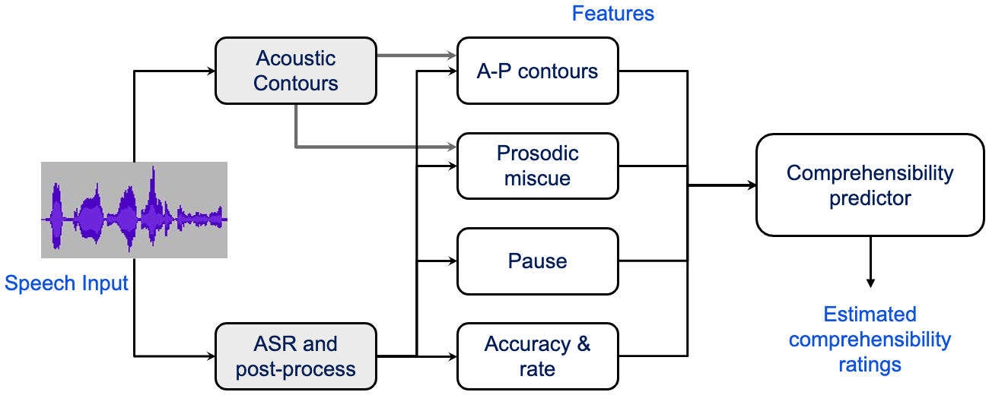
Baseline work
Focus of Stage 1
Current work builds upon recent PhD thesis by Kamini Sabu [3]
Baseline uses Random Forest Classifier (RFC) on hand-crafted features
Diagram credits: Kamini Sabu
Notes:
Give examples of HC features in each category.
Explain that ‘prosodic miscue’ comes from comparing detected prosodic events with the reference information structure.
Therefore PED (by deep learning) was the motivation for your first stage work.

Slide 8
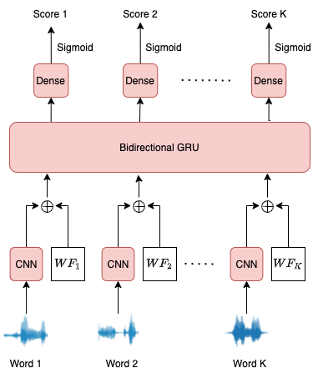
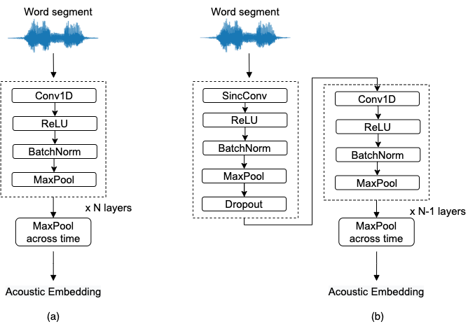
Stage 1 summary
Baseline work by Kamini combined hand-crafted (HC) features with RFC for detecting prominence and phrase breaks​
Proposed end-to-end model operating on word segments
Benefited from:
Sinc-based feature extraction
Multi-task Learning
Improved performance of:
Prominence: 0.69 -> 0.74
Phrasing: 0.85 -> 0.89

Slide 9
Comprehensibility dataset
Recordings of children aged 10-14 reading out stories
Two filters are applied to weed out recordings with poor lexical fluency:
WCPM < 70
Lexical miscue % > 15%
1447 recordings read by 165 students from a pool of 148 unique paras
50-70 words per paragraph
Duration varies from 12 s to 56 s with mean = 25 s and std = 8 s
Total duration: 10 hours
~10 recordings/speaker; 2 speakers with >50 recordings
Split into 6 speaker non-overlapping folds

Slide 10
ASR/Manually Transcribed
ASR/Manual transcription (FA) gives uttered words
Compared with canonical text to obtain word miscues
Force aligned to obtain word alignments
ASR system:
TDNN acoustic model trained on 80 hours of Indian English
Tri-gram language model trained on children story texts
WER = 5.55% on our dataset
Hand-crafted features are affected by choice of ASR vs FA

Slide 11
Effect of ASR/Manually transcribed
Accuracy and Rate features more accurate for FA
Significantly different for ASR and FA
Diagram credits: Kamini Sabu

Slide 12
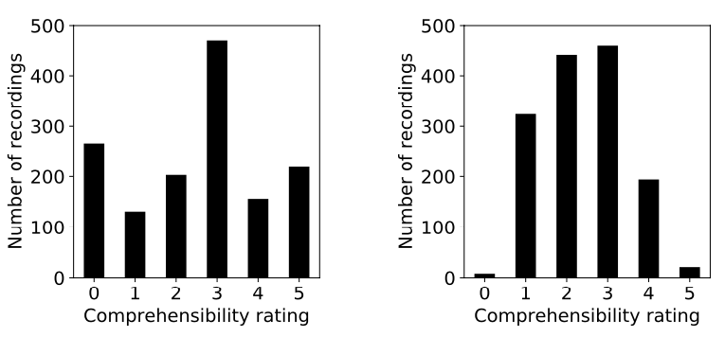
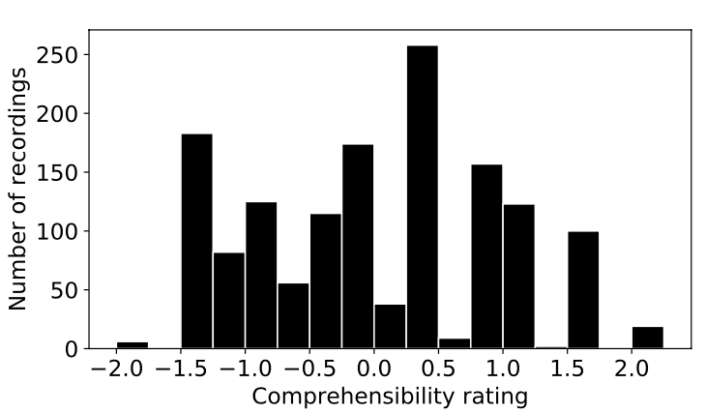
Rater bias
Despite the standard rating rubric, raters have different preferences
Final score obtained on averaging z-score normalized rating of the two raters
Continuous targets supplied for fine-grained distinctions

Slide 13
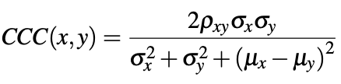
Evaluation metrics
For regression tasks, popular metrics:
Pearson correlation: Invariant to scaling and offset by design
Root Mean Squared Error (RMSE): Sensitive to outliers; value depends on scale and bias ⇒ comparing across datasets is difficult
Concordance Correlation Coefficient (CCC):
Can be interpreted as combination of MSE and Pearson
Notes:
Pearson: Measure of linear trend between two variables
Ratings: x, y, z while model outputs x+1, y+1, z+1 -> Pearson will be 1 not good

Slide 14
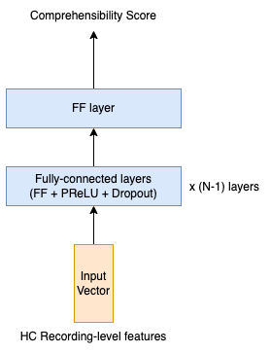
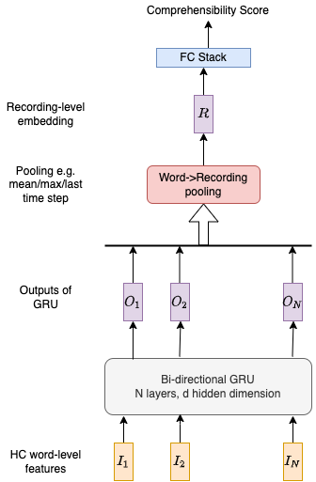
Neural Network baselines
Replace RFC with
Recording-level MLP
Word-level RNN
operating on HC features discussed previously

Slide 15
RFC vs MLP vs RNN
Model | Dataset | Val CCC | Test CCC | Test Pearson
RFC | ASR |  | 0.736 | 0.774
 | FA |  |  | 0.794
MLP | ASR | 0.769 | 0.767 | 0.777
 | FA | 0.793 | 0.789 | 0.796
RNN | ASR | 0.747 | 0.750 | 0.761
 | FA | 0.762 | 0.767 | 0.777
MLP ~ RFC for all feature sets
RNN slightly inferior
FA > ASR in all cases
Superior lexical miscues feature set
Ablation gives same results for only A-P contour features
Can we:
Eliminate HC features?
Improve performance?
Results on using ALL recording-level/word-level HC features
Notes:
RFC trained on MSE and hence comparing pearson is more appropriate. RNN does not have access to all features

Slide 16
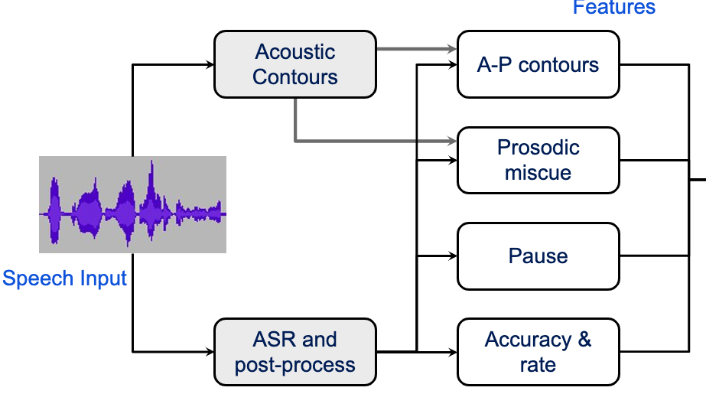
Motivation for wav2vec
Progress in deep learning
Eliminate
Large datasets
GPU/CPU compute improvements
But
ASR: LibriSpeech (960 hours)
Emotion recognition: RAVDESS (20 hours), IEMOCAP (12 hours)
Comprehensibility: Ours (10 hours)
Notes:
DL scales very well with data due to more expressive power
We want to do away with feature extraction
But Leanring from waveform is very difficult - can we start off

Slide 17
Wav2vec usage
Stage 1: Pre-training
Original Wav2vec2.0 paper reported competitive ASR results with just 10 minutes of labelled data
Emotion recognition: Pepino et al. [7]
Ideally, in stage 2, Wav2vec2.0 can be further tuned but we freeze it due to computational constraints
Unlabelled corpus e.g. VoxCeleb
Wav2vec2.0
Stage 2: Fine-tuning
Labelled corpus for given task
Pre-trained Wav2vec2.0
Frame-level embeddings
Downstream model e.g. FC layers
Predictions

Slide 18
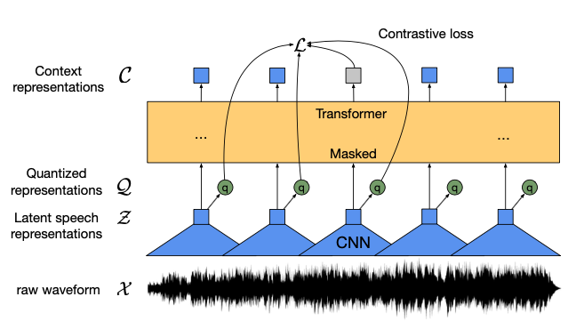
Wav2vec2.0
Pre-trained on thousands of hours of speech in self-supervised fashion
CNN encoder gives frame-level embeddings every 20 ms
Transformer for capturing utterance-level dependencies
Mask certain frames and ask Transformer to predict them back; model learns robust representations in the process
Picture credits: Original Wav2vec2.0 paper [6]
Notes:
Why wav2vec in particular?
Already used for emo recog

Slide 19
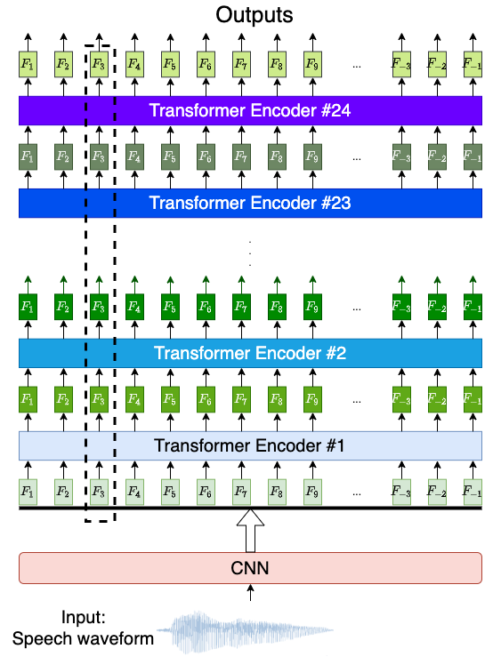
Wav2vec layers
Hugging Face model pre-trained on 960 hours of LibriSpeech
Take outputs from:
Specific layer
Mean across all 12/24 layers
Gaussian weighted combination, centred at the middle layer
Notes:
Transformer has 12/24 layers with embedding dimensionality of 768/1024 for base/large wav2vec
Different layers encode different speech characteristics
Output layers: optimal for ASR
Intermediate layers: optimal for prosodic tasks such as emotion recognition

Slide 20
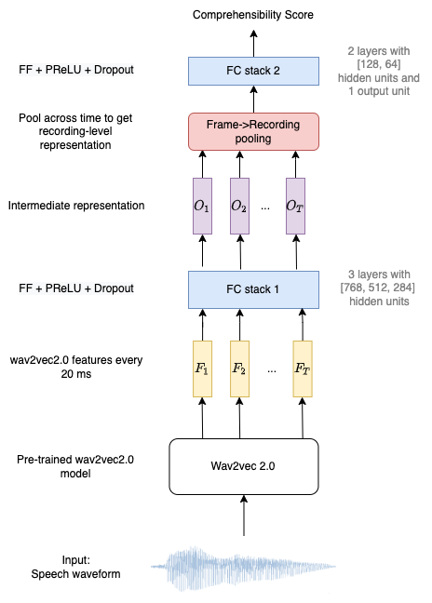
W2Vanilla
Simplest wav2vec-based architecture
Input: Waveform; Output - Rating
Stack of fully-connected (FC) layers with:
Linear layer
Activation function: PReLU
Dropout: 0.2 by default
Mean pooling for Frame -> Recording
Another FC stack for final prediction
Notes:
Mention own testing + Amazon paper

Slide 21
W2Vanilla results
Model | Val CCC | Test CCC | Test Pearson
RFC |  |  | 0.794
MLP | 0.793 | 0.789 | 0.796
Which layer | Val CCC | Test CCC | Test Pearson
1 | 0.723 | 0.696 | 0.721
5 | 0.732 | 0.558 | 0.644
10 | 0.803 | 0.803 | 0.813
15 | 0.813 | 0.803 | 0.816
16 | 0.814 | 0.809 | 0.817
17 | 0.816 | 0.808 | 0.821
18 | 0.809 | 0.808 | 0.817
21 | 0.787 | 0.787 | 0.796
24 | 0.77 | 0.772 | 0.778
Mean | 0.813 | 0.814 | 0.823
Gaussian (20) | 0.813 | 0.817 | 0.822
Wav2vec models, without any explicit lexical information, outperforms both RFC and MLP trained on extensive hand-crafted features!
Performance peaks at layer 17
We use mean of layers for further experiments
Performance of RFC/MLP on
HC FA features
Which layer | Val CCC | Test CCC | Test Pearson
Output | 0.765 | 0.759 | 0.772
Mean | 0.800 | 0.786 | 0.808
Gaussian | 0.801 | 0.807 | 0.813
Performance of wav2vec2-base
Performance of wav2vec2-large
Notes:
Use large for all subsequent exps (mean because we used that first)

Slide 22
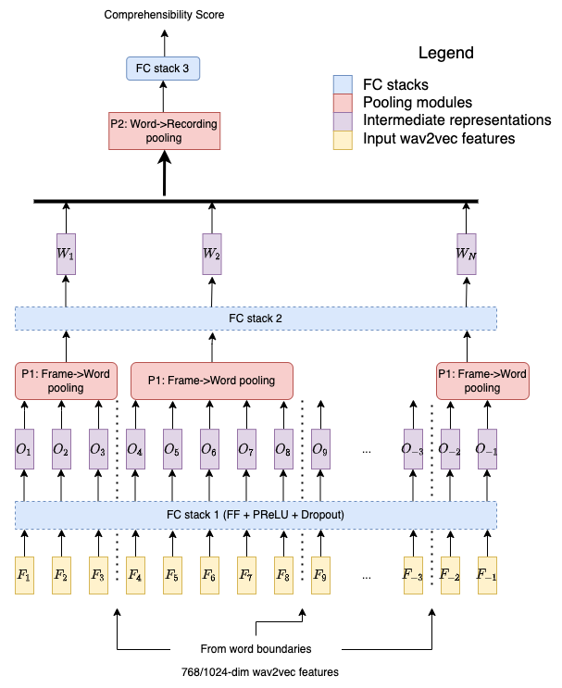
W2VAligned
Additional pooling stage at word-level
Motivation: access to word-level representations
Use mean pooling for Frame->Word
Unexpected drop in performance (rigid pooling mechanism?)
Alignments | Val CCC | Test CCC | Test Pearson
- | 0.813 | 0.814 | 0.823
FA | 0.808 | 0.778 | 0.814
ASR | 0.804 | 0.781 | 0.815

Slide 23
Probing
Wav2vec embeddings not directly interpretable
Do Wav2vec representations encode any known knowledge-based features?
Previous work by Stehwien [8]:
CNN trained for prominence detection
Predict known features such as loudness, voicing prob. from trained CNN representations
Our methodology: add MLP probes on top and predict HC features
Motivation:
Understand features being captured by wav2vec
If known feature not being captured, incorporate it explicitly

Slide 24
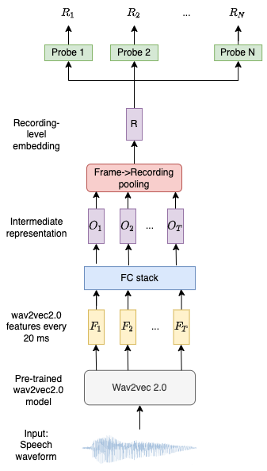
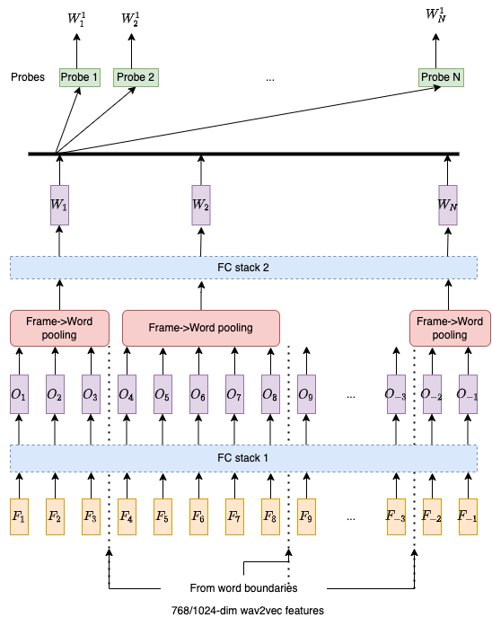
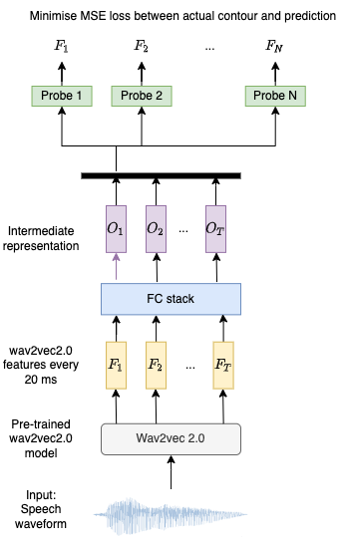
Probing architectures

Slide 25
Methodology
Train model for comprehensibility prediction
Remove final comprehensibility prediction layer
Add linear probe (1 hidden layer of 128 units) per HC feature
Freeze layers in blue and tune ONLY probes using MSE loss
Report Pearson corr. between HC feature and probe prediction
Notes:
Look at yellow contour in plots

Slide 26
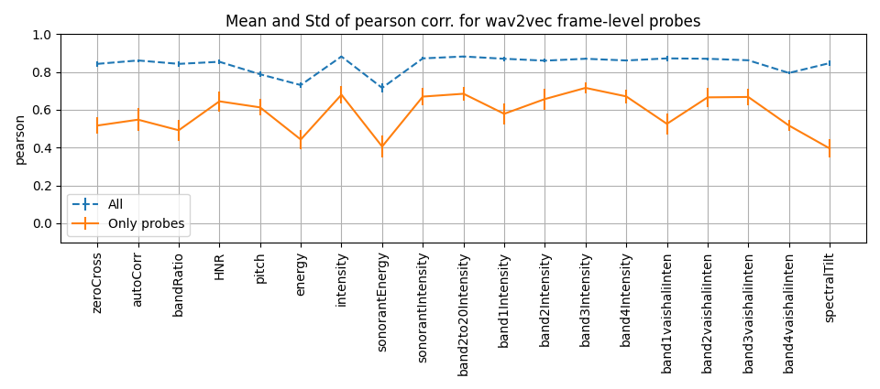
Probing results (frame)
energy and sonorantEnergy
Intensity = silence normalised log energy
⇒ some recording-level normalisation by Transformer
Expected increase in all from yellow to blue plot

Slide 27
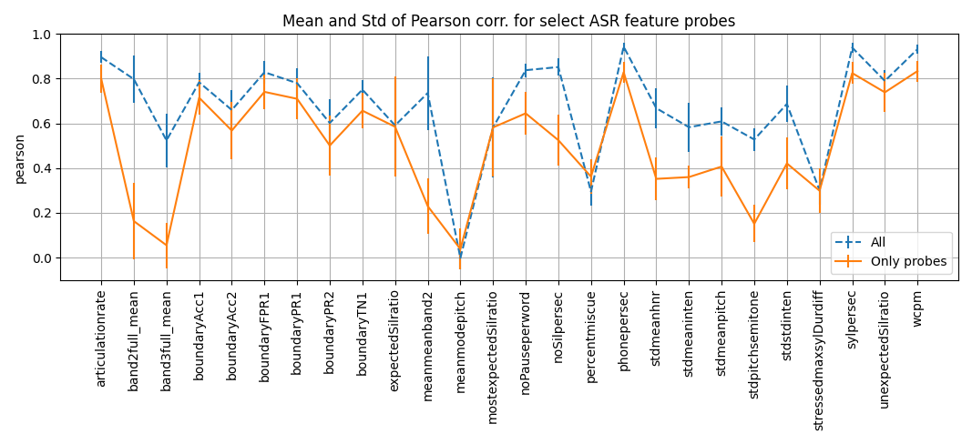
Probing results (select rec-level ASR features)
Rate based (wcpm, articulationrate, sylpersec, silences)
Word->Recording pitch aggregates (meanmodepitch, stdmeanpitch)
Average band intensities
Lexical miscues
Average band intensity
Word-level pitch aggregate (stdmeanpitch), recording-level pitch aggregate (stdpitchsemitone)
Notes:
FPR: false positive rate

Slide 28
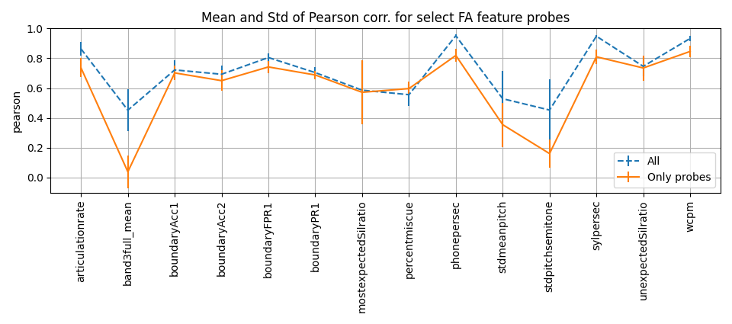
Probing results (select rec-level FA features)
Rate based (wcpm, articulationrate, sylpersec, silences)
Word/Recording-level pitch aggregates (stdmeanpitch/ stdpitchsemitone)
Average band intensity
Lexical miscues (as opposed to ASR)
Average band intensity
Word-level pitch aggregate (stdmeanpitch), recording-level pitch aggregate (stdpitchsemitone)

Slide 29
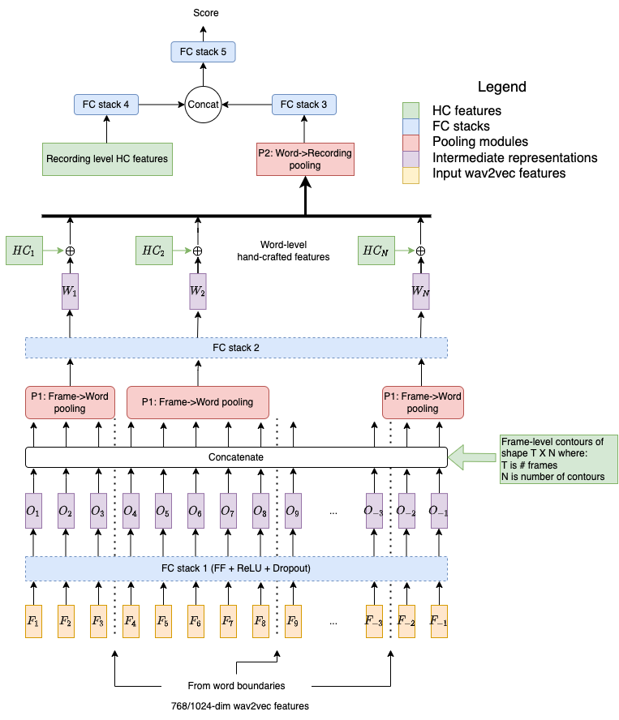
W2VCat
Do HC features carry information complementary to wav2vec?
Can test by concatenating them at various hierarchies
FC stacks before concatenation to bring them to same space
Trained end-to-end for comprehensibility
Use FA dataset for maximum performance
Notes:
In the course of these exp, word did not improve

Slide 30
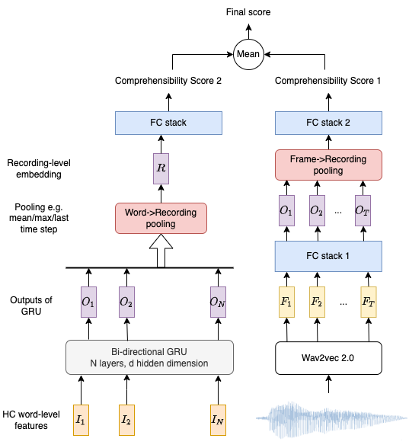
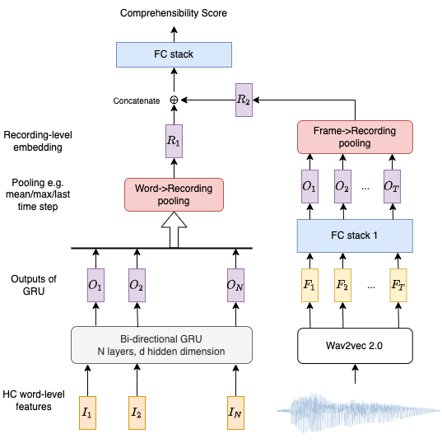
RNN Fusion
Word-level features could be any combination of word-level HC features
Can train each branch separately for comprehensibility and load pre-trained weights
Decision fusion
Embedding fusion

Slide 31
Results
HC recording-level features | Model | LR | Val CCC | Test CCC | Test Pearson
- | W2Vanilla | 0.001 | 0.813 | 0.814 | 0.823
- | W2VAligned | 0.001 | 0.808 | 0.778 | 0.814
All except | W2VCat | 0.0003 | 0.824 | 0.825 | 0.832
A-P contour | W2VCat | 0.0007 | 0.798 | 0.803 | 0.813
All | W2VCat | 0.0003 | 0.819 | 0.807 | 0.821
 | W2VCat | 0.0007 | 0.812 | 0.806 | 0.814
W2VCat:
Improvement of 0.01 in Test Pearson/CCC on concatenating recording non-acoustic features
Including acoustic HC degrades performance
Fusion:
Initialisation of model with pre-trained weights improves performance
Embedding > Decision
HC word-level features | RNN Fusion | Pre-trained | LR | Val CCC | Test CCC | Test Pearson
Non-acoustic | Embed | Y | 0.0001 | 0.819 | 0.821 | 0.828
 |  | N | 0.0001 | 0.818 | 0.817 | 0.825
 | Decision | Y | 0.0001 | 0.792 | 0.795 | 0.805
 |  | N | 0.0001 | 0.785 | 0.789 | 0.803
Acoustic | Embed | Y | 0.0003 | 0.811 | 0.805 | 0.815
 |  | N | 0.0003 | 0.799 | 0.767 | 0.805

Slide 32
Multi-Task Learning (MTL)
HC features expensive to compute
W2VCat requires them during inference
Can we exploit them only during training? -> Yes! MTL!
Ask model to predict them in auxiliary branch
Train end-to-end; model should learn robust representations in order to predict knowledge-based features
Total loss = weighted MSE loss from each branch

Slide 33
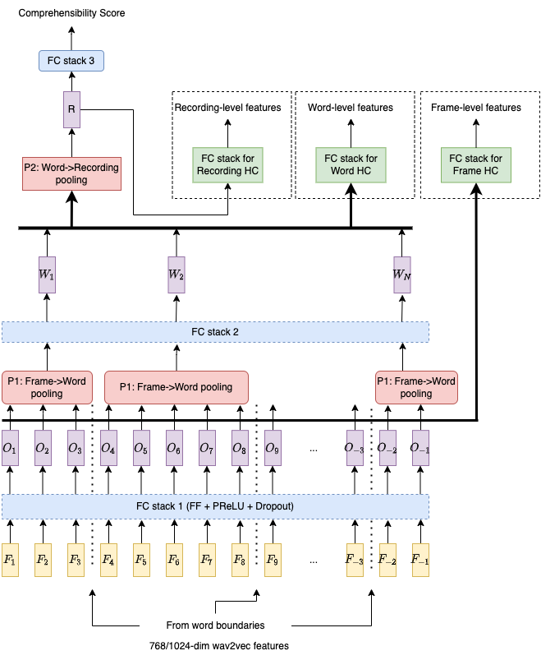
MTL architecture
Predict HC features in auxiliary branch at various hierarchies
Train end-to-end with comprehensibility as main task
Control relative importance with weighting of loss for each branch

Slide 34
Results
4 experiments: (Recording or Word-level) x (Acoustic or Non-acoustic feature sets)
No improvement in performance over W2Vanilla
Can be improved by:
More hyperparameter tuning
Both word and recording-level branches simultaneously (latter could especially benefit from former)
Different loss functions for different features (Cross-entropy for classification tasks)

Slide 35
Summary
Model | HC Features | Dataset | Val CCC | Test CCC | Test Pearson
RFC | Recording (All) | ASR |  | 0.736 | 0.774
 |  | FA |  |  | 0.794
MLP |  | ASR | 0.769 | 0.767 | 0.777
 |  | FA | 0.793 | 0.789 | 0.796
RNN | Word (All) | ASR | 0.747 | 0.750 | 0.761
 |  | FA | 0.762 | 0.767 | 0.777
W2Vanilla | - | - | 0.813 | 0.814 | 0.823
W2VCat | Recording (All except A-P contour) | ASR | 0.814 | 0.797 | 0.822
 |  | FA | 0.824 | 0.825 | 0.832
RNN Fusion (Embedding) | Word (All except Acoustic) | FA | 0.819 | 0.821 | 0.828

Slide 36
Future Work
Domain shift: further pre-train on children’s speech
Ablation with dataset size to understand impact of pre-trained wav2vec in low-resource setting
Other pre-trained models such as XLSR, Data2vec, HuBERT
Wav2vec ASR branch
Self-Supervised Learning (SSL) framework

Slide 37
Key contributions
Improved PED performance using Sinc+MTL on waveform segments
First end-to-end trained model for oral fluency assessment with no hand-engineered feature extraction; outperforms RFC baseline (by 0.05)
Probing revealed that rate features are being captured by wav2vec representations
Improved perf. by bringing in recording-level non-acoustic HC features (FA)
MTL framework for exploiting HC features
Proposed a promising self-supervised learning framework

Slide 38
Examples
Ground truth | Prediction | Demo link
0.88 | 0.91 | https://www.ee.iitb.ac.in/LMEDS/audio_examples/MithileshDDP/results/keerthi-dollin-hanumantappa_06-a-018_ballaravada-siv_hubli_18112019-163824-1_h003_2.html
3.88 | 4.82 | https://www.ee.iitb.ac.in/LMEDS/audio_examples/MithileshDDP/results/pcy_27122016_1_cs_f1_1.html
3.05 | 3.21 | https://www.ee.iitb.ac.in/LMEDS/audio_examples/MithileshDDP/results/aaravkumar05a001_25102018_1_vjhs_m001_1.html
0.47 | 2.78 | https://www.ee.iitb.ac.in/LMEDS/audio_examples/MithileshDDP/results/dbs_16122016_1_cs_e1_2.html

Slide 39
References
[1] - The annual status of education report (rural) 2016
[2] - Dimensions of Speech
[3] - Kamini Sabu. “Automatic Assessment of Fluency in Children’s Oral Reading using Prosody Modeling”. PhD thesis, Indian Institute of Technology Bombay, Mumbai, India, Submitted on 28th February 2022.
[4] - White, Sheida, et al. "The 2018 NAEP Oral Reading Fluency Study. NCES 2021-025." National Center for Education Statistics (2021).
[5] - Optuna
Notes:
PR: Give a proper reference format to the PhD thesis.

Slide 40
References
[6] - Baevski, Alexei, et al. "wav2vec 2.0: A framework for self-supervised learning of speech representations." Advances in Neural Information Processing Systems 33 (2020): 12449-12460.
[7] - Pepino, Leonardo, Pablo Riera, and Luciana Ferrer. "Emotion recognition from speech using wav2vec 2.0 embeddings." arXiv preprint arXiv:2104.03502 (2021).
[8] - Stehwien, Sabrina, Antje Schweitzer, and Ngoc Thang Vu. "Acoustic and temporal representations in convolutional neural network models of prosodic events." Speech Communication 125 (2020): 128-141.
[9] - Ravanelli, Mirco, et al. "Multi-task self-supervised learning for robust speech recognition." ICASSP 2020-2020 IEEE International Conference on Acoustics, Speech and Signal Processing (ICASSP). IEEE, 2020.
[10] - Sabu, Kamini, and Preeti Rao. "Prosodic event detection in children’s read speech." Computer Speech & Language 68 (2021): 101200.

Slide 41
Appendix

Slide 42
Literature review
Reference | Technique | Comments
Zhou et al. (ETS) [13] | MLP on recording-level HC features concatenated with BLSTM summary from frame-level contours | 0.71 -> 0.72 on adding frame-level BLSTM to MLP on recording-level features
Chen et al. [14] | CNN/RNN on word-level acoustic features + word-embeddings | 0.58 (HC features) -> 0.62 (BLSTM with attention)

Slide 43
Training details
Loss: Concordance Correlation Loss = 1 - CCC
Optimizer: Adam
Activation: PReLU
Learning Rate: 0.001 (unless specified otherwise)
Batch Size: 128 (unless specified otherwise)
Early stopping on validation CCC:
Patience: 10 epochs
Delta: 0.005
Hyperparameter tuning: Optuna library [5]
Ensembling to reduce bias (5 fold CV on folds except test)
Notes:
PR: No need to dedicate a slide to this. Put it in a small box on the next slide of results.

Slide 44
Ensembling
6 speaker non-overlapping folds
Ensembling for reducing bias
1 fold left out for test; 5 used for training+validation
5 models trained in CV manner on 5 folds
Output is averaged on the left-out test fold
Example: Prediction for test fold 1 = [O(1.1)+O(1.2)+O(1.3)+O(1.4)+O(1.5)]/5
Model name | Train folds | Validation fold (for early stop) | Test fold
1.1 | 3,4,5,6 | 2 | 1
1.2 | 4,5,6,2 | 3 | 1
1.3 | 5,6,2,3 | 4 | 1
1.4 | 6,2,3,4 | 5 | 1
1.5 | 2,3,4,5 | 6 | 1

Slide 45
Waveform-based model
OR

Slide 46
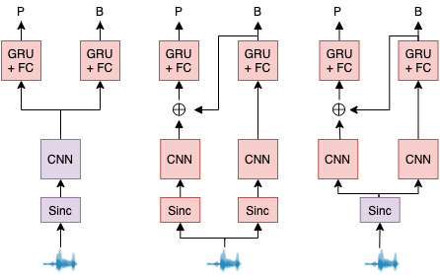
Multi-Task Learning
Motivation: Exploit dependencies between Prominence and Phrasing
What kind of dependencies?
Sharing of low-level feature extractors to reduce overfitting
Knowledge of one (phrase boundary) is a strong signal for the other (prominence)

Slide 47
Results
Single-task learning
Multi-task learning
No. | Input | Acoustic Model | Layer 1 (type, width, stride) | Pearson correl.
1. | A34 | RFC | - | 0.696
2. | A34 | BGRU | - | 0.726
3. | Wav | CRNN | Standard, 51, 1 | 0.692
4. | Wav | CRNN | Sinc, 31, 2 | 0.721
5. | A34+ Wav | CRNN | Sinc, 31, 2 | 0.735
No | MTL variant | Pearson correl.
1. | Sinc | 0.721
2. | Shared Sinc | 0.727
3. | Conditioned | 0.727
4. | Shared Sinc + Conditioned | 0.740
5. | Row 4 + A34 + A27 | 0.757
6. | Row 5 + GloVe | 0.813

Slide 48
Baselines
Baseline RFC operates on recording-level HC features derived after RFECV:
Hierarchy | Feature set | # | Examples
Recording | Lexical miscues | 8 | # insertions, deletions, hesitations
 | A-P contour | 88 | Functionals of pause, aggregates of word pitch properties across recording
 | Prosodic miscue | 46 | Precision and Recall of prominence and phrase boundary for each word
 | Rate | 5 | WCPM, speed variation
Word | A-P contour (Acoustic) | 29 | Various band intensities, pitch contour correlation with various shapes
 | Duration | 11 | Functionals of silence and syllable durations
 | Lexical identity (LexId) | 16 | POS tags, content word flag
 | Lexical miscues (LexMisc) | 4 | Binary flags C/I/S for correct/inserted/substituted, noInsertions before
 | Prosodic miscues (PEDMisc) | 6 | Information structure, automatic prosodic event predictions obtained from stage 1, prosodic miscue
Frame | Acoustic | 19 | Pitch, Energy, Intensity, HNR, Auto-correlation

Slide 49
Word-level RNN results
Dataset | Feature sets | Val CCC | Test CCC | Test Pearson
ASR | A-P contour (Acoustic) | 0.654 | 0.659 | 0.676
 | Lexical Identity (LexId) | 0.394 | - | -
 | Lexical Miscue (LexMis) | 0.341 | - | -
 | Duration | 0.7 | 0.703 | 0.714
 | All | 0.738 | 0.741 | 0.751
FA | A-P contour (Acoustic) | 0.648 | 0.653 | 0.672
 | Lexical Identity (LexId) | 0.412 | - | -
 | Lexical Miscue (LexMis) | 0.58 | 0.581 | 0.584
 | Duration | 0.681 | 0.685 | 0.697
 | PED Miscue | 0.605 | 0.603 | 0.608
 | All | 0.762 | 0.767 | 0.777
For Acoustic, MT ~ ASR
For LexMis, MT > ASR as discussed
Standalone acoustic and duration are powerful
Adding lexical features improves performance ⇒ complementary information
Performance comparable with RFC; slightly lower than MLP

Slide 50
W2VCat word-level
Word-level HC feature sets | Model | LR | Val CCC | Test CCC | Test Pearson
- | W2Vanilla | 0.001 | 0.813 | 0.814 | 0.823
 | W2VAligned | 0.001 | 0.808 | 0.778 | 0.814
acoustic | 1a | 5E-05 | 0.805 | 0.804 | 0.817
 | 1b | 0.00015 | 0.807 | 0.802 | 0.815
duration | 2a | 5E-05 | 0.805 | 0.803 | 0.817
 | 2b | 0.00015 | 0.807 | 0.808 | 0.816
lexical | 3a | 5E-05 | 0.805 | 0.803 | 0.817
 | 3b | 0.00015 | 0.807 | 0.808 | 0.815
miscue | 4a | 5E-05 | 0.805 | 0.809 | 0.817
 | 4b | 0.00015 | 0.806 | 0.803 | 0.813
prosodic miscue | 5a | 0.00015 | 0.805 | 0.8 | 0.815
 | 5b | 5E-05 | 0.805 | 0.804 | 0.817
acoustic+duration+lexical | 6a | 0.00015 | 0.808 | 0.802 | 0.815
+miscue+prosodic miscue | 6b | 5E-05 | 0.804 | 0.806 | 0.816
All sets give improvement over W2VAligned
However, still lower than W2Vanilla
Motivation for different fusion technique

Slide 51
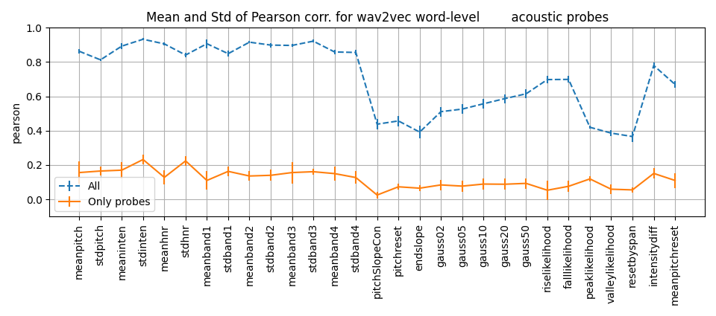
Probing results (acoustic word HC)
None being captured by wav2vec tuned for comprehensibility
Aggregates of pitch, HNR, band intensities across word
Word contour shapes (gaussxx, likelihood)

Slide 52
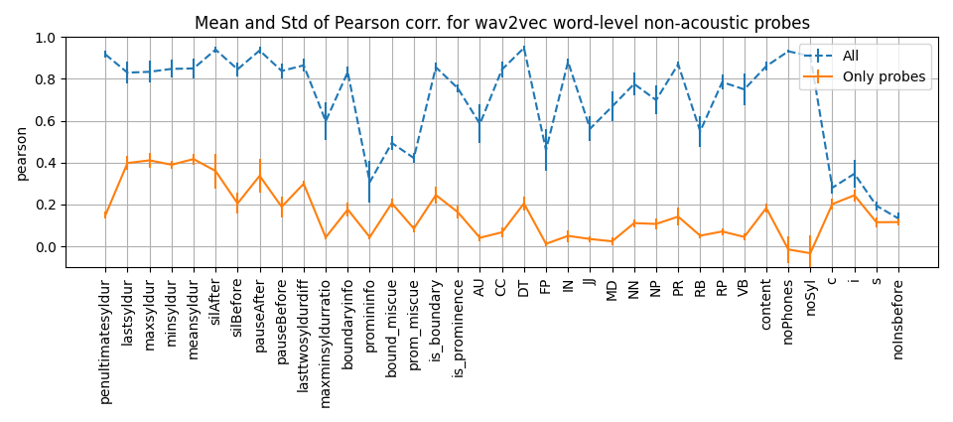
Probing results (non-acoustic word HC)
Syllable duration functionals
Most POS tags
Syllable durations, Prosodic events (prominence and phrasing), POS tags
Miscue tags (prosodic event and lexical both)

Slide 53
Results
Hierarchy | HC feature sets | Model | LR | Val CCC | Test CCC | Test Pearson
 | - | W2Vanilla | 0.001 | 0.813 | 0.814 | 0.823
 |  | W2VAligned | 0.001 | 0.808 | 0.778 | 0.814
Recording | All except | 1a | 0.0003 | 0.824 | 0.825 | 0.832
 | A-P contour | 1b | 0.0007 | 0.798 | 0.803 | 0.813
 | All | 2a | 0.0003 | 0.819 | 0.807 | 0.821
 |  | 2b | 0.0007 | 0.812 | 0.806 | 0.814
Word | All except | 3a | 0.00015 | 0.806 | 0.805 | 0.817
 | A-P contour | 3b | 5E-05 | 0.805 | 0.806 | 0.817
 | All | 4a | 0.00015 | 0.808 | 0.802 | 0.815
 |  | 4b | 5E-05 | 0.804 | 0.806 | 0.816
Improvement of 0.01 in Test Pearson/CCC on concatenating recording non-acoustic features
Including acoustic HC degrades performance
Sensitive to LR
No improvement on using word-level features -> motivation for fusion architecture

Slide 54
Results
HC word-level features | Fusion | Pre-trained | LR | Val CCC | Test CCC | Test Pearson
Non-acoustic | - | - | 0.0001 | 0.763 | 0.766 | 0.775
Acoustic | - | - | 0.0001 | 0.646 | 0.653 | 0.676
W2Vanilla | - | - | 0.001 | 0.813 | 0.814 | 0.823
W2VCat | - | - | 0.0003 | 0.824 | 0.825 | 0.832
Non-acoustic | Embed | TRUE | 0.0001 | 0.819 | 0.821 | 0.828
 |  | FALSE | 0.0001 | 0.818 | 0.817 | 0.825
 | Decision | TRUE | 0.0001 | 0.792 | 0.795 | 0.805
 |  | FALSE | 0.0001 | 0.785 | 0.789 | 0.803
Acoustic | Embed | TRUE | 0.0003 | 0.811 | 0.805 | 0.815
 |  | FALSE | 0.0003 | 0.799 | 0.767 | 0.805
 | Decision | TRUE | 5E-05 | 0.792 | 0.795 | 0.805
 |  | FALSE | 5E-05 | 0.785 | 0.789 | 0.803
Parallel RNN branch with non-acoustic word-level features gives slight improvement
Initialisation of model with pre-trained weights improves performance
Embedding > Decision

Slide 55
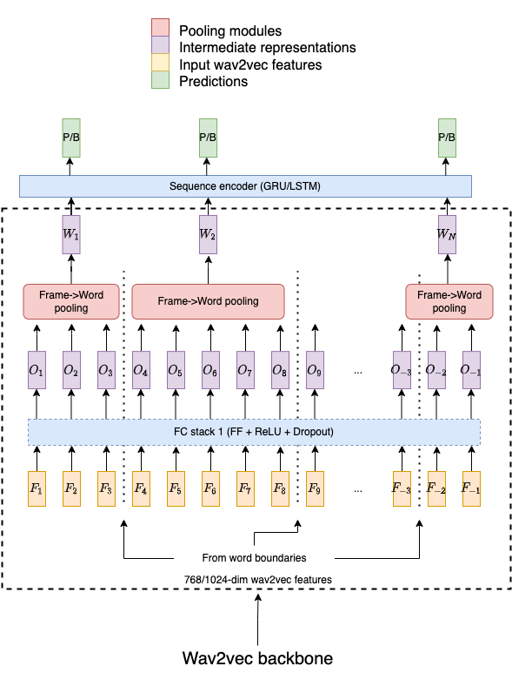
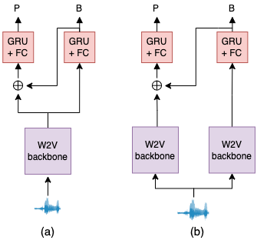
Wav2vec for PED
Replaced Sinc+MTL model proposed in Stage 1 with frame-level wav2vec features
CNN/RNN for Frame->Word pooling
BGRU for sequential modelling
MTL for exploiting linguistic association between the two

Slide 56
PED Results
Task | Pooling | Stack 1 | MTL | Test Pearson
Prominence | Mean | [512, 256] | N | 0.745
 | Mean | [512, 256] | Y (shared backbone) | 0.737
 | Mean | [512, 256] | Y (different backbones) | 0.744
 | CNN | [512, 256] | N | 0.387
 | CNN | - | N | 0.759
Boundary | Mean | [512, 256] | N | 0.901
 | CNN | [512, 256] | N | 0.906
 | CNN | - | N | 0.906
Task | Model | HC features | MTL | Test Pearson
Prominence | GRU | A34 | N | 0.725
 | SincConv+GRU | - | N | 0.721
 | SincConv+GRU | - | Y | 0.74
 | SincConv+GRU | A34+A27 | Y | 0.757
 | SincConv+GRU | A34+A27+GloVe | Y | 0.8
Boundary | SincConv+GRU | - | N | 0.887
 | SincConv+GRU | - | Y | 0.894
 | SincConv+GRU | A27+GloVe | Y | 0.927
Wav2vec-based models
Stage 1 models

Slide 57
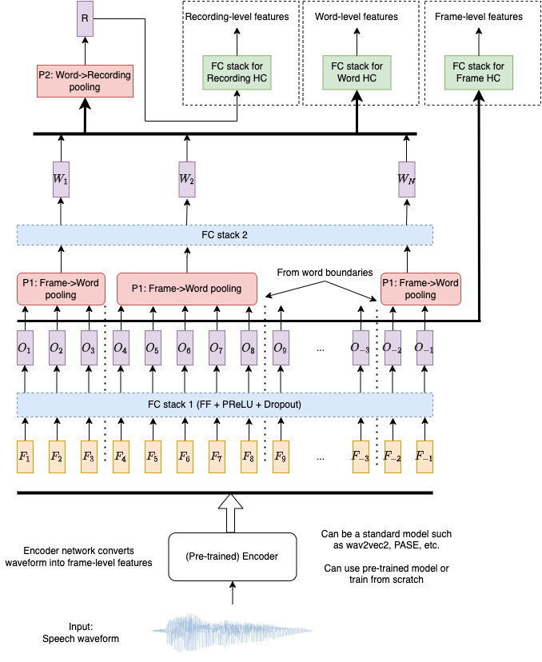
Self-Supervised Learning
Wav2vec2.0 task-agnostic by design; PASE [9] allows control over nature of information extracted in self-supervision
Proposed architecture similar to MTL, except no comprehensibility branch
All HC features can be derived from input; no comprehensibility labels required (hence self-supervision)
Can use pre-trained encoder such as Wav2vec2.0, PASE, etc.

Slide 58
Word-level Pooling
Frame->Word pooling can capture word-level acoustic patterns
Mean pooling loses temporal patterns
Chunking for other mechanisms such as CNN/RNN slows down code
Time taken by W2VAligned with:
Mean pooling: ~1 hour
Basic CNN: ~10 hours

Slide 59
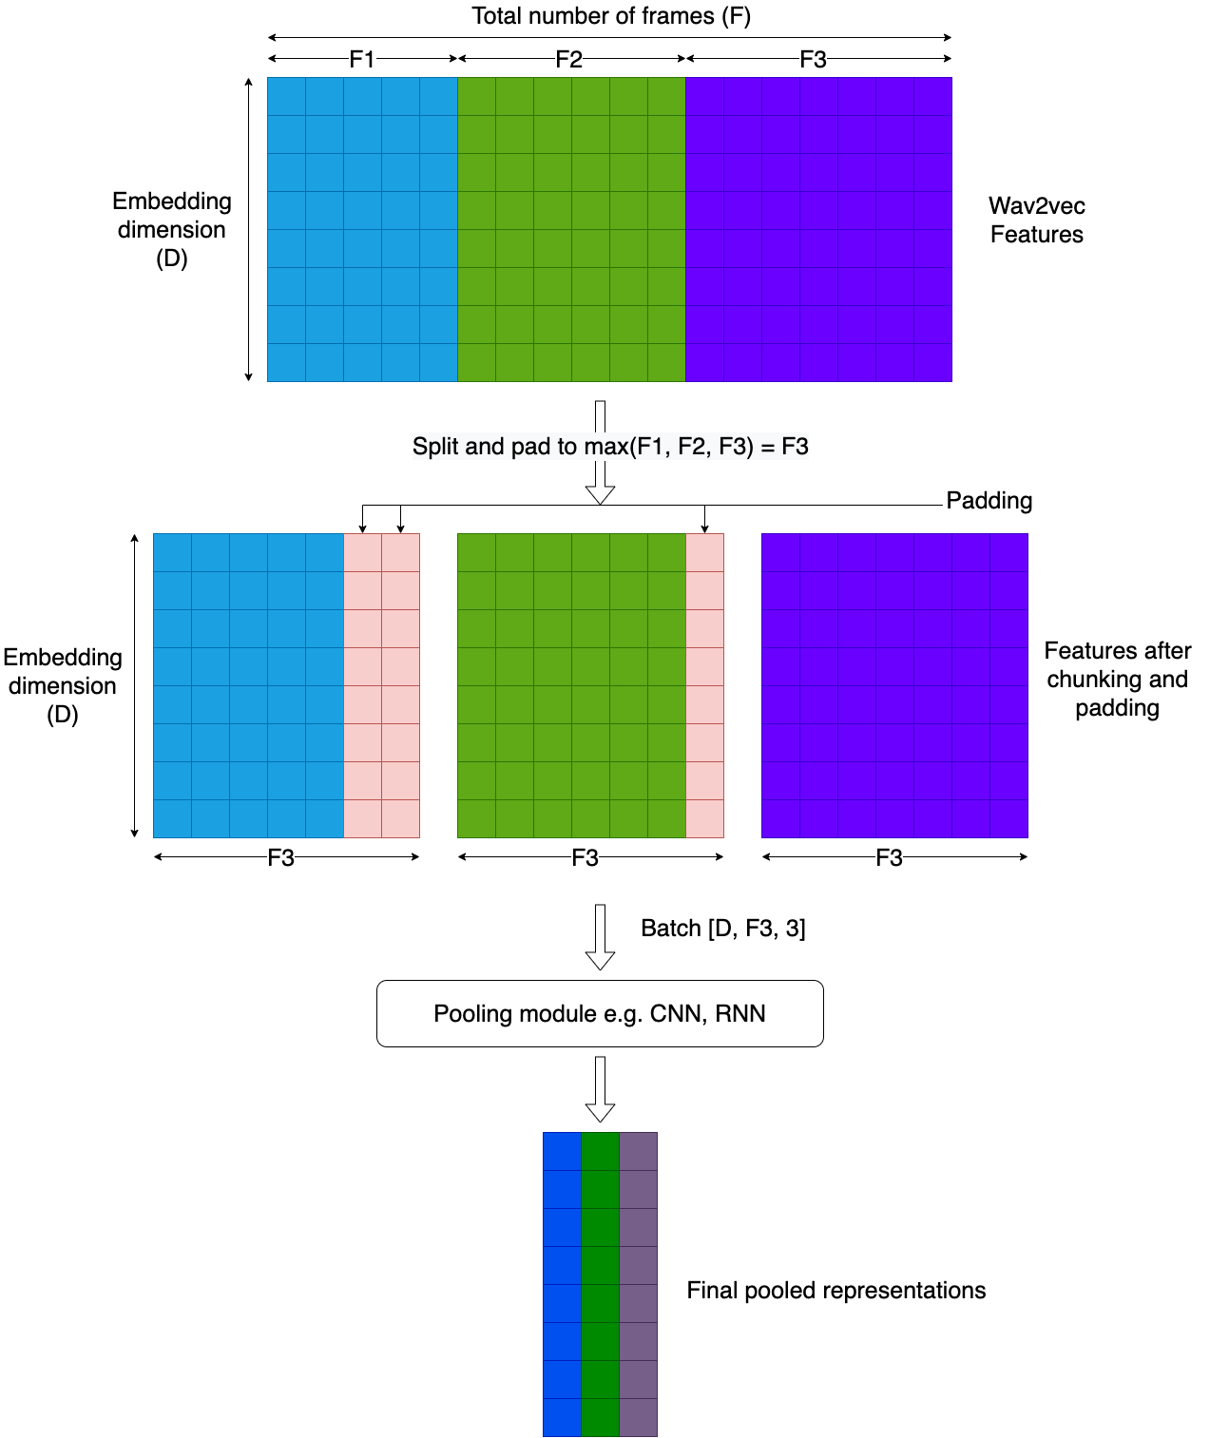
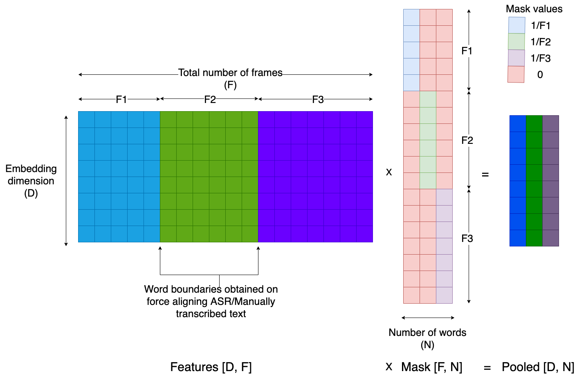
Word-level Pooling
vs

