Slide 1
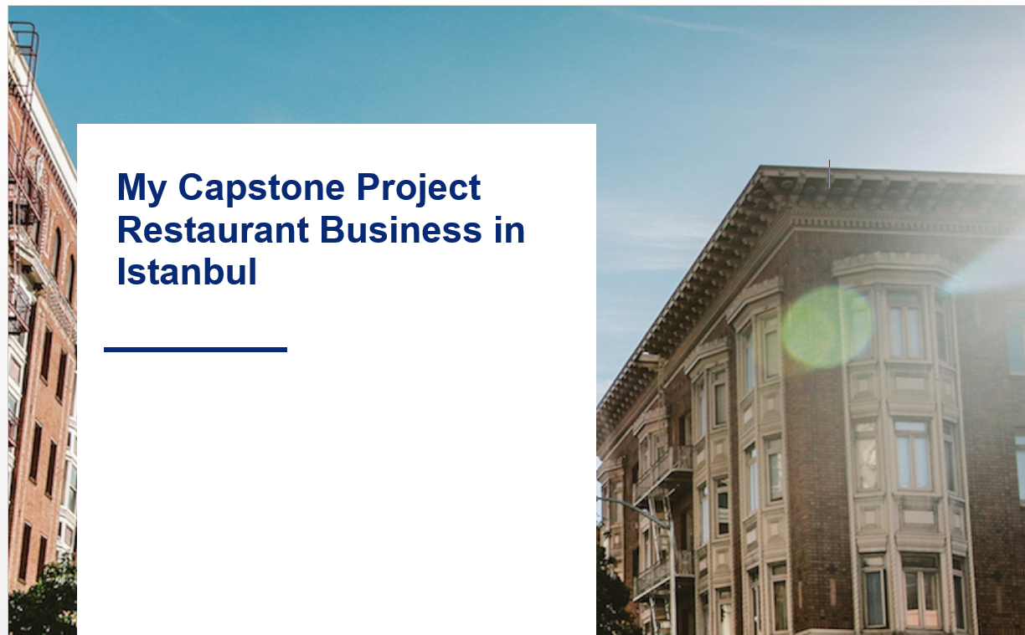

Slide 2
Introduction
Istanbul is the largest city in Turkey, constituting the country's economic, cultural and historical center. The population of almost 15 million lives in Istanbul's vast area of 5,343 square kilometers. Istanbul is situated at the Bosphorus – one of the world's busiest waterways – in northwestern Turkey, between the Sea of Marmara and the Black Sea. Its commercial and historical center lies in Europe, while a third of its population lives on the Asian side.
Foreign investors in Turkey often choose to open a restaurant or any other business establishment that can be linked to tourism. Turkey is an increasingly popular tourist destination and a large number of visitors will always represent a good clientele for a restaurant. Much as the country, the Turkish cuisine is a blend between different cultures - the Asian, Caucasian, Middle Eastern, Mediterranean and Balkan cuisines have shaped and influenced the Turkish food.

Slide 3
Business Problem
In recent months and years, the restaurant industry has seen its share of bankruptcies, including, but not limited to, filings from Bertucci’s, Logan’s Roadhouse, Real Mex Restaurants, fast casual Noon Mediterranean, Romano’s Macaroni Grill, Scotty’s Brewhouse, Ruby’s Diner, and Iron Chef Jose Garces. Bankruptcies aren’t anything new in the industry, but they’ve been proliferating at a rapid pace, compared to more sporadic declarations 10 years ago.
If you are an investor and decided to open a new restaurant, you should know that location is one of the most important decisions you need to make. In this project, I will analyze restaurant locations and try to provide some valuable recommendation to the foreign or internal investors who want to enter restaurant business in Istanbul.

Slide 4
Data
Based on definition of our problem, factors that will influence our decision are:
Number of existing restaurants in every Borough from Foursquare API
Latitude and Longitude values of 39 boroughes in Istanbul from Github (https://gist.github.com/ismailbaskin/2492196)

Slide 5
Methodology
In this project we will direct our efforts on detecting areas of Istanbul that have low restaurant density, particularly those with low number of Italian restaurants.
In first step we have collected the location data of 39 Boroughes in Istanbul from the Github. Since the format of the data that I found at that website was not ready to use, I have prepared the location dataframe manualy by using the original data. I have also identified Italian restaurants (according to Foursquare categorization).
Second step in our analysis will be calculation and exploration of 'restaurant density' across different areas of Istanbul
In third and final step we will focus on most promising areas and within those create clusters of locations that meet some basic requirements established in discussion with stakeholders: we will take into consideration locations with no more than two restaurants in radius of 250 meters, and we want locations without Italian restaurants in radius of 400 meters. We will present map of all such locations but also create clusters (using k-means clustering) of those locations to identify general zones / neighborhoods / addresses which should be a starting point for final 'street level' exploration and search for optimal venue location by stakeholders.

Slide 6
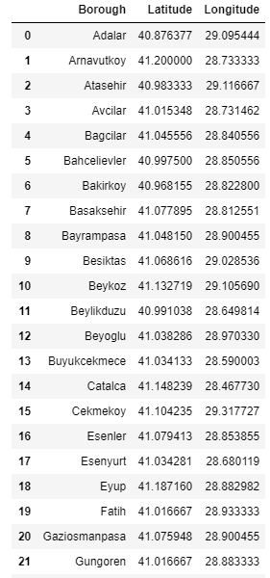
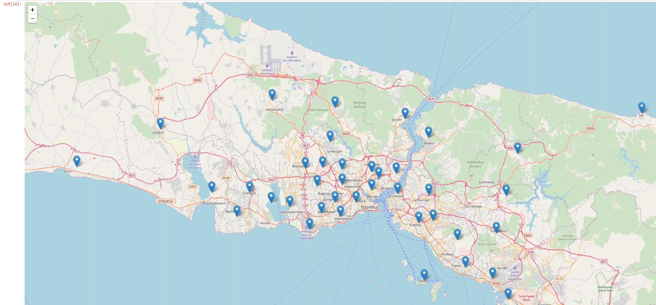
Visualization

Slide 7
Results and Discussions
Our analysis shows that although there is a great number of restaurants in Istanbul, there are pockets of low restaurant density fairly close to city center. Highest concentration of restaurants was detected near Bosphorous, so we should focused our attention to those areas . Boroughs which offer a combination of popularity among tourists, closeness to city center, strong socio-economic dynamics a number of pockets of low restaurant density will give us better conclusions.
Result of all this is 39 boroughes containing largest number of potential new restaurant locations based on number of and distance to existing venues - both restaurants in general and Italian restaurants particularly. This, of course, does not imply that those zones are actually optimal locations for a new restaurant! Purpose of this analysis was to only provide info on areas close to the Bosphorous, but not crowded with existing restaurants (particularly Italian) - it is entirely possible that there is a very good reason for small number of restaurants in any of those areas, reasons which would make them unsuitable for a new restaurant regardless of lack of competition in the area.

Slide 8
Coclusion
Purpose of this project was to identify Istanbul areas close to center with low number of restaurants (particularly Italian restaurants) in order to aid stakeholders in narrowing down the search for optimal location for a new Italian restaurant. By calculating restaurant density distribution from Foursquare data we have first identified general boroughs that justify further analysis, and then generated extensive collection of locations which satisfy some basic requirements regarding existing nearby restaurants.
Clustering of those locations was then performed in order to create major zones of interest (containing greatest number of potential locations) and addresses of those zone centers were created to be used as starting points for final exploration by stakeholders.
Final decision on optimal restaurant location will be made by stakeholders based on specific characteristics of neighborhoods and locations in every recommended zone, taking into consideration additional factors like attractiveness of each location , levels of noise / proximity to major roads, real estate availability, prices, social and economic dynamics of every neighborhood etc.

