Slide 1
REVIEWLY
Libra team members:
Ephraim Schoeburn
Mike Dipalma
Yashwanth Kumar Pamidimukkala

Slide 2


Reviewly Architecture
Back End
Web Scraped Data
Recommendation Engine

Slide 3
Project Summary
Period: 27th June, 2018 – 28th July, 2018
Worked on Recommendation Engine only for this time period.
Tasks:
Setup a simple csv file to explore and model the data.
Utilized Yelp data for building the prototype by narrowing the data to only restaurants in Toronto.
Explored the data and built a baseline model in jupyter notebook to perform text similarities and recommend similar users.
Software:
Framework: Jupyter Notebook.
Language: Python
Libraries: nltk, sklearn, pandas, numpy, collections, os, re, string.

Slide 4
Recommendation Engine Overview
Pre-condition:
User U visits Business B
Filter data:
Filter rows by users that review business B
Filter columns by places that user U reviewed.
Calculate cosine similarities:
Compute similarities by column to yield similarity score for each business.
Compute similarities by row to yield final similarities between users.
Accuracy:
Return top 5 users similar to user U.
Aggregate their average rating R_{p} for a business B which will be user U’s predicted rating.
Compare predicted rating R_{p} with actual rating R_{a} of user U.

Slide 5
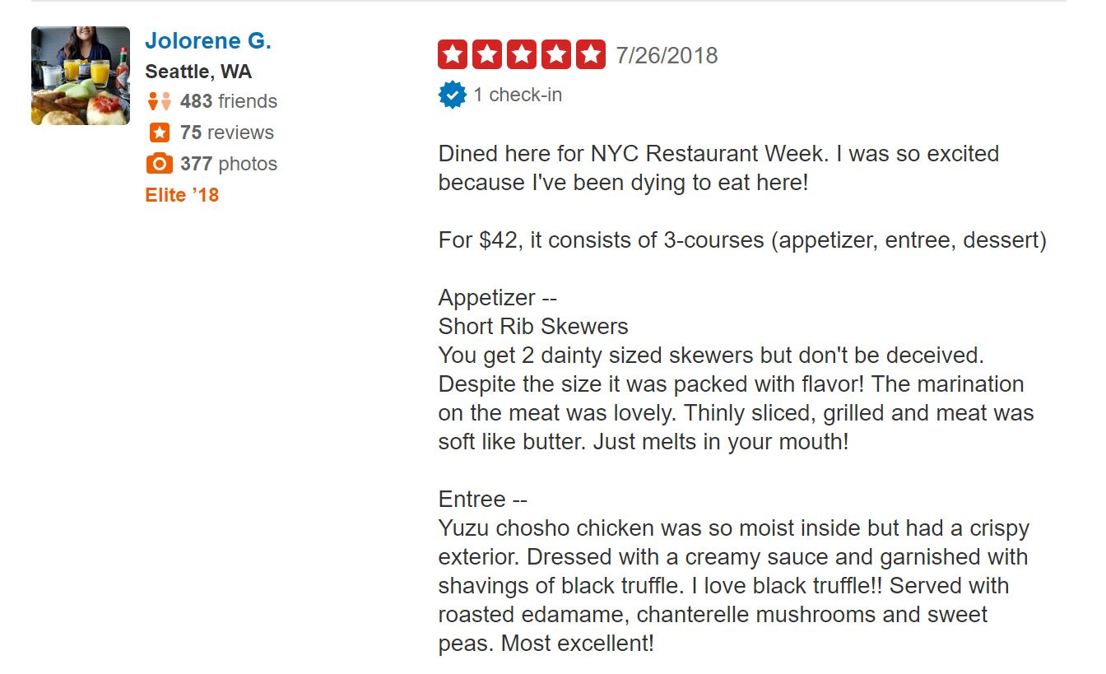

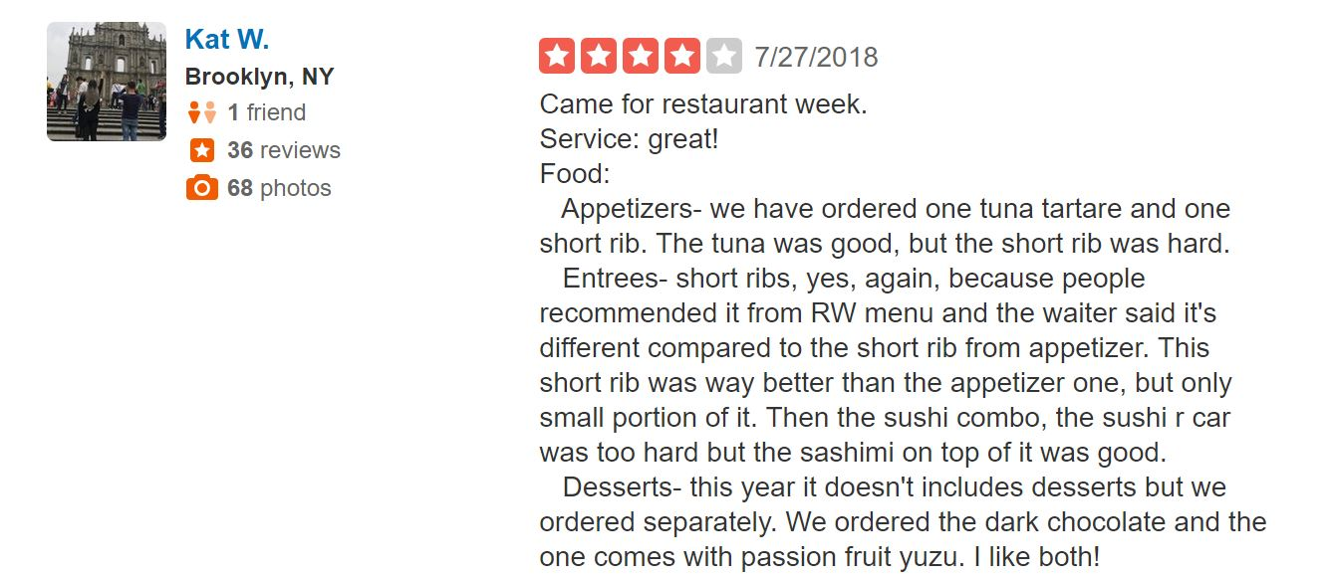
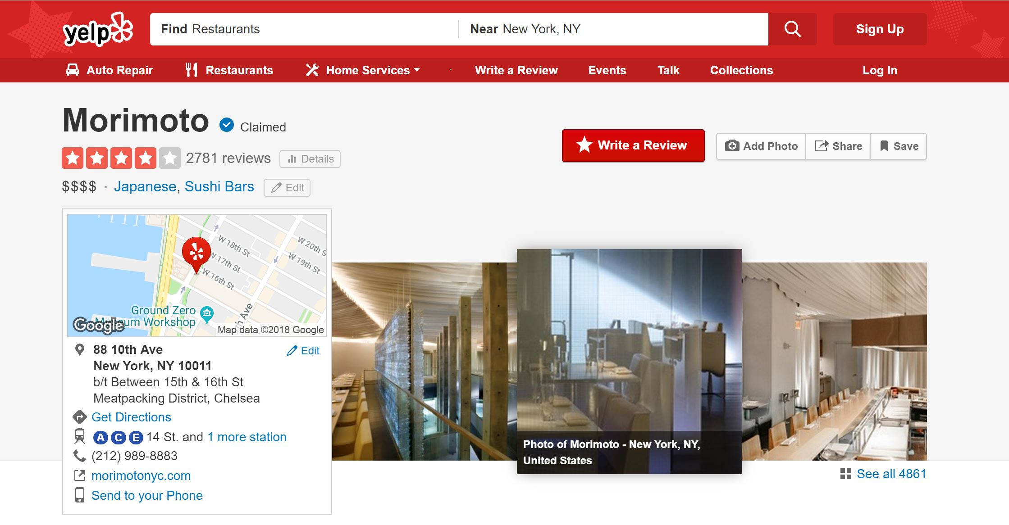
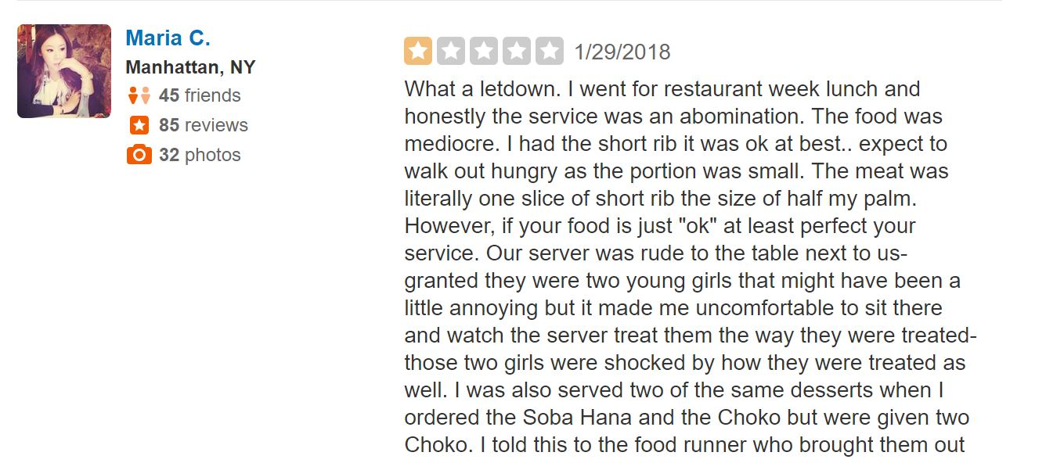
For each user
Visiting a specific business
Which reviews are best representative of users taste
Problem Space:
?
Which reviews should user see?
Visits
?
…
?
Goal: Iterate through every User – Business pair, Get top N reviews, compare their avg rating to our user’s actual rating

Slide 6
Findings and Improvements
Findings:
RMSE = .83; Error of prediction within 1 star rating of user rating
Current model tends to be slow in computing similarities
Improvements:
Matrix Factorization
Hyperparameter tuning
Number of users to return (Default: 5)
GridSearch: [1, 3, 5, 7, 9….]
Percentage of total number of reviews on business
Threshold Based on Similarity
Cloud Computing
AWS (EC2/RDS/S3) Instance

Slide 7
Findings and Improvements
Improvements:
Adding features
Sentiment analysis
Topic modeling
Metadata from restaurants
Different Similarity Calculations
Minhashing
Jaccard
Levenshtein

Slide 8
Potential Direction
We have done data exploration and established a baseline model for our recommendation engine.
We would like take our project further with these steps:
Setup database and integrate with cloud technologies
Develop different models for our recommendation engine that would outperform our current model
Focus on making the model more robust and scalable.

Slide 9
Thank You

