Slide 1
REVIEWLY
Libra team members:
Mike DiPalma
Yashwanth Kumar Pamidimukkala
Ephraim Schoenbrun

Slide 2
Phase 1
Period: 27th June, 2018 – 28th July, 2018
Tasks:
Setup a simple csv file to explore and model the data.
Utilized Yelp data for building the prototype by narrowing the data to only restaurants in Toronto.
Explored the data and built a baseline model to perform text similarities and recommend similar users.

Slide 3
Problem Statement
Users of products gain better utility from websites when reviews are relevant to specific user
A curated group of reviews that represents the user’s preferences can improve user experience and increase site engagement, driving higher sales
We aim to build a predictive model that will return the reviews from users that are most similar to the visitor

Slide 4

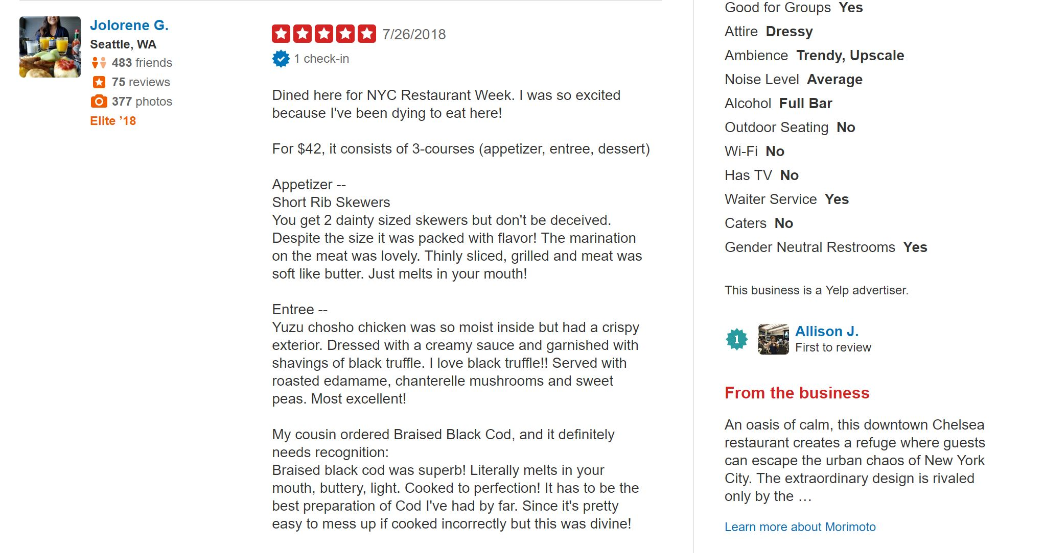
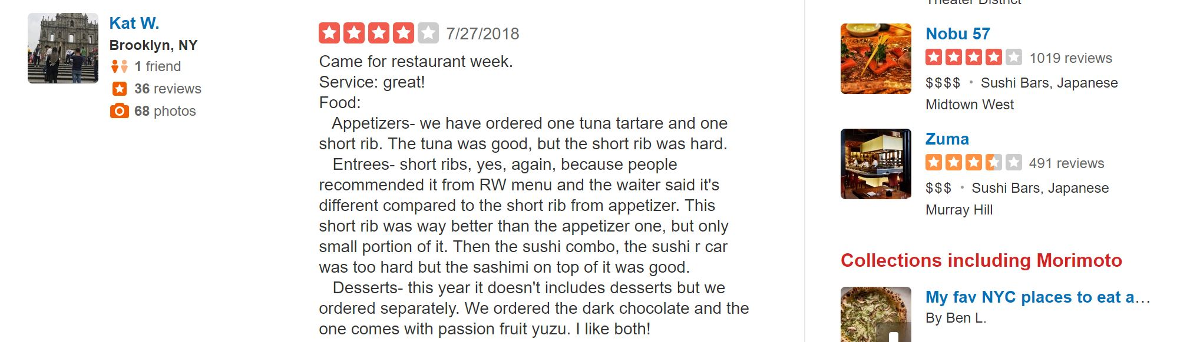
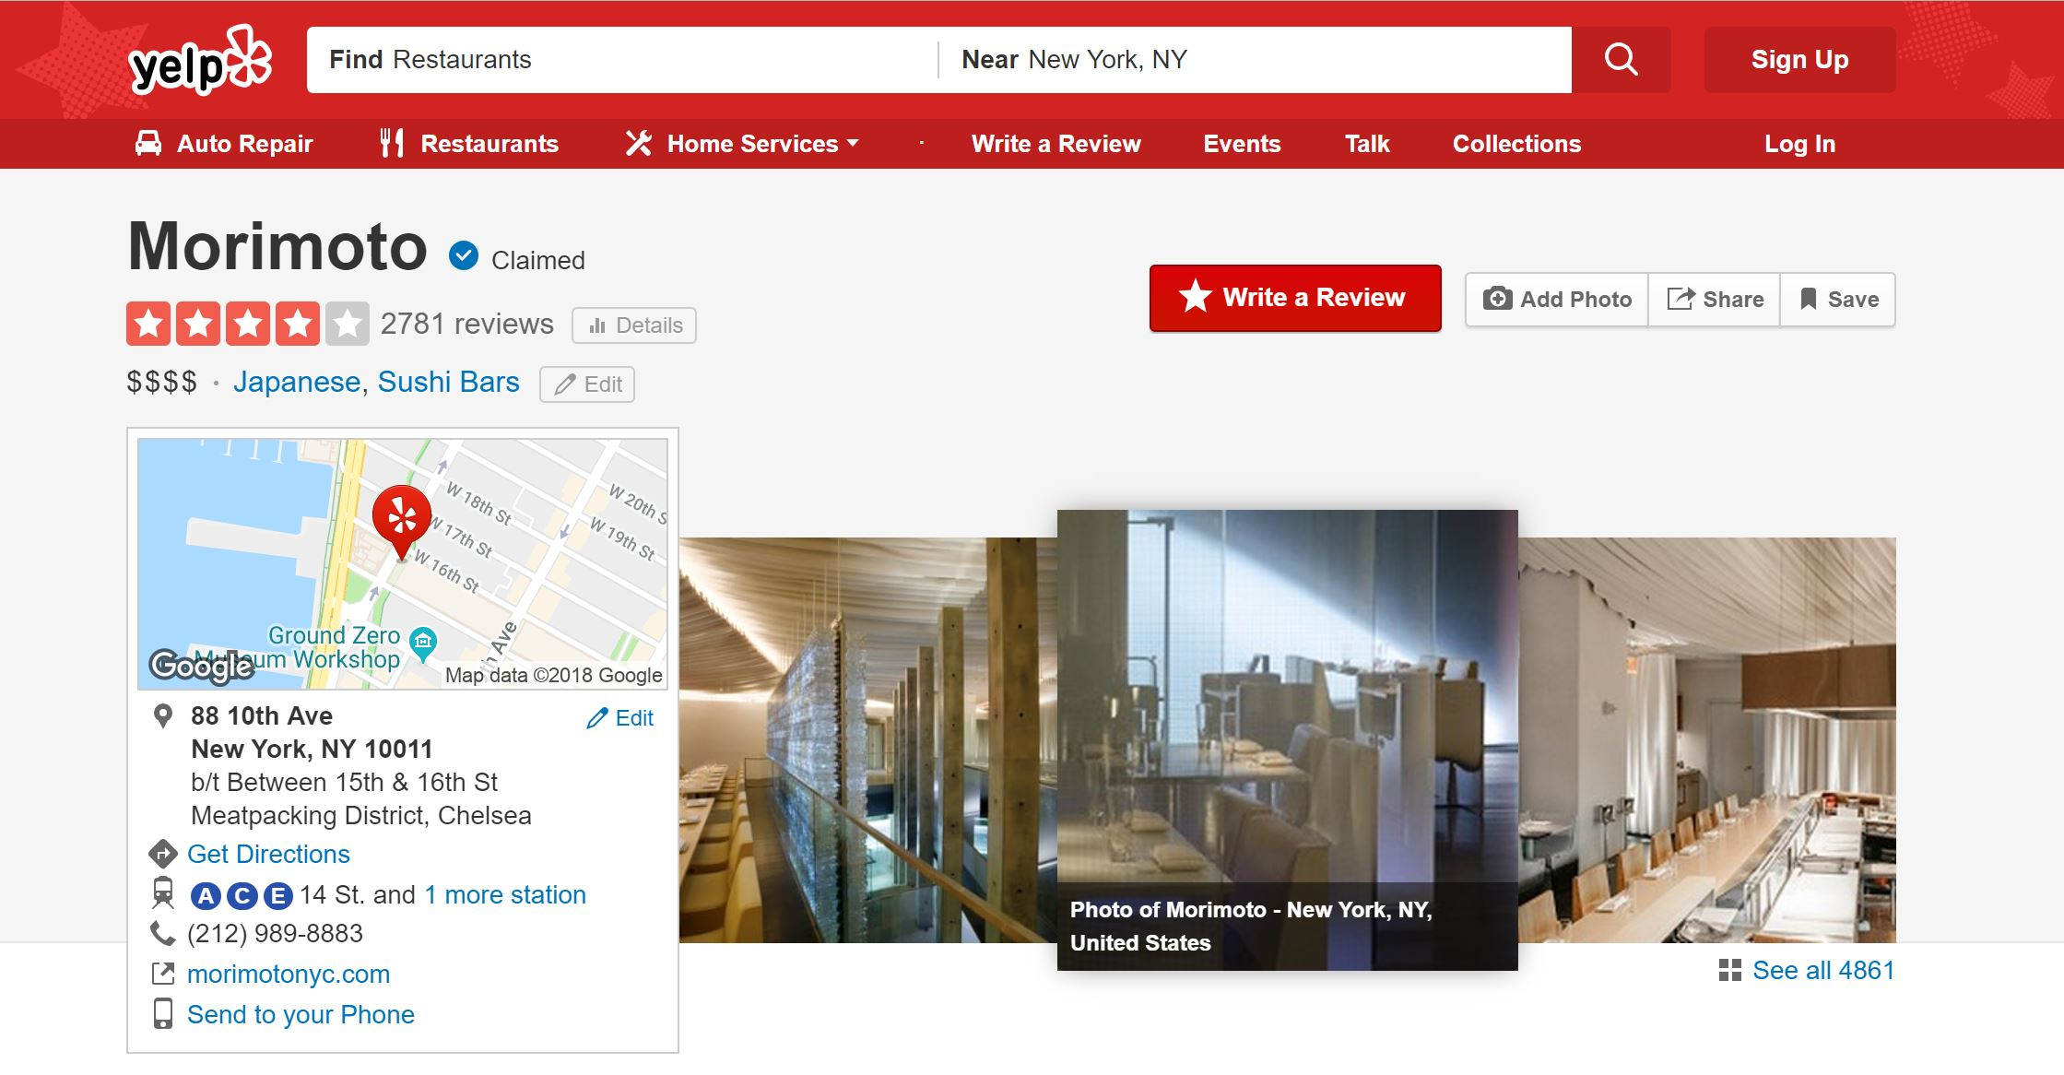
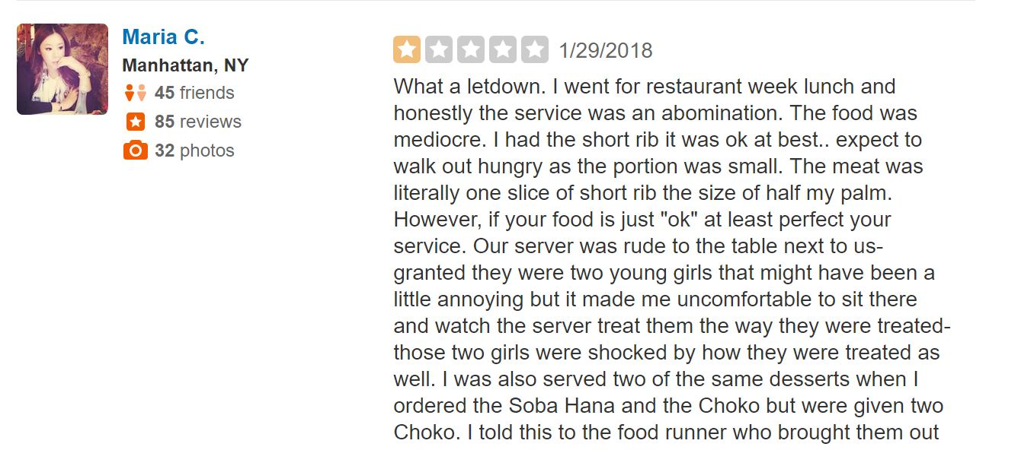
Which reviews should user see?
?
Visits
?
…
?

Slide 5


Reviewly Architecture
Back End
Web Scraped Data
Recommendation Engine

Slide 6
Dataset
We used the Yelp dataset, publicly available as part of the Yelp Data Challenge (https://www.yelp.com/dataset/)
Free-form text data of user reviews provides potential for more nuanced similarities and preferences
We filtered the data down to Restaurants and filtered the data to the city of Toronto, which had the most restaurant reviews
This gave us 73,045 users reviewing 7,149 restaurants

Slide 7
Data Science Question and Plan
If users express preferences, tastes, and behaviors in their review, comparing those keywords to other users’ can illustrate how similar two users are
We would want to compare users reviews of the same business, since each business might elicit different responses
But we also want to gauge the overall similarity between all of the users’ reviews

Slide 8
Data Science Question and Plan
Collaborative Filtering recommends new items based off of what similar users like
We can employ the same technique, but we would only need to find the similar users
Once we calculate the similar users, we would test our accuracy by averaging their ratings and comparing it to the visitor’s rating
We used Cosine Similarity over Jaccard to calculate distance since it accounts for word duplication
We used TF-IDF to calculate term importance

Slide 9
Preprocessing and Analysis
Our model followed the following workflow:
User U visits Business B
Build Dataset:
Filter rows by users that review B
Filter columns by places that U reviewed.
Calculate cosine similarities:
Compute similarities by column to yield similarity score for each business.
Compute similarities by row to yield final similarities between users.
Accuracy:
Return top 5 users similar to user U.
Aggregate their average rating R_{p} for a business B which will be user U’s predicted rating.
Compare predicted rating R_{p} with actual rating R_{a} of user U.
Iterate for every User – Business permutation

Slide 10
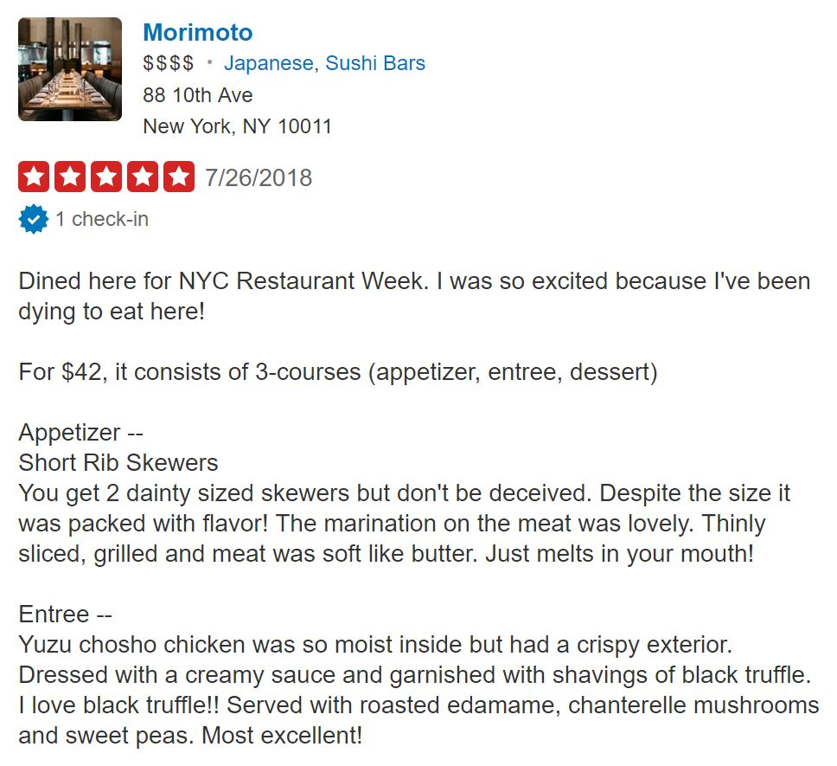
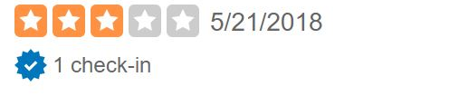
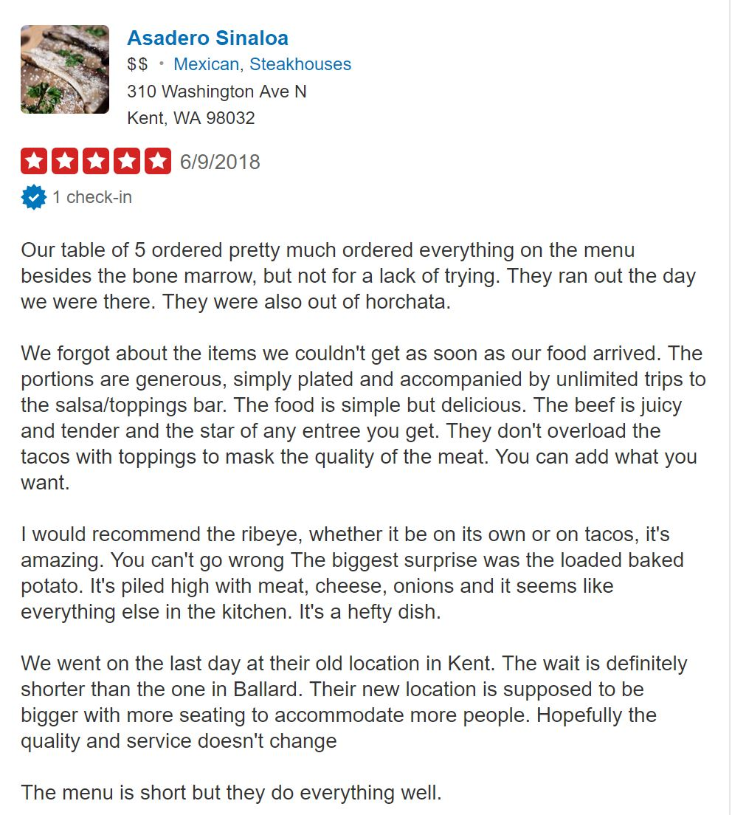
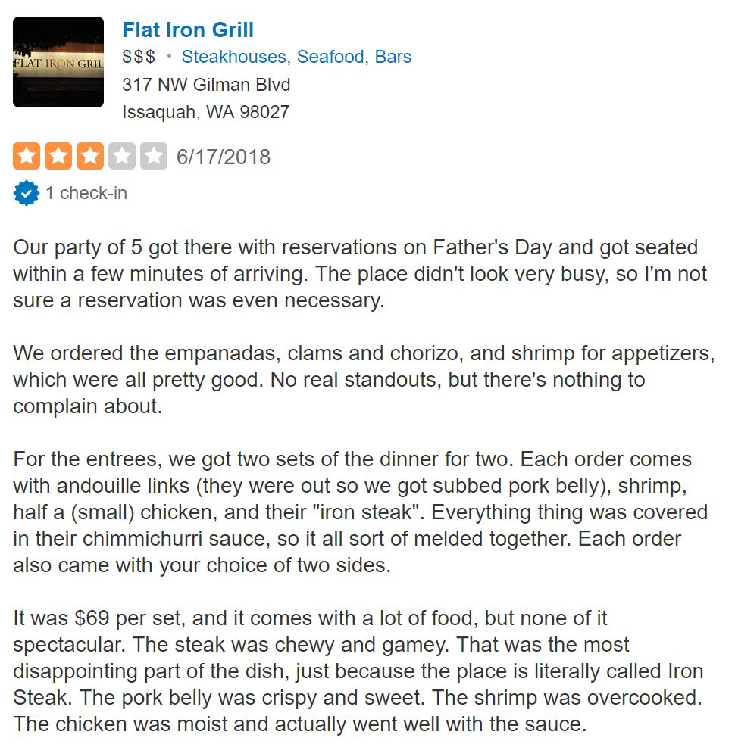
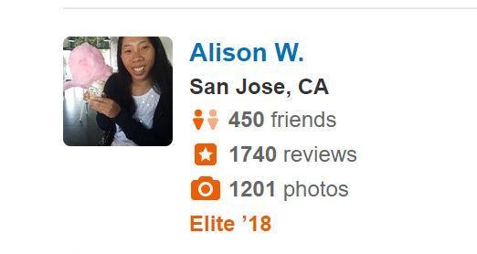
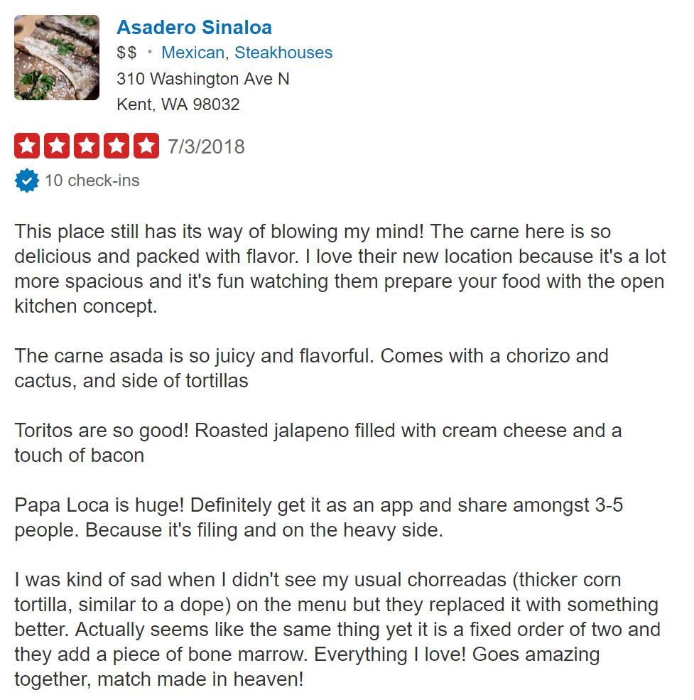
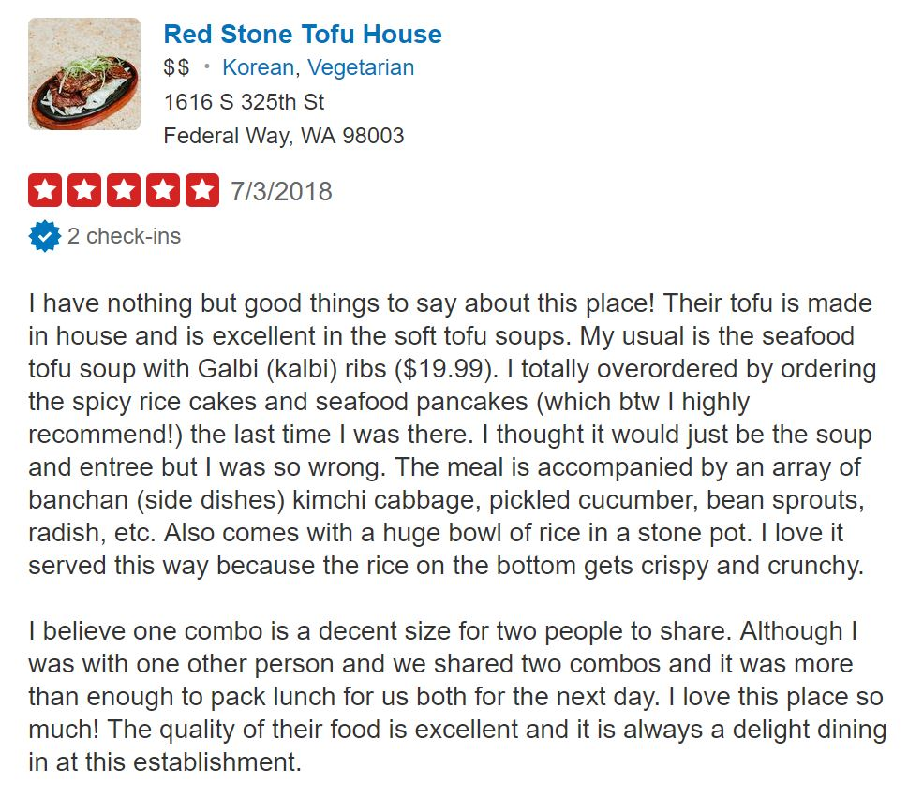
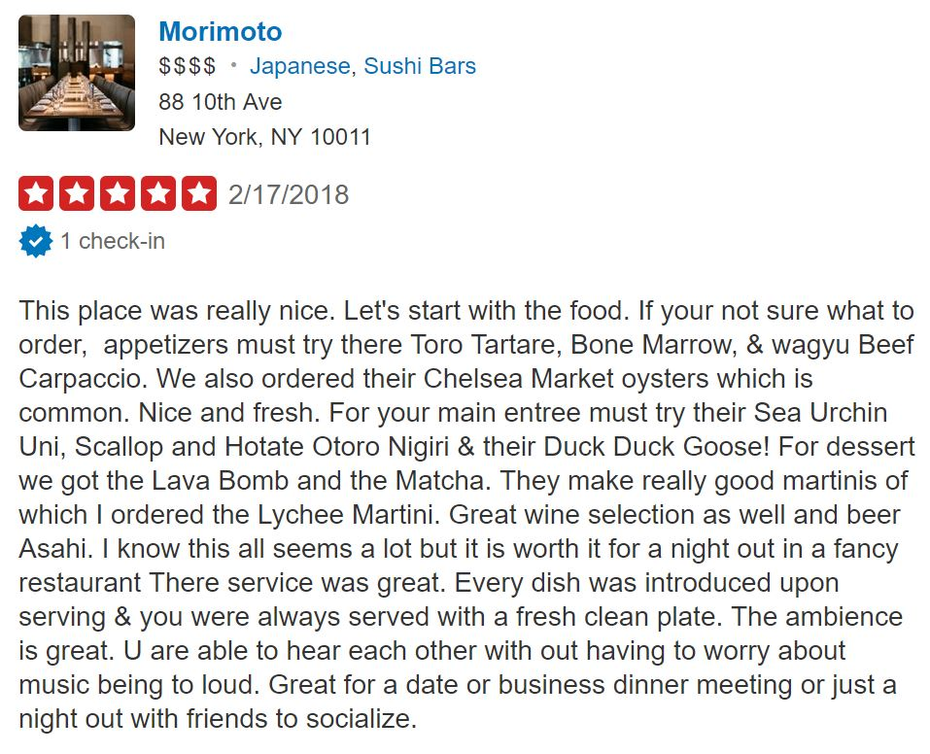
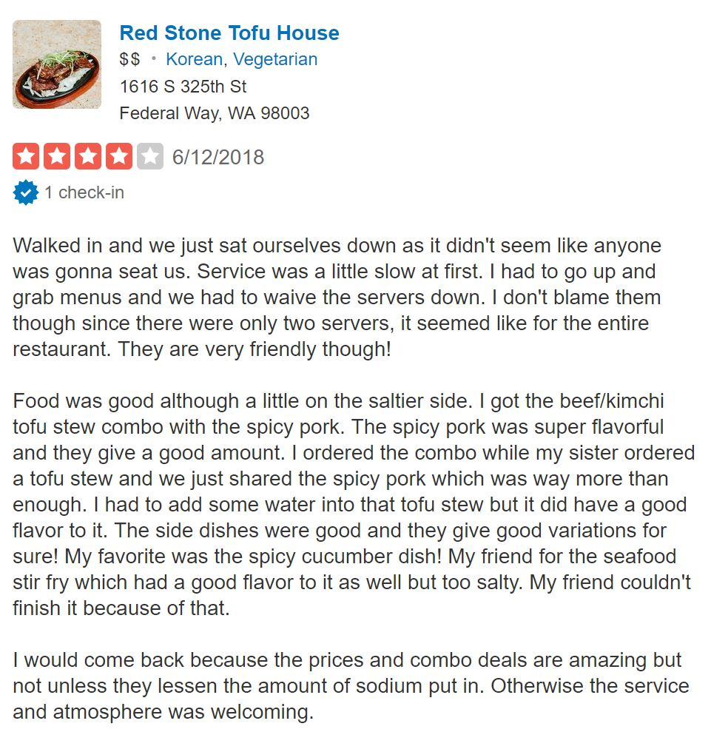
(a-b)
We want to get all the reviews, from every user, from all the places that the visitor has previously reviewed

Slide 11
The User – Item Matrix for user U and business B
* Note: Text was prepossessed and TFIDF calculated before calculating similarity

Slide 12
(c) Calculating Cosine Similarity within each business
 | 1
 | .007
 | .052

Slide 13
(d) Calculating Cosine Similarity within each business
 | 1 | 1 | 1
 | .007 | .381 | 0
 | .052 | 0 | .133
1
…

Slide 14
Evaluate Results
Our RMSE was 0.83, which means that the error in our model’s prediction was within 1 star rating of user rating.
We are curious if there are better ways to gauge accuracy of the model
We calculated the TFIDF for each iteration of a user-business pair, which limits the dictionary. We are curious if expanding it to the entire corpus will a) improve our results, b) speed up the model
We calculated the cosine similarity of users within each business first. We are curious if calculating the similarity of the entire matrix at once will improve accuracy and time
We calculated cosine similarity from the visitor to every other user. We are curious if calculating everyone’s similarity at once would yield different results

Slide 15
Evaluate Results
The computation was very intensive, with the entire dataset taking nearly 26 hours.
Code has been updated since to replace loops with vectorization and built in functions in sklearn that are optimized for these operations.
However, further review should be given to see if there can be substantial improvements.

Slide 16
Next Steps
Matrix Factorization
Sampling to test model
Cloud Computing
AWS (EC2/RDS/S3) Instance
Hyperparameter tuning
Number of users to return
GridSearch: [1, 3, 5, 7, 9….]
Percentage of total number of reviews on business
Threshold Based on Similarity
Adding features
Sentiment analysis
Compiling user profiles from metadata from restaurants they rated highly
Process Text Differently
Topic modeling / LDA
Only retrieve nouns
N-Grams
Other Similarity Calculations
Minhashing
Jaccard
Levenshtein

Slide 17
Potential Direction
We have done data exploration and established a baseline model for our recommendation engine.
We would like take our project further with these steps:
Setup database and integrate with cloud technologies
Focus on making the model more robust and scalable.
Develop different models for our recommendation engine that would outperform our current model
Thank you

