Slide 1

Predicting Similar Users Using NLP On Yelp Dataset
Team: Saggita (1) Anubhav Chaturvedi (2) Rajesh Pothamsetty (3) Mohammed Ahmed

Slide 2
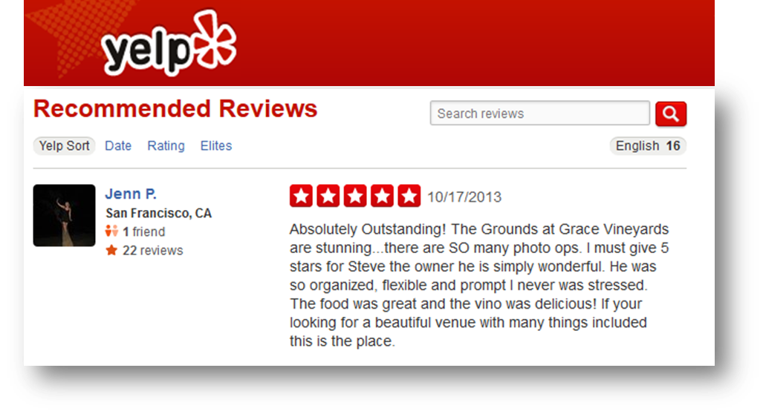
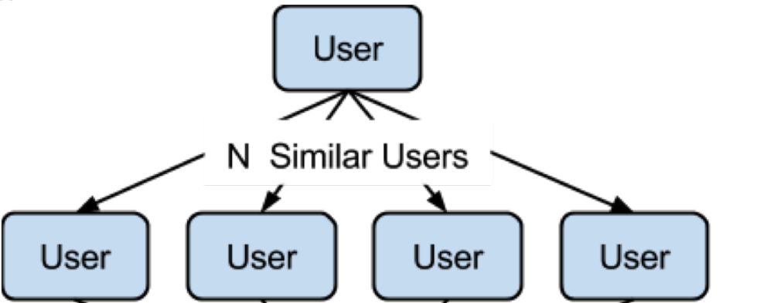

What is the goal of our project?

Slide 3
Exploratory Data Analysis
Food businesses in toronto

Slide 4
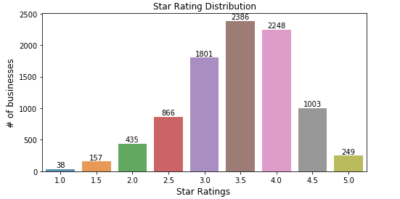
How are the businesses rated?

Slide 5
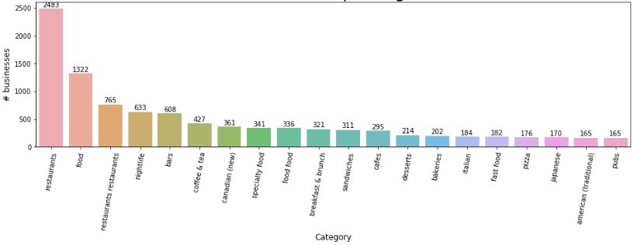
What are the top categories?

Slide 6
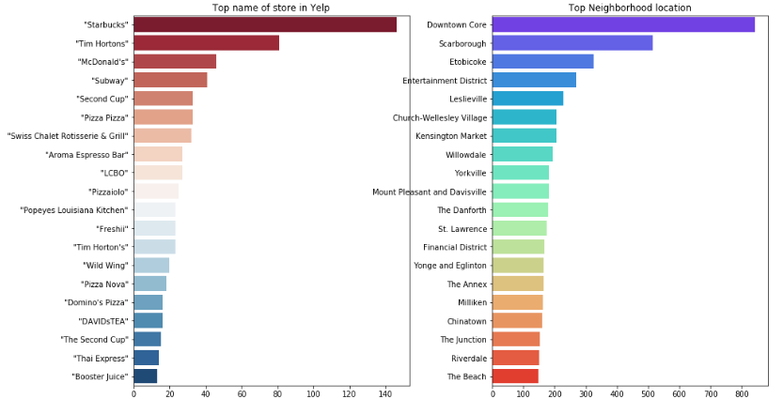

Slide 7
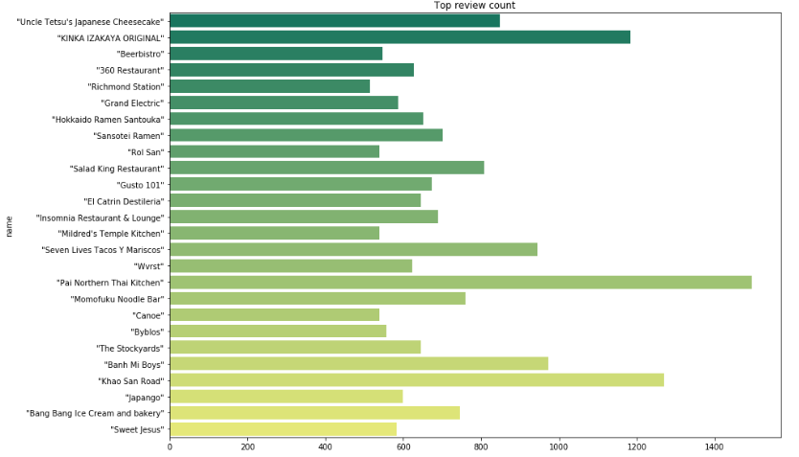

Slide 8
NLP of Reviews
Applying nlp to find similar users

Slide 9
Steps in NLP
User
Reviews
Text
Tokenization (Regex)
No Stop words
Word2vec
Reviews 1/2/3...
Category = Food

Slide 10
Why is word2vec?
Word2Vec is a group of models which helps derive relations between a word and its contextual words.

Slide 11
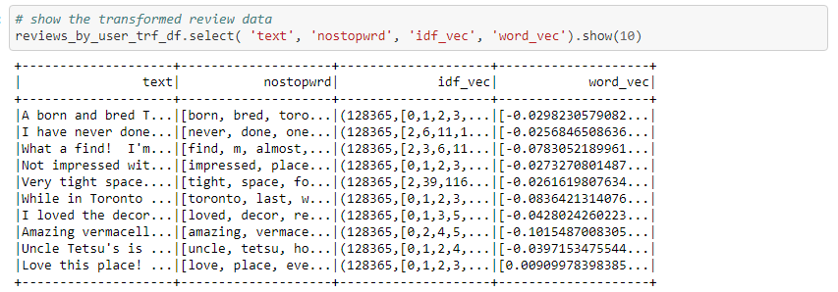
Post transformation of Review Data

Slide 12
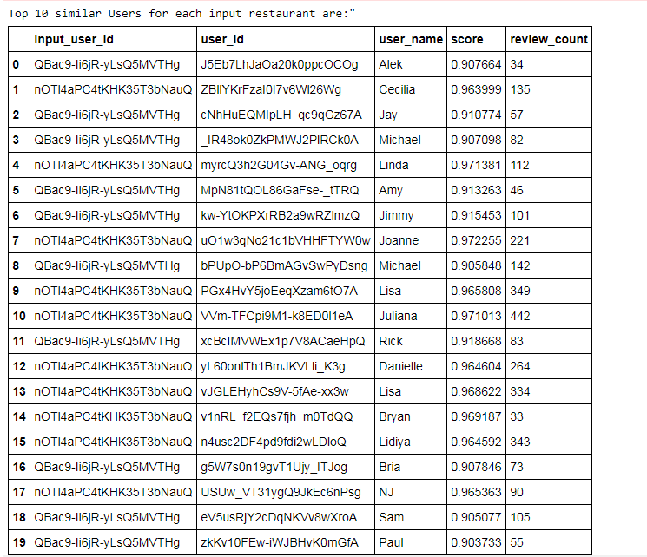
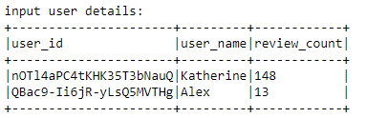
Taking two users and finding users
similar to them

Slide 13
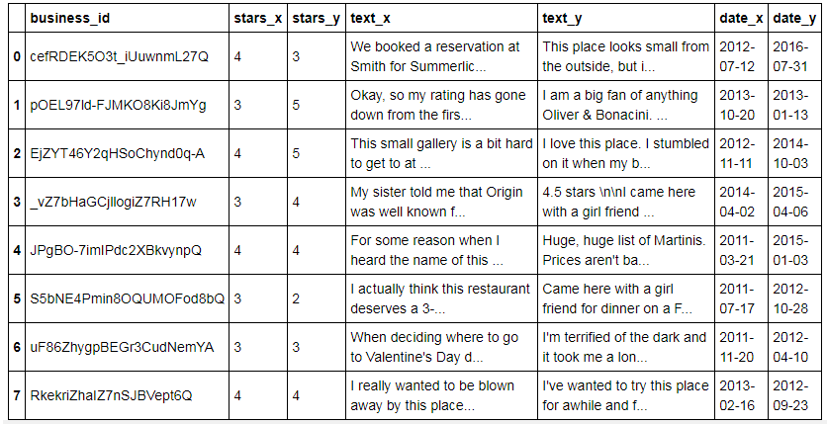
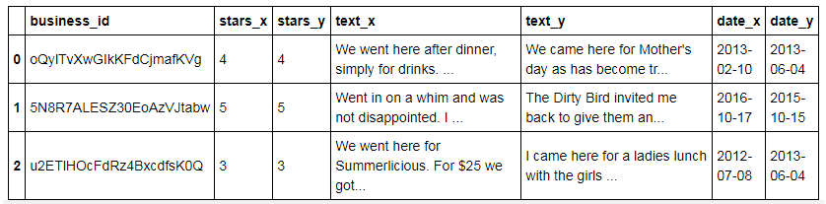

Slide 14
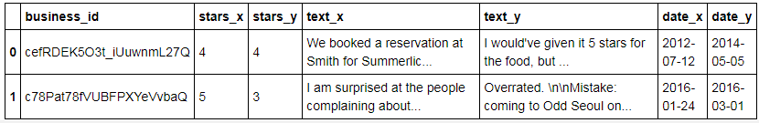
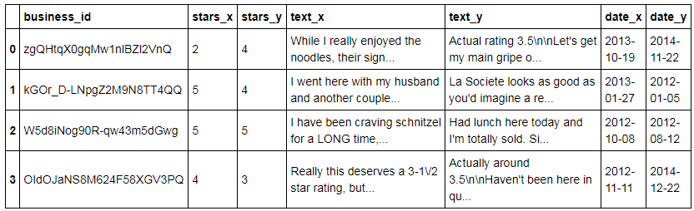
Both users wanted to rate the place 3.5 - one rated 4 and the other 3 but NLP was brilliantly here.

Slide 15
Final Results – 4,894 reviews compared
131 unique users –
At least 1 similar user for every user
Maximum 10 found for 4 users

