Slide 1
Explanation of the Terms:

Slide 2
Data Warehouse: A large, centralized repository of structured and integrated data collected from multiple sources. Used for business intelligence (BI), reporting, and analytics.

Slide 3
Data Warehousing: The process of collecting, storing, and managing data in a data warehouse. Includes data extraction, transformation, and loading (ETL).

Slide 4
Database: A system used to store, manage, and retrieve data in real time.
Optimized for transactions (CRUD operations: Create, Read, Update, Delete).

Slide 5
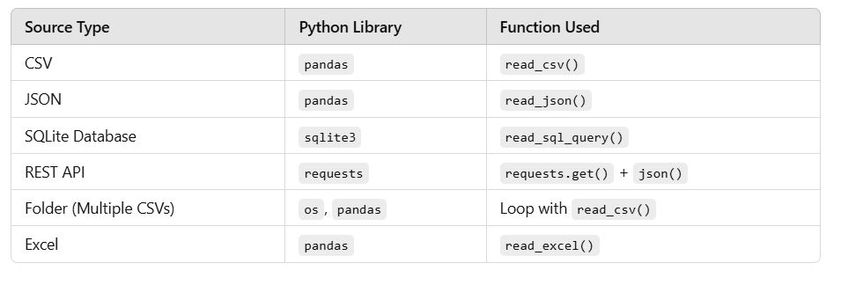

Slide 6
ETL Process (Extract, Transform, Load)
Extract: Retrieve data from multiple sources (databases, APIs, flat files, cloud storage, etc.).
Transform: Clean, validate, aggregate, and reformat the data to make it suitable for analysis.
Load: Store the transformed data into a target system like a data warehouse.

Slide 7
ETL Example Flow:
Extract data from MySQL, CSV files, or APIs.
Transform by removing duplicates, converting data types, and aggregating.
Load into a PostgreSQL database or a data warehouse.

Slide 8
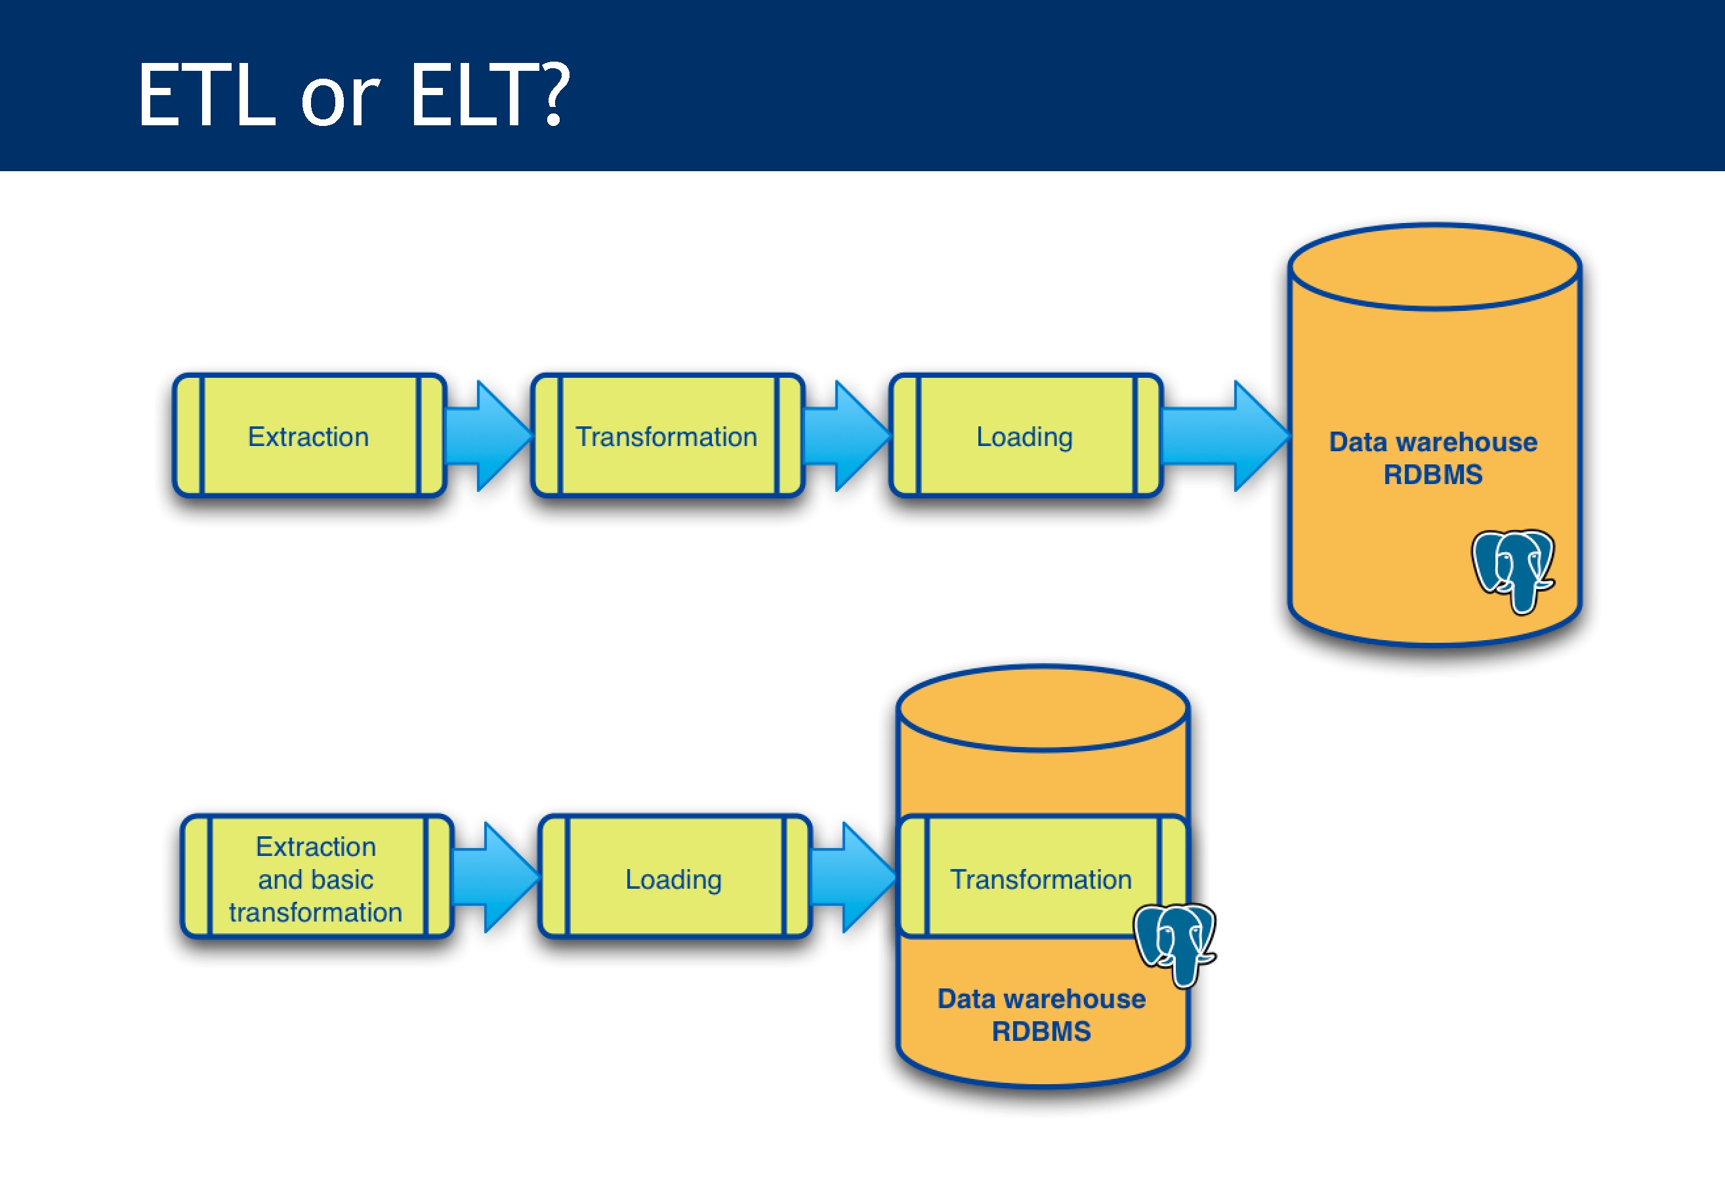

Slide 9
ETL operates at the integration server level, while ELT operates at the infrastructure level, using SQL and related procedural features of the relational database to optimize performance.

Slide 10
Extracting Multiple Files from Different Sources Using Python In ETL (Extract, Transform, Load) processes, extraction is the first step where data is collected from different sources such as databases, APIs, CSV files, JSON files, cloud storage, and more.

Slide 11
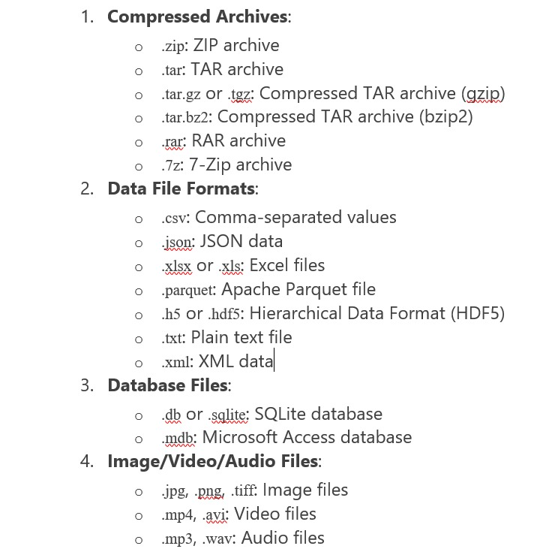
Common Dataset File Extensions:

Slide 12
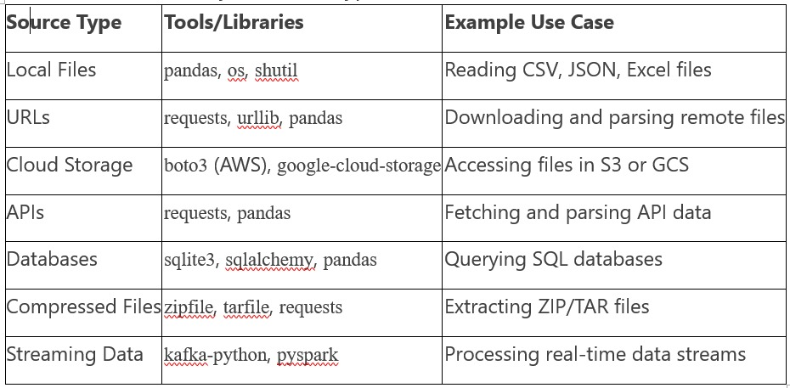

Slide 13
Thank You

