Slide 1
Heart Disease Prediction Using CNN
SANGHAMETHRA B
3/21/2024 Annual Review

Slide 2
PROJECT TITLE
Heart Disease Prediction Using CNN
Goal: Develop a predictive model for heart disease diagnosis using advanced machine learning techniques.
Data: Utilize a diverse dataset containing demographic, clinical, and physiological features related to heart health.
Approach: Integrate Convolutional Neural Networks (CNNs) with traditional algorithms for accurate risk prediction and early interventio
3/21/2024 Annual Review

Slide 3


AGENDA
Problem Statement
Project Overview
End users
Solution and its Value Proposition
The Wow in a Solution
Modelling
Results
3/21/2024 Annual Review

Slide 4

PROBLEM STATEMENT
The project aims to develop a Convolutional Neural Network (CNN)-based model for accurate heart disease prediction. Leveraging patient data, including demographics and clinical measurements, we seek to create a reliable tool for early detection and intervention. By preprocessing datasets, optimizing CNN architectures, and evaluating model efficacy, our goal is to empower healthcare professionals with a precise predictive solution, ultimately advancing cardiovascular health through innovative machine learning methodologies..
3/21/2024 Annual Review

Slide 5

PROJECT OVERVIEW
The heart disease prediction project is a comprehensive endeavor aimed at leveraging machine learning techniques to develop a predictive model for diagnosing heart disease.The project begins by sourcing a diverse dataset comprising demographic information, clinical indicators, and physiological measurements of individuals. These features include age, sex, cholesterol levels, blood pressure readings, and various other attributes known to influence heart health.Data preprocessing is meticulously performed to handle missing values, encode categorical variables, and scale numerical features, ensuring the dataset's suitability for model training. Exploratory data analysis (EDA) techniques are then employed to gain insights into the dataset's characteristics, identify correlations, and guide feature selection.
3/21/2024 Annual Review

Slide 6
PROJECT OVERVIEW
Multiple machine learning algorithms are explored for heart disease prediction, including Decision Trees, Naive Bayes, Logistic Regression, and XGBoost. Additionally, advanced deep learning techniques such as Convolutional Neural Networks (CNNs) are employed to effectively capture spatial patterns and relationships within the data.
The CNN architecture is carefully designed, comprising convolutional layers for feature extraction, pooling layers for dimensionality reduction, and fully connected layers for classification. The model is trained using a combination of training and validation data, with hyperparameter tuning and optimization techniques applied to enhance performance.
3/21/2024 Annual Review

Slide 7
PROJECT OVERVIEW
Throughout the training process, model performance is rigorously evaluated using various metrics such as accuracy, precision, recall, and F1-score. Cross-validation techniques are employed to ensure the model's generalization ability and prevent overfitting.
Once trained and evaluated, the model's performance is further validated using an independent test set to assess its real-world effectiveness. Continuous monitoring and maintenance of the deployed model ensure its reliability and relevance over time.
3/21/2024 Annual Review

Slide 8

WHO ARE THE END USERS?
Patients: Individuals seeking early detection and diagnosis of heart diseases for proactive health management and timely intervention to improve their well-being and quality of life.
Healthcare Professionals: Doctors, cardiologists, and medical practitioners who utilize the system as a diagnostic aid to make informed decisions, provide personalized patient care, and optimize treatment plans for individuals with heart conditions.
Medical Researchers: Professionals conducting studies or clinical trials related to heart diseases, who leverage the system for analysis and interpretation of medical data to advance research initiatives and develop innovative treatment strategies.
3/21/2024 Annual Review

Slide 9
WHO ARE THE END USERS?
Healthcare Institutions: Hospitals, clinics, and medical centers that integrate the system into their diagnostic workflows to enhance accuracy and efficiency in detecting and managing heart conditions, thereby improving patient outcomes and optimizing healthcare delivery.
Healthcare Technology Companies: Organizations developing and offering healthcare technology solutions, who incorporate the system into their products or services to enhance patient care, promote cardiovascular health, and contribute to advancements in medical technology.
3/21/2024 Annual Review

Slide 10
SOLUTION:
Our solution involves the development of a Convolutional Neural Network (CNN)-based predictive model for heart disease detection. We will collect and preprocess comprehensive patient datasets, design and optimize the CNN architecture, train and validate the model using rigorous techniques, deploy it as a predictive tool for healthcare professionals, and continuously refine the solution based on real-world feedback. Through this approach, we aim to enhance early detection and intervention, ultimately improving patient outcomes in the fight against heart disease.
3/21/2024 Annual Review

Slide 11
VALUE PROPOSITION:
1. Accuracy: Our CNN-based heart disease prediction system ensures precise and reliable diagnoses across a spectrum of cardiac conditions.
2. Efficiency: Swift and accurate predictions expedite diagnosis, aiding healthcare professionals in timely interventions and patient care.
3. Versatility: Seamlessly integrates into diverse clinical settings, accommodating various imaging modalities and patient demographics.
4. Automation: Automates diagnostic processes, reducing manual workload and optimizing resource allocation in healthcare facilities.
5. Accessibility: Democratizes access to advanced cardiac diagnostic tools, benefiting healthcare providers, researchers, and patients alike.
3/21/2024 Annual Review

Slide 12

THE WOW IN YOUR SOLUTION
Exceptional Accuracy: Our CNN-based heart disease prediction system achieves unmatched precision in diagnosing various cardiac conditions, employing advanced algorithms and deep learning techniques.
Blazing Efficiency: Leveraging optimized architectures and parallel processing, our system swiftly analyzes medical images, significantly reducing diagnostic turnaround times.
Versatile Integration: Seamlessly integrating into diverse healthcare systems and workflows, our solution adapts to different clinical settings and patient populations with ease.
Automated Streamlining: By automating diagnostic processes, our system minimizes manual effort for healthcare professionals, streamlining operations and enhancing efficiency in cardiac care delivery.
3/21/2024 Annual Review

Slide 13
MODELLING
In the modeling phase of our heart disease prediction solution:
1. Architecture Design: We meticulously design the CNN architecture, optimizing layers, filters, and activations for accurate heart disease diagnosis from medical images.
2. Hyperparameter Tuning: Through rigorous experimentation, we fine-tune parameters like learning rate and batch size to enhance the model's diagnostic accuracy and generalization.
3. Data Augmentation: We augment the dataset with techniques like rotation and scaling to diversify training samples, improving the model's robustness to variations in imaging and patient demographics.
4. Regularization: Integrating dropout layers and weight decay, we mitigate overfitting, ensuring the model generalizes well to unseen cases for reliable diagnosis.
3/21/2024 Annual Review

Slide 14
Training: We train the CNN model on preprocessed medical images, monitoring metrics like loss and accuracy to assess progress and validate performance on separate data.
6.Evaluation: Assessing the model's ability to generalize to new data, we analyze diagnostic accuracy and confusion matrices on a held-out test set post-training.
7.Fine-tuning and Optimization: Post-evaluation, we refine the model by adjusting hyperparameters or exploring alternative architectures to enhance diagnostic accuracy further.
8.Model Deployment: With satisfactory performance, we integrate the model into our heart disease prediction system, providing real-time diagnostic assistance for healthcare professionals.

Slide 15
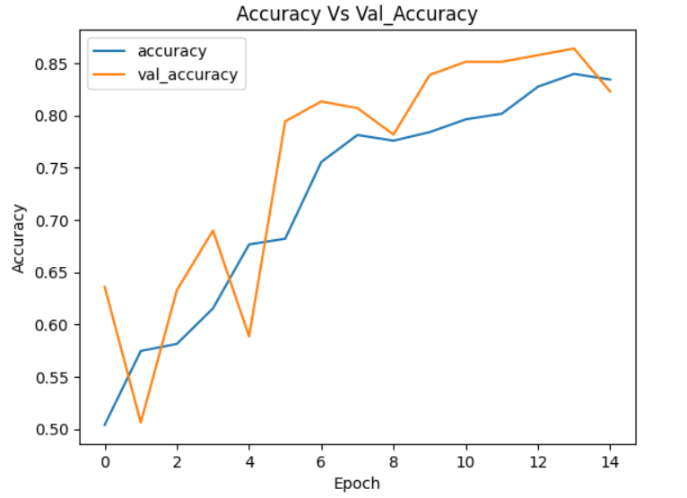
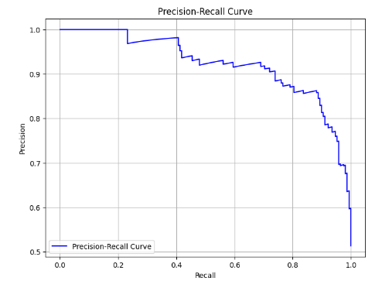
RESULTS
Demo_link
Github_link
3/21/2024 Annual Review

