Slide 1
Intro to Statistics

Slide 2
Statistics
Early History
  Collection of Data on Demographics
  Collection of data on all aspects of life
  Analysis and interpretation of data
Current Uses
  Statistical Inference
  Probability
  Design of experiments
  Machine Learning
  Artificial Intellgience

Slide 3
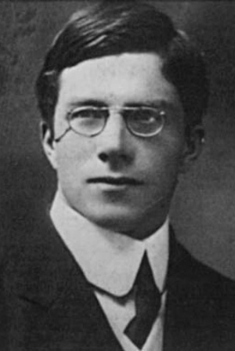
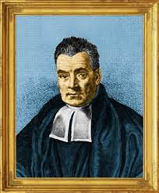
Great Statisticians
Ronald Fischer
Thomas Bayes

Slide 4

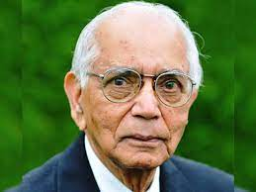
Great Statisticians
Brad Efron
CR Rao

Slide 5
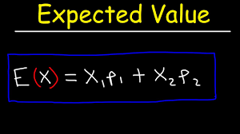
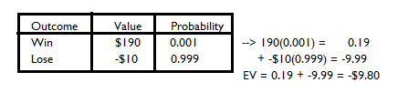
Statistical Ideas : Expected Value

Slide 6
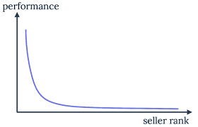
Statistical Ideas
Power Laws
  The Richter scale follows a power-law distribution scale. A 9 is 10x more destructive than an 8, and an 8 is 10x more destructive than a 7.

Slide 7
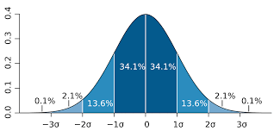
Statistical Ideas
Normal Distribution

Slide 8
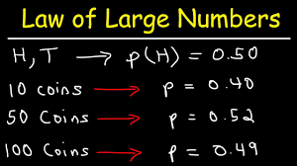
Statistical Ideas
Law of large Numbers : Casinos make money

Slide 9
Statistical Ideas
Regression to the mean
  In a normal distribution, large deviations from the average will return to the average as the numbers of observations increase.
Example
  Performance in a test
  Games of chance

Slide 10
SAMPLING…….
STUDY POPULATION
SAMPLE
TARGET POPULATION

Slide 11
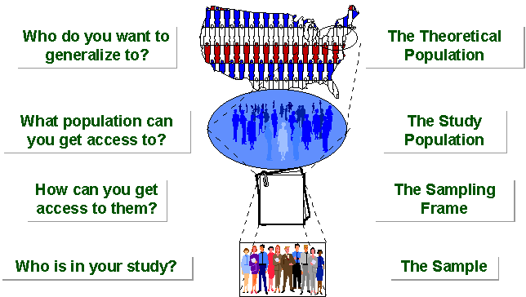
SAMPLING BREAKDOWN
Notes:
Picture of sampling breakdown

Slide 12
SAMPLING
A sample is “a smaller (but hopefully representative) collection of units from a population used to determine truths about that population” (Field, 2005)
Why sample?
  Resources (time, money) and workload
  Gives results with known accuracy that can be calculated mathematically
The sampling frame is the list from which the potential respondents are drawn
  Registrar’s office
  Class rosters
  Must assess sampling frame errors
Notes:
Sampling frame errors: university versus personal email addresses; changing class rosters; are all students in your population of interest represented?

Slide 13
SAMPLING……
What is your population of interest?
    To whom do you want to generalize your results?
      All doctors
      School children
      Indians
      Women aged 15-45 years
      Other
Can you sample the entire population?
Notes:
How do we determine our population of interest?
Administrators can tell us
We notice anecdotally or through qualitative research that a particular subgroup of students is experiencing higher risk
We decide to do everyone and go from there
3 factors that influence sample representativeness
Sampling procedure
Sample size
Participation (response)
When might you sample the entire population?
When your population is very small
When you have extensive resources
When you don’t expect a very high response

Slide 14
Types of Samples
Probability (Random) Samples
Simple random sample
  Systematic random sample
  Stratified random sample
  Multistage sample
  Multiphase sample
  Cluster sample
Non-Probability Samples
  Convenience sample
  Purposive sample
  Quota
Notes:
Two general approaches to sampling are used in social science research. With probability sampling, all elements (e.g., persons, households) in the population have some opportunity of being included in the sample, and the mathematical probability that any one of them will be selected can be calculated. With nonprobability sampling, in contrast, population elements are selected on the basis of their availability (e.g., because they volunteered) or because of the researcher's personal judgment that they are representative. The consequence is that an unknown portion of the population is excluded (e.g., those who did not volunteer). One of the most common types of nonprobability sample is called a convenience sample – not because such samples are necessarily easy to recruit, but because the researcher uses whatever individuals are available rather than selecting from the entire population.
Because some members of the population have no chance of being sampled, the extent to which a convenience sample – regardless of its size – actually represents the entire population cannot be known

Slide 15
NON-PROBABILITY SAMPLING
Any sampling method where some elements of population have no chance of selection
Example: We visit every household in a given street, and interview the first person to answer the door. In any household with more than one occupant, this is a nonprobability sample, because some people are more likely to answer the door (e.g. an unemployed person who spends most of their time at home is more likely to answer than an employed housemate who might be at work when the interviewer calls) and it's not practical to calculate these probabilities.

Slide 16
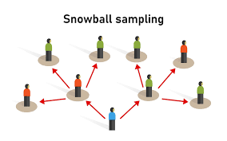
Snowball Sampling
Initial subjects recruit additional subjects

Slide 17

CONVENIENCE SAMPLING…….
  Use results that are easy to get

Slide 18
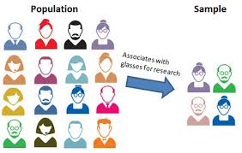
Judgement Sampling

Slide 19
PROBABILITY SAMPLING…….
Probability sampling includes:
Simple Random Sampling,
Stratified Random Sampling,

Slide 20
PROBABILITY SAMPLING
A probability sampling scheme is one in which every unit in the population has a chance (greater than zero) of being selected in the sample, and this probability can be accurately determined.
.

Slide 21
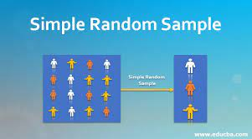
Simple random sample

Slide 22
SIMPLE RANDOM SAMPLING
Applicable when population is small, homogeneous & readily available
All subsets of the frame are given an equal probability. Each element of the frame thus has an equal probability of selection.
It provides for greatest number of possible samples. This is done by assigning a number to each unit in the sampling frame.
A table of random number or lottery system is used to determine which units are to be selected.

Slide 23
SIMPLE RANDOM SAMPLING……..
Estimates are easy to calculate.
Simple random sampling is always an EPS design, but not all EPS designs are simple random sampling.
Disadvantages
If sampling frame large, this method impracticable.
Minority subgroups of interest in population may not be present in sample in sufficient numbers for study.

Slide 24
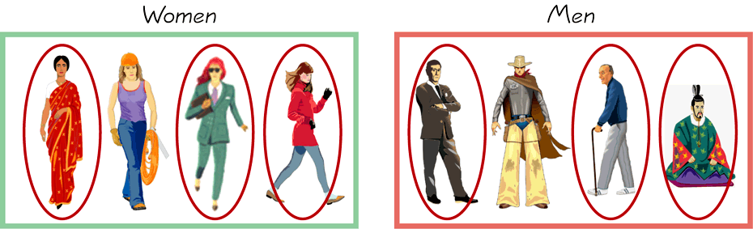
STRATIFIED SAMPLING…….
        Draw a sample from each stratum

Slide 25
STRATIFIED SAMPLING
Where population embraces a number of distinct categories, the frame can be organized into separate "strata." Each stratum is then sampled as an independent sub-population, out of which individual elements can be randomly selected.
Every unit in a stratum has same chance of being selected.
Using same sampling fraction for all strata ensures proportionate representation in the sample.
Adequate representation of minority subgroups of interest can be ensured by stratification & varying sampling fraction between strata as required.

Slide 26

Questions???

