Slide 1
CHAPTER 1 - Introduction
Database Systems -
Introduction to Databases and Data Warehouses

Slide 2
INITIAL TERMINOLOGY
Data - facts that are recorded and can be accessed
Data formats – text, numbers, figures, graphics, images, audio/video recordings and more
Data is recorded and kept because it is considered to be of use to an intended user
Information - refers to the data that is accessed by a user for some particular purpose
Typically, getting the needed information from a collection of data requires performing an activity, such as searching through, processing, or manipulating the data in some form or fashion
Notes:
The terms “data” and “information” are illustrated on Page 1 by the following examples:
Phone book lookup of the phone number for Pizza Adria
ZAGI Retail Company manager needing information about quarterly apparel sales
The terms “data” and “information” are often interchanged and used as synonyms for each other (information is simply the data that we need)

Slide 3
INITIAL TERMINOLOGY
Metadata - data that describes the structure and the properties of the data
Metadata is essential for the proper understanding and use of the data

Slide 4
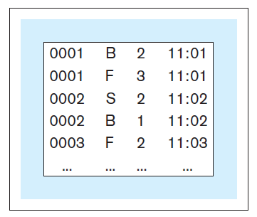
INITIAL TERMINOLOGY
Data without metadata - example

Slide 5
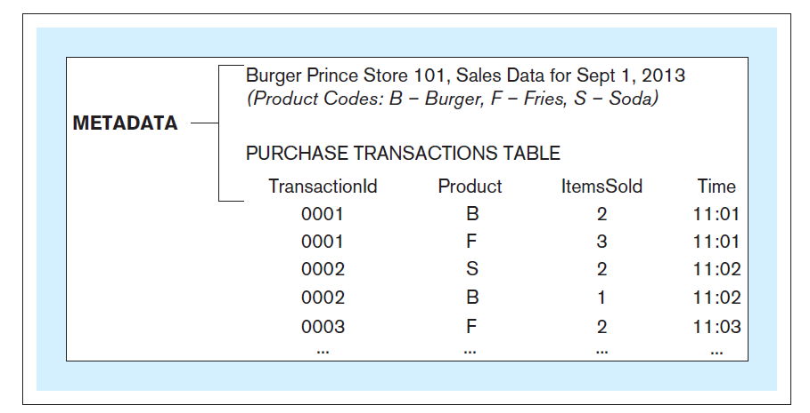
INITIAL TERMINOLOGY
Data with metadata - example

Slide 6
INITIAL TERMINOLOGY
Database - structured collection of related data stored on a computer medium
Organizes the data in a way that facilitates efficient access to the information captured in the data
Database metadata – represents the structure of the database
Database content that is not the data itself (data about the data)
Contains:
Names of data structures
Data types
Data descriptions
Other information describing the characteristics of the data
Chapter 1 – Slide 6

Slide 7
INITIAL TERMINOLOGY
Database management system (DBMS) - software used for:
Creation of databases
Insertion, storage, retrieval, update, and deletion of the data in the database
Maintenance of databases
Database system - computer-based system whose purpose is to enable an efficient interaction between the users and the information captured in a database
Chapter 1 – Slide 7
Notes:
A comparison of the relationship between a DBMS and a database with the relationship between the presentation software (such as MS PowerPoint) and a presentation, is given on Pages 2-3.

Slide 8
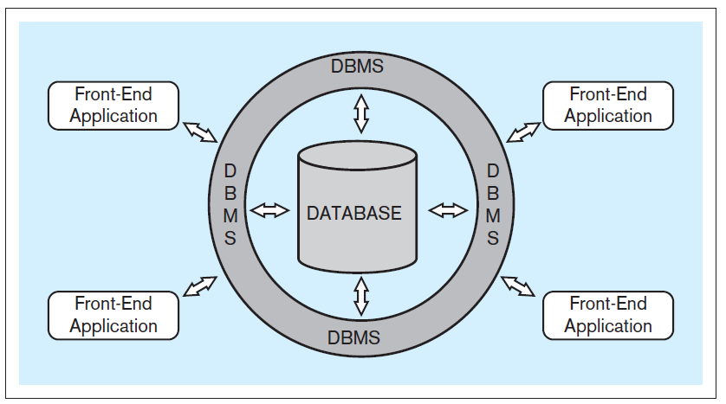
INITIAL TERMINOLOGY
Typical database system architecture

Slide 9
INITIAL TERMINOLOGY
Front-end applications - provide a mechanism for easy interaction between the users and the DBMS
End-users (business-users) - users using a database system to support their tasks and processes
Indirect interaction - end-user communicating with the database through front-end applications
Direct interaction - end-user communicating with the database directly through DBMS
Notes:
An example of an ATM user interacting with the DBMS by using a front-end application is described on Page 3.

Slide 10
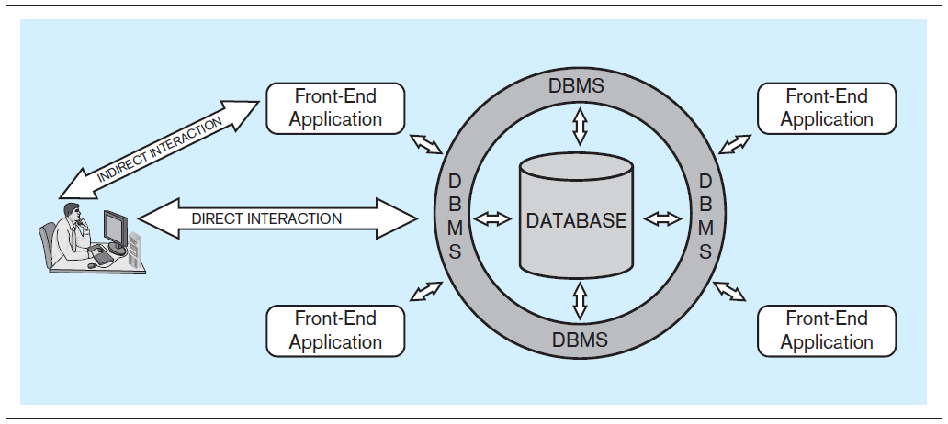
INITIAL TERMINOLOGY
Typical database system architecture
Notes:
The discussion of indirect and direct interaction is given on Pages 3-4.

Slide 11
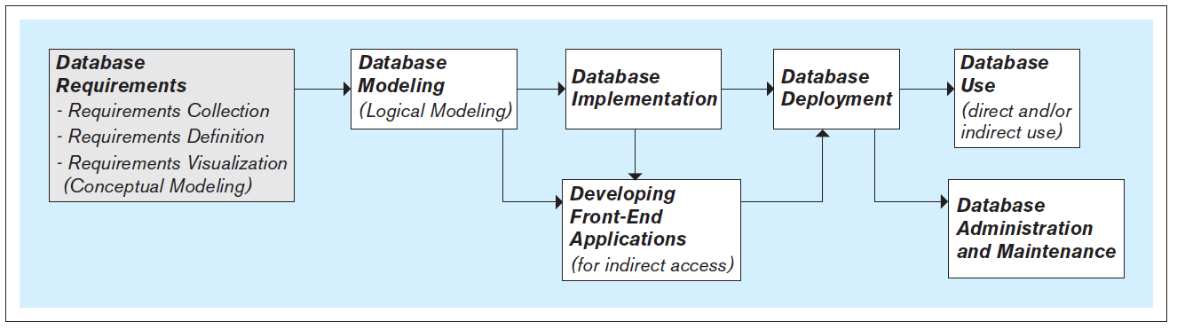
STEPS IN THE DEVELOPMENT OF DATABASE SYSTEMS

Slide 12
STEPS IN THE DEVELOPMENT OF DATABASE SYSTEMS
Requirements collection, definition, and visualization - results in the requirements specifying which data the future database system will hold and in what fashion, and what the capabilities and functionalities of the database system will be
The collected requirements should be clearly defined and stated in a written document, and then visualized
Notes:
The first and most critical step in the development of the database.

Slide 13
STEPS IN THE DEVELOPMENT OF DATABASE SYSTEMS
Requirements collection, definition, and visualization
Conceptual database model – a visualization of requirements by using a conceptual data modeling technique (such as entity-relationship [ER] modeling)

Slide 14
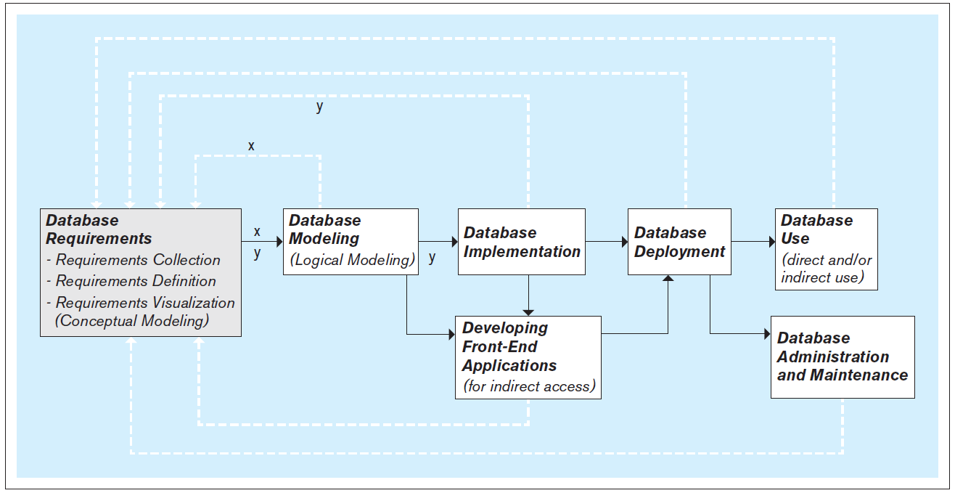
STEPS IN THE DEVELOPMENT OF DATABASE SYSTEMS
Iterative nature of the database requirements collection, definition, and visualization process
Notes:
The discussion about iterative nature of the database requirements collection, definition, and visualization process is given on Pages 5-6.

Slide 15
STEPS IN THE DEVELOPMENT OF DATABASE SYSTEMS
Database modeling (logical database modeling ) - creation of the database model that is implementable by the DBMS software
Logical database modeling follows conceptual database modeling
Notes:
A database has two models:
Conceptual model - created as a visualization of requirements during the requirements collection, definition, and visualization step and serves as a as a blueprint for the actual (logical) database model
Logical model - actual database model, created during the database modeling step to be used in the subsequent step of database implementation using the DBMS

Slide 16
STEPS IN THE DEVELOPMENT OF DATABASE SYSTEMS
Database implementation - using a DBMS to implement the database model as an actual database
Most modern databases are implemented using a relational DBMS (RDBMS) software
Notes:
SQL is a language used by most relational DBMS software packages.
SQL includes commands for creating, modifying and deleting database structures (these commands are used during database implementation).

Slide 17
STEPS IN THE DEVELOPMENT OF DATABASE SYSTEMS
Developing front-end applications - designing and creating applications for indirect use by the end-users
Front-end applications are based on the database model and the requirements specifying the front-end functionalities
Front-end applications contain interfaces (such as forms and reports) accessible via a navigation mechanism (such as a menu)
Notes:
The design and creation of front-end applications can commence and proceed in parallel with database implementation (as shown in Figure 5.1). The actual creation of a front-end application involves connecting it to the database. Connecting front-end application to the database can only be done once the database is implemented.

Slide 18
STEPS IN THE DEVELOPMENT OF DATABASE SYSTEMS
Database deployment - releasing the database system for use by the end users
Notes:
Typically, database deployment also involves populating the implemented database with the initial set of data.

Slide 19
STEPS IN THE DEVELOPMENT OF DATABASE SYSTEMS
Database use - the insertion, modification, deletion and retrieval of the data in the database system
Notes:
The database system can be used indirectly, via the front-end applications, or directly via the DBMS.
SQL includes commands for insertion, modification, deletion and retrieval of the data. These commands can be issued by front-end applications (indirect use), or directly by the end-users themselves (direct use)

Slide 20
STEPS IN THE DEVELOPMENT OF DATABASE SYSTEMS
Database administration and maintenance - performing activities that support the database end user, including dealing with technical issues, such as:
Providing security for the information contained in the database
Ensuring sufficient hard-drive space for the database content
Implementing the backup and recovery procedures

Slide 21
THE NEXT VERSION OF THE DATABASE
The new version of the database follows the same development steps as the initial version
Notes:
In most cases, after a certain period of use, the need for modifications and expansion of the existing database system becomes apparent, and the development of a new version of the existing database system is initiated.

Slide 22
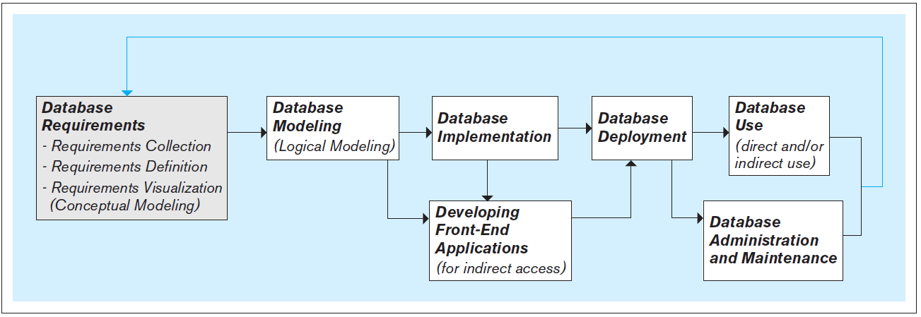
THE NEXT VERSION OF THE DATABASE
Notes:
The difference between developing the initial and subsequent versions of the database is discussed on Page 8.

Slide 23
DATABASE SCOPE
Databases can vary in their scope from small single-user (personal) databases to large enterprise databases that can be used by thousands of end-users
Regardless of their scope, all databases go through the same fundamental development steps (requirements, modeling, implementation, deployment, use, etc.)
Notes:
The difference in the scope of databases is reflected in the size, complexity and cost in time and resources required for each of the steps.

Slide 24
PEOPLE INVOLVED WITH DATABASE SYSTEMS
Database analysts, designers, and developers
Database analysts - involved in the requirements collection, definition, and visualization stage
Database designers (a.k.a. database modelers or architects) - involved in the database modeling stage
Database developers – in charge of implementing the database model as a functioning database using the DBMS software
Notes:
It is not uncommon for the same people to perform more than one of these roles. In fact (especially in smaller companies and organizations), the same people may be in charge of all aspects of the database system, including the design, implementation, administration, and maintenance.

Slide 25
PEOPLE INVOLVED WITH DATABASE SYSTEMS
Front-end applications analysts and developers
Front-end application analysts - in charge of collecting and defining requirements for front-end applications
Front-end applications developers - in charge of creating the front-end applications

Slide 26
PEOPLE INVOLVED WITH DATABASE SYSTEMS
Database administrators (DBAs) - perform the tasks related to the maintenance and administration of a database system

Slide 27
PEOPLE INVOLVED WITH DATABASE SYSTEMS
Database end users - use a database system to support their work- or life-related tasks and processes
Users differ in:
Level of technical sophistication
Amount of data that they need
Frequency with which they access the database system
Notes:
Arguably, database end users are the most important category of people involved with database systems. They are the reason for the existence of database systems. The quality of a database system is measured by how quickly and easily it can provide the accurate and complete information needed by its end users.

Slide 28
OPERATIONAL VERSUS ANALYTICAL DATABASES
Operational information (transactional information) - the information collected and used in support of day to day operational needs in businesses and other organizations
Operational database - collects and presents operational information in support of daily operational procedures and processes
Analytical information - the information collected and used in support of analytical tasks
Analytical information is based on operational (transactional) information
Analytical database - collects and presents analytical information in support of analytical tasks
Notes:
Examples of operational information, operational procedures and processes, analytical information, and analytical tasks are given on Page 10.

