Slide 1

Credibility of reviews
By Metin Senturk

Slide 2
Goal and importance
In a customer’s perspective, reviews are a key factor while choosing a service from a business.
In a business’ perspective, customer opinion may enlighten more insights about how well a business operating.
For both, the quality of the content matters in order to seek the need from reviews.
“Objective is to find characteristics of fake/ spam reviews.”

Slide 3
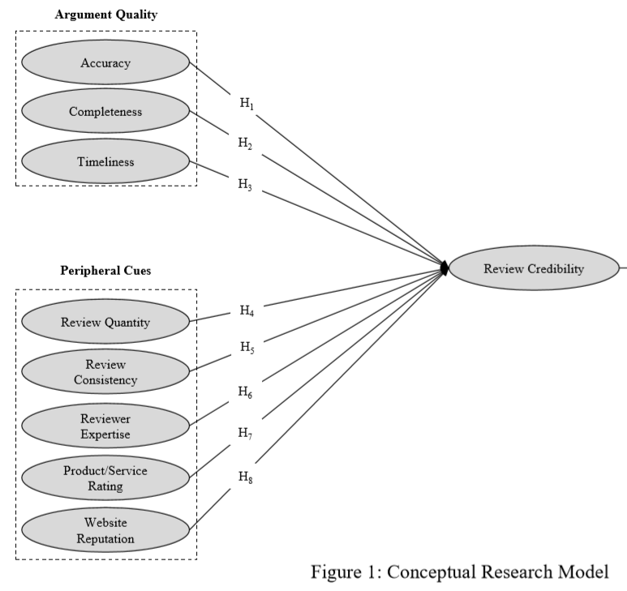
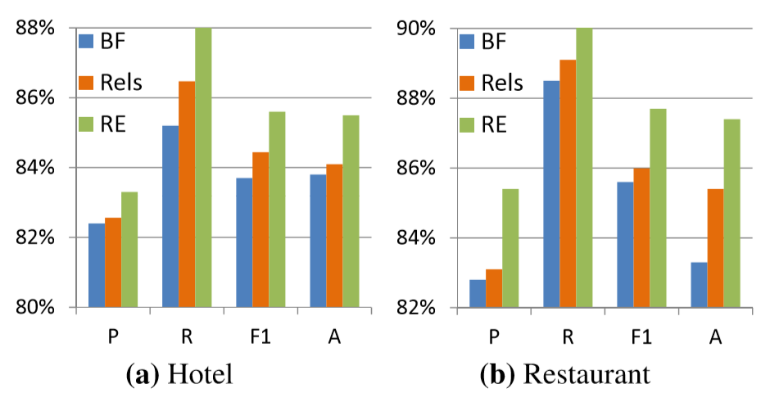
Literature review
Previous studies divided into two main studies.
Feature generation through linguistic and behavioral characteristics
Domain-centric approach. Hotels, restaurants, etc.

Slide 4
Analyzing review credibility process
EDA
Data Cleansing & Processing
Results
Models
Data

Slide 5







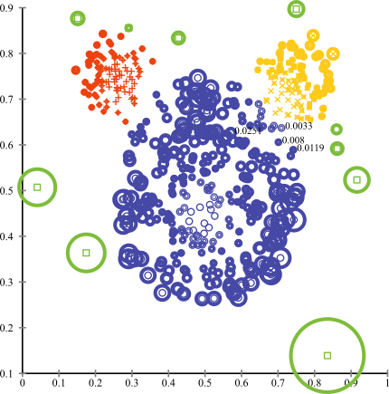
Data and stack
Python
Relational Databases
6,685,900 reviews
192,609 businesses
200,000 pictures
10 metropolitan areas
Machine Learning
Outliers
Clustering
1,223,094 tips by 1,637,138 users
Over 1.2 million business attributes like hours, parking, availability, and ambience
Aggregated check-ins over time for each of the 192,609 businesses

Slide 6
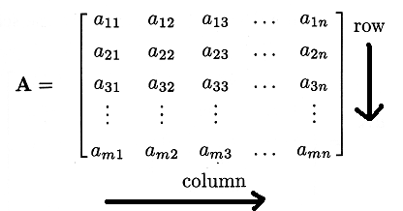
Data cleaning and preprocessing
Cleaning:
Users less than 10 reviews
Users with more than 10 friends
Users with reviews ratings greater than/ less than
Reviews longer than 600 words
Reviews with more than 10 funny/cool/useful tags
Preprocessing:
Most features are mostly continuous, or categorical.
Transformation with one-hot-encoding & min-max standardization

Slide 7
Exploration – Daily review counts
More than 2 reviews
Less than 2 reviews

Slide 8
Exploration – Review positivity
Users with more than 80% positive reviews
Users with less than 80% positive reviews

Slide 9
Exploration – Given average star rating
Rating being more than 4
Rating being less than 4

Slide 10
results
Using behavioral features of users, linguistic characteristics of reviews can shed light on credibility.
Using clustering algorithms, fake reviews can be detected.

Slide 11
dıscussıon
Observations and setbacks
Having no ground-truth and struggle with visualization
Complexity of relationships
Computational struggle
Future Work
Many example of good reviews, therefore, training a good review detector and reversing the set.
Cleaning documents from most common words (ones with less words or none could be fake).
Word embeddings integration

Slide 12
Thank you!
Feel free to contact with my regarding any questions about the presentation, project, and studies.

