Slide 1


Navacharak - IRC Senior Team
Team Essentials:-
Pranshu Gahlawat
Lovish Narwal
Navdeep Rana

Slide 2
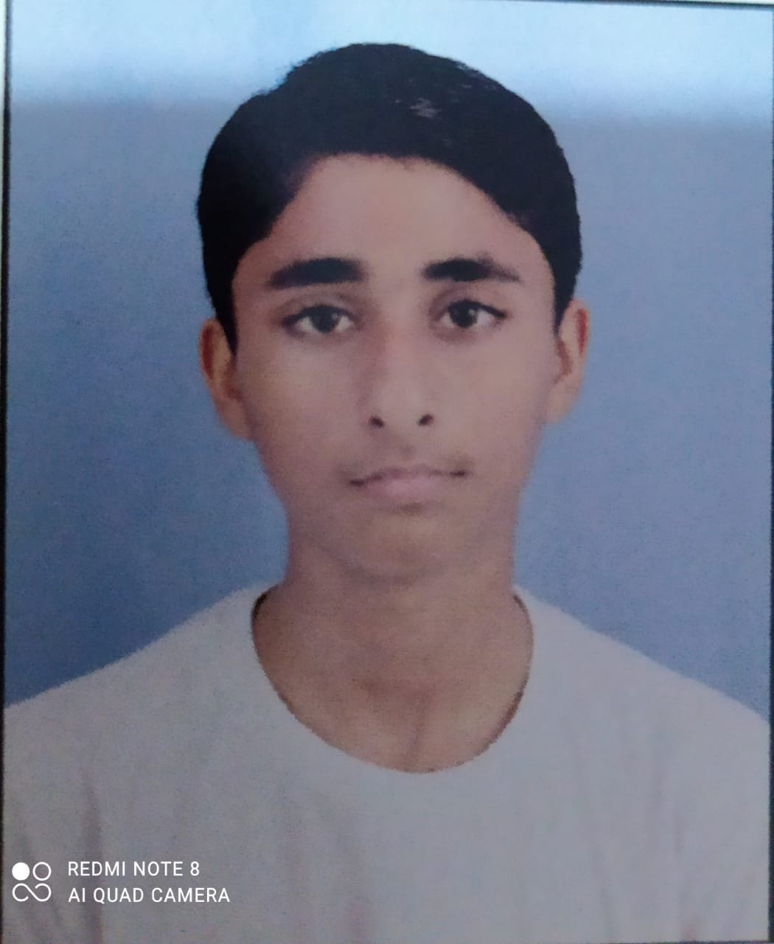
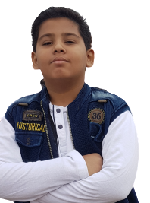
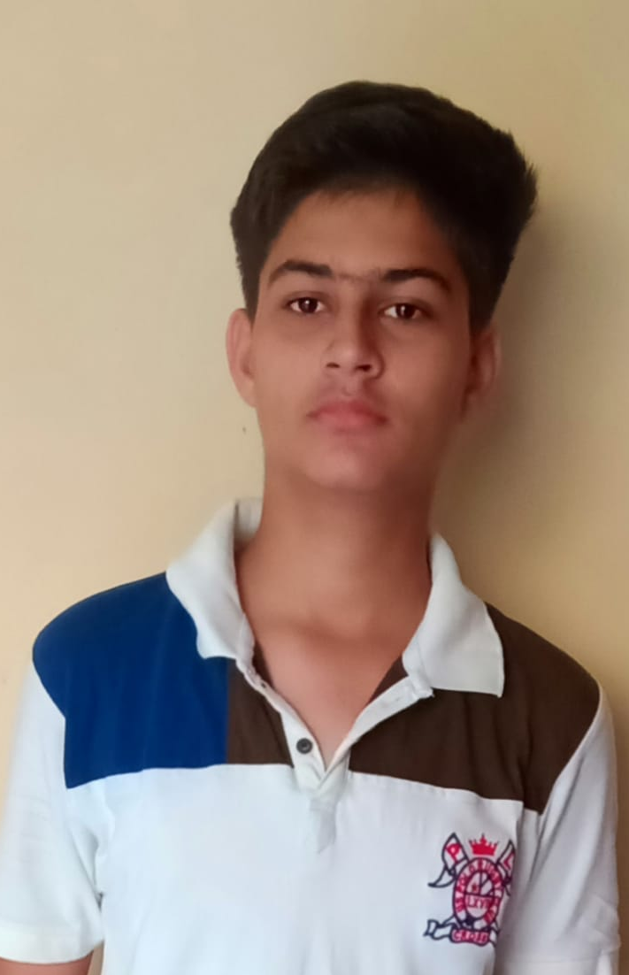
Team Details
Navacharaks - IRC Senior Team
Navdeep Rana
Class-9th
DAV Public School, Thermal Colony, Panipat
Pranshu Gahlawat
Class-9th
DAV Public School, Thermal Colony, Panipat
Lovish Narwal
Class-9th
DAV Public School, Thermal Colony, Panipat

Slide 3
What does IRC mean to us?
Why did we participated in IRC?
We participated in IRC because we wanted to test our Robotics and Programming Skills and also to gain some experience for real life problem solving.
How do we think IRC has helped us grow?
With the help of IRC we have learned different kind of programming methods like multiple line following. And also boosted up our interest in Avishkaar as well as Robotics.

Slide 4
My Team
Navacharak means Innovator in Hindi. Being Indian as Hindi is our national language So, we proudly call ourselves as Navacharaks and also kept the team name as NAVACHARAKS.So, it has a lot of significance for us.
Pranshu Gahlawat -- Team Leader
Lovish Narwal -- Lead Robot Builder
Navdeep Rana -- Lead Robot Designer
Our Coach AJAY Sir helped us in every aspect whenever we required irrespective of time. He mentored us and made us capable enough to complete IRC Tasks.

Slide 5
Robot Designing
Our Robot is quite durable as it is made up of metal parts and have proper axle-locks on the axles all thanks to our Lead Robot Builder(Lovish Narwal). The Mechanism used is simple and efficient.In the front, We have used a torque motor to rotate the arm up and down because we wanted to make it simple and steady.The design made is very optimized and compact as we have not used any unnecessary parts in it all thanks goes to our Lead Designer(Navdeep Rana).

Slide 6
Program Designing
Flow Chart is as follows:-
i)Follow black line stop at both color sensor yellow.
ii)Pickup block by following yellow line.
iii)Skip first green and on 2nd green drop the block.
Create it in loop along with variables changing on both sensor sensing black and both sensing green and when both sensing blue. It was the thoughts considered before making the program.
The Program made is very optimised as various variables and functions have also been made for easy code understanding and there a repeat while loop is used in which there is an if statement with many cases making it a very easy going code with an optimum use of variables, functions, if statements, color sensors,display and many more to keep the program simple and easy to understand all thanks to our Team Leader(Pranshu Gahlawat) who made it all possible.

Slide 7
Winning Strategy
Our Team is using the strategy of always caring one block in every time it switches its Social Bubble. Its help in doing it the fastest and always setting all the speeds of motors to high and obviously keeping it simple. It itself make it a lot faster.And we believe in winning the game with whole truthfulness and dedication.

Slide 8
Community Impact
IRC and our robot which we made had a great impact on our school and in our neighbourhood as the people around had changed their focus instead of watching tv, movies,etc. They are now building Robots and programming to Win which I think is a good sign for the Community. We have also built a Website for our team in which we have listed about our idea for the virtual world.
Website URL:-https://metpranshug.github.io/Navacharak/index.html

