Slide 1

DA 204o: Data Science in Practice Course Project Proposal Flight Price Prediction
Abhishek Kushary, abhishekkush@iisc.ac.in
Aju John Thomas, ajuthomas@iisc.ac.in
Taru Kaushik, tarukaushik@iisc.ac.in
Yuvasree Pamujula, yuvasreep@iisc.ac.in

Slide 2
Problem Definition and Data Overview
Problem Statement
The goal of this project is to predict flight ticket prices based on various factors such as departure and arrival locations, airlines, flight duration and other relevant features. Accurately predicting flight prices will help to understand and predict various factors (like distance, no. of stops, travel duration etc.) that can impact the fares of flight tickets and thus can help to plan accordingly.
Data source(s)
The datasets for this project are collected from Kaggle. The specific dataset contains historical flight prices, flight details, airport details and related features for flight price prediction.
This datasets is a CSV file where each row is a purchasable ticket found on Expedia pertaining to year 2022
Description of the data
The data sets includes features such as Flight Date, Starting Airport, Destination Airport, Travel Duration, Base Fare, Total Fare, Airlines IATA codes, IsRefundable, IsNonStop.
The overall size of the data set is 31.09 GB (currently we using subset of around 1.4 GB)
The original dataset is in CSV format and contains 27 columns which has ~6M unique values.
Airports dataset is used to convert the IATA code in the flight price dataset to get airport name and city name.

Slide 3
Tools and Models Used
Tools/Technologies used
Storage: Google Drive
Platform Used: Google Colab
Coding Languages: Python
Libraries: Pandas, NumPy, Matplotlib/Seaborn, Scikit-learn, xgboost, datetime, warnings
Overview of methods or models used
RandomForest: Enhances model training by reducing overfitting and improving accuracy
XGBRegressor: Efficiently handles large datasets and improves prediction accuracy through gradient boosting
Justification for choosing the final model
XGBRegressor: Based upon comparison of different models used, XGBRegressor was selected for further hyperparameter tuning and cross-validation, as it was observed to be giving better score on evaluation metrics, essentially the R2 score.

Slide 4
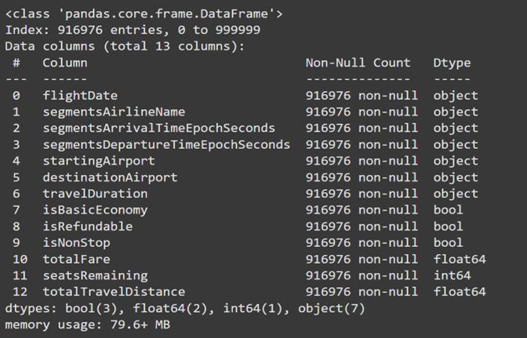
Implemented Methodology
Data Collection
Flight details and Airlines datasets collected from open source Kaggle datasets
Ensured that the data is sufficient and represented different features such as flight routes, airlines, Stops, Distance, Duration etc.
Out of ~6M records and 27 columns, the selected Data frame includes 1M samples and 13 relevant columns, which are used for further data preprocessing, EDA, training and prediction for implementation.

Slide 5
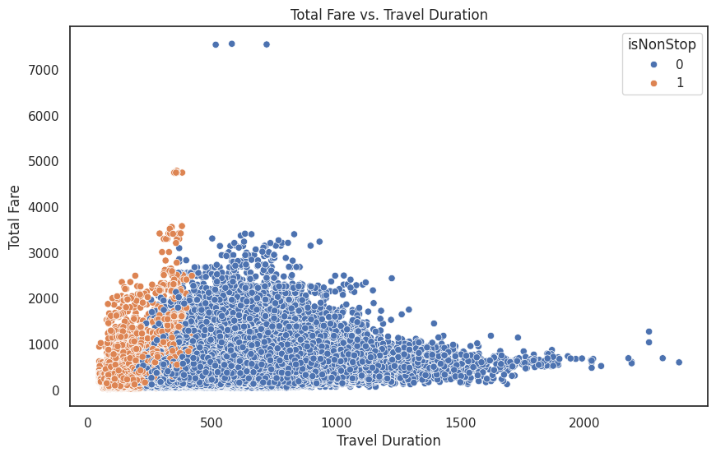
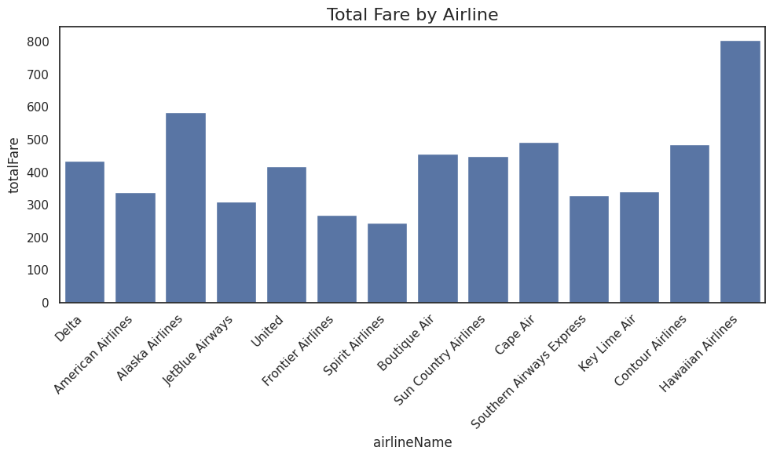
Implemented Methodology
Data Preprocessing
Handling Missing Data for Numerical columns and categorical columns
Removing duplicate values
Datatype conversion from Boolean to integer
Datetime conversion to separate columns for day, month, year and hour
Encoding Categorical Features
Standardization – Handling Skewness and Outliers
Exploratory Data Analysis
Longer flights tend to be more expensive
Most tickets are for one-stop journeys
‘totalFare’ is impacted by ‘totalTravelDistance’ and ‘numberOfStops’

Slide 6
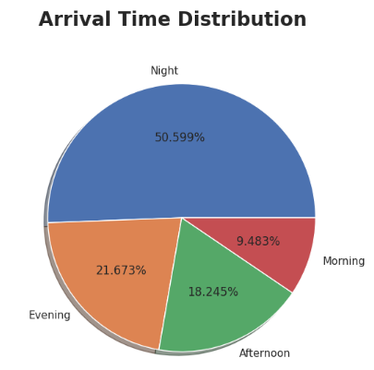
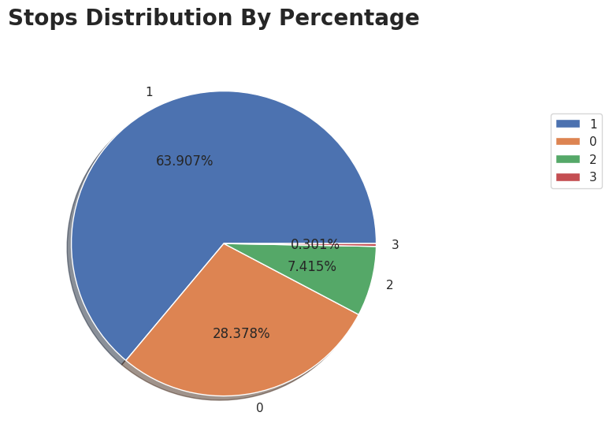
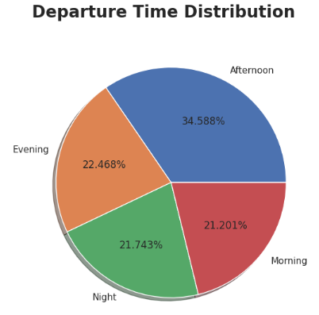
Implemented Methodology
Feature Engineering
Encoded categorical columns using the get_dummies function and dropped the original categorical columns
Redundant data and irrelevant features removed to prepare the final dataframe for model training
Categorization of features to add new features to help in model training
New features created - ‘season’, 'arrives’ and 'departs’

Slide 7


Implemented Methodology
Model Building
Used RandomForest and XGBRegressor model to train the data
Compared both models and the best-performing model XGB selected for further fine tuning
Outlier capping and skewness handling of data was ensured to enable model training on standardized data
Performed hyperparameter tuning to optimize model performance by using RandomizedSearchCV with the XGBRegressor model
Model Evaluation
The models were evaluated and compared using metrics - MSE, MAE, R-squared.
Cross-validation and evaluation of the CV scores also shows model performance to be robust and in-line with the model metrics observed.

Slide 8
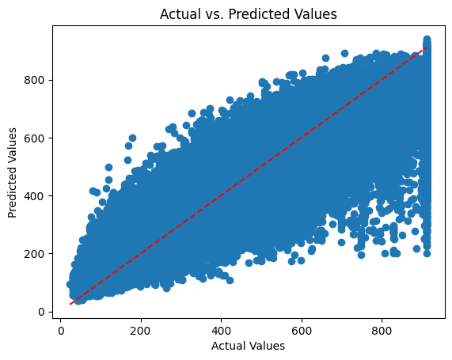
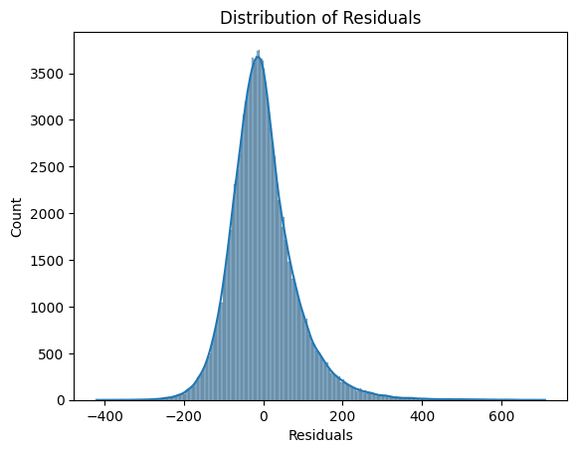
Evaluation Score
Comparison of Model 1 and Model 2
Error Metrics: Model 2 has a significantly lower MSE (8307.88 vs. 15020.32) and MAE (67.37 vs. 79.10) compared to Model 1. This indicates that Model 2’s predictions are generally closer to the actual values.
R-squared (R2): The R² value for Model 2 (0.7635) is higher than that of Model 1 (0.6624). This suggests that Model 2 explains a greater proportion of the variance in the dependent variable, indicating a better fit.
Cross-Validation MSE Scores: The cross-validation MSE scores for Model 2 are quite consistent, with a mean of 8386.32. This consistency suggests that Model 2’s model is robust and performs reliably across different subsets of the data.
Overall, Model 2 outperforms Model 1 across all key metrics, making it the better model for predicting flight delays. The lower error metrics and higher R² value indicate more accurate and reliable predictions.

Slide 9
Challenges and Mitigation Plan
Challenges Observed
Handling of large dataset handling
Identifying most suitable features which influence the target prices.
Identifying the best matched algorithm to train the model for achieving maximum accuracy.
Difficulty in running Ensemble model due to limited compute power in Google Collab
Mitigation undertaken
Subset of dataset (1M records) out of ~6M considered for further preprocessing
Implemented the correlation matrix and feature importance for feature selection to identify the important features for the target price. Also created new features to help in model training process
Performed the accuracy prediction testing on different models and selected the best suited algorithm for further training and fine-tuning the model.

Slide 10
Key Observations and Outcome
The analysis compares two models for predicting flight fares - RandomForest and XGBRegressor
The initial XGBoost model had better performance than the Random Forest regressor.
After outlier handling, XGBoost's performance further improved.
The final XGBoost model showed good performance with an RMSE of 91.58, an R-squared of 0.76, and consistent cross-validation scores.
The model is considered reliable in predicting flight fares within a reasonable range of error.
Links to Original Data Source:
Flight Dataset [Kaggle]
Airports Dataset [Kaggle]
Detailed project report with complete code repo is available on GitHub:
https://github.com/metricMastersData/DSP_Project

Slide 11
Data Science Canvas |  |  | Project: | Flight Price Prediction
 |  |  | Team: | Abhishek Kushary, Aju John Thomas, Taru Kaushik, Yuvasree Pamujula
Problem Statement |  |  |  | Execution & Evaluation |  | Data Collection & Preparation
Business Case & Value Added Which business case should be analyzed and what added value does it generate? The goal of this project is to predict flight ticket prices based on factors like travel distance, number of stops and airlines. Accurately predicting flight prices will help to understand and predict various factors which impact the fares of flight tickets and thus can help to plan ahead accordingly. | Model Selection Which analysis methods can be considered on the basis of the specific data landscape and the business case? Random Forest Regressor XGB Regressor Final Model selected: XGB Regressor, basis score of evaluation metrics | Model Requirements Which model requirements must be complied with in order to obtain a valid model? Data preprocessing Feature Selection Feature Engineering Choice of algorithm Model Training Hyperparameter tuning Cross validation Model evaluation Residual analysis Visualization/EDA | Skills What skills are needed to provide the data and model development? Python Programming Data Wrangling Machine Learning Data Visualization | Model Evaluation Which indicators require quality control and validation and how should they be interpreted? Is real-time monitoring necessary? Evaluation metrics (MSE, MAE and R2) used to evaluate model prediction performance. R2 score provides major insights in determining the overall accuracy of the model in predicting flight fares. | Data Storytelling What requirements does the target group have for the presentation of the results and how do I effectively communicate this data? Visualizing tools like Correlation matrix, Bar plots, Histogram Scatter plots and Pie Charts have been used to effectively understand the data, present data features and identify correlations among them. Correlation matrix and feature importance visualizations show ‘totalTravelDistance’, ‘numberOfStops’ and ‘isBasicEconomy’ have major impact on target variable ‘totalFare’ | Data Selection & Cleansing Which of the available data is relevant? Do the data have to be cleaned up? Data selection: Subset of dataset (1M records) out of ~6M considered for further preprocessing Data cleaning: Performed by handling duplicate records and null values. | Data Collection How and with which methods should additionally required data be collected? What properties has this data to fulfil? No additional data source is used. Only Kaggle has been used to collect open-source datasets. Flight Prices (kaggle.com) Predicting flight delays [Tutorial]
Data Landscape Which data is required for this and which is already available? Which additional data has to be collected? Both datasets for this project are collected from Kaggle, and contain historical flight prices, Airline, flight details, and related features for flight price prediction. Flight Prices (kaggle.com) Predicting flight delays [Tutorial] |  | Software & Libraries Which software should be used? Is there already a standard solution? Which libraries are used? Notebook used: Google Collab Data Storage: Google Drive Libraries: Pandas, numpy, matplotlib, seaborn, sklearn |  |  |  | Data Integration In which system should the data from different sources be migrated? Google Drive used for data storage, which is further imported and analysed in Google Collab. | Explorative Data Analysis Are there outliers or structures to be considered? Creation of descriptive key figures for the first assessment of the data. Outlier and skewness were observed and finally handled using Outlier capping.

