Slide 1
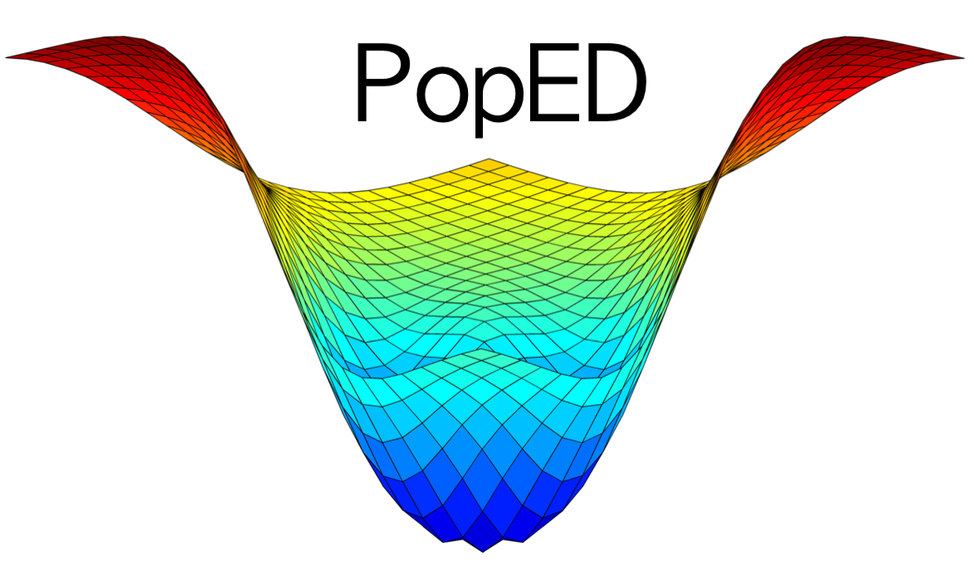


*We are not affiliated, associated, authorized, endorsed by, or in any way officially connected with PopED, or any of its subsidiaries or its affiliates.
*Only Kyle is affiliated, associated, authorized, endorsed by, or in any way officially connected with mrgsolve, or any of its subsidiaries or its affiliates.

