Slide 1

Cloud Foundry

Slide 2
What is it?
Open Source cloud computing platform (PaaS)
can be deployed on many infrastructure platforms:
  AWS
  Azure
  OpenStack
  VMware
  local (vagrant)

Slide 3
Language support
supports multiple languages:
  Java
  Ruby
  Node.js
  Go
  PHP
  Python
  static files
support is provided by buildpacks

Slide 4
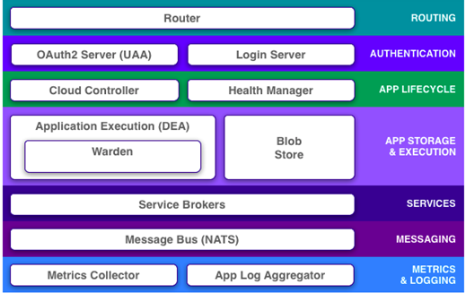
Platform components

Slide 5
PoC Cloud providers
Pivotal
  PCF (Pivotal Cloud Foundry) running on AWS
IBM
  Bluemix public cloud (large shared public env)

Slide 6





Demo setup
github
git clone
PCF
config service
app
jenkins
cf push
mysql
artifact (jar)
autoscale
bintray
git push
manual:
cf push
cf scale
cf stop/start

Slide 7
demo

Slide 8
demo
#prepare:
cf delete -f testapp1
cf delete-route -f apps.pcfnl.examples.cf --hostname testapp1-4712
sudo /etc/init.d/mysql start
#demo:
cd ~/workspace/testapp1
git pull
mvn clean spring-boot:run
# test on http://localhost:8080
mvn -Dmaven.test.skip package
ls -lh target
export CF_HOME=~/.cf_pcf && cf login -a https://api.system.pcfnl.examples.cf -u harry -p `cat ~/cf/pcf.pw` -o rabobank-org -s sandbox
cf push testapp1 --no-manifest --no-start -m 768M -k 512M -i 1 -b java_buildpack_offline -p target/testapp1-0.1.1.jar --hostname testapp1-4712
cf marketplace
cf service testapp1-db
cf bind-service testapp1 testapp1-db
cf bind-service testapp1 cfg-server
cf bind-service testapp1 srv-reg
cf logs testapp1 (in another terminal)
cf start testapp1
cf routes
# ==> show URL
cf scale testapp1 -i 4
cf app testapp1
#cleanup
cf delete -f testapp1 && \
cf delete-route -f apps.pcfnl.examples.cf --hostname testapp1-4712 && \
cf logout

Slide 9

Questions ?

