Slide 1

角色协同计算与院校建设社会仿真 RBC and its Social Simulation w.r.t College Construction
刘冬宁 博士/教授
广东工业大学 计算机学院
2021年7月5日

Slide 2

Outline
Collaboration
Role-Based Collaboration
The E-CARGO Model
Role Negotiation & Agent Evaluation
Group Role Assignment
Case Study

Slide 3
Nature of Collaboration
Task distribution
Task specification, Agent evaluation, Task assignment, Optimization.
Task execution
Process, Sharing, Negotiation, Interaction, Coordination, Decision making.
The paid effort:
Task Distribution
Task Execution
Task Distribution
Task Execution

Slide 4
Outline
Collaboration
Role-Based Collaboration
The E-CARGO Model
Role Negotiation & Agent Evaluation
Group Role Assignment
Case Study

Slide 5
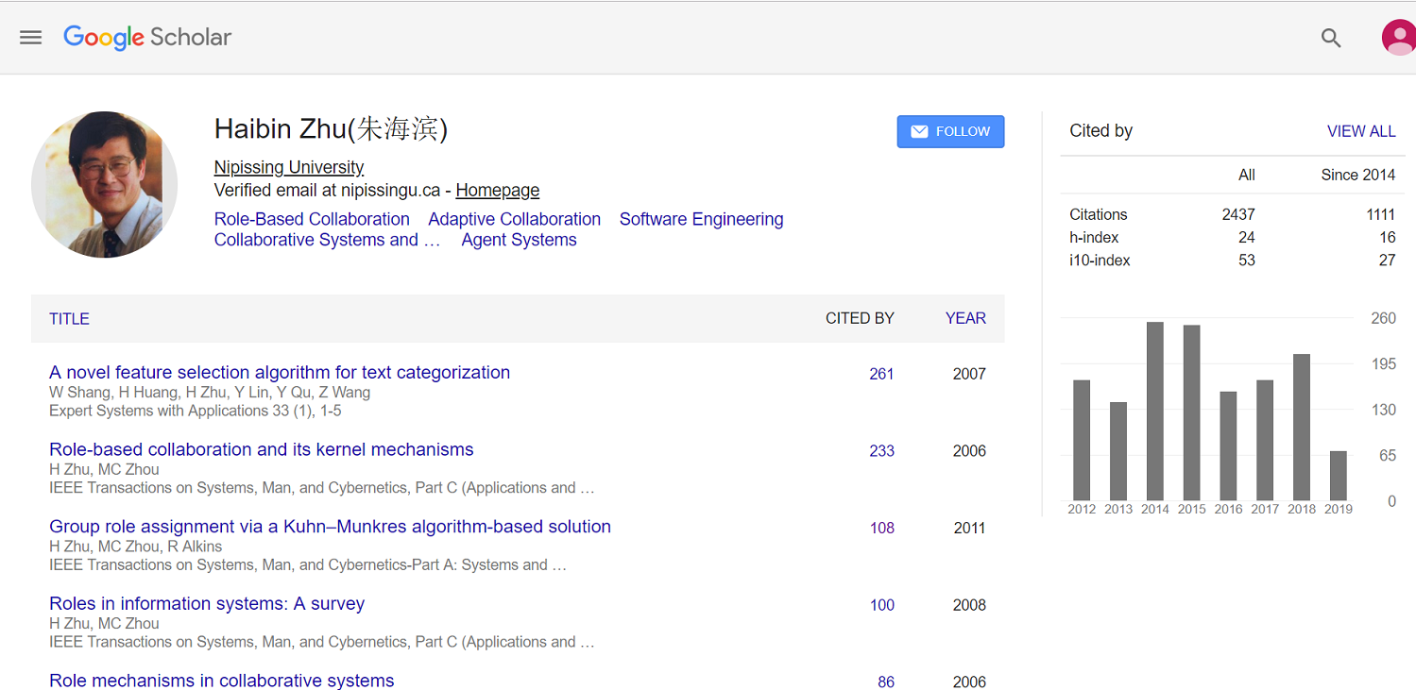
Role-Based Collaboration (RBC)
基于角色的协同，简称“角色协同”，又称角色协同计算

Slide 6
What is Role-Based Collaboration?
“名不正，则言不顺；言不顺，则事不成。”
“Ming bu zheng, ze yan bu shun; yan bu shun, ze shi bu cheng”.
——《论语 • 子路》卫君待子而为政
“君君臣臣，父父子子。 ”
“Jun Jun, Chen Chen, Fu Fu, Zi Zi”.
——《论语 • 颜渊》齐景公问政
为什么要引入角色？怎样引入角色？

Slide 7
Procedure of Role-Based Collaboration
Distribution
Initiation
Communication
Goal setting
Information sharing
View sharing
Coordination
Resource management
Conflict resolution
Evaluation
Decision making
Execution

Slide 8
Outline
Collaboration
Role-Based Collaboration
The E-CARGO Model
Role Negotiation & Agent Evaluation
Group Role Assignment
Case Study

Slide 9
The E-CARGO Model
∑ ::= <C, O, A, M, R, E, G, s₀, H>
Environments
Classes
Agents
Roles
Groups
Objects
Object-Oriented
Agent-Oriented
Role-Based
面向对象 → 面向Agent → 基于角色的协同

Slide 10
Symbols
m – the number of agents
n – the number of roles
Q – the matrix of agent evaluation
L – the vector of lower ranges of roles (L & U)
W – the vector of weights of each role
T – the assignment matrix

Slide 11
Outline
Collaboration
Role-Based Collaboration
The E-CARGO Model
Role Negotiation & Agent Evaluation
Group Role Assignment
Case Study

Slide 12
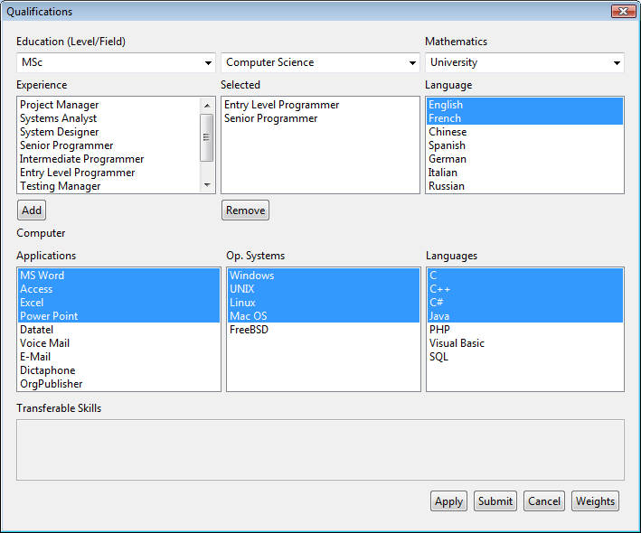
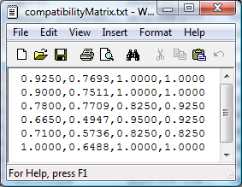
Agent Evaluation

Slide 13
Outline
Collaboration
Role-Based Collaboration
The E-CARGO Model
Role Negotiation & Agent Evaluation
Group Role Assignment
Case Study

Slide 14
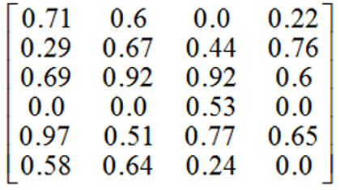
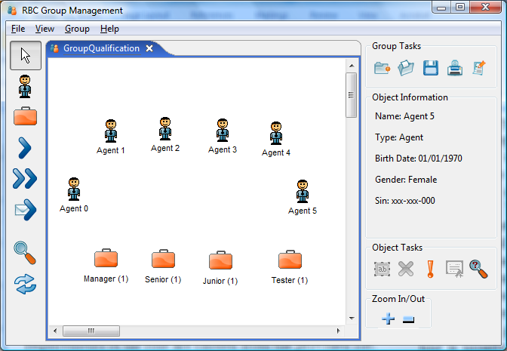
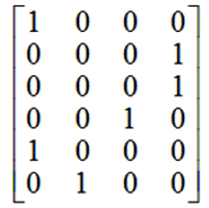
Outline
Assumed that L = [2, 1, 1, 2]
匈牙利算法、混合整数规划算法、多对多指派算法等

Slide 15
报告提纲
Collaboration
Role-Based Collaboration
The E-CARGO Model
Role Negotiation & Agent Evaluation
Group Role Assignment
Case Study

Slide 16
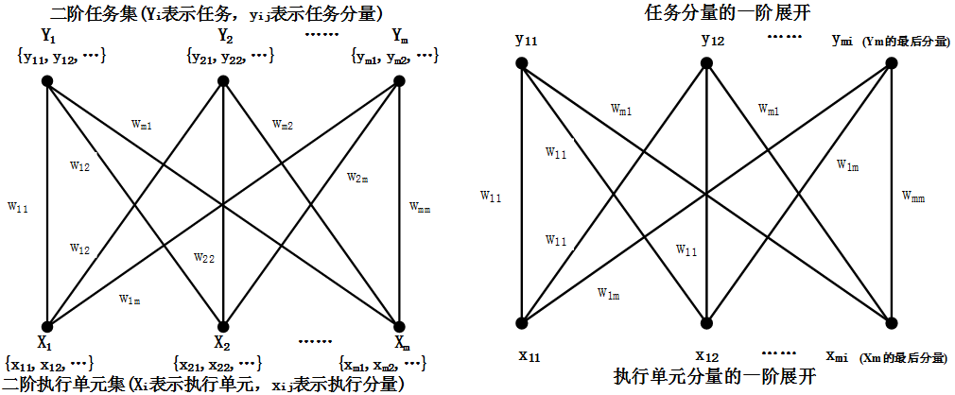

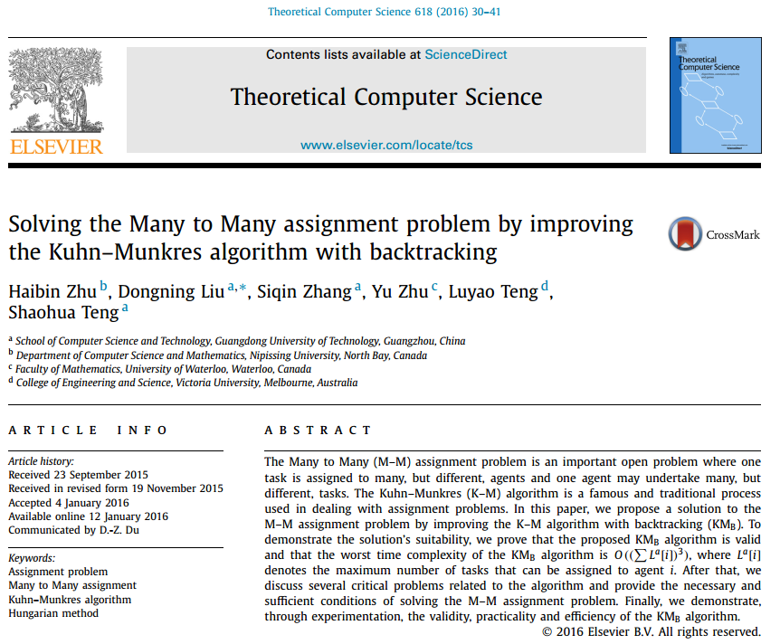
Papers
Theoretical Computer Science、IEEE TCYB/TSMC/TASE/TCSS

Slide 17


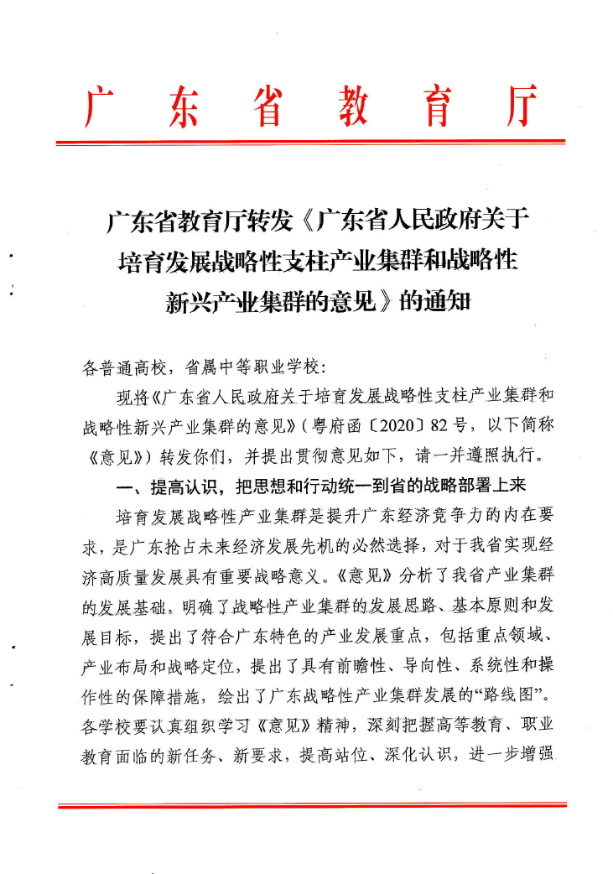
New Case
一所高水平大学，学校投入是什么样的？期求什么的结果？能仿真吗？
院校建设：学生培养、科研成果、服务社会
学生培养：见就业年报，包括就业起薪、区域等
科研成果：论文、专利、基础研究性课题
服务社会：科技计划类课题、横向课题及成果转化
科学假设：
每一部分归一化到（0,1）空间，设立三个参数{α，β，γ}对应三项输出；
假设学校当前的分配是对学校最有利的，反向计算出{α，β，γ}取值，反推学校类型和建设意图；
科学判断：
{α，β，γ}取值变化对学校建设的影响
与《广东省XXX意见》吻合程度及动态调整影响
算法仿真与可视化分析—对学校建设、学院建设建言荐行

Slide 18
The End
路漫漫其修远兮
吾将上下而求索

