Slide 2
Dimensionality reduction of waveform data from test processes for health state evaluation
department of Applied Mathematics, Computer Science and Statistics
Dylan Meysmans

Slide 3
INTRODUCTION
Data
Problem statement
Research objectives
Notes:
Data on 35 bar proportional valves from an automotive supplier company
The valves are to be mounted in more complex hydraulic subsystems of a dual-clutch transmission (DCT)
They contain a solenoid: to open and close them, a current is sent through the coil
Tested on a test bench, we focus on the current sweep test here
Sensor waveforms are logged for pressure, current, temperature...
Scalar values extracted by software specified by product and process engineers (domain experts) and implemented by software engineers
Problems: man hours for product and process engineers and software engineers and rigidity of ad hoc algorithms, both are financial losses for the company

Slide 4
RelATED wORK: Relational Database Management Systems
Keys
Indices
Normalization
Notes:
CSV or TSV files, while popular with statisticians, are lacking for large data sets (depend on OS or file system for search facilities) and for high-dimensional data (vector-valued fields)
No mention of relational database management systems in the Statistical Science major of the programme, so relevant here
Both keys and indices help us address
Superkeys are columns in the data on which the data is functionally dependent, we can construct a function from the key to the data
A candidate key is a minimal superkey, it uses the least amount of fields
Multiple overlapping candidate keys can exist
The primary key is the candidate key which we choose for our data
Natural keys are keys present in the data, as opposed to surrogate keys
Indices, commonly implemented as B+-trees (R-trees, space-partioning trees… are used for specialized use cases) or hash tables
Indices based on B+-trees support comparison and equality constraints
Normalization of the data avoids various anomalies associated with updating and deletion of data

Slide 5
RelATED wORK: TIME Series
Dimensionality reduction
Classification
Notes:
Note: the pressure waveforms are not stationary time series => often assumed in statistical analysis of time series and sometimes in digital signal processing
High-dimensional data, waveforms have 30,000 data points => dimensionality reduction
More valves than data points per waveform, so possible without dimensionality reduction
Ridge regression
Least absolute shrinkage and selection operator) (LASSO) regression
Elastic net regression
All 3 require hyperparameter tuning, for instance via cross-validation
Principal components analysis: maximizing variance in a lower dimension, related linear discriminant analysis (Fisherian, more stringent assumptions such as multivariate normality)
Spectral decomposition methods: DFT (assumes stationarity), short-time DFT, wavelet transform
Piecewise linear approximation through sliding window, bottom-up segmentation, top-down segmentation => hyperparameter: number of segments has to be known in advance
Matrix profile: sliding window Euclidean distances => motifs have a near neighbour, discords do not
Second inspiration: classification
Based on dimensionality reduction: matrix profile regression
Directly: shapelets, subsequences of time series which allows us to best discriminate between classes
Shapelet learning

Slide 6
RelATED wORK: Software
PostgreSQL
NumPy, Pandas, SciPy, statsmodels, Scikit-learn, Tslearn
Matplotlib, seaborn, Plotly
Notes:
PostgreSQL is the only free and open-source RDBMS which has an array column data type
It transparently (no manual intervention) compresses large columns, relevant for 1.7 TB of data
It can both statically (before execution) and dynamically (during execution) analyze resource consumption for query plans, useful for deciding whether to create indices or whether to partition tables
While R is popular within the programme, the research group of Prof Van Hoecke primarily uses Python (when in Rome, do as the Romans do)
Statsmodels, Scikit-learn, and Tslearn depend on NumPy for multidimensional arrays, Pandas for data frames, and SciPy for numerical mathematics

Slide 7
Data Preparation: ingestion, Cleaning, AND Sampling
Flat files
File server
Relational database
Missing values

Slide 8
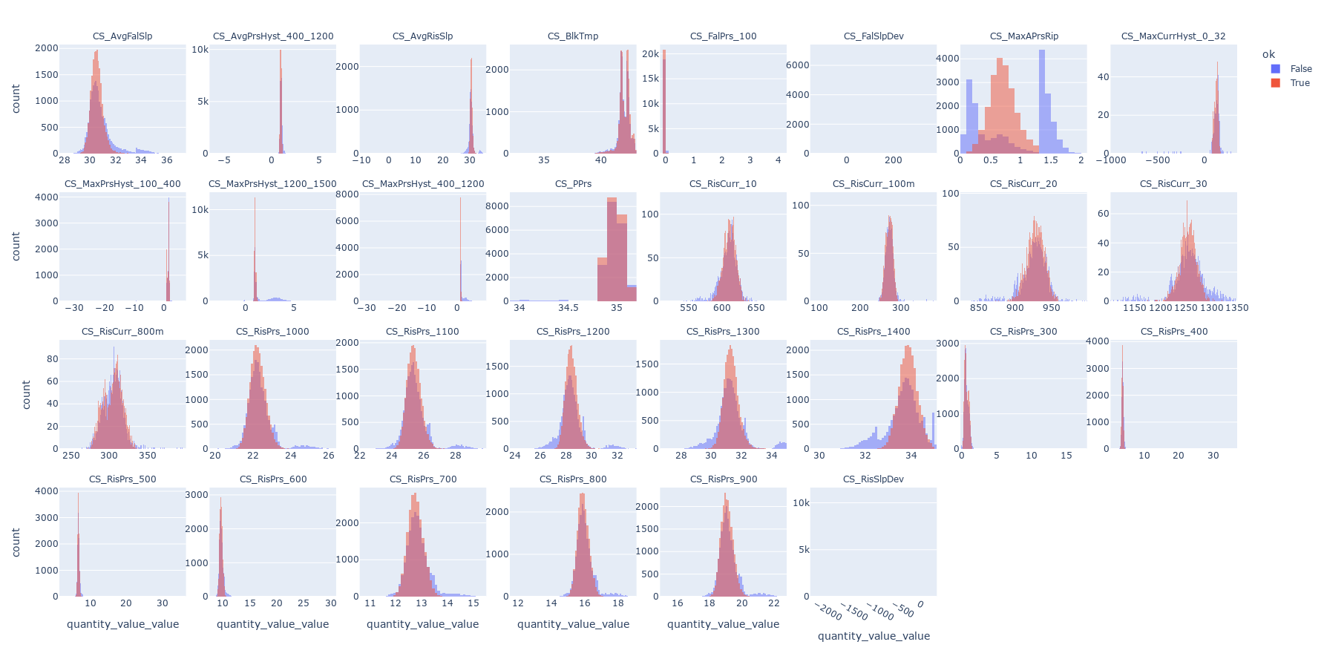
Data Preparation: VISUALIZATION

Slide 9
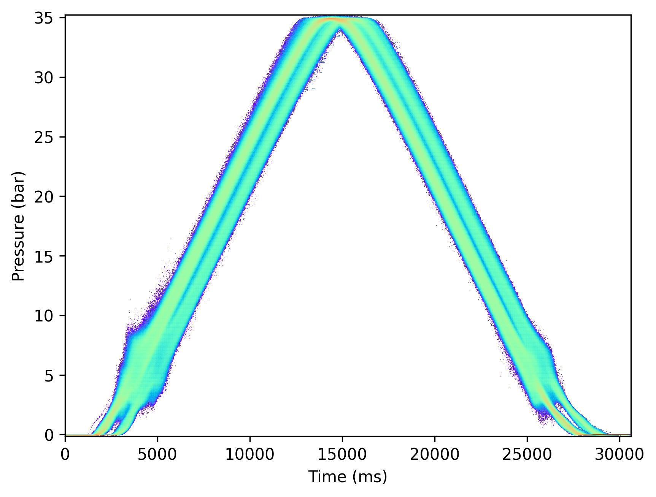
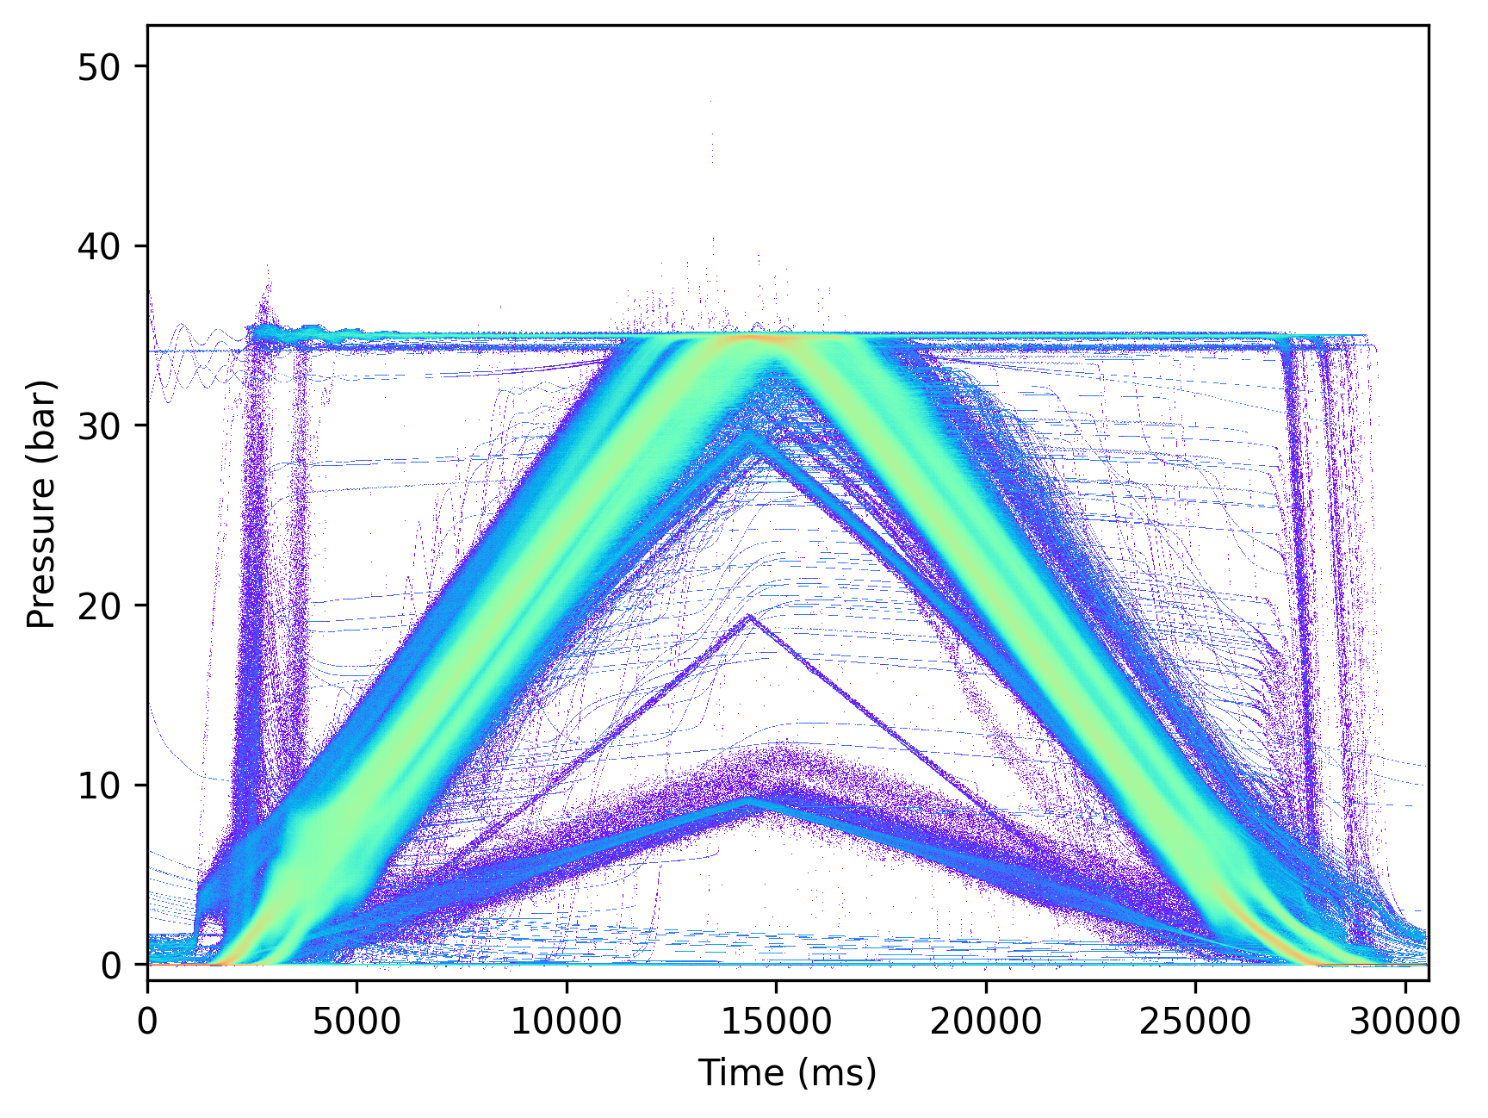
Data Preparation: VISUALIZATION

Slide 10
MULTIPLE LOGISTIC REGRESSION ON sCALAR vARIABLES
Manual variable selection by domain experts
Risk of multicollinearity
AIC and VIF stepwise regression with forward variable selection
Elastic net regression

Slide 11
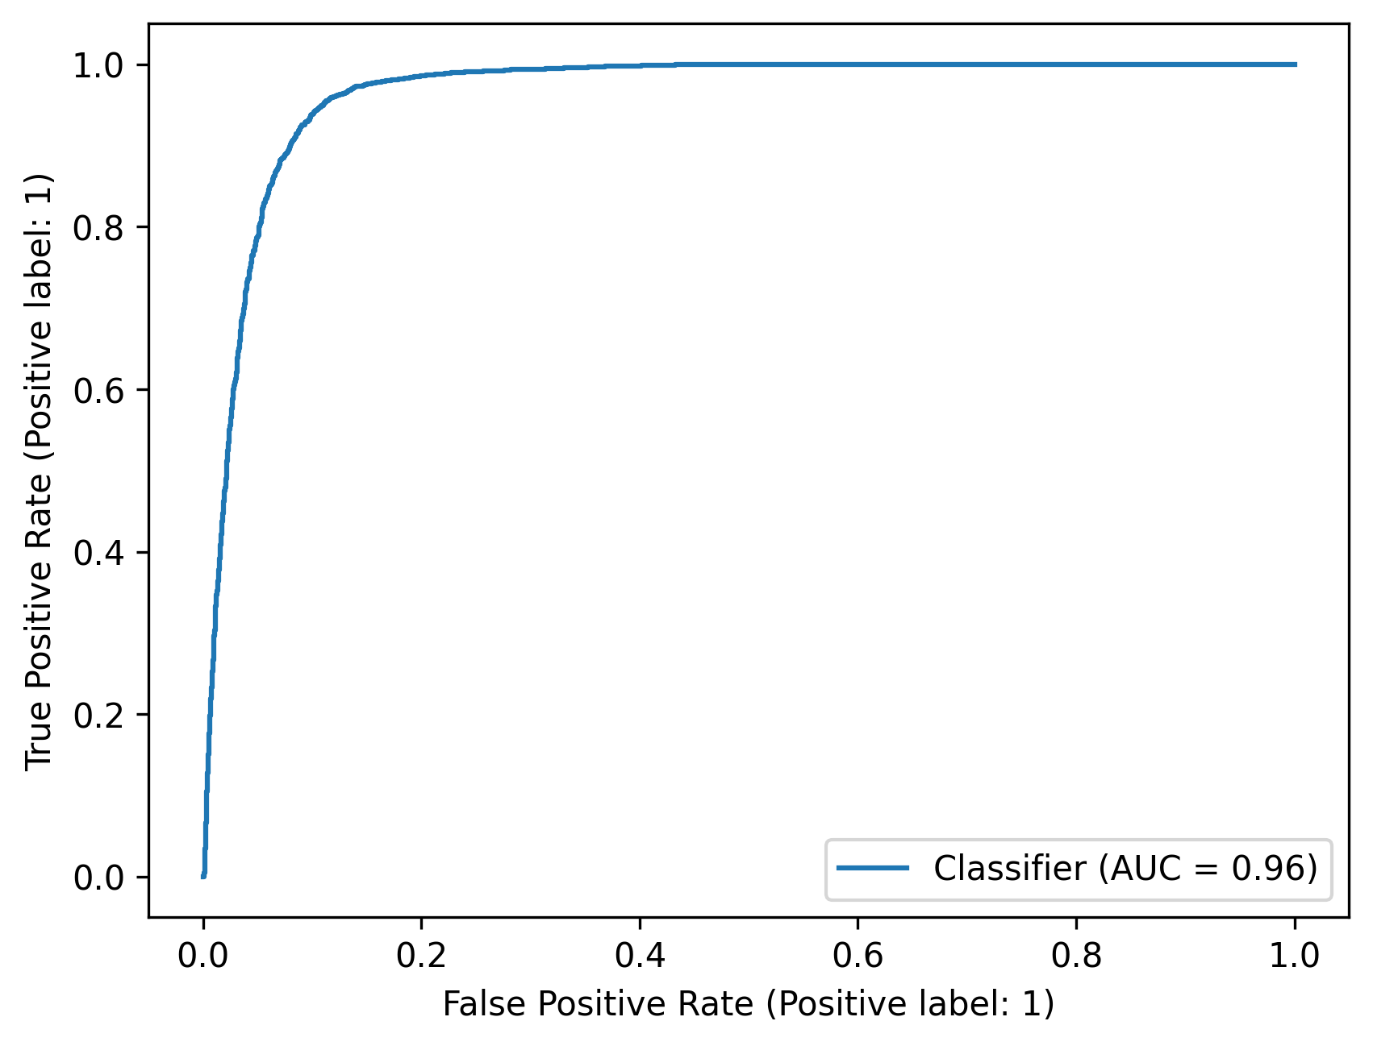
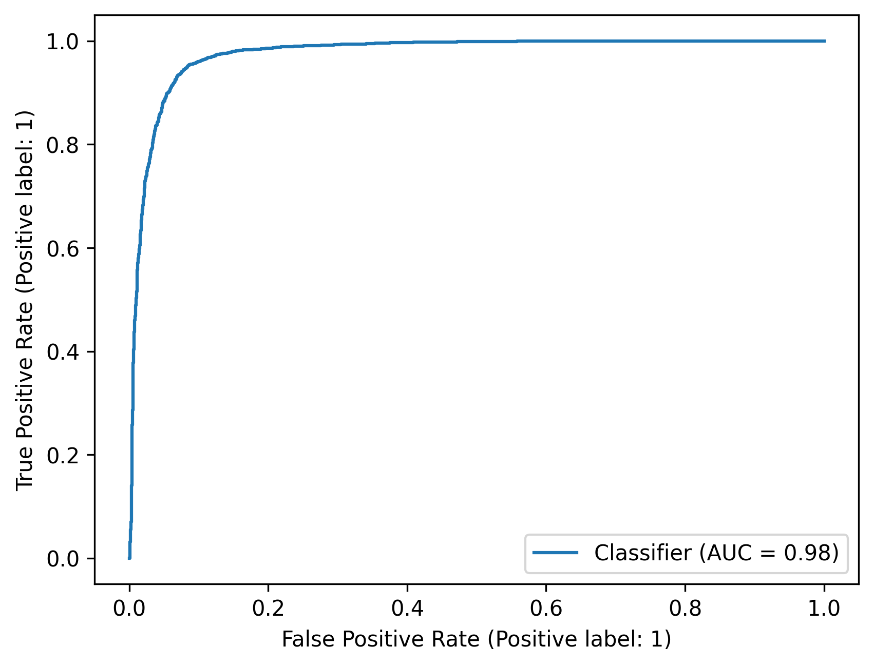
Multiple logistic regression on scalar variables

Slide 12
Motif and discord Logistic regression on sensor waveforms
Motif and discord voting
Multicollinearity risk: elastic net regression
Manual hyperparameter tuning

Slide 13
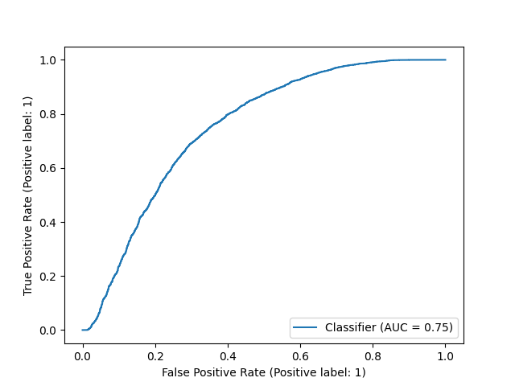
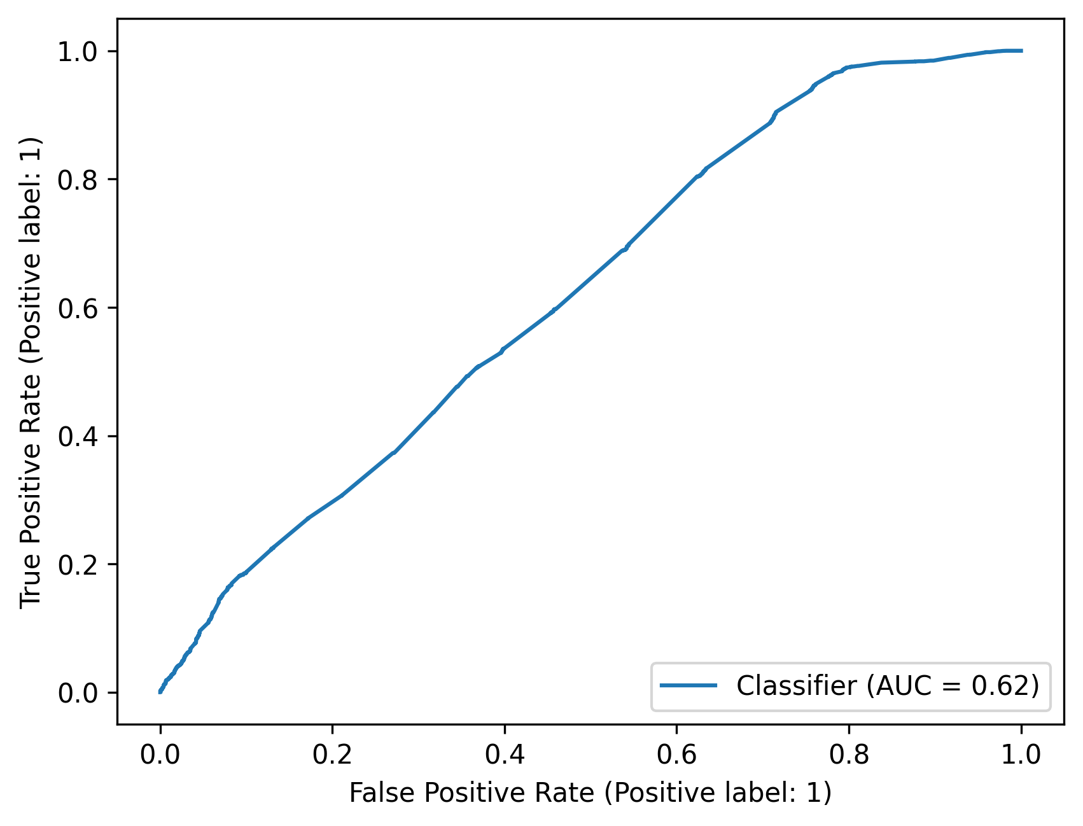
Motif and discord Logistic regression on sensor waveforms

Slide 14
LEARNING sHAPELETS FROM SENSOR wAVEFORMS
Manual hyperparameter tuning
Space-time tradeoff: batching

Slide 15
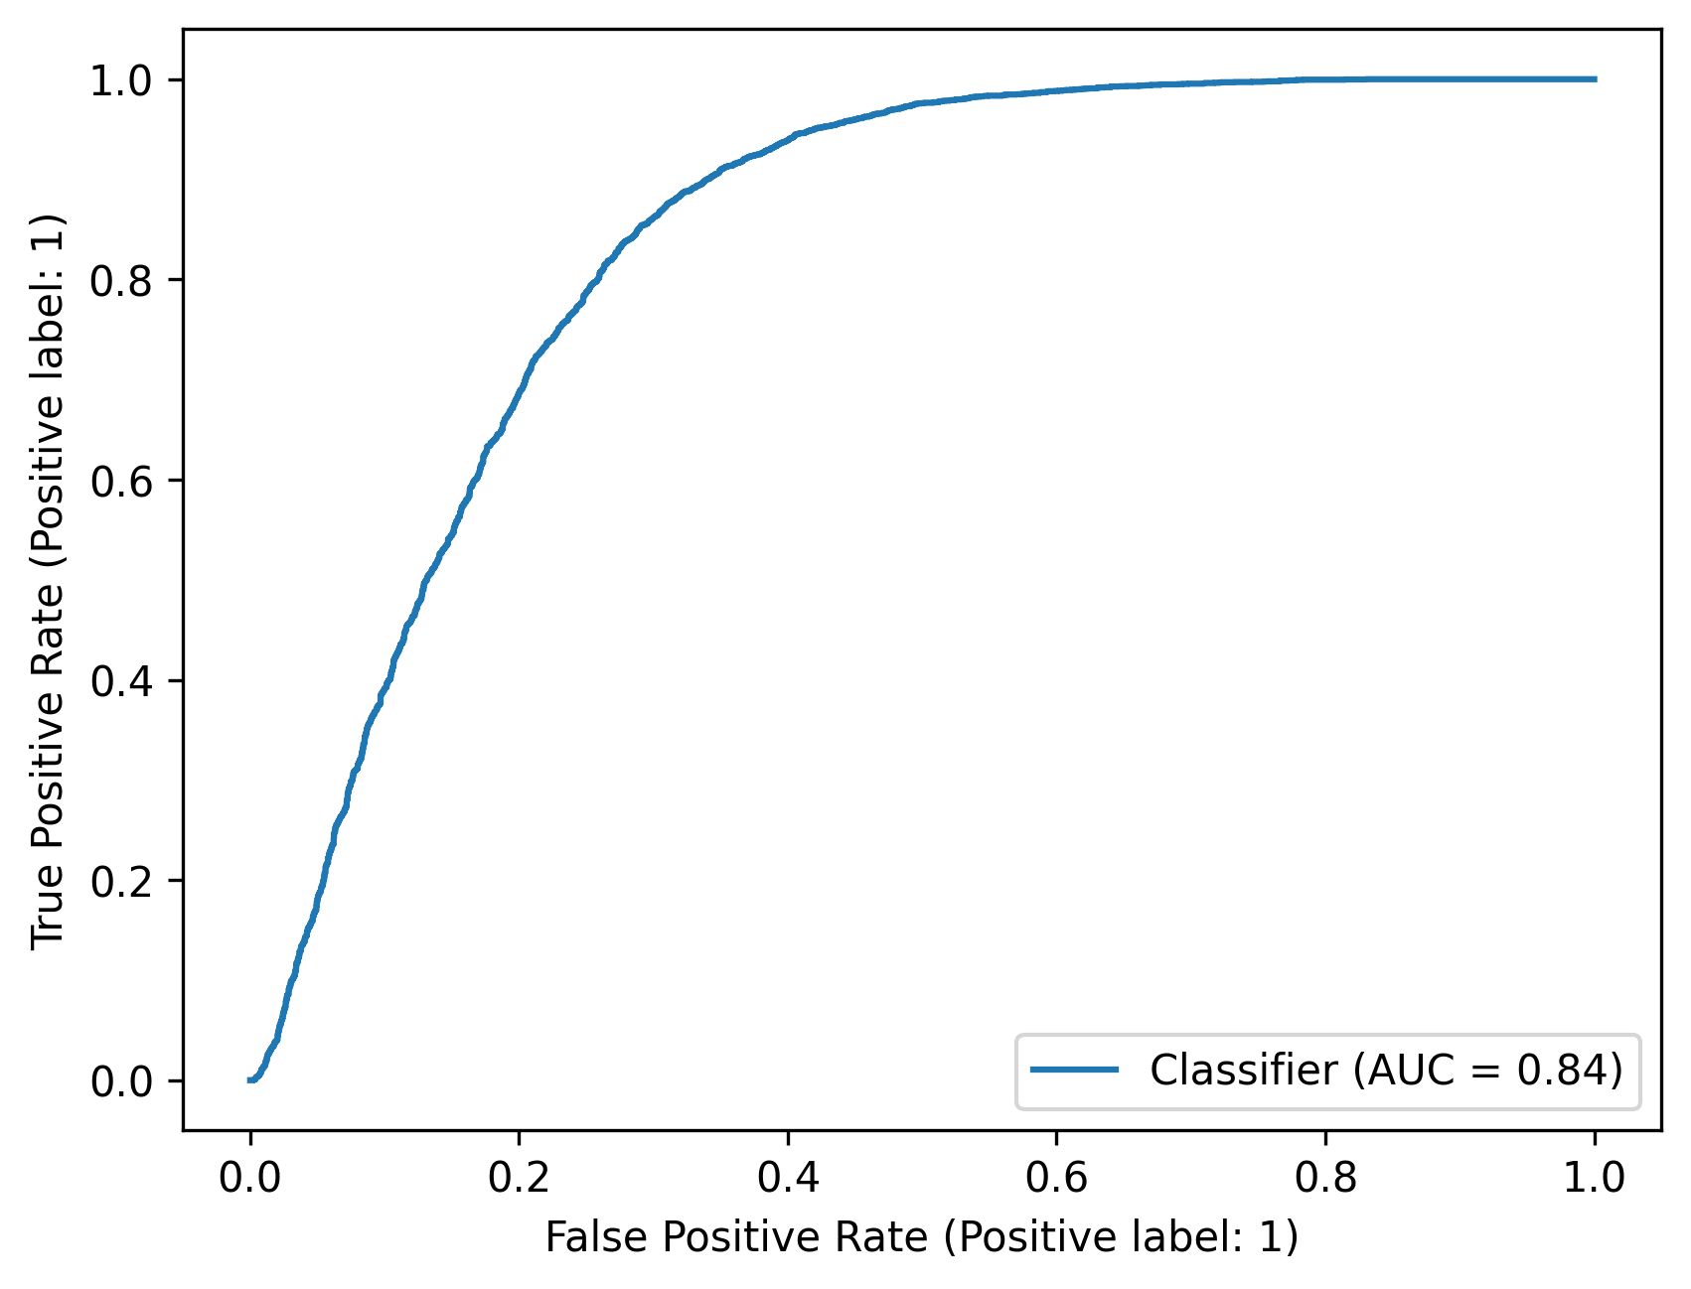
LEARNING sHAPELETS FROM SENSOR wAVEFORMS

Slide 16
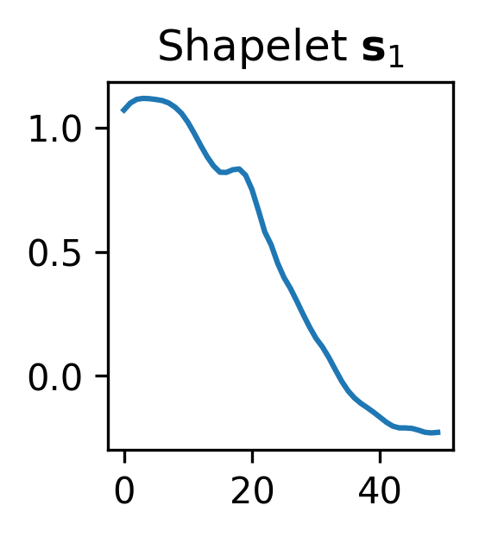
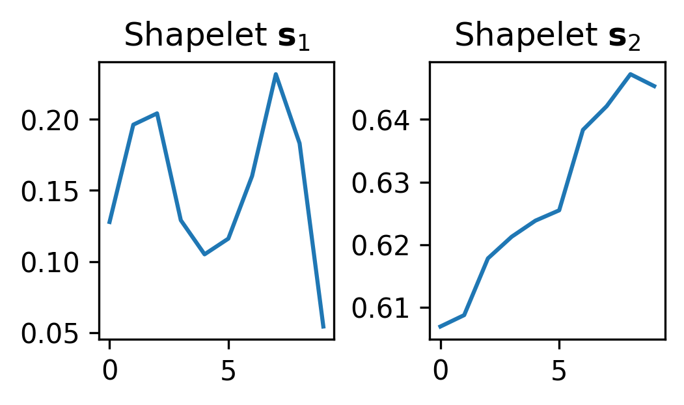
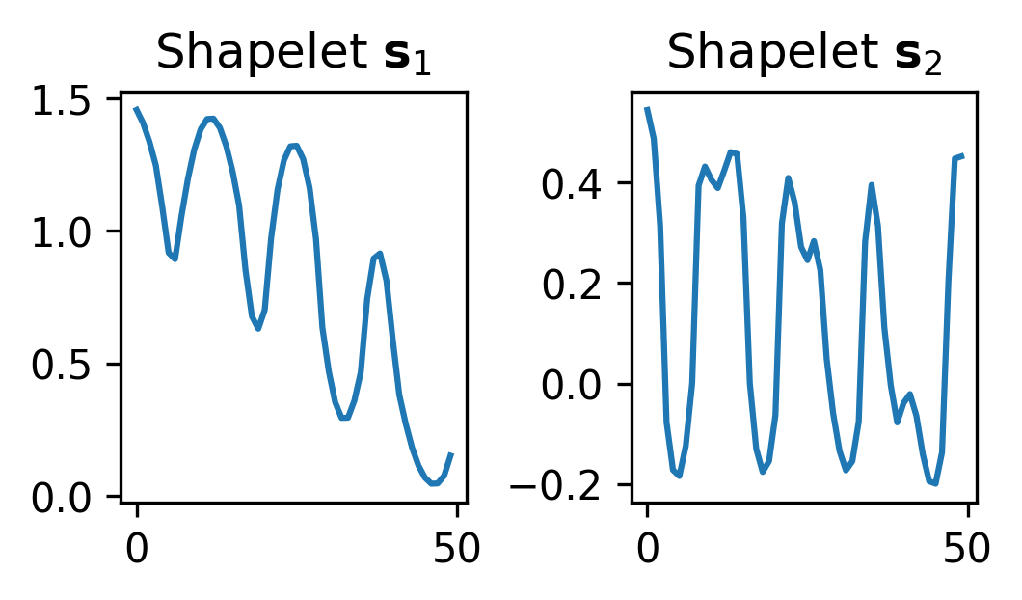
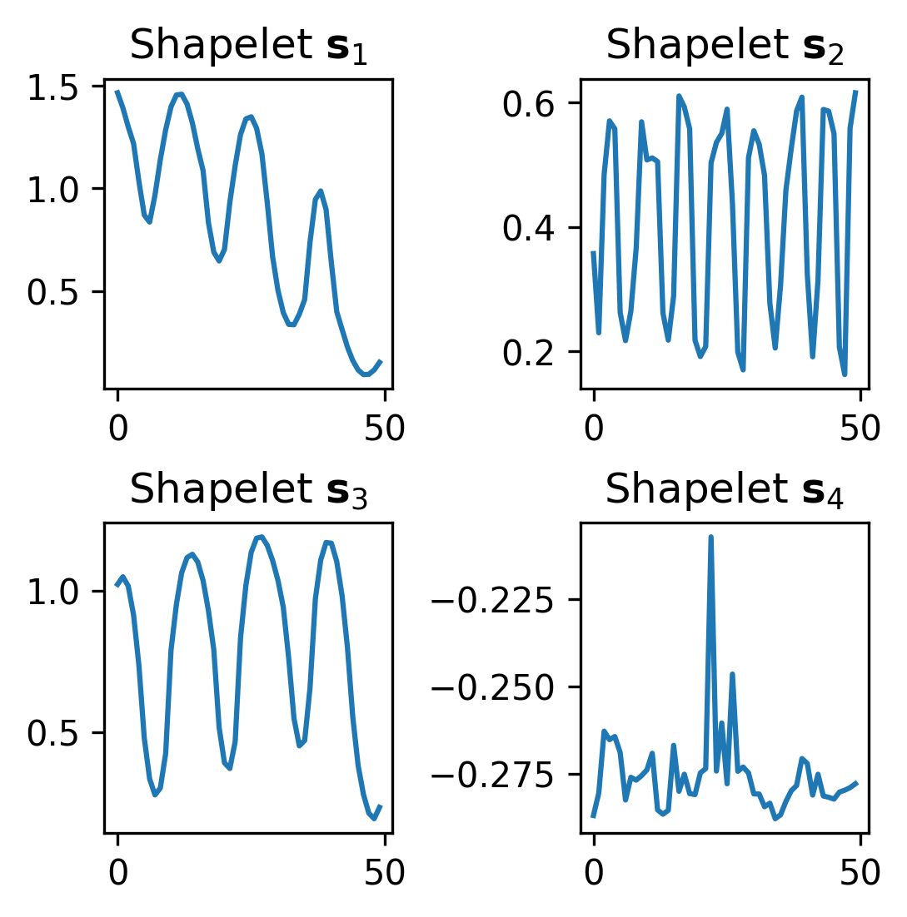
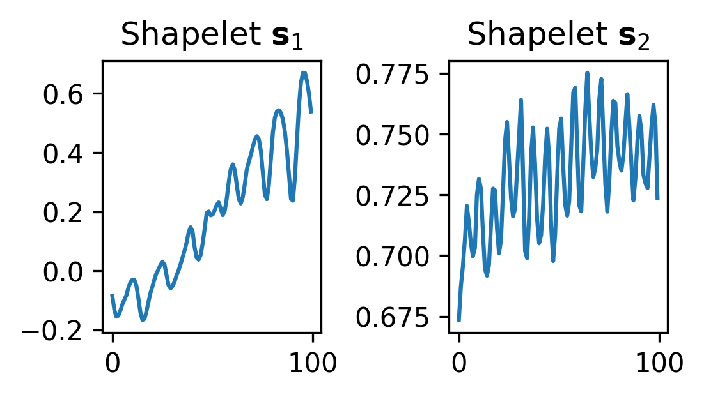
LEARNING sHAPELETS FROM SENSOR wAVEFORMS

Slide 17
Review
Domain experts are hard to beat
Matrix profile regression predicts fine and is not complex
Shapelet learning predicts best at the cost of space complexity
Shapelets are difficult to explain

Slide 18
Future work
Matrix profile transformations
Multinomial regression
Other methods of dimensionality reduction

Slide 19




Dylan Meysmans
DEPARTMENT OF APPLIED MATHEMATICS, COMPUTER SCIENCE AND STATISTICS
E dylan.meysmans@ugent.be www.ugent.be
Universiteit Gent
@ugent
@ugent
Ghent University

