Slide 1

Simulation and control of autonomous drone using Reinforcement Learning
CPSP Project – 2023/2024
Daniele Paccusse – Mattia Guazzaloca

Slide 2
Main Goals
Study PPO (Proximal Policy Optimization) Reinforcement learning algorithm and SKRL libraty
Create an environment using Isaac Gym
Implement a Neural Network to control the drone using camera images
Design a reward function for obstacle avoidance
Train and test

Slide 3
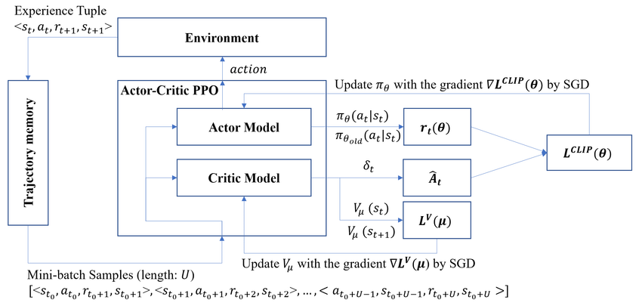
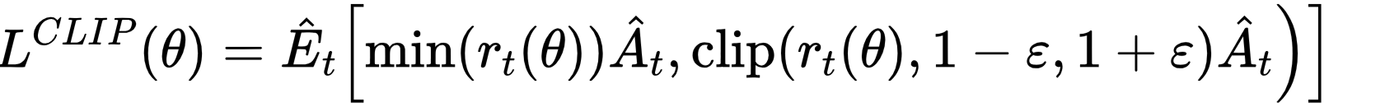
Proximal Policy Optimization (PPO)
Stochastic on-policy gradient algorithm
Actor-Critic method
Main steps: sampling data, optimize a surrogate objective function

Slide 4



SKRL and PyTorch
PyTorch
Dynamic computation graph (eager execution)
Strong GPU acceleration
Extensive support for machine learning and deep learning
Versatile and user-friendly API
Built on PyTorch for seamless integration
Implements popular RL algorithms (included PPO)
Modular and extensible design
Support for environments like Gym and Isaac Gym
SKRL
Supports large-scale simulations
IsaacGym
Realistic physics simulations
Exploits NVIDIA GPU

Slide 5

SKRL and PyTorch
PyTorch
Dynamic computation graph (eager execution)
Strong GPU acceleration
Extensive support for machine learning and deep learning
Versatile and user-friendly API
SKRL
Built on PyTorch for seamless integration
Implements popular RL algorithms (included PPO)
Modular and extensible design
Support for environments like Gym and Isaac Gym

Slide 6
IsaacSim and SKRL interaction

Slide 7


Reaching a target
Goal: reach a yellow sphere in a simulated rectangular room while avoiding collision with either the walls or the floor and without excessive movements
1
2
3
4
Environment Creation
SKRL Model Implementation
Reward Function Definition
Task Simulation & Training
INSERIRE IMMAGINE
AMBIENTE SIMULATO CON DRONE E PALLA
Observations
Actions
Actor model
Critic model
Main parameters
Inputs
Outputs
Components
Reset array
Physics
Logging
Data collection

Slide 8
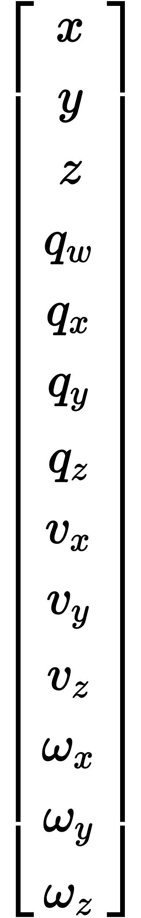
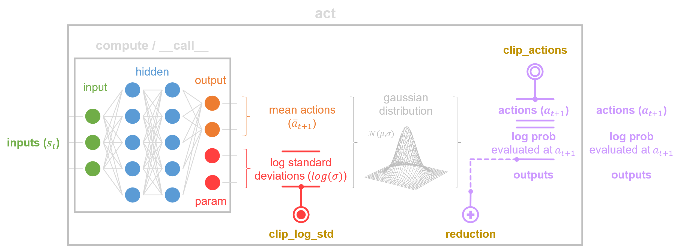
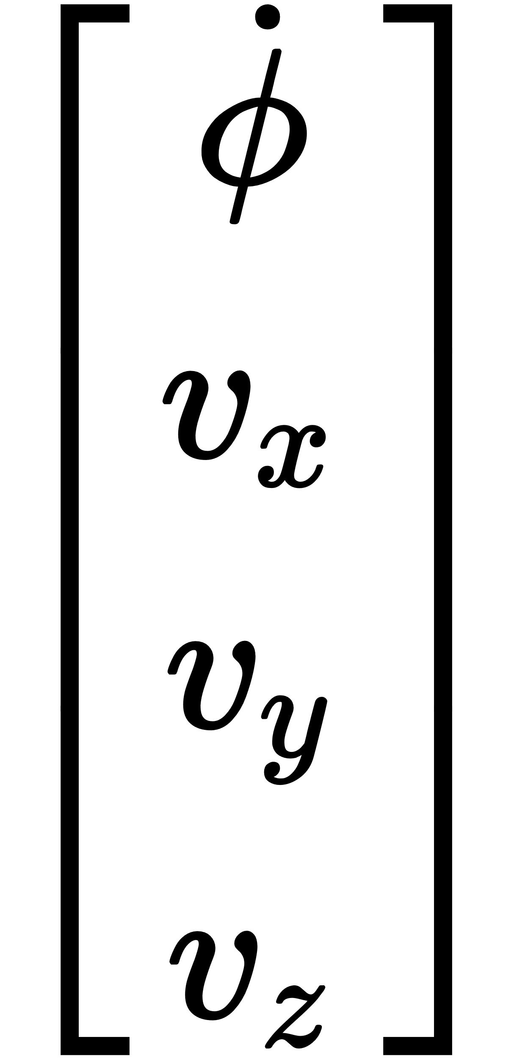
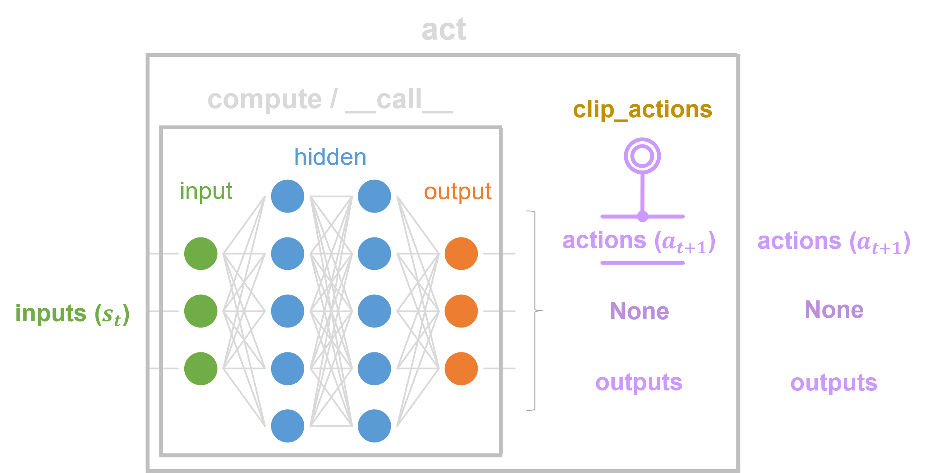
Reaching a target – SKRL Model
Observations
Shared Model
Position
Actor Model – Gaussian MLP
Actions
Orientation
Yaw Rate
Flight Controller
Linear Velocities
Critic Model – Deterministic MLP
Linear Velocities
Angular Velocities
Environment
Agent

Slide 9
Reaching a target – Reward Function

Slide 10
Reaching a target - Training
INSERIRE SCREENSHOTS REWARDS DA WANDB

Slide 11
Reaching a target - Demo
INSERIRE VIDEO DRONE VERSO PALLA GIALLA

Slide 12
Vision-based navigation
Goal: reach a yellow sphere in a simulated rectangular room using only the camera sensors while avoiding collision with either the walls, the floor or a set of randomly placed cubic obstacles and without excessive movements
1
2
3
4
Environment Creation
Camera Sensors Data Collection
SKRL Model Implementation
Reward Function Definition
INSERIRE IMMAGINE
AMBIENTE SIMULATO CON DRONE E OSTACOLI
5
Task Simulation & Training

Slide 13
Vision-based navigation – Cameras
TALK ABOUT:
HOW CAMERAS ARE NOT AGENTS BUT A SENSORS
DIFFERENCE BETWEEN COLOR AND DEPTH CAMERAS
IMAGES COPY FROM GPU TO MAIN MEMORY FOR OBSERVATION COMPUTATION

Slide 14
Vision-based navigation – SKRL Model
Observations
Position
Actor Model – Gaussian CNN
Actions
Orientation
Yaw Rate
Flight Controller
Linear Velocities
Critic Model – Deterministic CNN
Linear Velocities
Angular Velocities
Environment
Agent

Slide 15
Vision-based navigation – Issues
TALK ABOUT:
HOW CAMERAS ARE NOT AGENTS BUT A SENSORS
DIFFERENCE BETWEEN COLOR AND DEPTH CAMERAS
IMAGES COPY FROM GPU TO MAIN MEMORY FOR OBSERVATION COMPUTATION

Slide 16
Recap

Slide 17
Thank you for your attention

