Slide 1

Simulation and control of autonomous drone using Reinforcement Learning
CPSP Project – 2023/2024
Daniele Paccusse – Mattia Guazzaloca

Slide 2
Main Goals
Study PPO (Proximal Policy Optimization) Reinforcement learning algorithm and SKRL library
Create an environment using Isaac Gym where agents can interact
Implement a Neural Network to control the drone using camera images applying PPO
Design a reward function for obstacle avoidance
Train and test

Slide 3
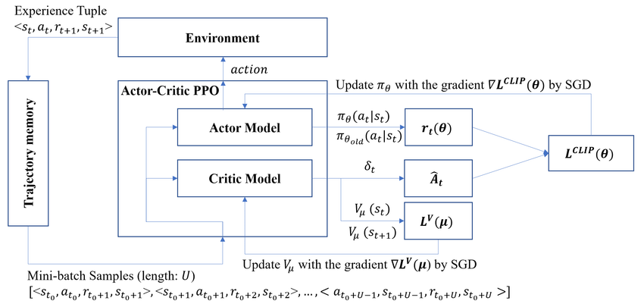
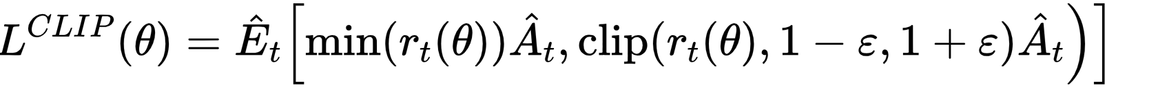
Proximal Policy Optimization (PPO)
Stochastic on-policy gradient algorithm
Actor-Critic method
Main steps: sampling data, optimize a surrogate objective function

Slide 4


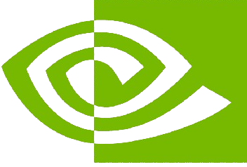
SKRL and PyTorch
PyTorch
Dynamic computation graph (eager execution)
Strong GPU acceleration
Extensive support for machine learning and deep learning
Versatile and user-friendly API
Built on PyTorch or JAX for seamless integration
Implements popular RL algorithms (included PPO)
Modular and extensible design
Support for environments like Gym and Isaac Gym
SKRL
Supports large-scale simulations
IsaacGym
Realistic physics simulations
Exploits NVIDIA GPU

Slide 5
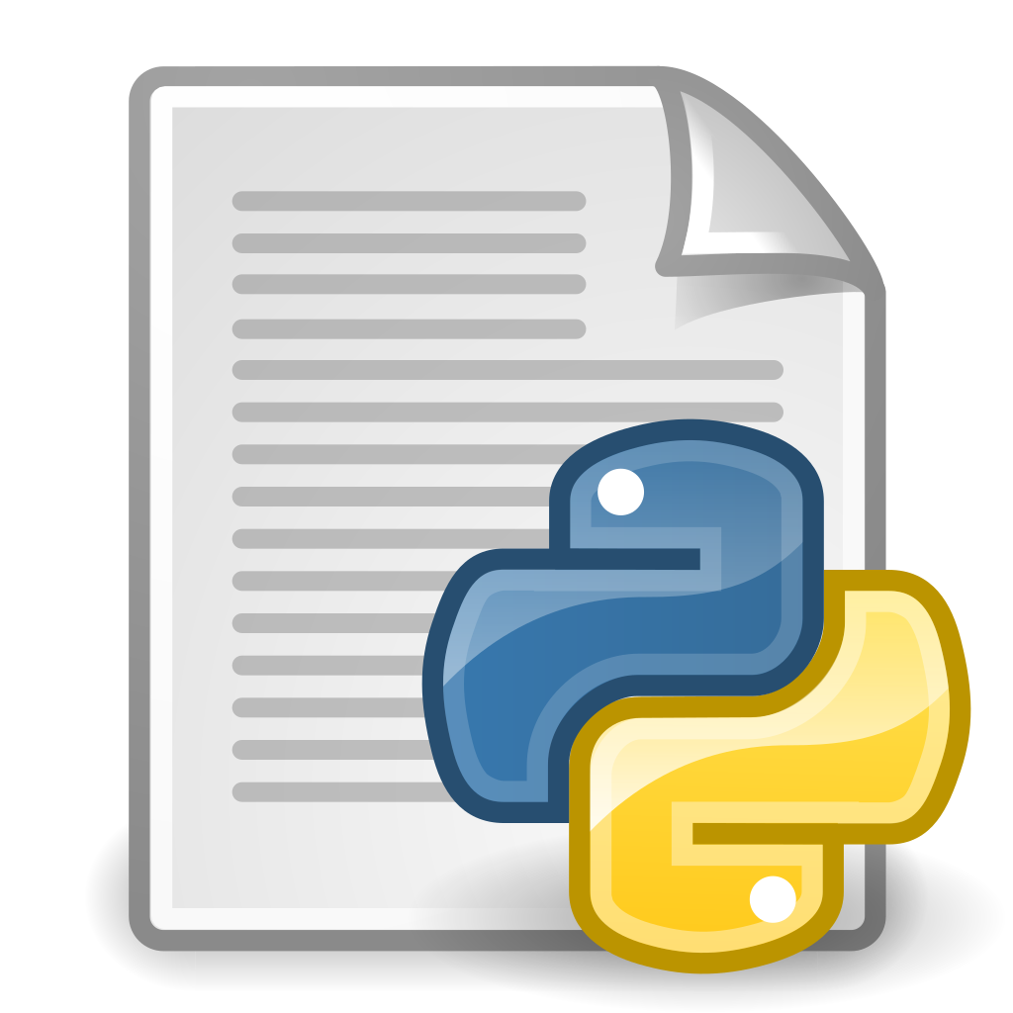
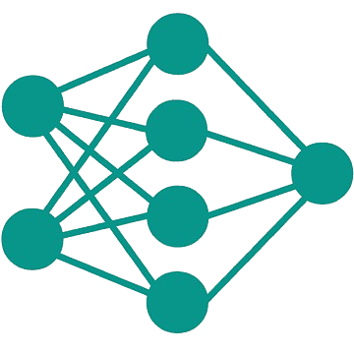

IsaacGym and SKRL interaction
IsaacGym
SKRL
torch.nn
quadrotor.py
ppo.py
- observation_space
- action_space
create_sim
pre_physics_step
post_physics_step
env
wrap_env
agent = PPO
sequential_trainer
controller
Proportional
+
Feedback linearization
actions

Slide 6
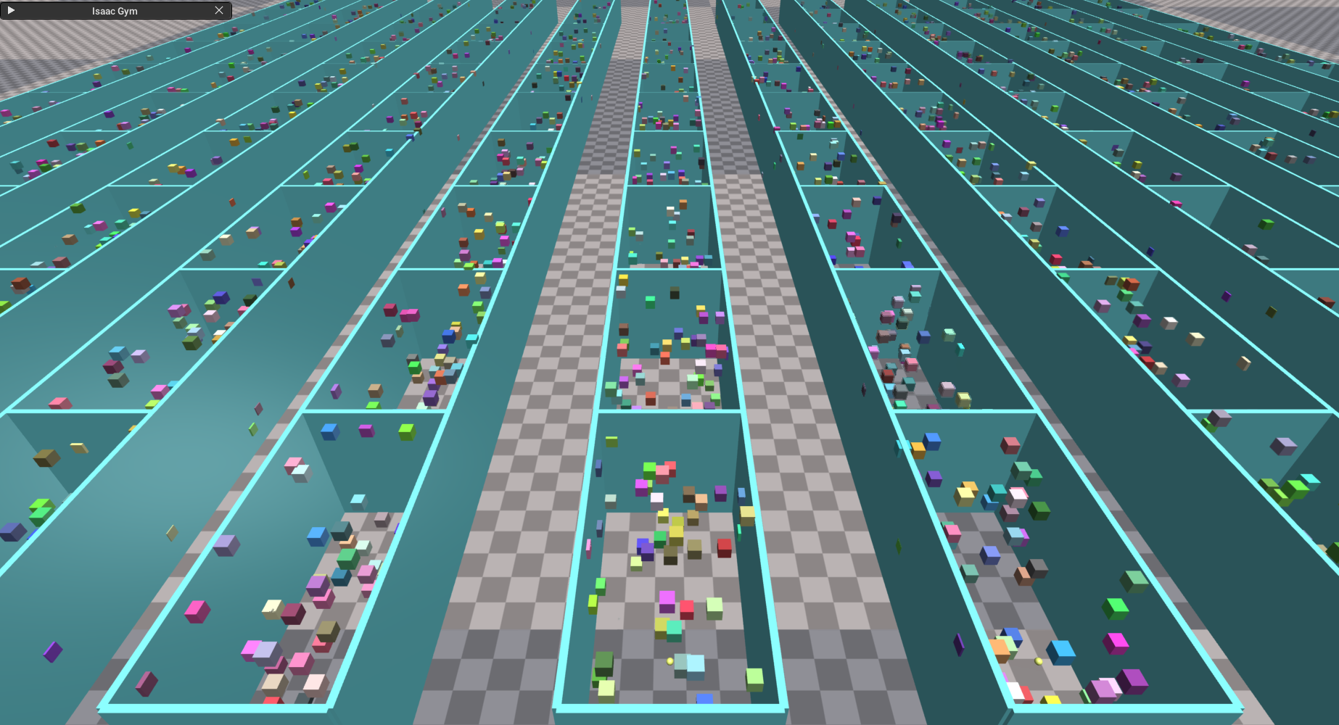
IsaacGym environment creation
quadrotor.py
create_sim
create_envs
create_ground_plane
load_assets: walls, obstacles URDF
For each environment:
create_actor: initial position, collision group
Each object is an actor

Slide 7
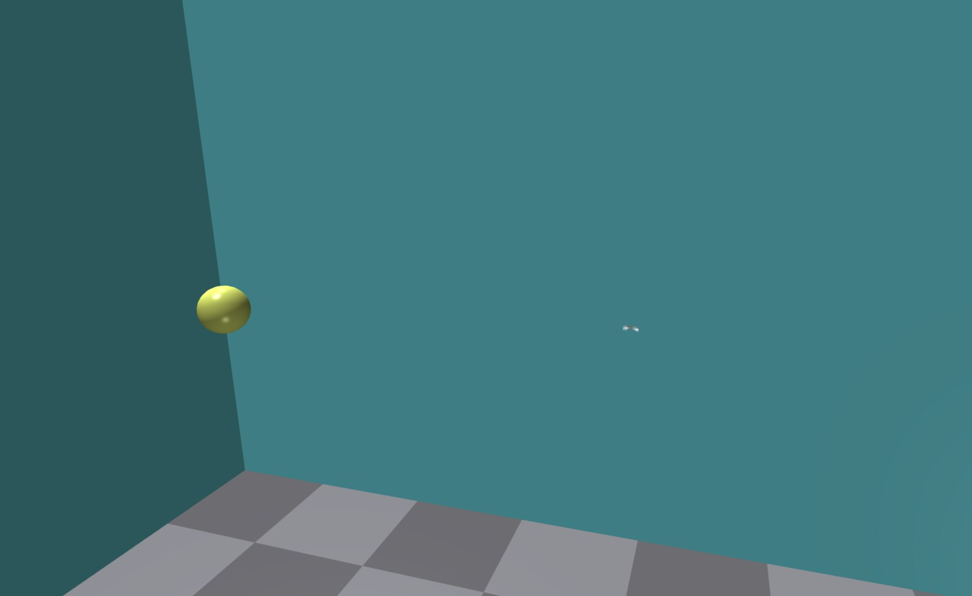


Reaching a target
Goal: reach a yellow sphere in a simulated rectangular room while avoiding collision with either the walls or the floor and without excessive movements
1
2
3
4
Environment Creation
SKRL Model Implementation
Reward Function Definition
Task Simulation & Training
Observations
Actions
Actor model
Critic model
Main parameters
Inputs
Outputs
Components
Reset array
Physics
Logging
Data collection

Slide 8
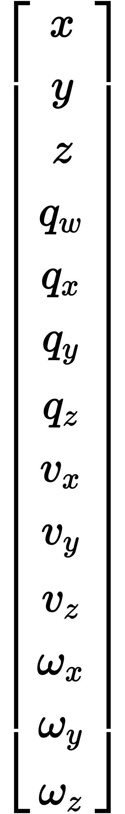
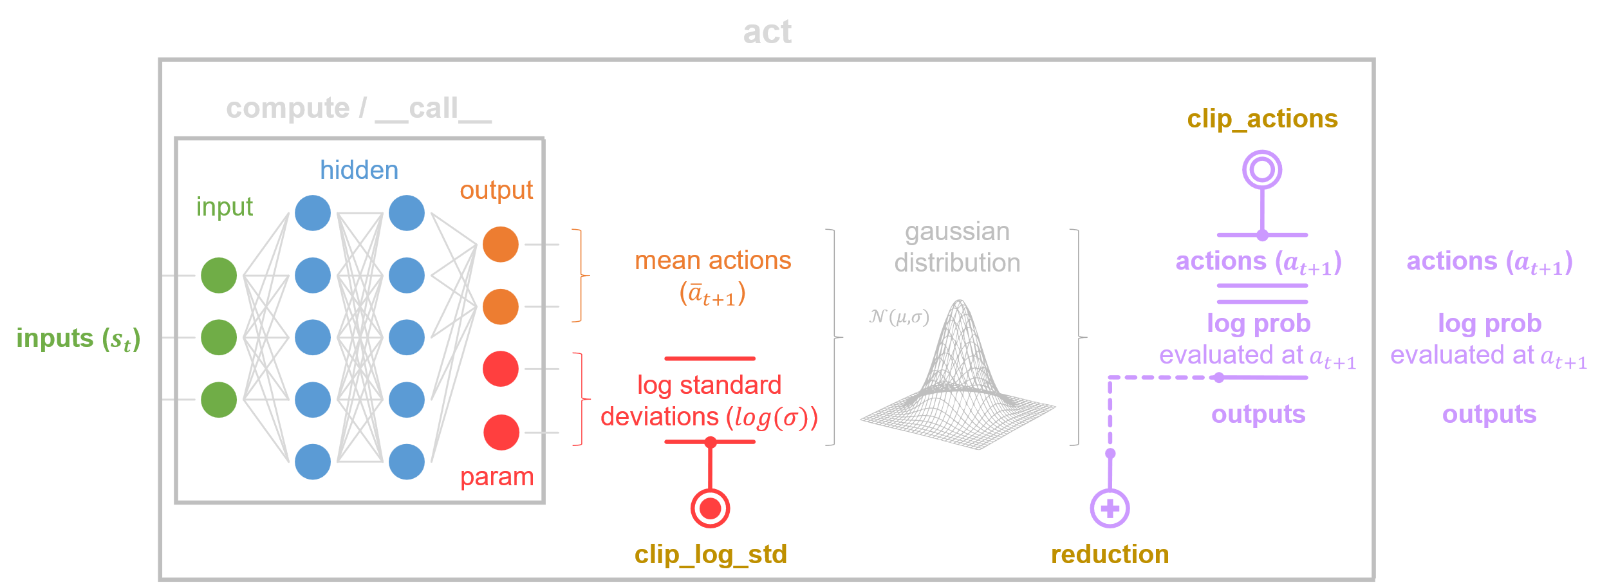
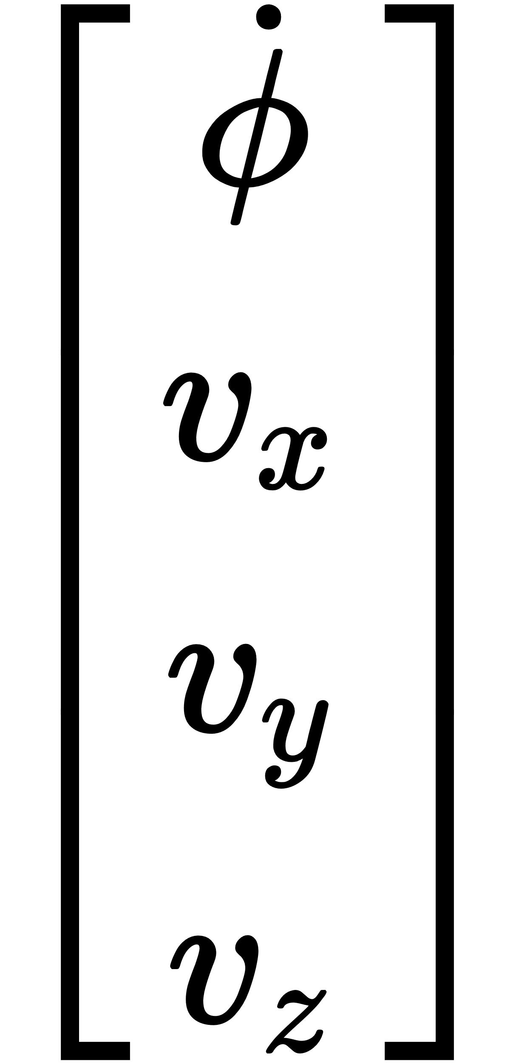
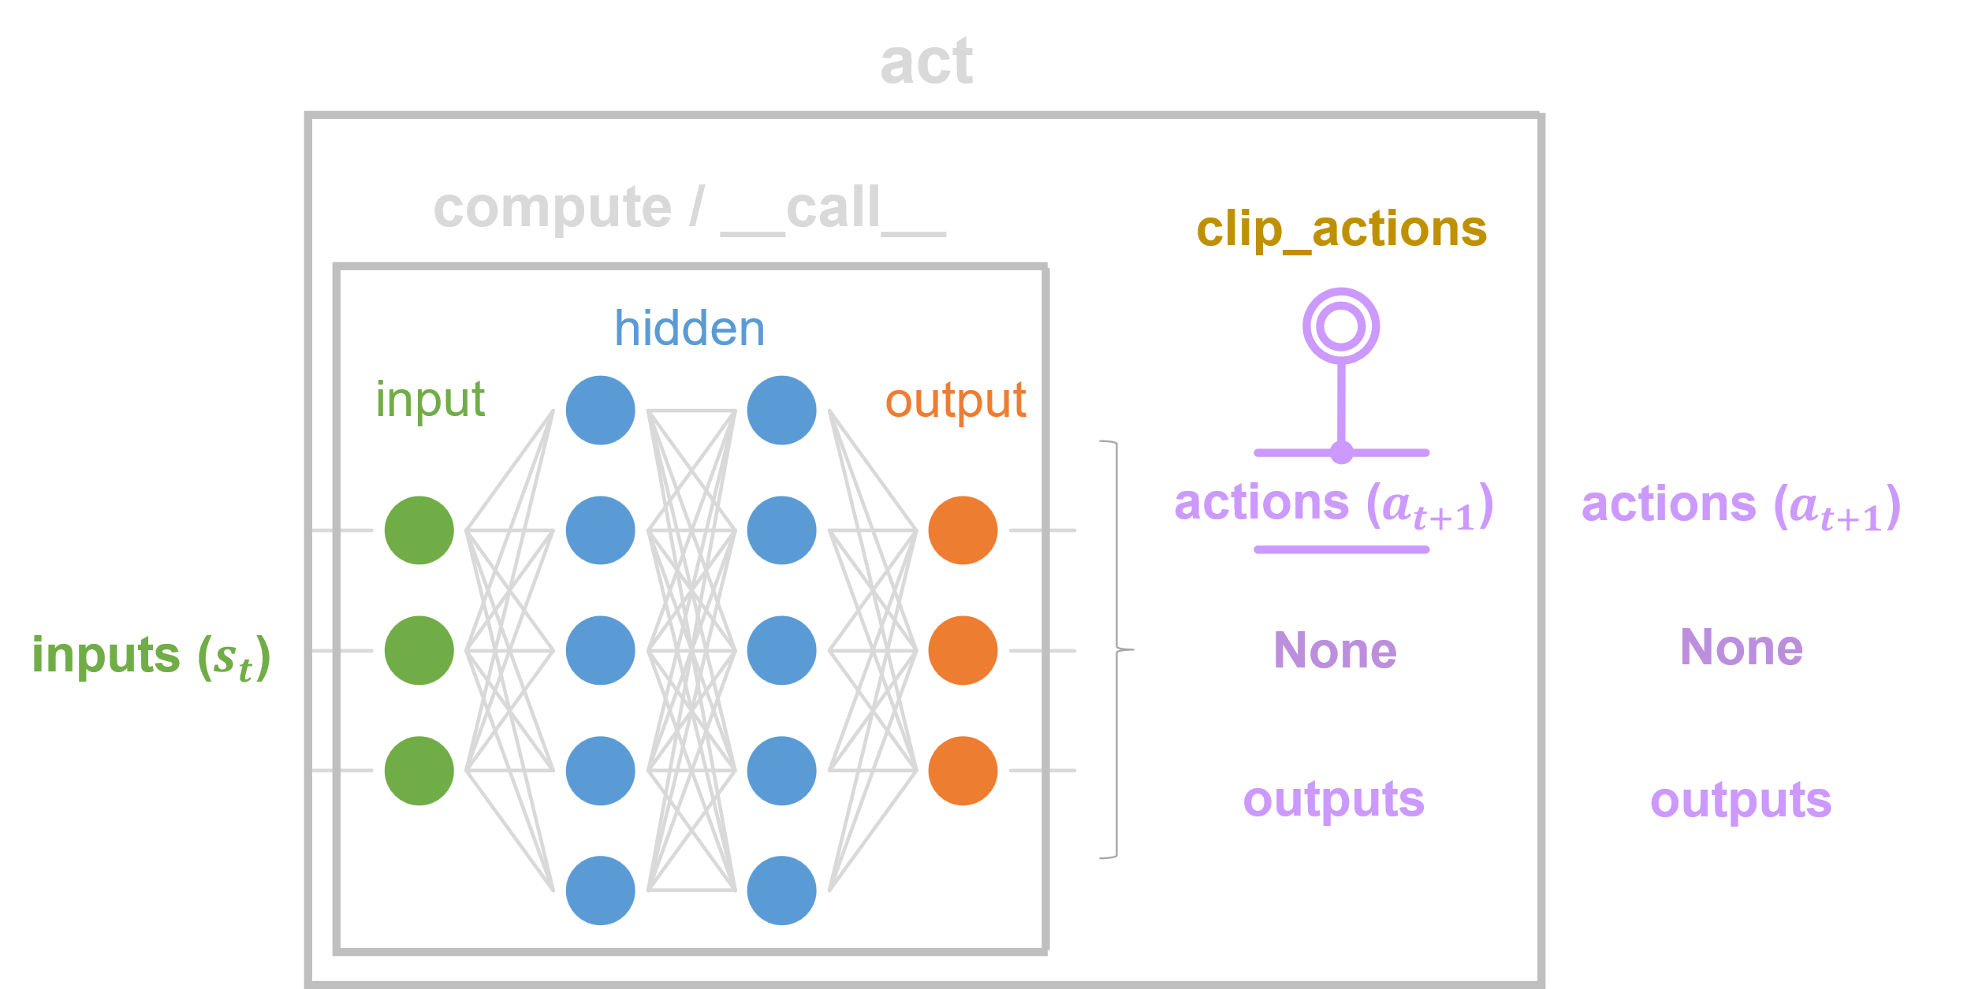
Reaching a target – SKRL Model
Observations
Shared Model
Position
Actor Model – Gaussian MLP
Actions
Orientation
Yaw Rate
Controller
Linear Velocities
Critic Model – Deterministic MLP
Linear Velocities
Angular Velocities
Environment
Agent

Slide 9
Reaching a target – Reward Function
Total Reward
=
Stability Reward
x
Position Reward
+
Position Reward
Uprightness Reward
Spinnage Reward
Velocity Reward
INSERIRE GRAFICI WANDB

Slide 10
Reaching a target – Environment Reset
Reset conditions
Collision with the room walls or the room floor
Maximum episode length of 500 timestamp reached
Distance from the target greater than a certain threshold
INSERIRE VIDEO DRONE CHE SI SCHIANTA E AMBIENTE CHE SI RESETTA

Slide 11
Reaching a target - Demo
INSERIRE VIDEO DRONE VERSO PALLA GIALLA

Slide 12
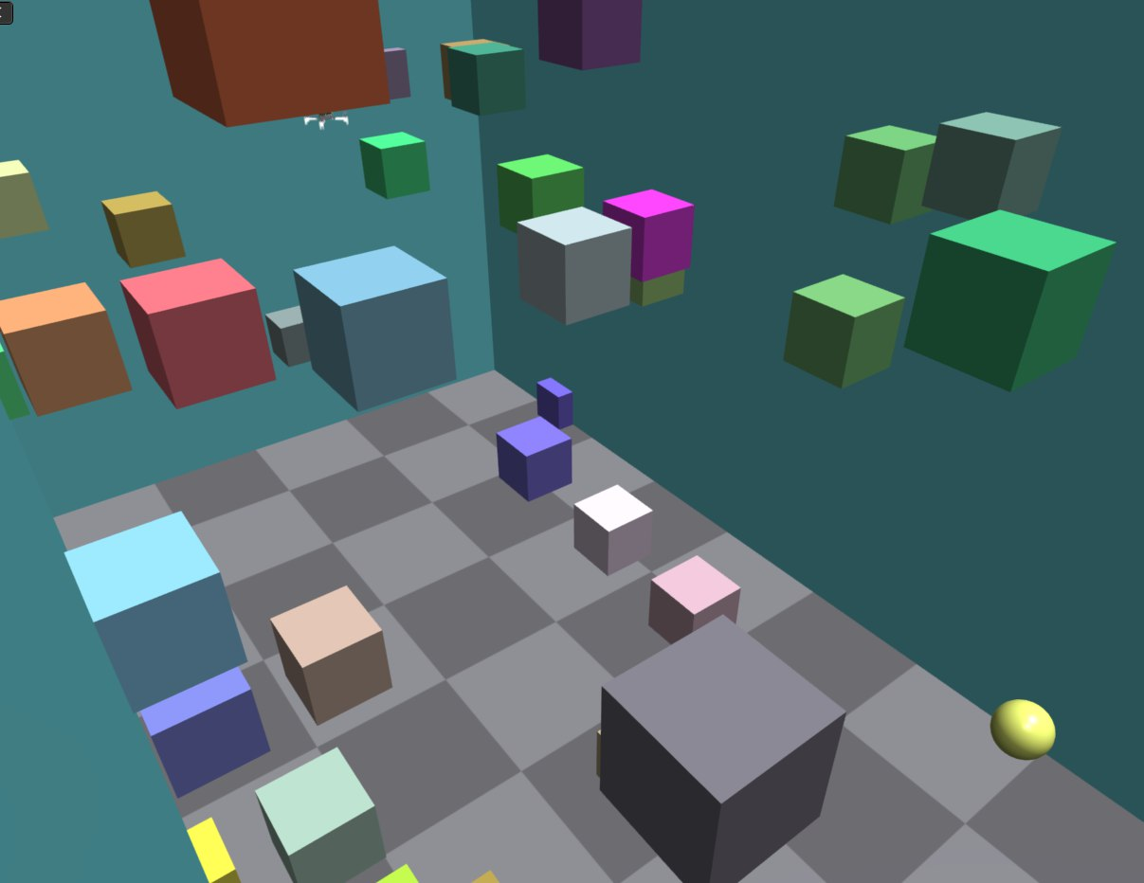
Vision-based navigation
Goal: reach a yellow sphere in a simulated rectangular room using only the camera sensors while avoiding collision with either the walls, the floor or a set of randomly placed cubic obstacles and without excessive movements
1
2
3
4
Environment Creation
Camera Sensors Data Collection
SKRL Model Implementation
Reward Function Definition
5
Task Simulation & Training

Slide 13


Vision-based navigation – Cameras
quadrotor_cameras.py
1
⚠️
Cameras are sensors not actors
2
create_envs
post_physics_step
Depth camera
Render cameras
Create camera sensor and attach to drone agent
Color camera
Copy GPU image tensor to CPU
Store reference to GPU image tensor

Slide 14
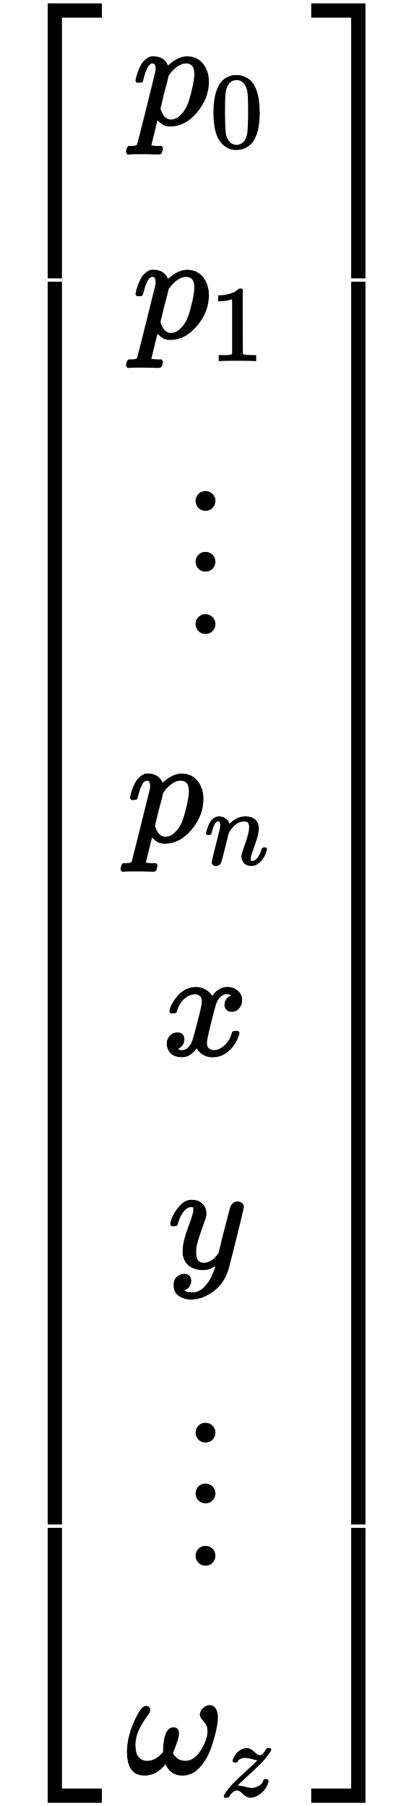
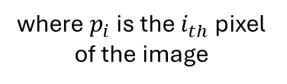
Vision-based navigation – SKRL Model
Observations
Actor Model – Gaussian CNN
Flatten Image
Actions
Yaw Rate
Controller
Linear Velocities
Drone States
Critic Model – Deterministic MLP
where $p_{i}$ is the $i_{th}$ pixel of the image
Environment
Agent

Slide 15
Vision-based navigation – Issues

Slide 16


Recap
SKRL API Application: Learned how to train and test reinforcement learning agents using the SKRL API.
Practical skills acquired:
Project Organization: manage projects using GitHub for version control and collaboration
Linux OS: installing libraries, managing dependencies
Docker Utilization: managing containers, configuration of virtual memory.
WandB Integration: Learned how to monitor experiments.
Python Programming: Improved coding abilities with a focus on modularity and readability.
IsaacGym API: Acquired experience in creating custom environments for RL and GPU-accelerated computing
SKRL API Application: Learned how to train and test reinforcement learning agents.
PyTorch Library : Learned how to build neural networks.
Knowledge acquired:
Proximal Policy Optimization RL algorithm
Reward Function Design for RL

Slide 17
Thank you for your attention

