Slide 1

Simulation and control of autonomous drone using Reinforcement Learning
CPSP Project – 2023/2024
Daniele Paccusse – Mattia Guazzaloca

Slide 2
Main Goals
Study PPO (Proximal Policy Optimization) Reinforcement learning algorithm and SKRL libraty
Create an environment using Isaac Gym
Implement a Neural Network to control the drone using camera images
Design a reward function for obstacle avoidance
Train and test

Slide 3
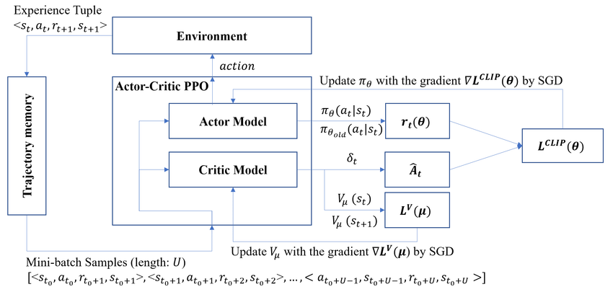
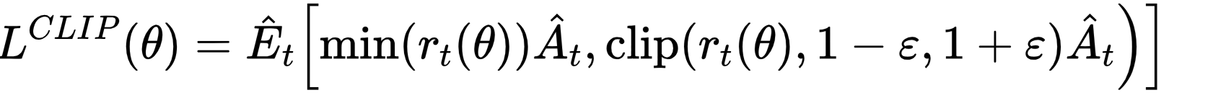
Proximal Policy Optimization (PPO)
Stochastic on-policy gradient algorithm
Actor-Critic method
Main steps: sampling data, optimize a surrogate objective function

Slide 4


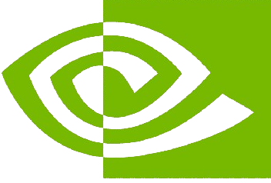
SKRL and PyTorch
PyTorch
Dynamic computation graph (eager execution)
Strong GPU acceleration
Extensive support for machine learning and deep learning
Versatile and user-friendly API
Built on PyTorch for seamless integration
Implements popular RL algorithms (included PPO)
Modular and extensible design
Support for environments like Gym and Isaac Gym
SKRL
Supports large-scale simulations
IsaacGym
Realistic physics simulations
Exploits NVIDIA GPU

Slide 5

SKRL and PyTorch
PyTorch
Dynamic computation graph (eager execution)
Strong GPU acceleration
Extensive support for machine learning and deep learning
Versatile and user-friendly API
SKRL
Built on PyTorch for seamless integration
Implements popular RL algorithms (included PPO)
Modular and extensible design
Support for environments like Gym and Isaac Gym

Slide 6
IsaacSim and SKRL interaction

