Slide 1
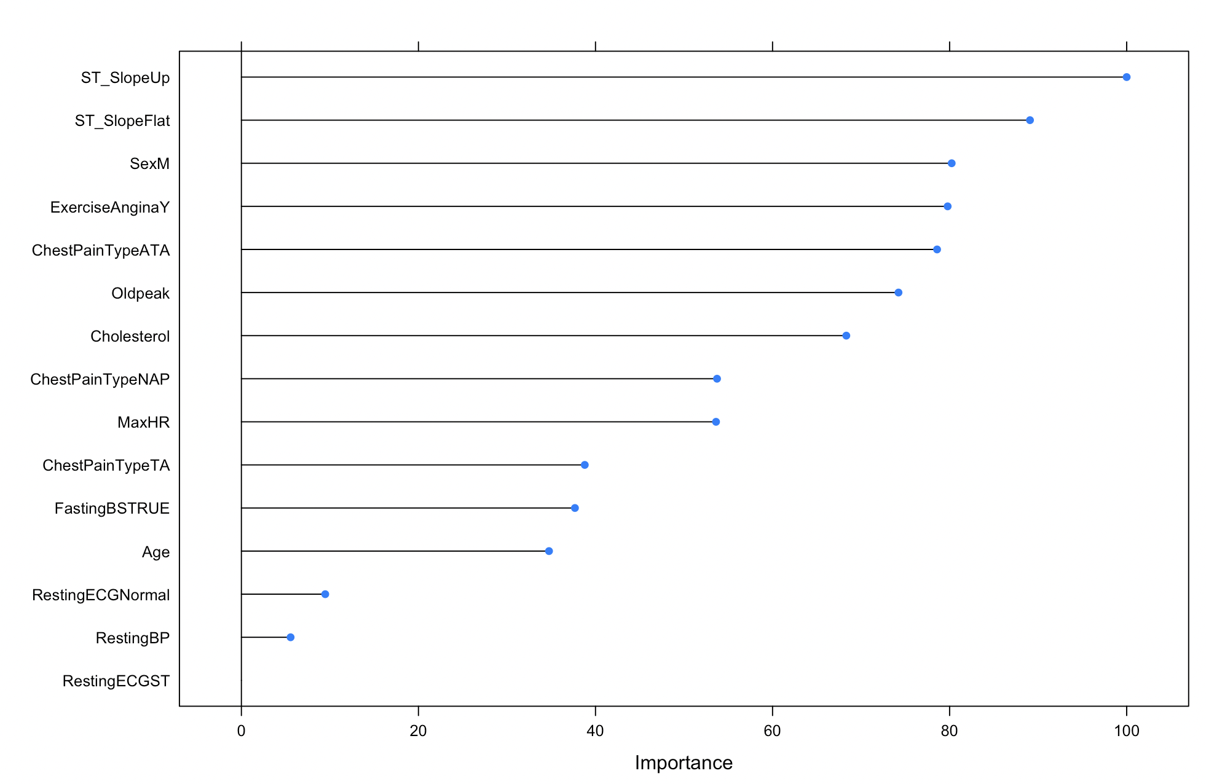
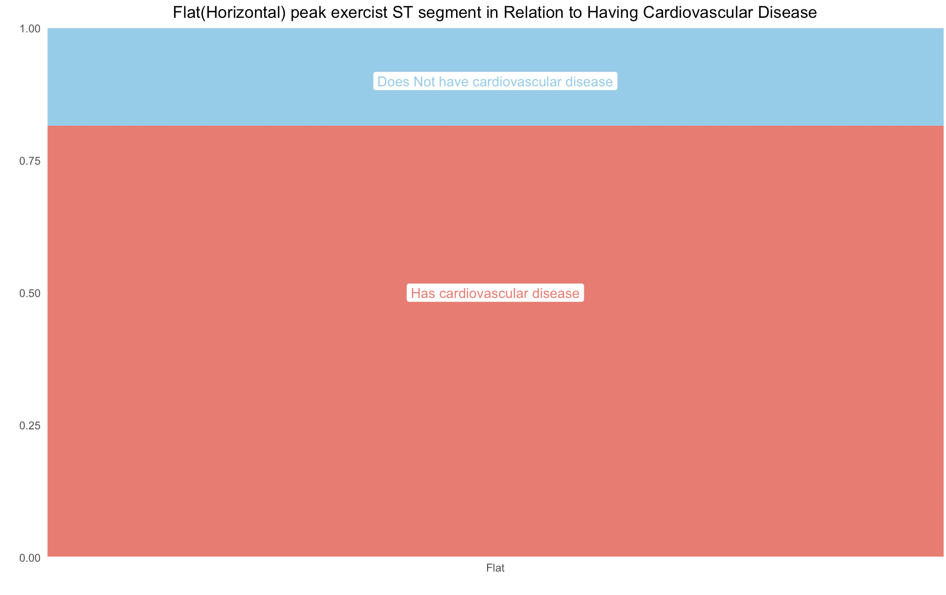
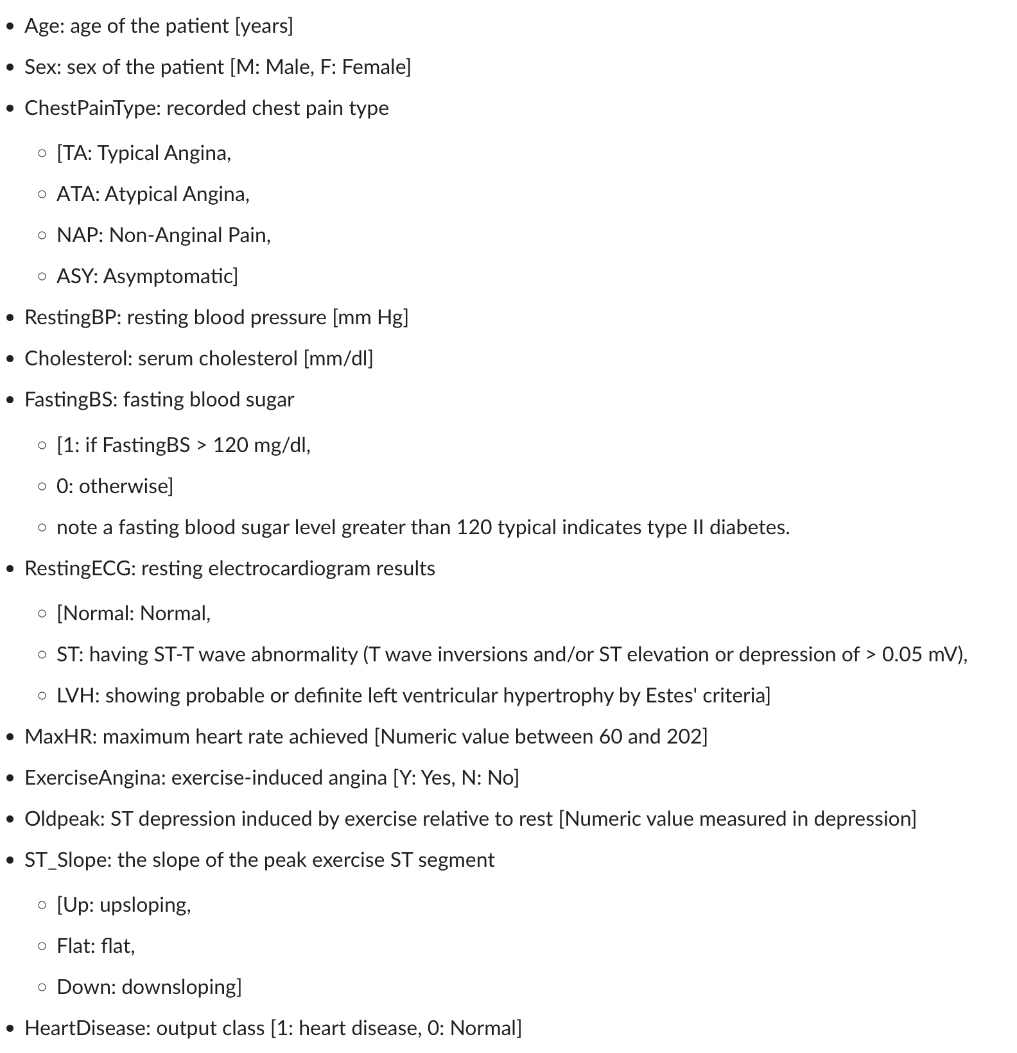
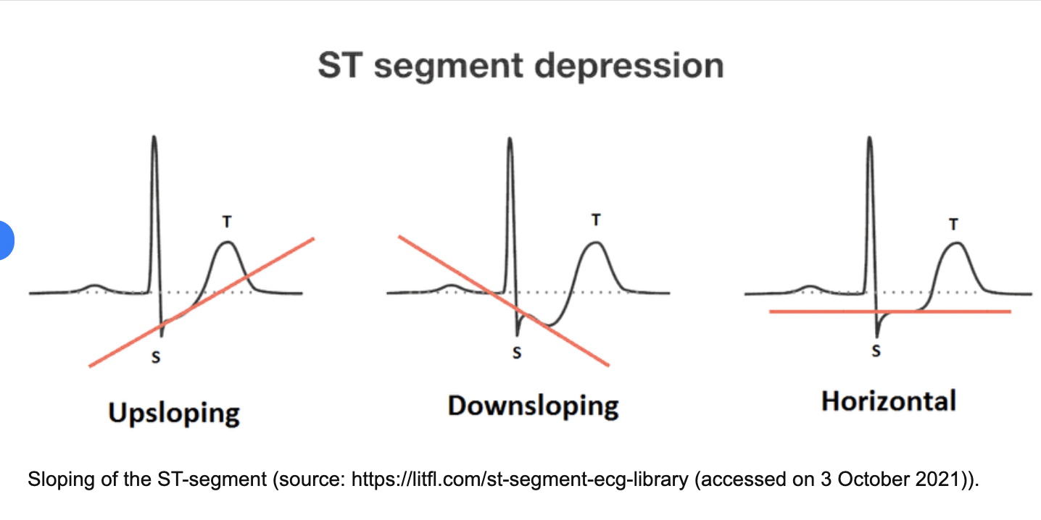
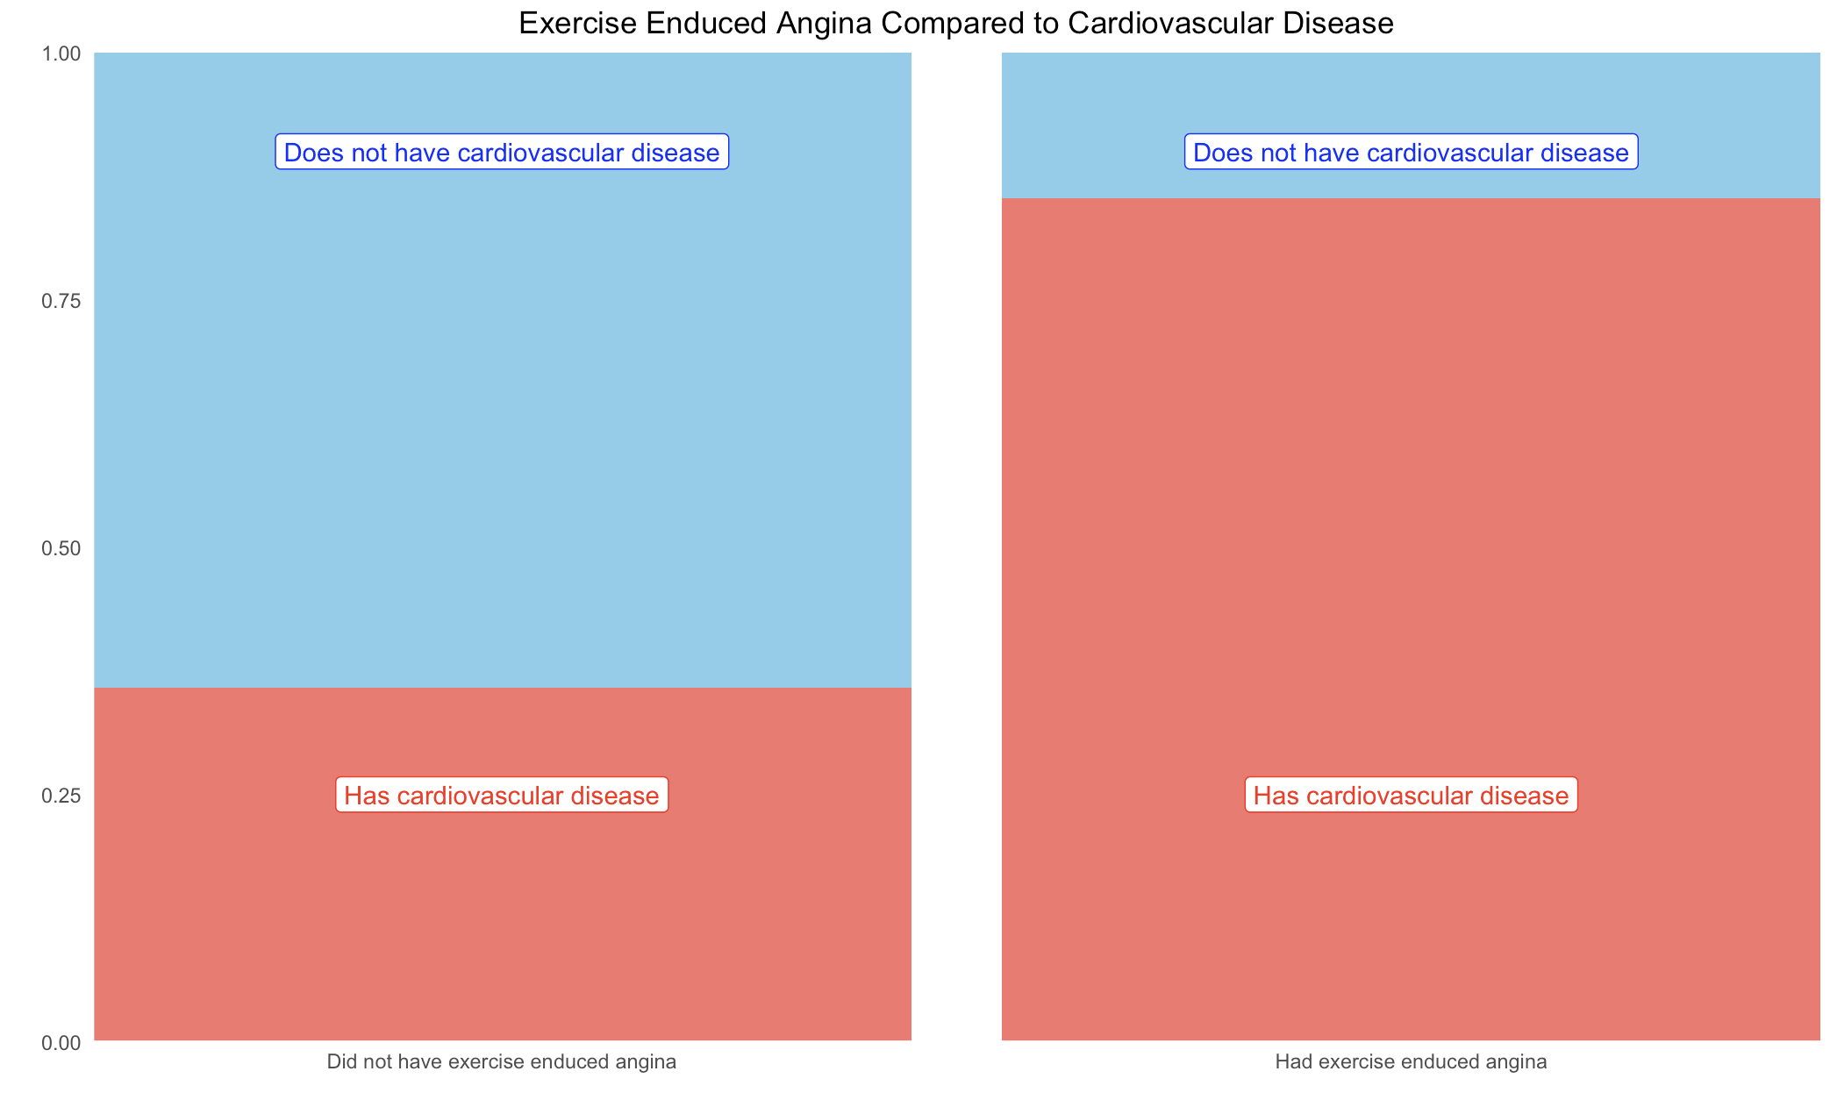
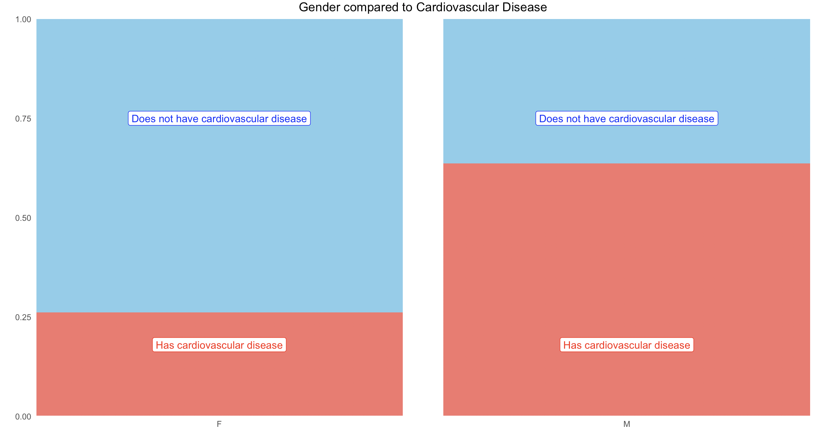
What Helps Predict Cardiovascular Disease? A random tree was fit to try to find out exactly what can help predict if an individual has cardiovascular disease
Output of our random tree model on what predictors are most imporant
What are the different ST segment depressions?
Variables studied:
Data from heart_desease data set

