Slide 1

Using R library rtweet

Slide 2

Installing rtweet
Install the rtweet library
All steps available here
https://rtweet.info/#create-an-app
Go to Twitter and request usage of their API
Verify with phone number, email
They ask you about your product
Usage
Project name
Primary country of use
How it will be delivered to customers
Etc.
Create an “app” to get the API keys
Fill out more information
You now have your keys/tokens for accessing Twitter’s API
Yay!... But wait there’s more!

Slide 3
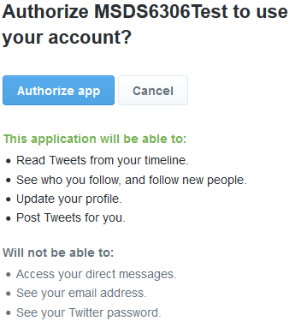
Use rtweet
Need httpuv Library
create_token(app=name, consumer_key=ckey, consumer_secret=cskey)
You receive more keys…
create_token(app=name, consumer_key=ckey, consumer_secret=cskey, access_token = acctok, access_secret = accsec)
Setup is now done!

Slide 4
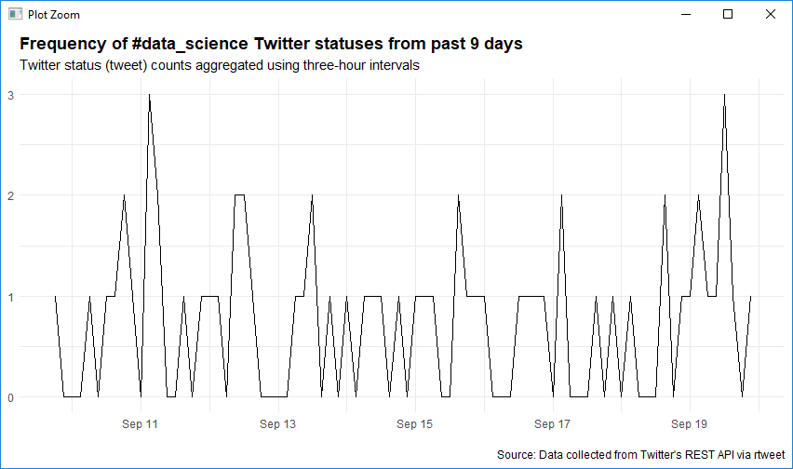
Example
rt <- search_tweets("#data_science", n = 180, include_rts = FALSE)
Columns
User_id
Status_id
Created_at
Screen_name
Text
Source
Display_text_width
Reply_to_status_id
Reply_to_user_id
reply_to_screen_name
Is_quote
Is_retweet
Favorite_count
Retweet_count
Hashtags
Saved into a vector
Etc.
There are a total of 88 columns

