Slide 1
Data Science and Programming Languages
Zackary Gill

Slide 2
Popular Data Science Languages (Analytics India Magazine website)
1. Python
2. Java
3. R
4. Julia
5. SAS
6. SQL
7. MATLAB
8. Scala
9. C
10. F#

Slide 3
Popular Data Science Languages (multiple websites)
1. Python
2. Java
3. R
4. Julia
5. SAS
6. SQL
7. MATLAB
8. Scala
9. C
10. F#

Slide 4
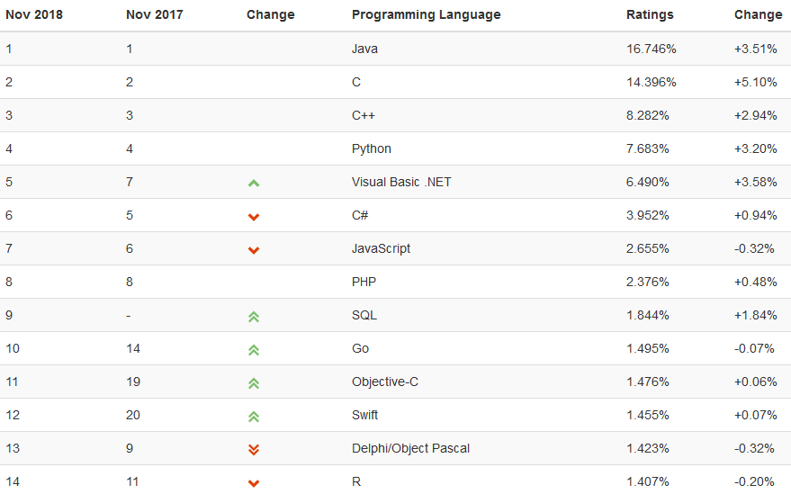
Popular Programming Languages
“The index is updated once a month. The ratings are based on the number of skilled engineers world-wide, courses and third party vendors. Popular search engines such as Google, Bing, Yahoo!, Wikipedia, Amazon, YouTube and Baidu are used to calculate the ratings.”

Slide 5
Popular Data Science Languages (paired with overall popularity)
1. Python 4
2. Java 1
3. R 14
4. Julia -
5. SAS -
6. SQL 9
7. MATLAB -
8. Scala -
9. C 2
10. F# -

Slide 6
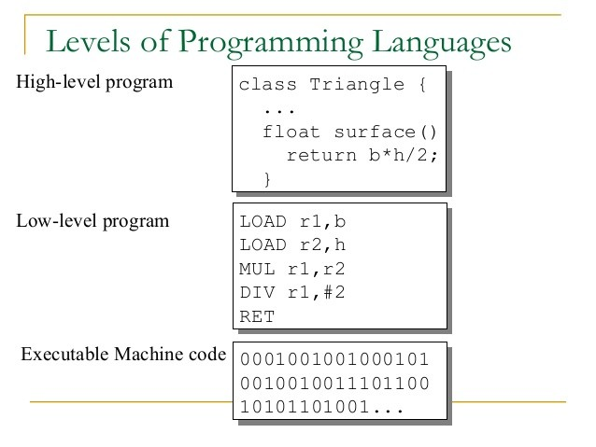
Programming Language Information
Python, R, SAS
SQL
Database
W3Schools.com
Julia
Similar to R / Python
MATLAB
Heavy-duty mathematics
Scala
Java
Java
Generally Popular
Established Language
Java/C# → C++

Slide 7
Conclusion
1. Python 4
2. Java 1
3. R 14
6. SQL 9
W3Schools
Java is Popular

Slide 8
Sources
https://www.analyticsindiamag.com/top-10-programming-languages-data-scientists-learn-2018/
https://www.tiobe.com/tiobe-index/
https://www.educba.com/high-level-languages-vs-low-level-languages/
https://www.cs.waikato.ac.nz/ml/weka/

