Slide 1
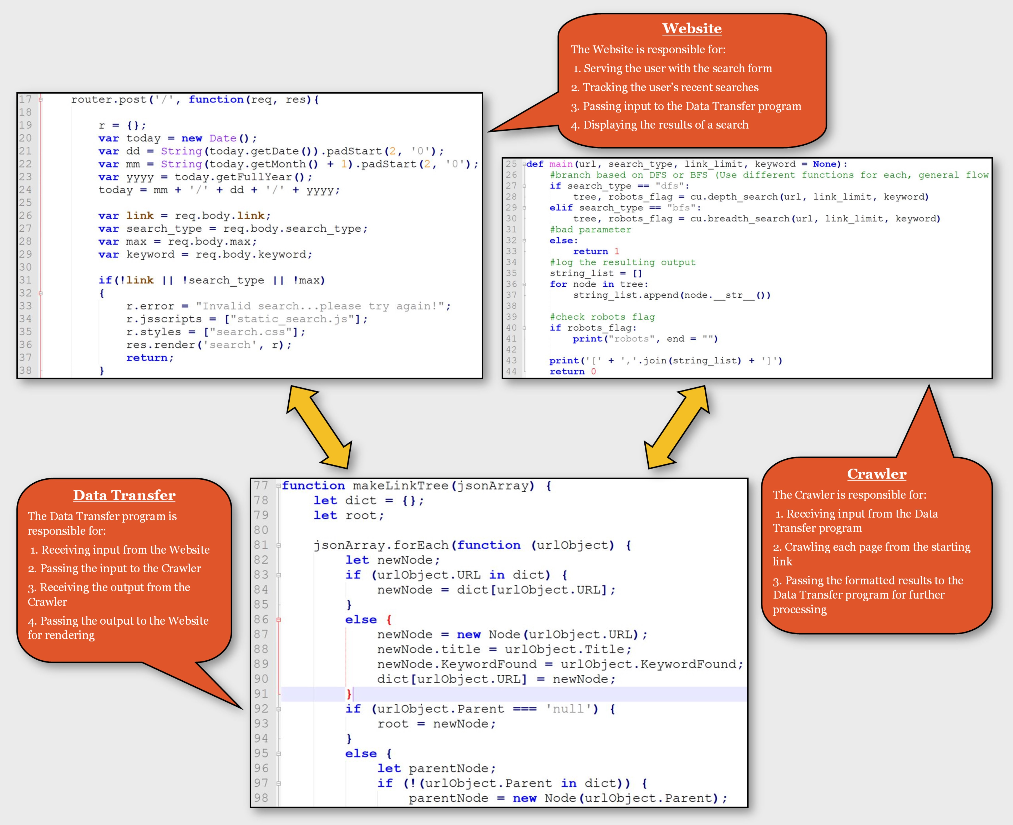
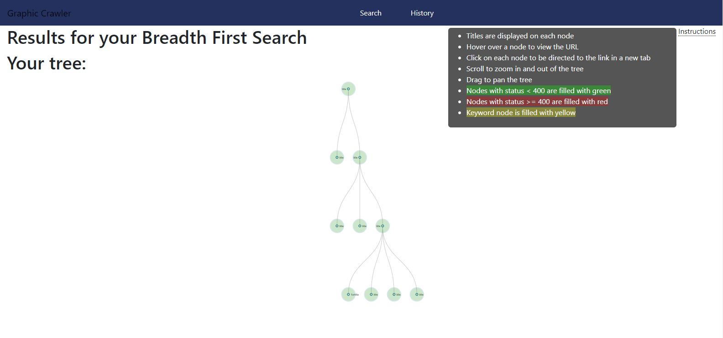
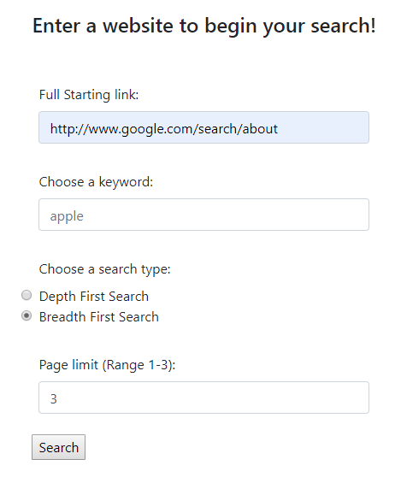
Gcrawler: Graphical web crawler
The GCrawler project is a graphical web crawler which crawls a user-supplied website, following links on each page as it goes. It displays a color-coded graph of what pages were crawled and how it reached each page. Try it: https://gcrawler-test.herokuapp.com/search
gcrawler features:
Intuitive: Complete a simple form to crawl any website. Supply a keyword to search for text on each page. GCrawler will halt when it finds the keyword. (left).
Retentive: GCrawler stores your sessions’ past searches on the History tab for easy re-use.
Flexible: Choose from Depth First Search or Breadth First Search methods. Depth First Search will follow a random link on each page until the specified page limit (1-10) is reached. Breadth First Search will follow all links on each page until the specified depth limit (1-3) is reached. (left)
Informative: GCrawler’s color-coded results display the title of each page on the node. The URL can be seen by hovering over the node. A user can click the node to open the page. (above)
Good Bot: GCrawler adheres to the Robot Exclusion Protocol by reading a page’s robots.txt file and abiding by its rules. It also evaluates pages and links for other indicators that it should not crawl the page or follow the links.
GCrawler Code Repository: https://github.com/metzgerb/cs467-project
Connect with the gcrawlers:
Christopher Beall (Data Transfer): https://github.com/beallch
Helen Jiang (UI/Website): https://github.com/hyjiang7
Brian Metzger (Crawler): https://github.com/metzgerb

