Slide 1
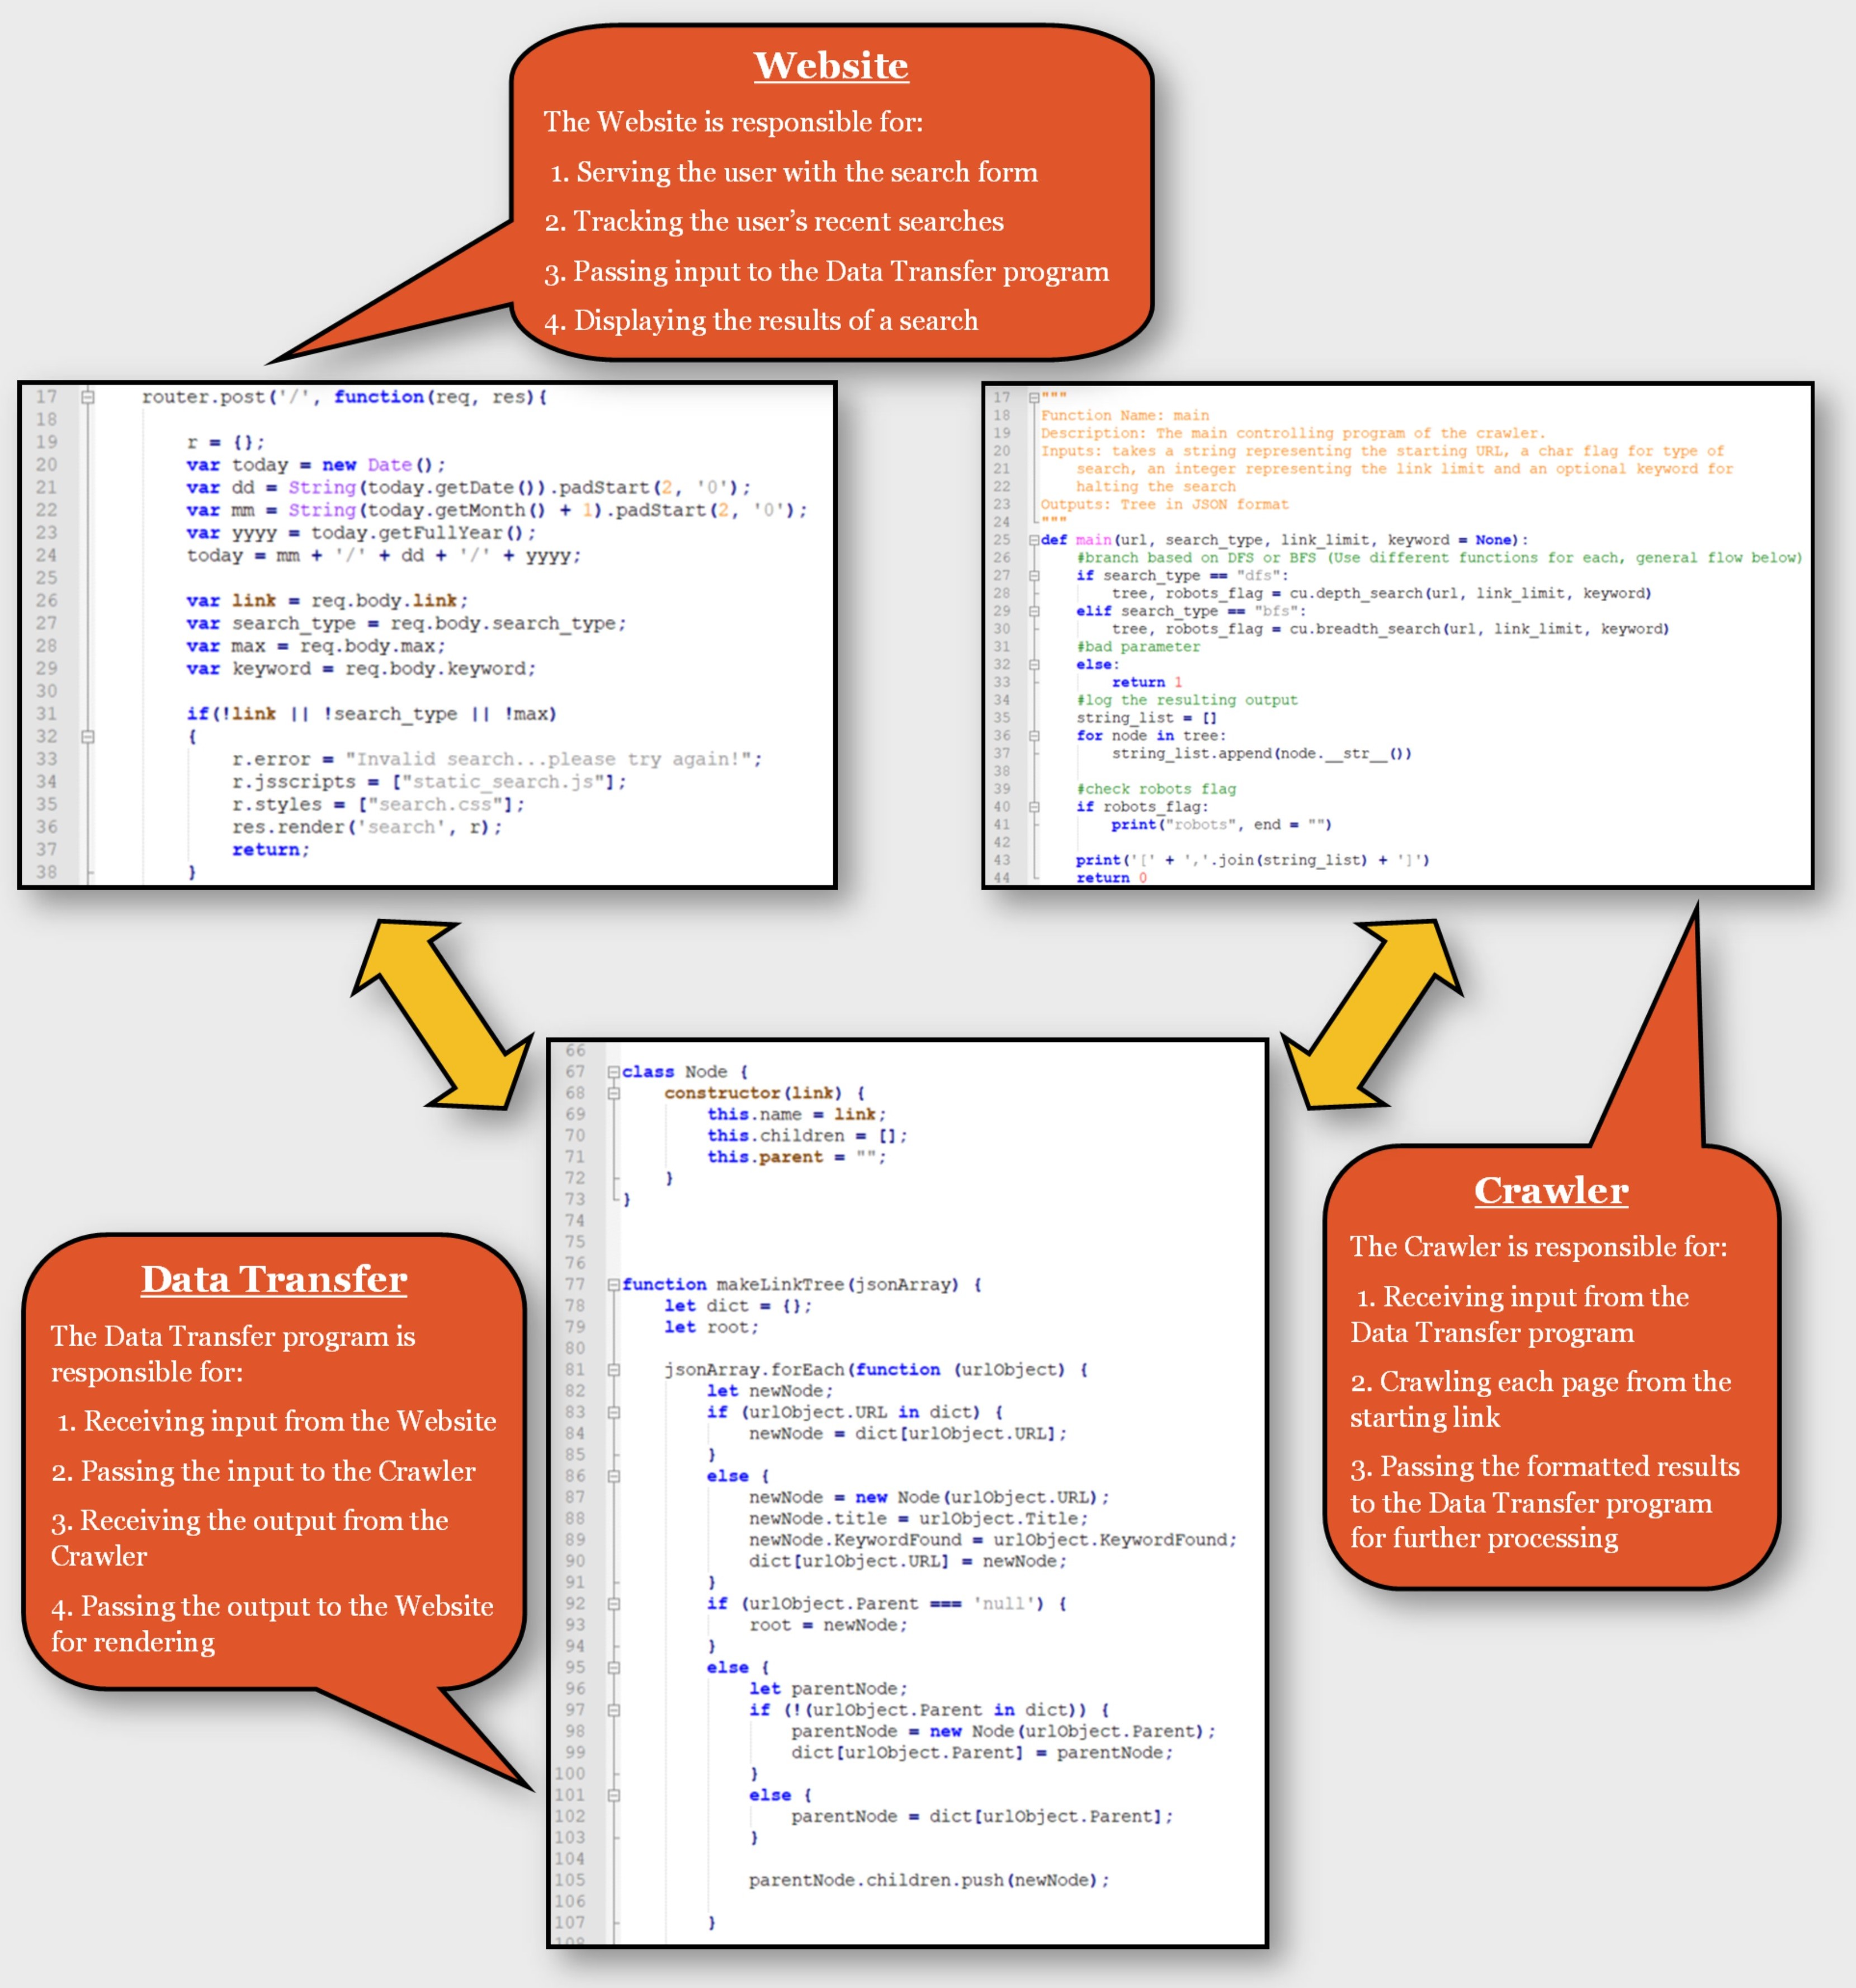
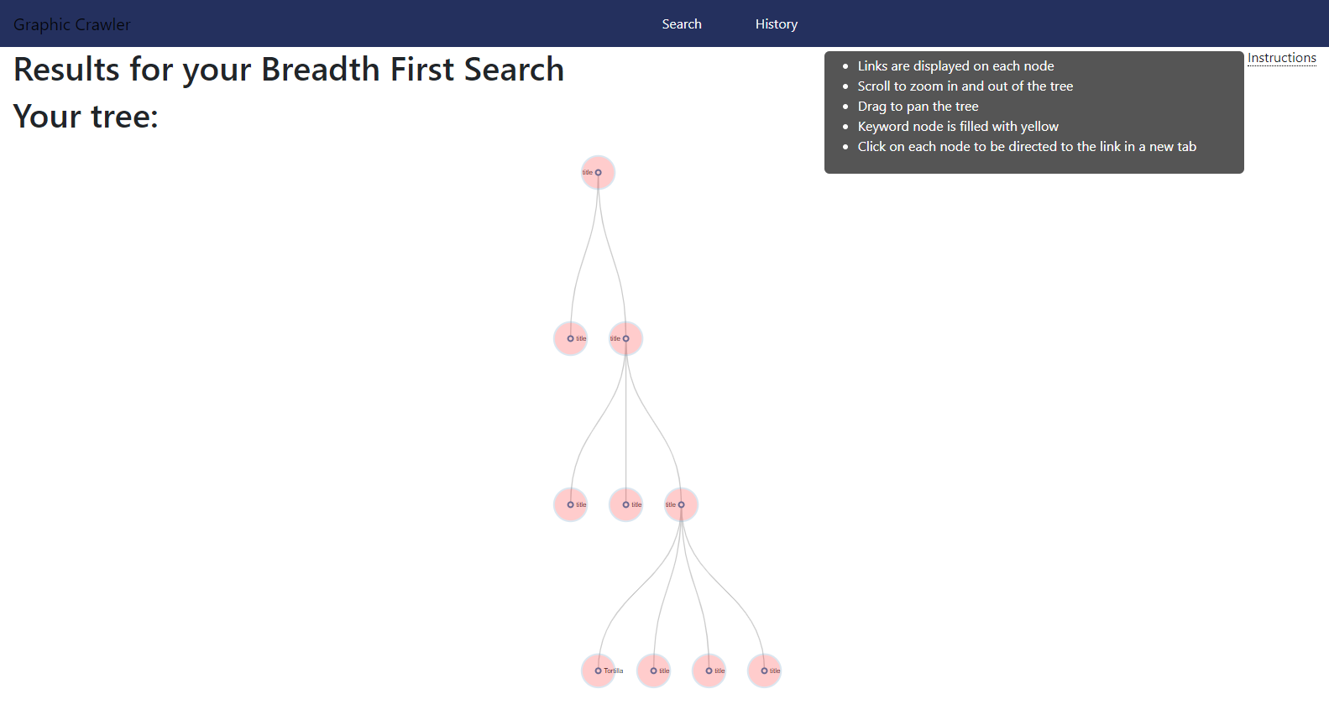
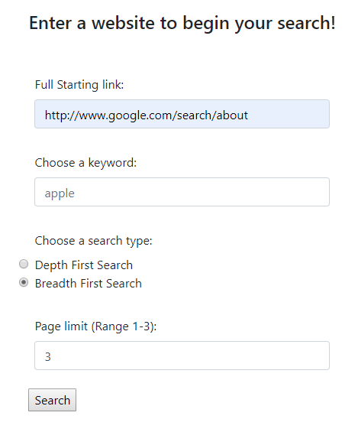
Gcrawler: Graphical web crawler
The GCrawler project is a graphical web crawler which crawls a user-supplied website, following links on each page as it goes. It displays a color-coded graph of what pages were crawled and how it reached each page. Try it out here: GCrawler App
gcrawler features:
Intuitive: Complete a simple form to crawl any website. Supply a keyword to search for text on each page. GCrawler will halt when it finds the keyword. (left).
Retentive: GCrawler stores your sessions’ past searches on the History tab for easy re-use.
Flexible: Choose from Depth First Search or Breadth First Search methods. Depth First Search will follow a random link on each page until the specified page limit (1-10) is reached. Breadth First Search will follow all links on each page until the specified depth limit (1-3) is reached. (left)
Informative: GCrawler’s color-coded results display the title of each page on the node. The URL can be seen by hovering over the node. A user can click the node to open the page. (above)
Good Bot: GCrawler adheres to the Robot Exclusion Protocol by reading a page’s robots.txt file and abiding by its rules. It also evaluates pages and links for other indicators that it should not crawl the page or follow the links.
Connect with the gcrawlers:
Christopher Beall (Data Transfer): https://github.com/beallch
Helen Jiang (UI/Website): https://github.com/hyjiang7
Brian Metzger (Crawler): https://github.com/metzgerb

