Slide 1
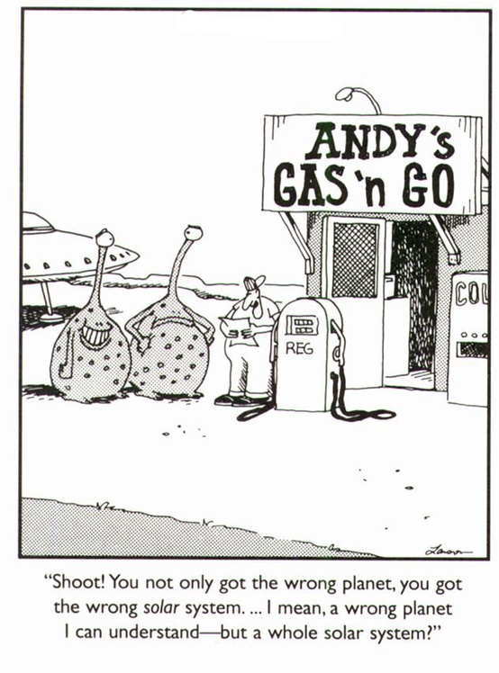
Cartoon Dataset
Robert Fischer

Slide 2
Cartoon Dataset
Dataset of Cartoons by Gary Larson
~2500 samples in total, for evaluation ~1500 (size of training set)
Each sample consists of: Cartoon (picture), punchline (text), id (integer), i_understand (boolean), funniness (1=not funny at all,…,7=very hilarious),
Created by myself for my diploma thesis DeepHumor with Dr. Horst Eidenberger
Primary goal: Model DNN which is able to predict how funny a cartoon is and “learn” humor
Visualization implemented using Python: Bokeh + Pandas + NLTK magic

Slide 3
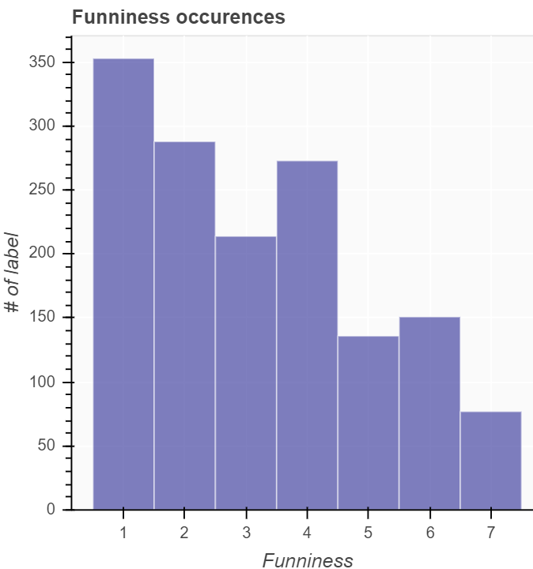

Slide 4
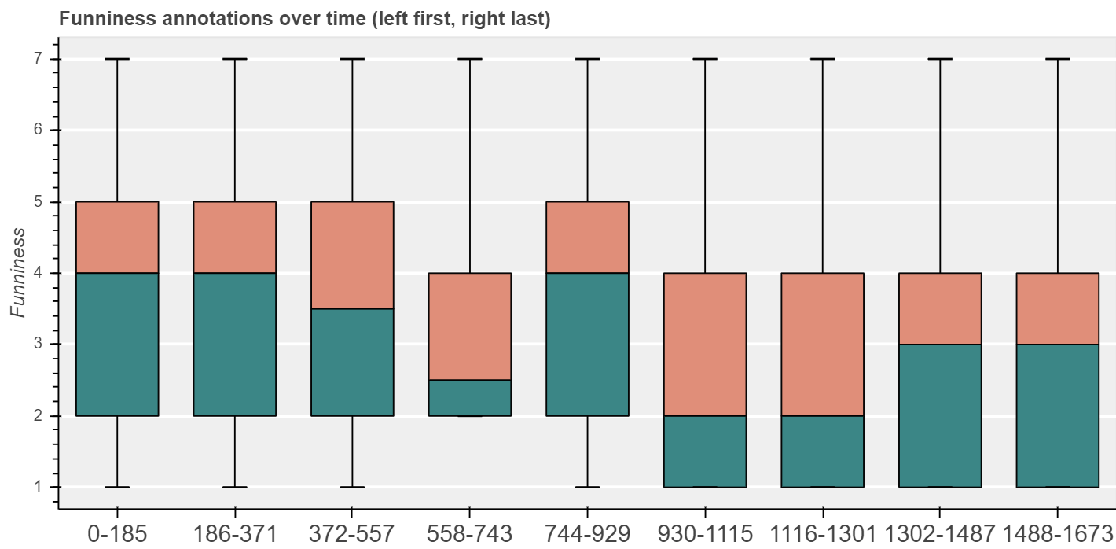

Slide 5
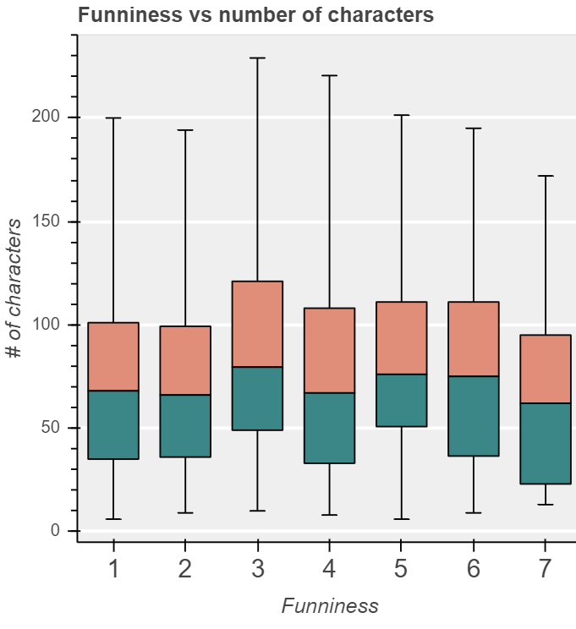

Slide 6
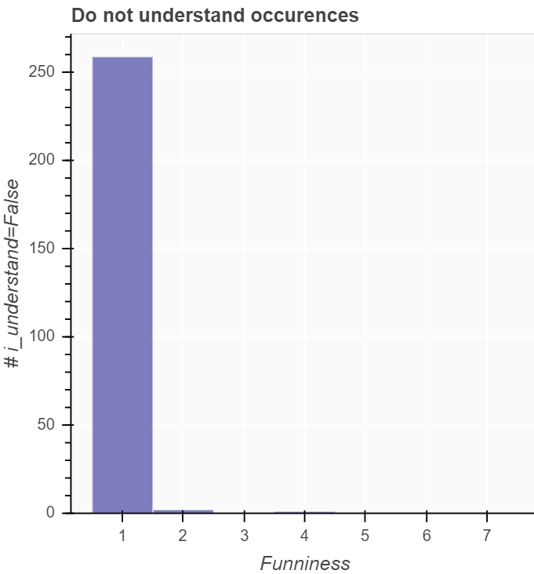

Slide 7
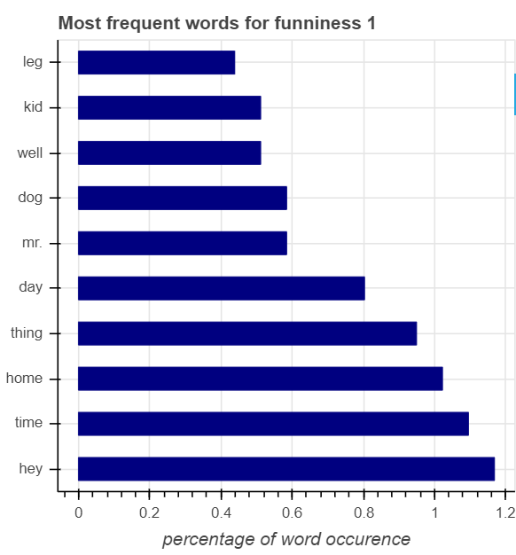
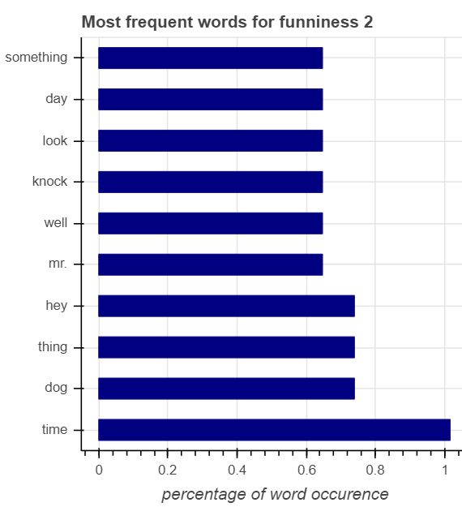

Slide 8
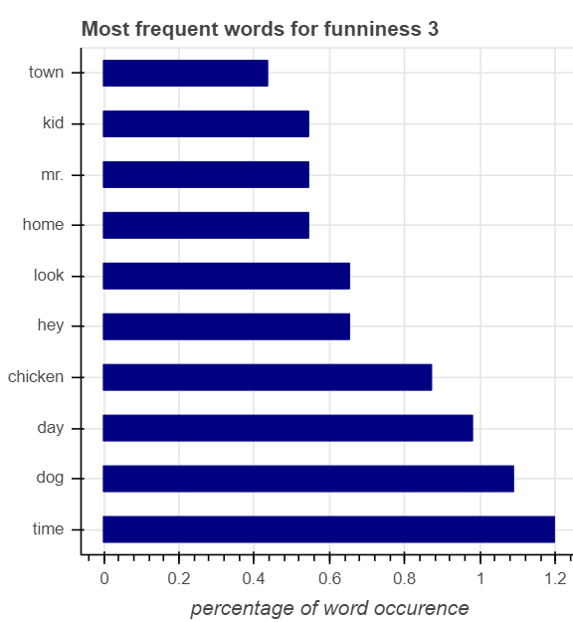
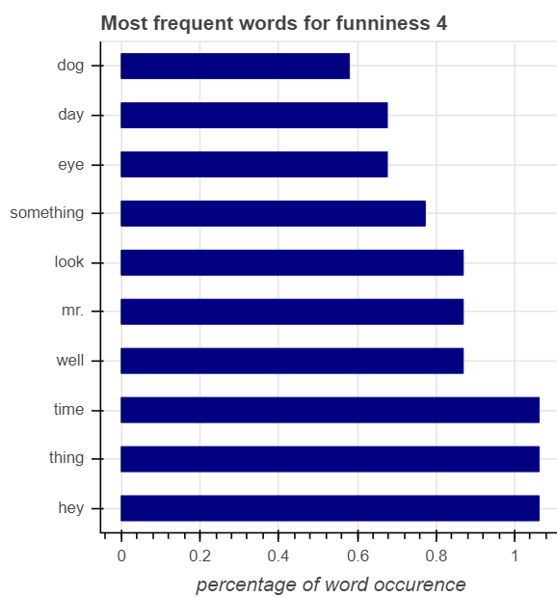

Slide 9
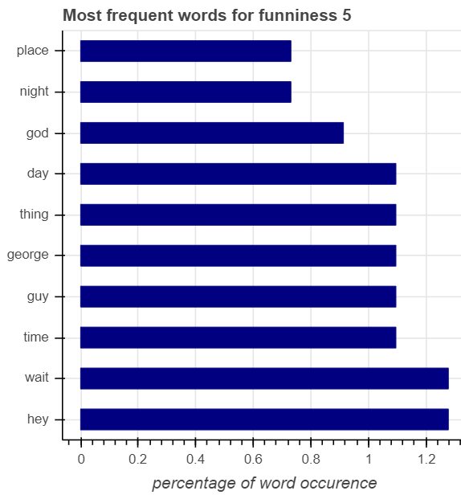
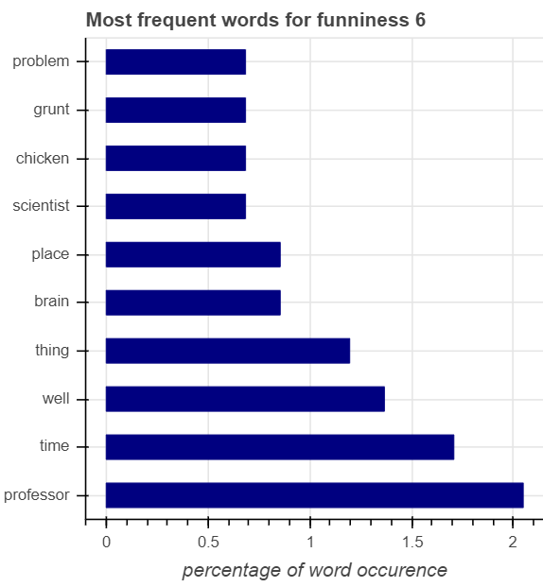

Slide 10
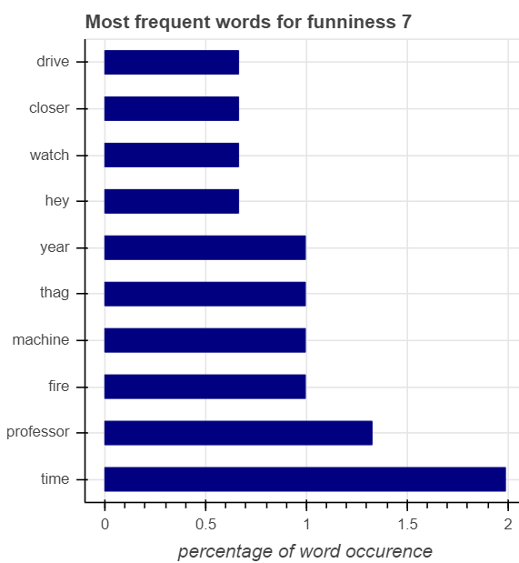

Slide 11
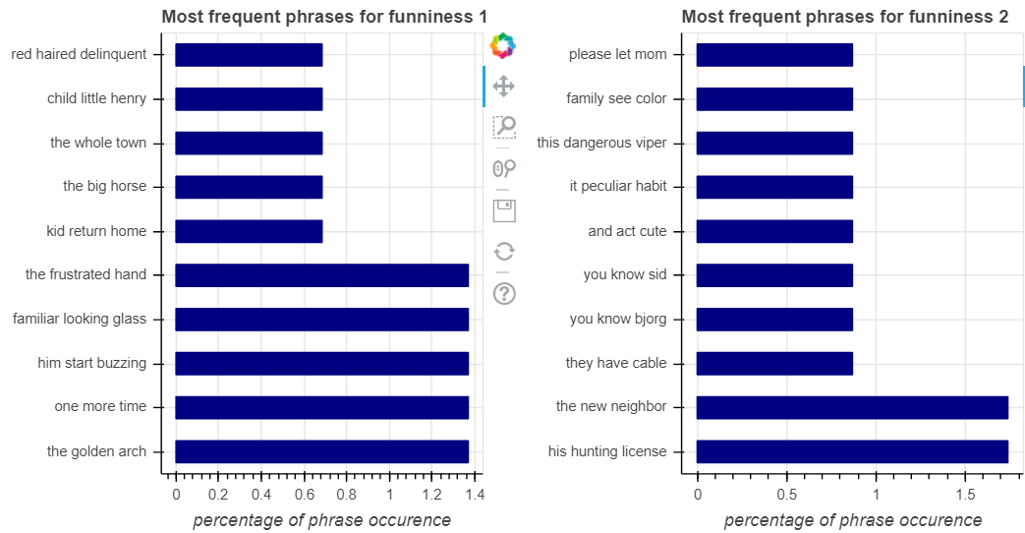

Slide 12
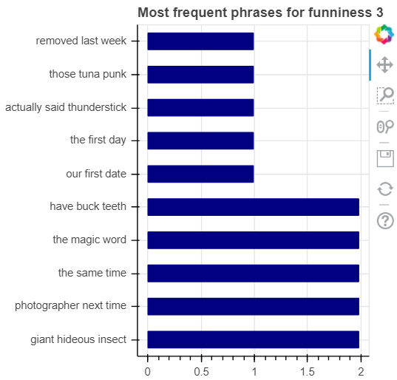
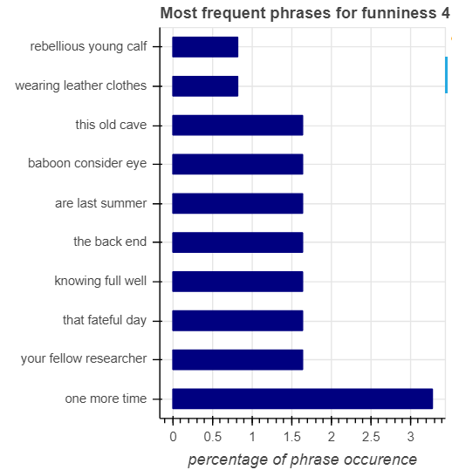

Slide 13
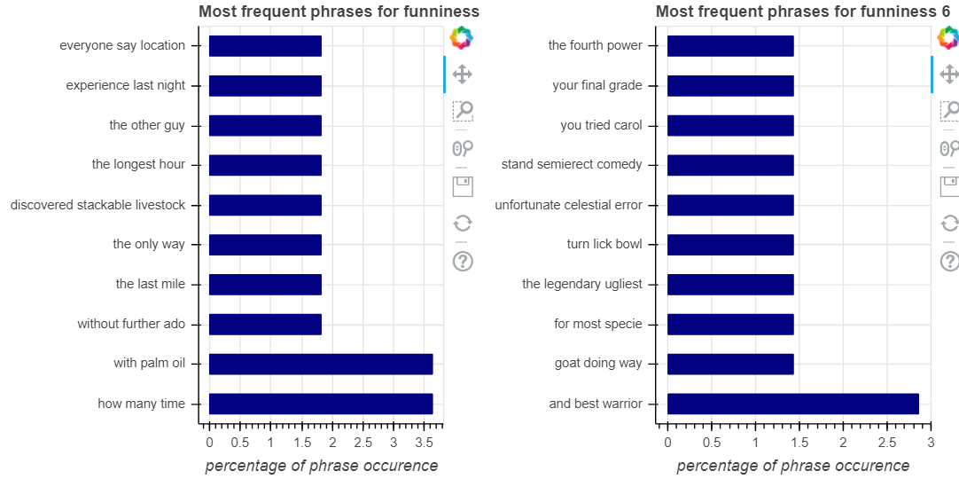
5

Slide 14
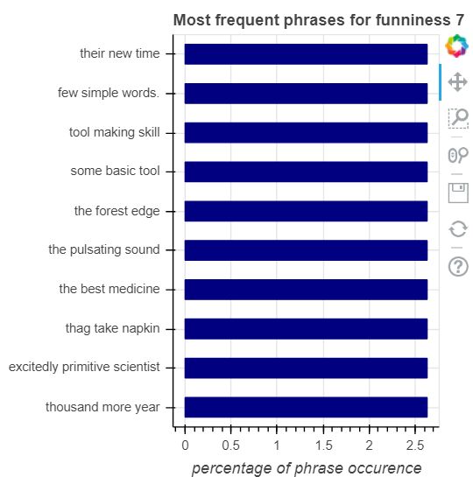

Slide 15
Sources
http://samfriedmansblog.blogspot.com/2016/06/june-13-gary-larson-cartoon-of-day.html

