Slide 1

Michael Eugene,
1/23/23

Slide 2
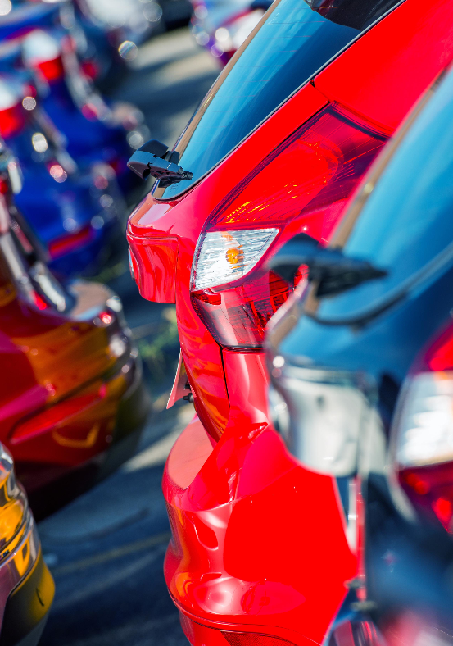
Summary
Using Data, we can predict the price of used cars in the currently declining car market. With used car Giants such as Carvana and others on the brink of bankruptcy we can used ML to capitalize on their downfall.

Slide 3
Agenda
Agenda & Table of Contents
1
Business Understanding
2
Data
3
Data evaluation
4
Recommendations
5
Next Steps & Conclusion

Slide 4

Business Understanding
Understanding the market
Utilizing Carvana’s Inventory
Used ML to predict car prices
Notes:
According to Forbes the online market is struggling post pandemic Carvana specifically.
There Inventory boomed during the pandemic and is now too large for them to sustain.
The data set we are going to used is Carvana's used car inventory

Slide 5
Data Understanding
Data
​Carvana Used Car Inventory
Contains over 20 thousand used cars
Ranging from 1995 to 2022
Important Numbers
The average price of a car in their inventory is 20k
The average amount of miles on their cars are 54k
Outliers
There are some older antic cars as well some new high-end cars
We will not be focusing on those

Slide 6
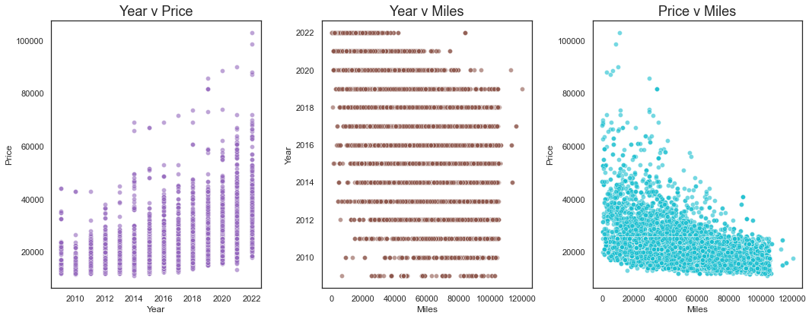
Understanding the market
Data

Slide 7
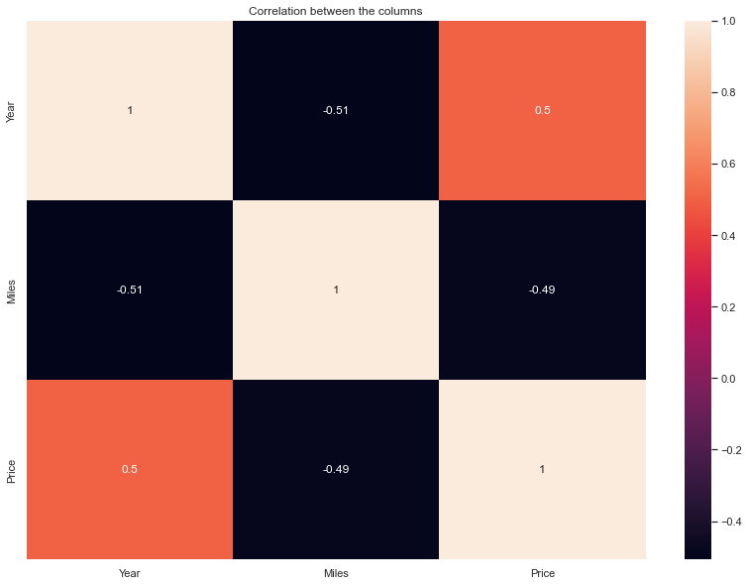
Understanding the market
Data

Slide 8
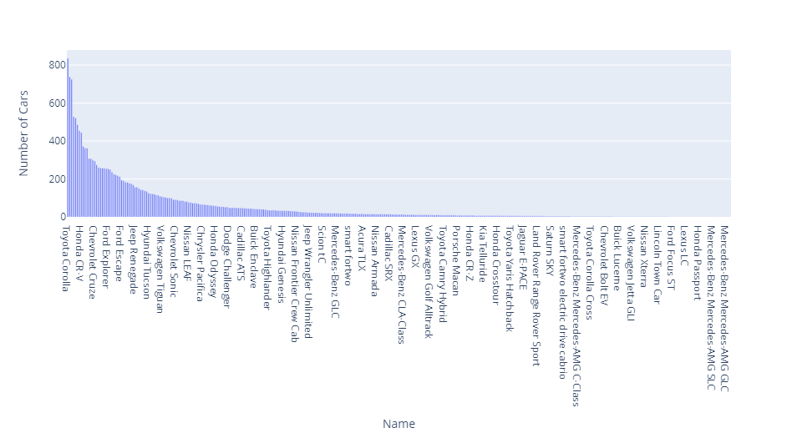
Carvana Used Car Inventory Visual
Data

Slide 9
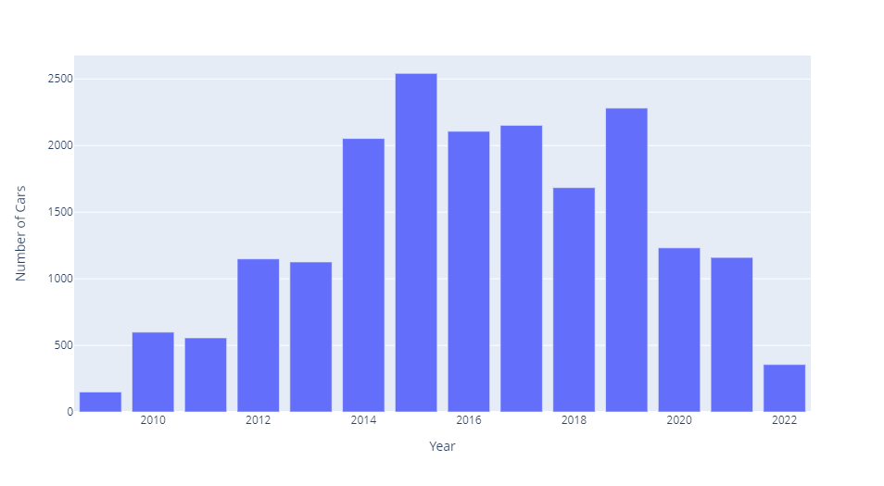
Carvana Used Car Inventory Visual pt. 2
Data

Slide 10
Prediction
Data
​The average price of a car in their inventory is 20k
We trained 3 different models
Decision Tree Regressor had the lowest amount error being able to predict within 1500$
The model predicted that the company show pay est. 18500$ for 2018 used car
Notes:
Linear Regression had an error of 3000
XB Boost had an error of 2500

Slide 11

Conclusion
Next Steps
In the future We would like to look at dataset with more values/categories to get a better understanding of the market
Notes:
While the dataset was up to date it only had the make/model/year/price key values that would of help get a more accurate prediction would things like mpg, fuel type, accidents history, owners etc.

Slide 12
Appendix

