Slide 1
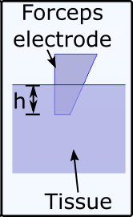
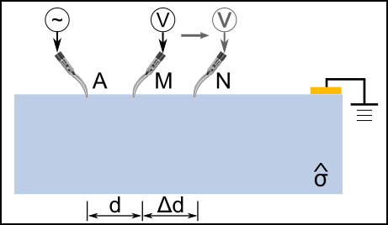
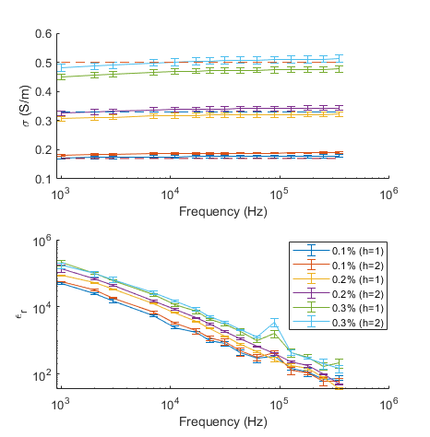
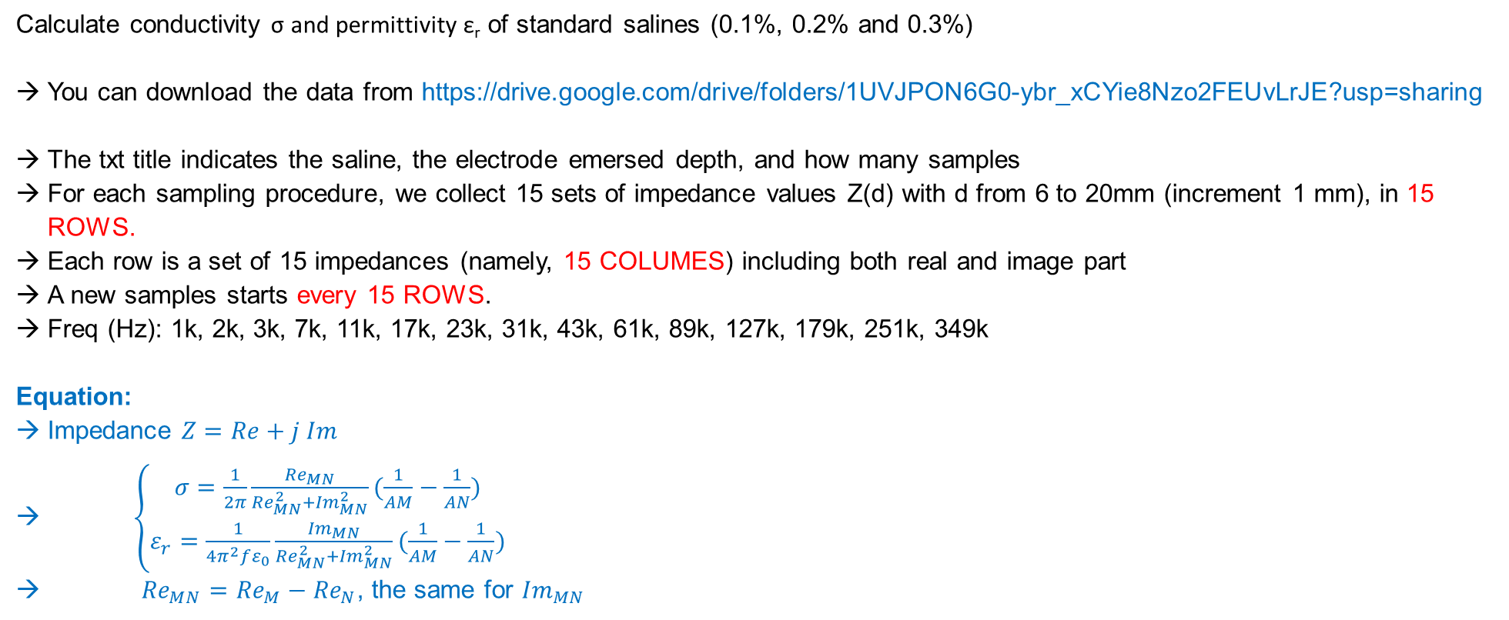
Exercise
Calculate conductivity σ and permittivity ε_{r} of standard salines (0.1%, 0.2% and 0.3%)
You can download the data from https://drive.google.com/drive/folders/1UVJPON6G0-ybr_xCYie8Nzo2FEUvLrJE?usp=sharing
The txt title indicates the saline, the electrode emersed depth, and how many samples
For each sampling procedure, we collect 15 sets of impedance values Z(d) with d from 6 to 20mm (increment 1 mm), in 15 ROWS.
Each row is a set of 15 impedances (namely, 15 COLUMES) including both real and image part
A new samples starts every 15 ROWS.
Freq (Hz): 1k, 2k, 3k, 7k, 11k, 17k, 23k, 31k, 43k, 61k, 89k, 127k, 179k, 251k, 349k
Equation:
Impedance $Z=Re+j Im$
$\left\{\begin{matrix}σ=\frac{1}{2π}\frac{{Re}_{MN}}{{Re}_{MN}^{2}+{Im}_{MN}^{2}}(\frac{1}{AM}−\frac{1}{AN}) \\ ε_{r}=\frac{1}{4π^{2}fε_{0}}\frac{{Im}_{MN}}{{Re}_{MN}^{2}+{Im}_{MN}^{2}}(\frac{1}{AM}−\frac{1}{AN})\end{matrix}\right.$
${Re}_{MN}={Re}_{M}−{Re}_{N}$, the same for ${Im}_{MN}$
Ref: "Robot Assisted Electrical Impedance Scanning for tissue bioimpedance spectroscopy measurement." Measurement.

