Slide 1

WHAT'S TOP-DOWN APPROACH AND HOW TO APPLY IT
Tainguyen~meumoc

Slide 2
1
2
3
4
5
1. Top-down Approach?
Advantage
Top-Down Approach
Disadvantage
Top-Down Approach
How to Apply Top-Down Approach
Tips for Top-Down Approach

Slide 3

1.Top-Down Approach
A top-down approach is a structured method that begins with the big picture and then gradually focuses on the details.

Slide 4

2.Advantage of Top-Down Approach
1
Clear Direction 🎯
2
Efficient Resource Allocation 📊
Provides a clear vision and direction for the entire organization.
Optimizes resource allocation by focusing on high-level goals.
3
Easy to understand and implement 🤝

Slide 5

3.DISADVANTAGES OF THE TOP-DOWN APPROACH
1
Dependency on Existing Knowledge: ✋
2
Limited Innovation 🚀
- Innovation and creativity may be stifled, as ideas and suggestions.
- Existing knowledge → limitation when dealing with novel or complex problems.
3
Inflexible to change ⏳
- Slow response to change.

Slide 6
4.HOW TO APPLY TOP-DOWN APPROACH
Clarity of Vision
Strategic Alignment
Effective Communication
Define a clear and compelling vision for the organization.
Ensure alignment of high-level objectives with day-to-day activities.
Communicate the top-down strategy clearly and consistently across the organization.

Slide 7



5.TIPS FOR TOP-DOWN APPROACH
Prepare carefully at the beginning.
Create a mind-map
Using bottom-up approach

Slide 8
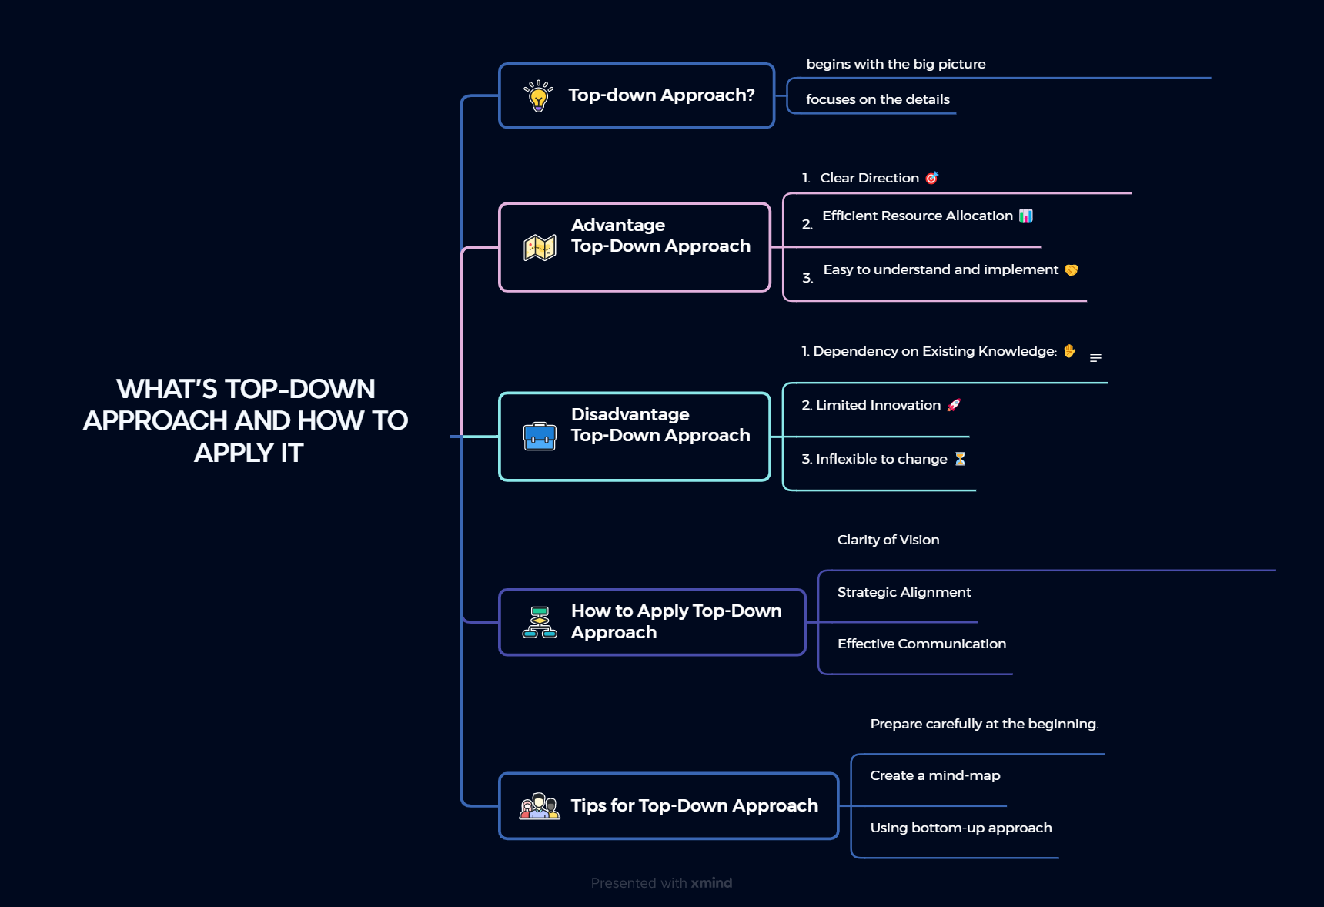

Slide 9
THANKS FOR WATCHING

