Slide 1
Web Tools Final Project
Meven DCunha - 001205003

Slide 2

Idea
Something for Music Lovers

Slide 3
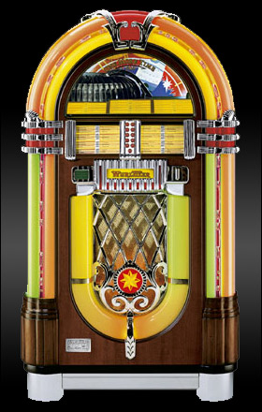
JUKEBOX

Slide 4
SYNC
A collaborative music player where users can join a “music room”, listen to the same tracks and add queue up music to listen to
Just like the good old JUKEBOX! but better

Slide 5
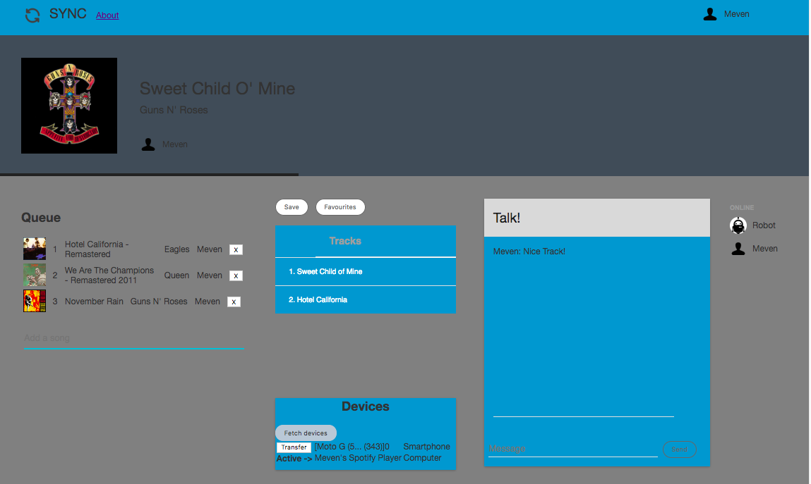

Slide 6
Features
Users with the same taste in music can listen to music in sync in real time.
Users in the same room can communicate with each other with the group chat feature.
Users can up-vote a song added to a queue based on their personal preferences.

Slide 7
Features
If no user has put a song in the queue, a bot is configured to play Spotify suggested songs in the room.
There is an option to transfer the music to another device configured to that Spotify account.
A user can save favorite tracks and can fetch them later in another session.

Slide 8
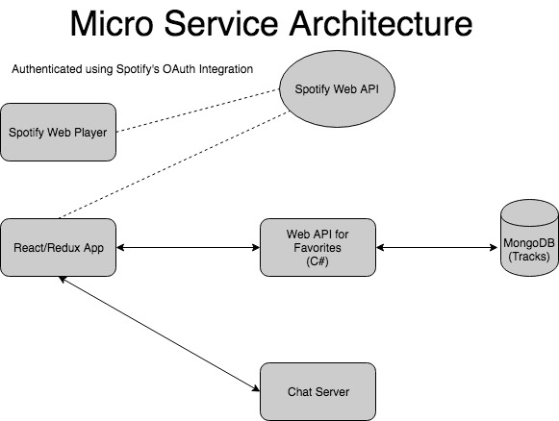

Slide 9
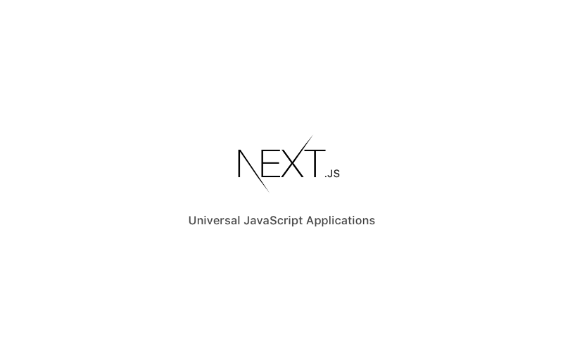
Background
Next.js was open-sourced 25th October 2016. The company behind Next is called ZEIT.

Slide 10
Next.js
Next.js is backed by an organization which is stable and is also very active in the open-source world. Next is not going away in a couple months and most likely is here to stay.
Why should I care? — I already know how to make quality React apps.
Being a developer means being a student for life

Slide 11
Features of Next.js
Ease of Use
Automatic Code Splitting
Prefetching
Server Side Rendering
HMR and Error Reporting

Slide 12
Next.js
https://learnnextjs.com/
https://www.codementor.io/tgreco/5-of-the-many-things-to-love-about-zeit-s-next-js-bpszu99g1#automatic-code-splitting
https://hackernoon.com/next-js-react-server-side-rendering-done-right-f9700078a3b6
https://medium.freecodecamp.org/server-side-rendering-your-react-app-in-three-simple-steps-7a82b95db82e (How SSR improves your react app performance)

Slide 13
What’s Next
Music Room Creation
Limit the number of users per room
Authentication to join a room
Integrate with Facebook API as well to get user details
Integrate with user’s Twitter profile to get recommendations
Integrate with a lyrics generator app
Integrate with a chord generator app

Slide 14
