Slide 1
Who wrote that song?
A neural network for predicting
classical composers
Mark Evers

Slide 2
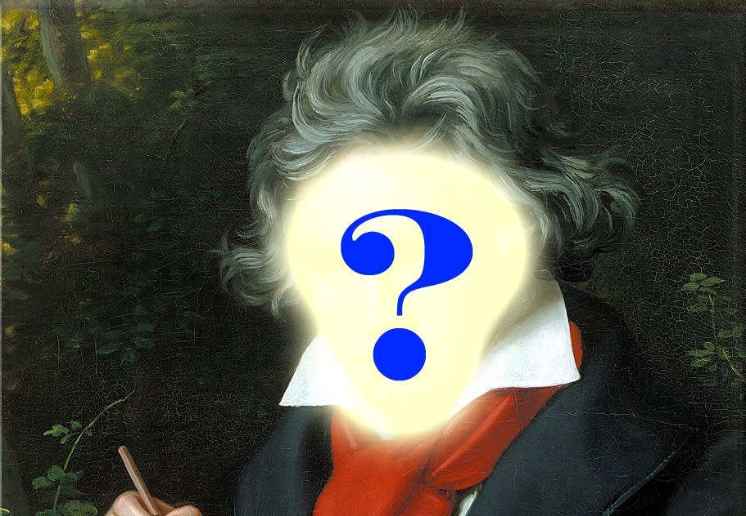
How are we able to recognize new songs by our favorite musicians?

Slide 3
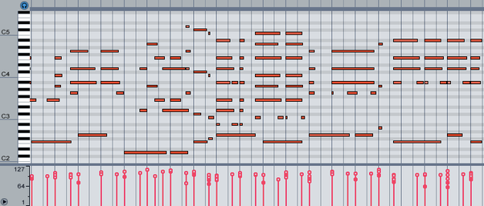
MIDI Files
Acronym for Musical Instrument Digital Interface
Binary file format
Sheet music for computers

Slide 4
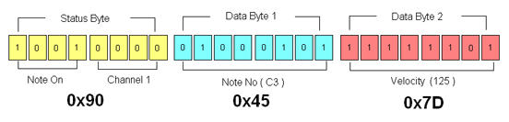
Challenge: Converting into usable input
MIDI is a data protocol
MIDI Message Structure
MIDI files are a timestamped sequence of MIDI
messages
Must be converted into a sequence of k-hot vectors.

Slide 5
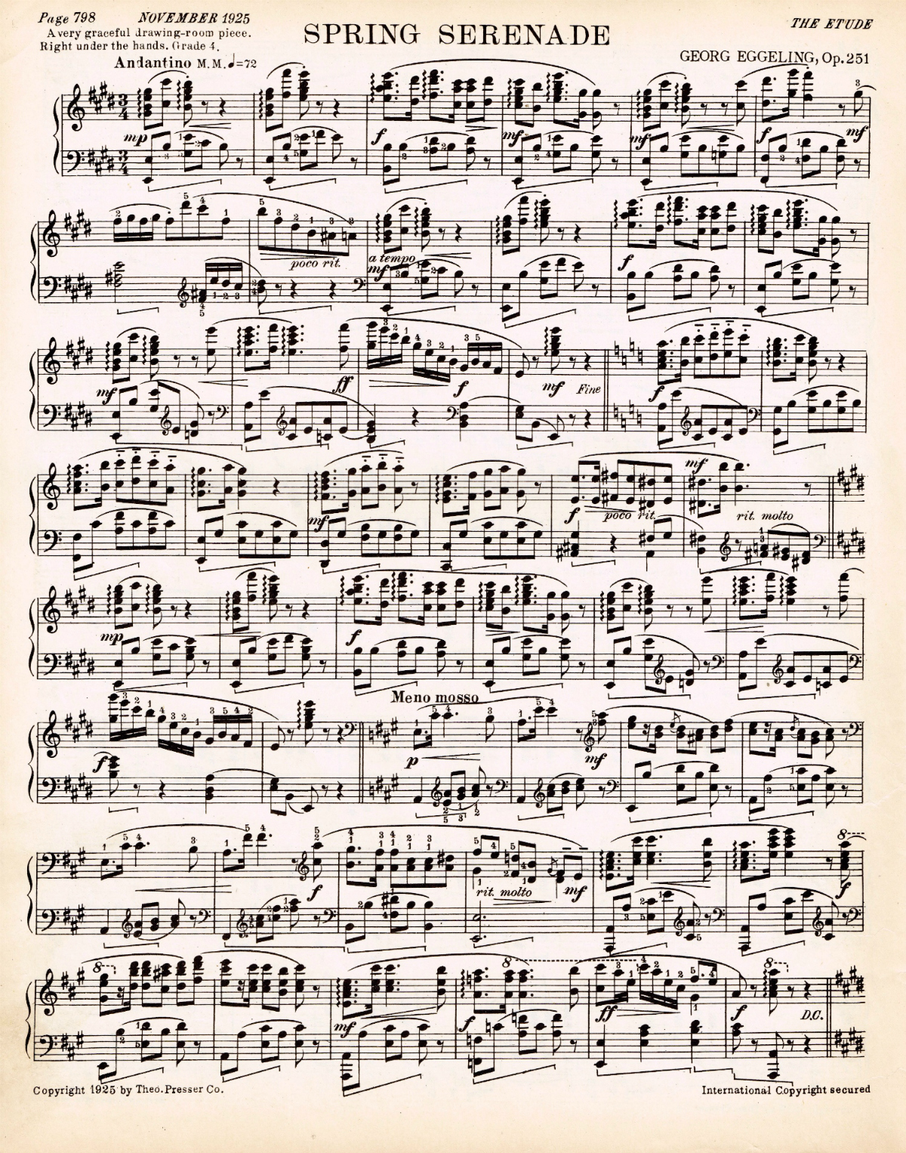
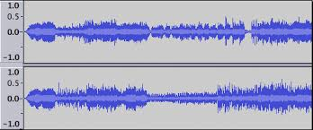
Input
It’s not audio!
Yes:
No:

Slide 6
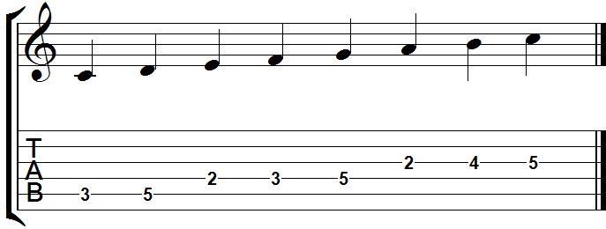
Music Notation
Vector Notation
n | C | C# | D | D# | E | F | F# | G | G# | A | A# | B | 1/2 | 1/4 | 1/8 | 1/16
1 | 1 | 0 | 0 | 0 | 0 | 0 | 0 | 0 | 0 | 0 | 0 | 0 | 0 | 1 | 0 | 0
2 | 0 | 0 | 1 | 0 | 0 | 0 | 0 | 0 | 0 | 0 | 0 | 0 | 0 | 1 | 0 | 0
3 | 0 | 0 | 0 | 0 | 1 | 0 | 0 | 0 | 0 | 0 | 0 | 0 | 0 | 1 | 0 | 0
4 | 0 | 0 | 0 | 0 | 0 | 1 | 0 | 0 | 0 | 0 | 0 | 0 | 0 | 1 | 0 | 0
5 | 0 | 0 | 0 | 0 | 0 | 0 | 0 | 1 | 0 | 0 | 0 | 0 | 0 | 1 | 0 | 0
6 | 0 | 0 | 0 | 0 | 0 | 0 | 0 | 0 | 0 | 1 | 0 | 0 | 0 | 1 | 0 | 0
7 | 0 | 0 | 0 | 0 | 0 | 0 | 0 | 0 | 0 | 0 | 0 | 1 | 0 | 1 | 0 | 0
Time

Slide 7
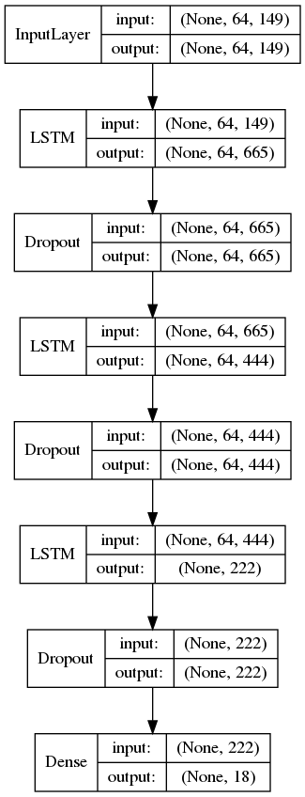
Neural Net Architecture
Recurrent Neural Network
Long Short Term Memory
Analyzes sequences of notes for patterns

Slide 8
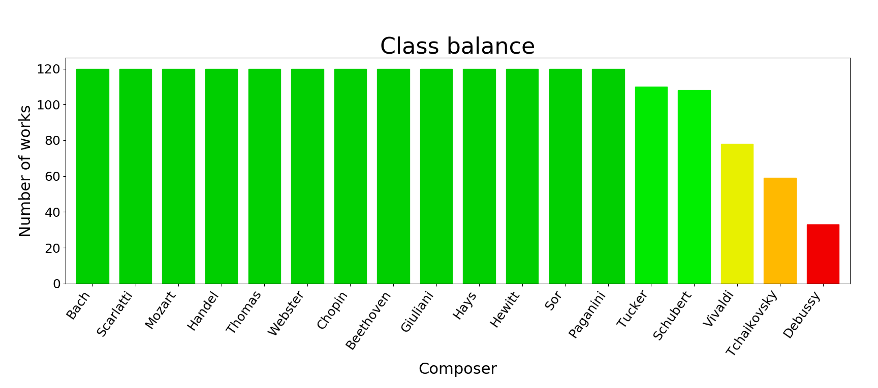
Composers
Bach
Beethoven
Chopin
Debussy
Giuliani
Handel
Hays
Hewitt
Mozart
Paganini
Scarlatti
Schubert
Sor
Tchaikovsky
Thomas
Tucker
Vivaldi
Webster

Slide 9
Results
Test categorical accuracy: 67.76%
Random guess accuracy: 5.56%
67.76%
5.56%

Slide 10
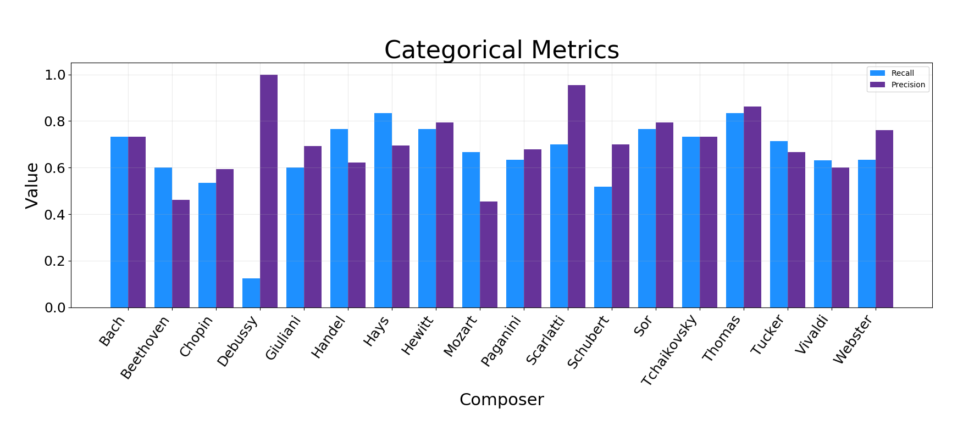
Categorical Metrics
Debussy had trouble from the class imbalance
Mozart and Beethoven have low precision

Slide 11
http://WhoWroteThatSong.net
Mark Evers
mevers303@gmail.com
linkedin.com/in/mevers303
github.com/mevers303/whowrotethatsong
Stack logos!

