Slide 1
假期进展汇报（二）
2022.01.13
姜新寅

Slide 2
What Context Features Can Transformer Language Models Use?
本文试图回答长文本中的哪些信息对Transformer为基础的语言模型有效

Slide 3
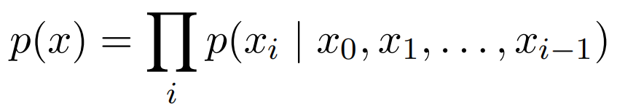
Approach
Most learned LMs do so by decomposing p(x) according to the chain rule and modeling the conditional distribution over a single target token given a (fixedor variable-length) context of previous tokens：
In transformer language models, this conditional distribution is modeled via a sequence of alternating neural feed-forward layers and self-attention layers

Slide 4
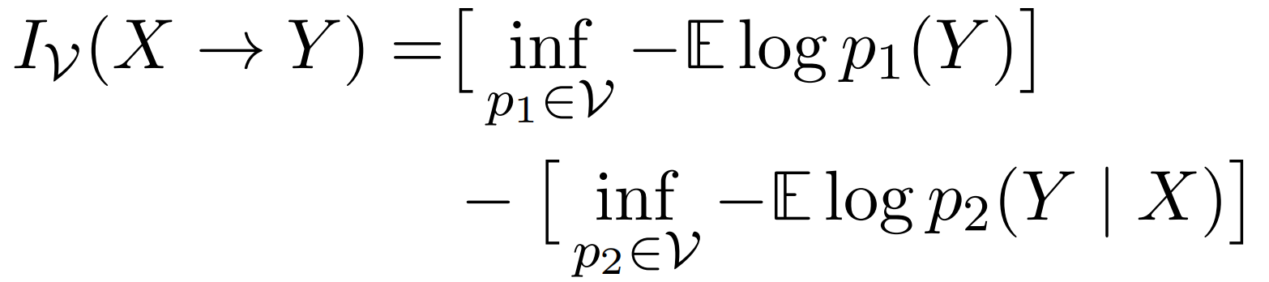
Approach
we wish to understand when (and why) increasing the size of the context improves model predictions.
Definition 1. The usable predictive information(formally, predictive V-information) from a random variable X to a random variable Y as：

Slide 5
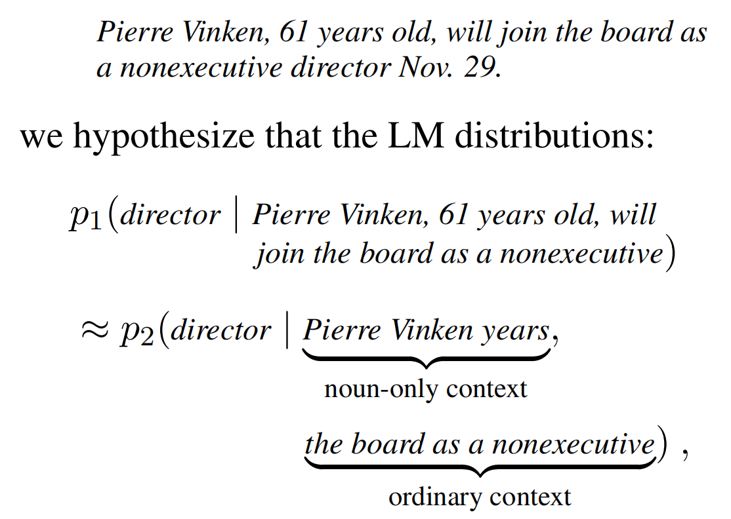

Approach
let us hypothesize that more than five tokens away from the target,models are only able to extract usable information from nouns.

Slide 6
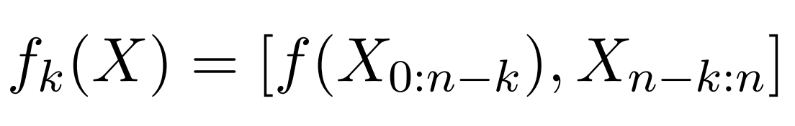
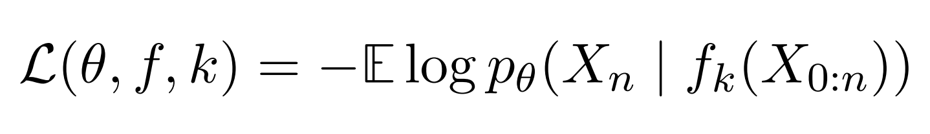
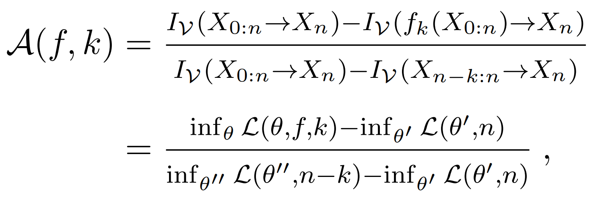
Approach
ablated context：
ablated negative log-likelihood：
Definition 2. The ablated information due to an ablation f at an offset k is:

Slide 7
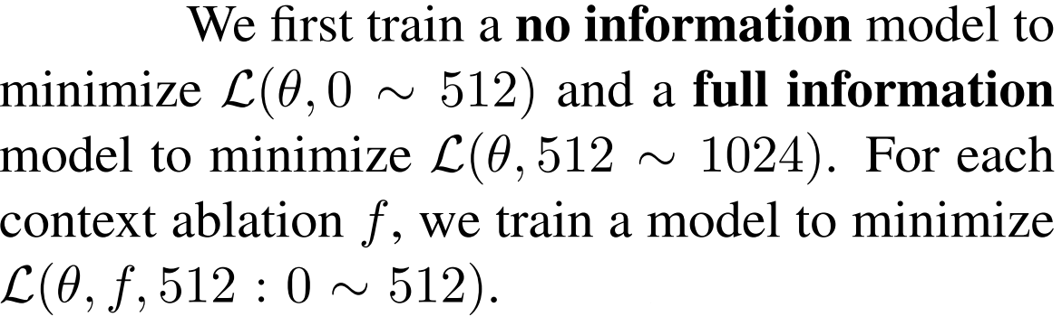
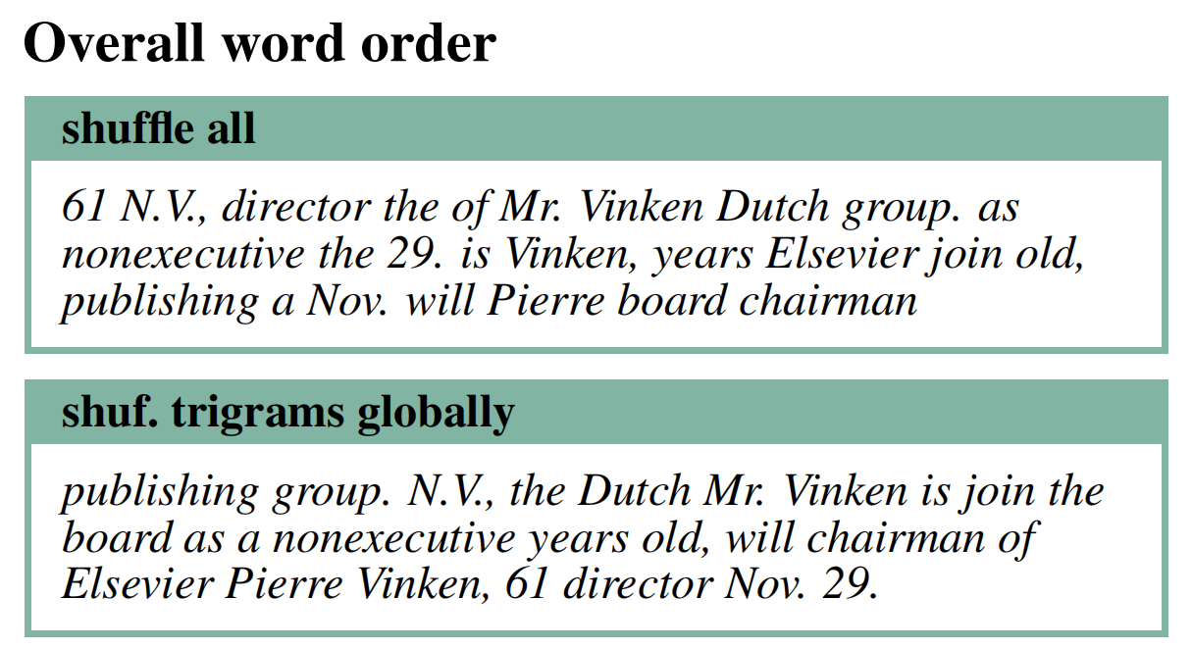
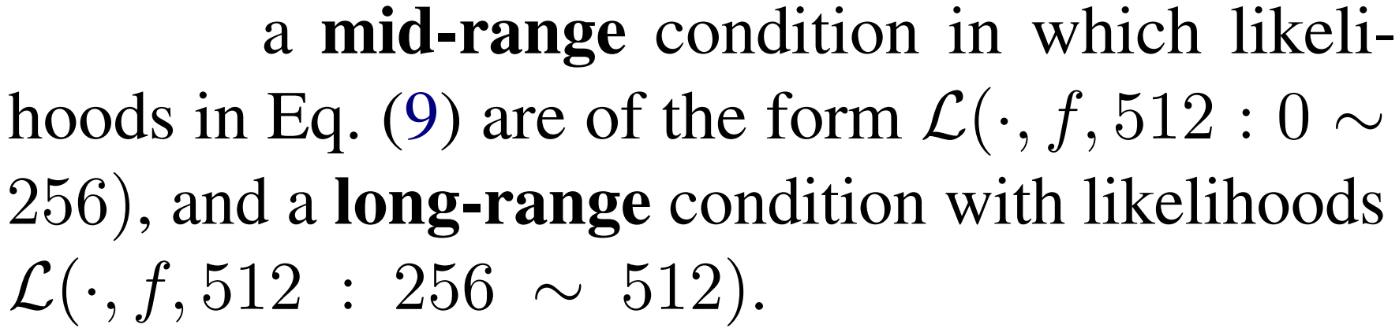
Experiments
Does order matter?
mid:41%
long:84%
mid:31%
long:50%
ordering information is important even very far from the target
local co-occurrence statistics carry a significant amount of usable information.

Slide 8
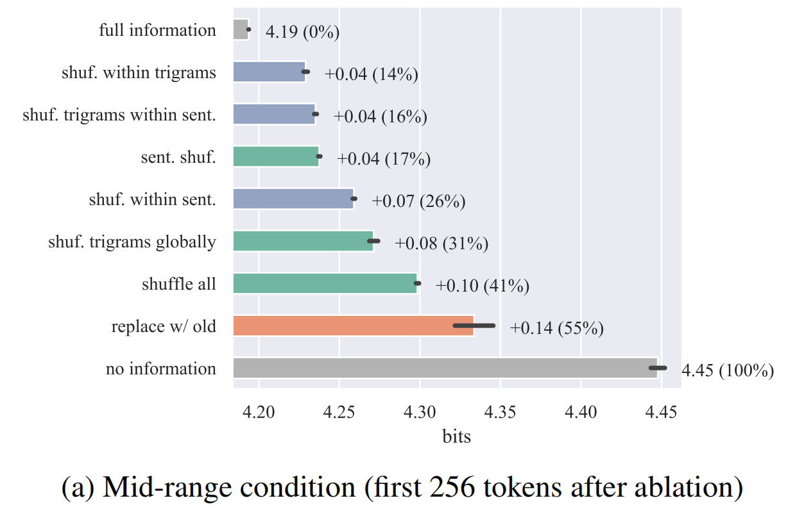
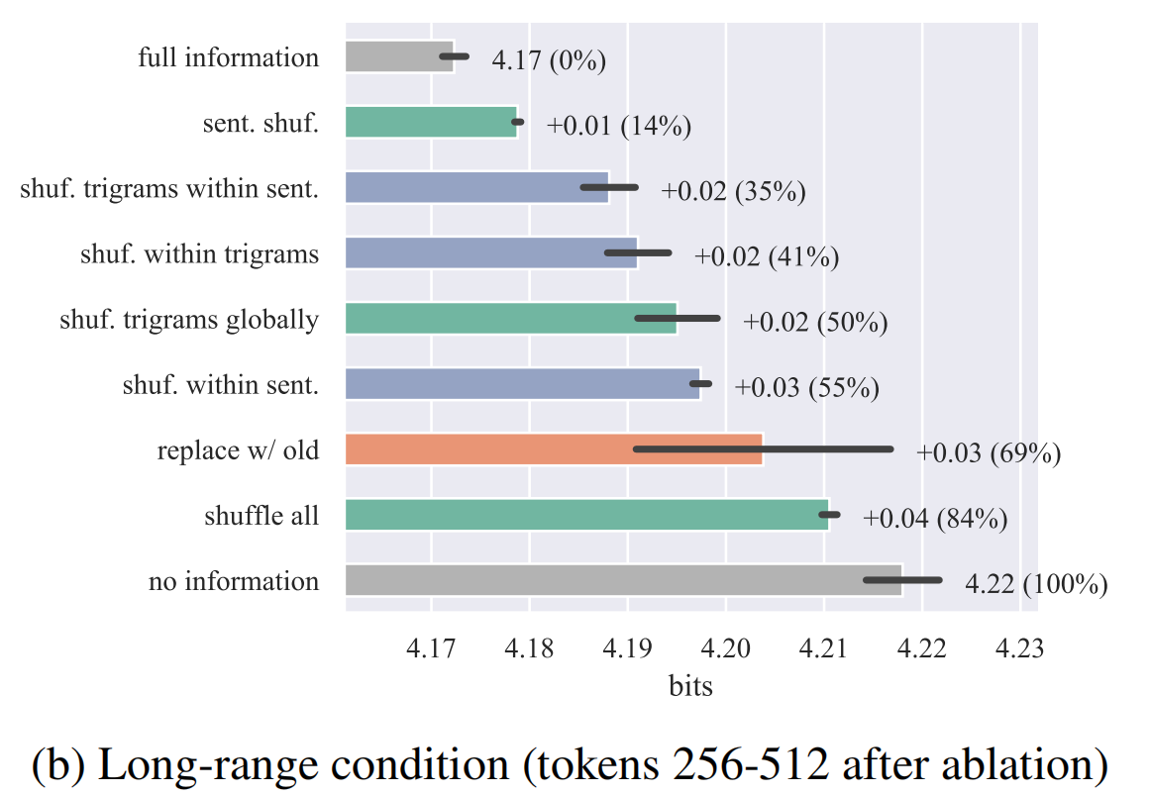
Experiments
The x axis shows ablated likelihood.
Figure:Effect of word order on usable information.

Slide 9
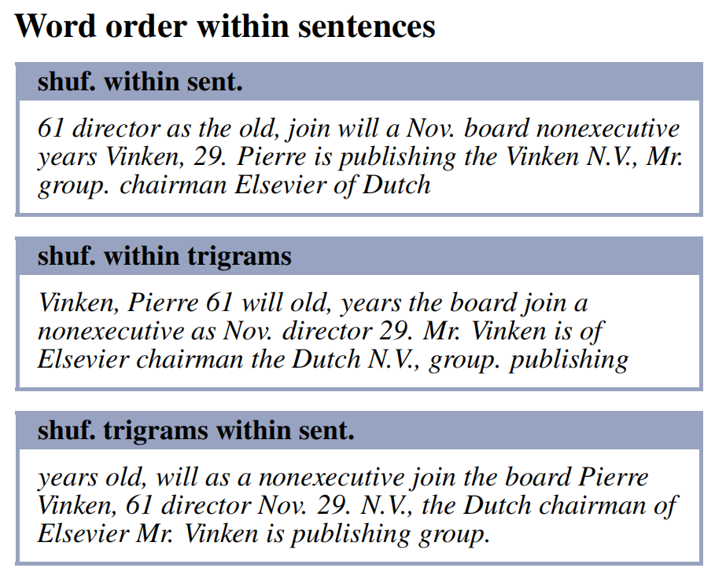
Experiments
a uniform random permutation of all the words in the sentence
a uniform random permutation of the words within each non-overlapping trigram in the sentence
a uniform random permutation of the order of the trigrams within the sentence
Usable information is decreased only slightly by ablations that preserve local co-occurrence statistics and/or linear information flow.

Slide 10
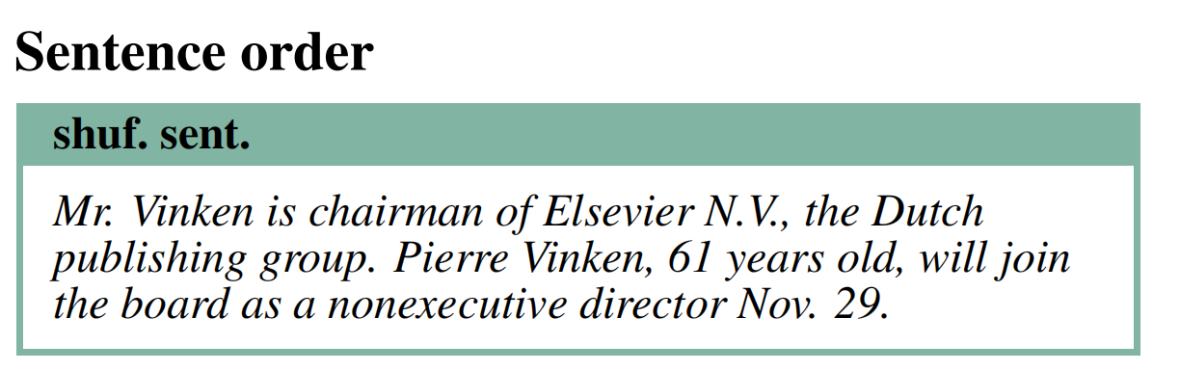
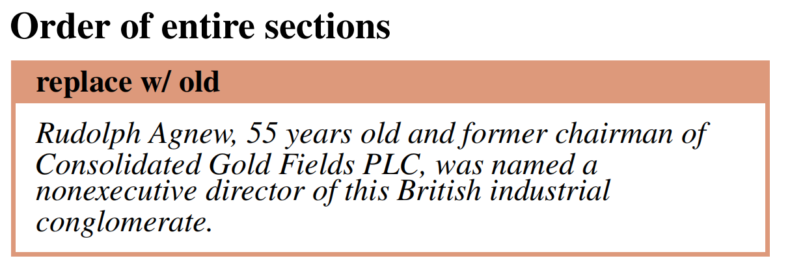
Experiments
prediction accuracy depends on infor mation about local word co-occurrence, but not fine-grained word order or global position.

Slide 11
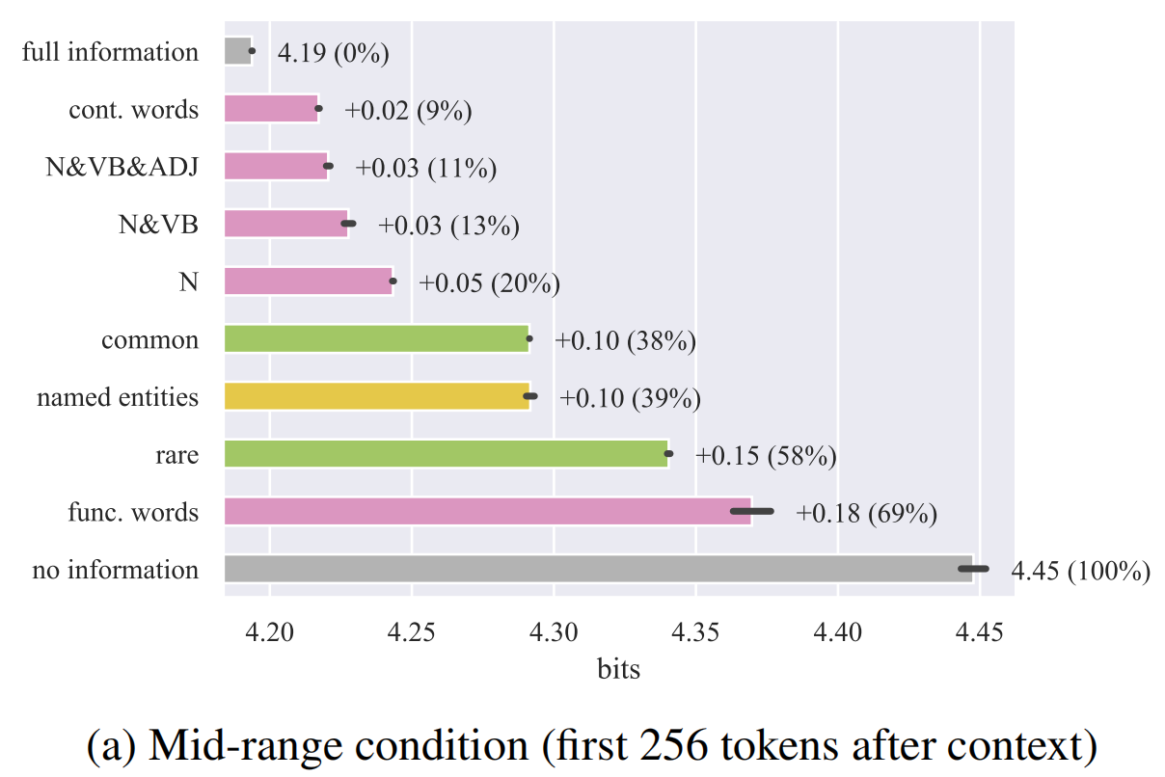
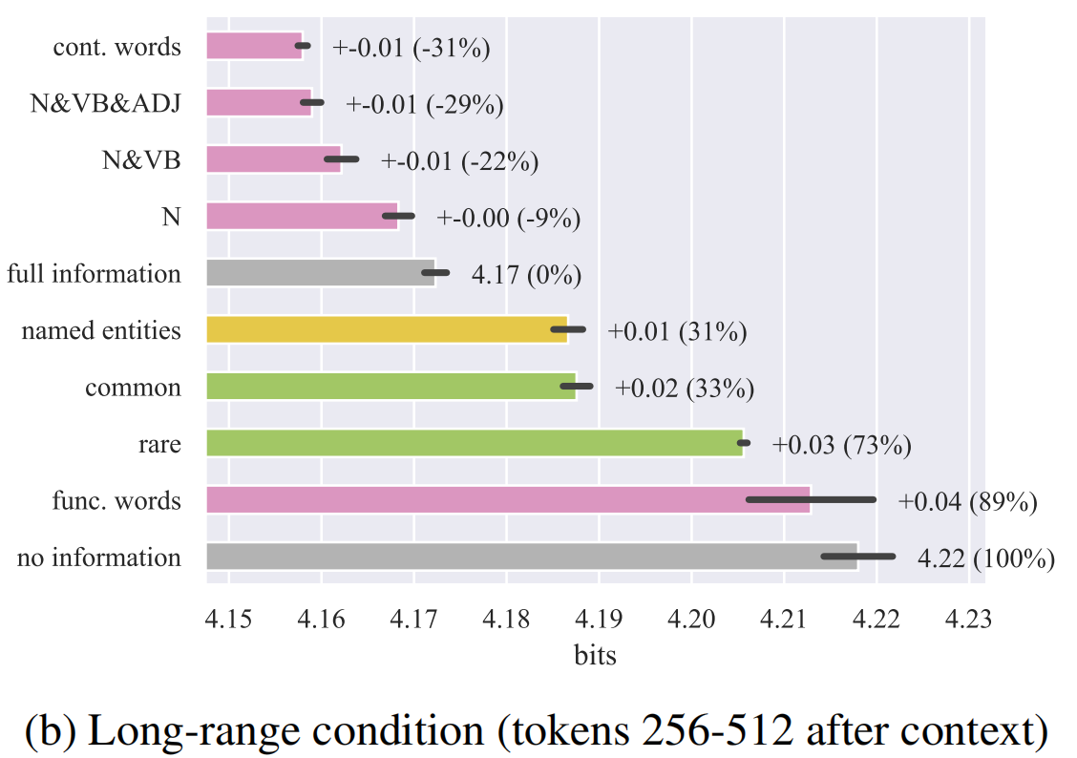
Experiments
Figure: Effect of word identity on usable information.
Long-range context is not simply a source of topic information: earlier text on the same theme is in some cases nearly as uninformative as no text at all.

Slide 12
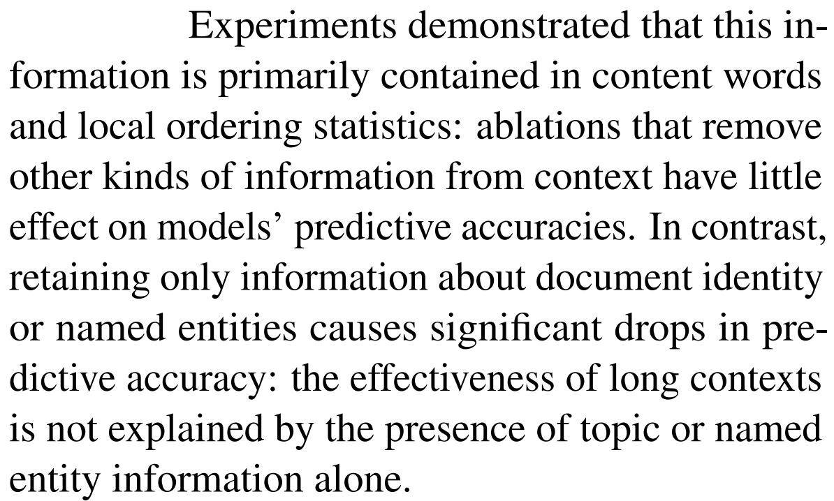
Conclusion

Slide 13
THANK YOU

