Slide 1
BIG DATA ANALYTICS (BIS701) · PROJECT PRESENTATION
DRISHTI दृष्टि
Disaster Risk Intelligence & Situational Hazard Tracking Interface
Disaster & Emergency Intelligence System: A MongoDB-Based Big Data Analytics Platform
Vichitra Attri 1BI23IS135
Vidhyashree S 1BI23IS136
Vidya Bai K 1BI23IS137
Vikram K 1BI23IS138
Under the guidance of
Prof. Roopa B
Assistant Professor, Dept. of ISE
Department of Information Science & Engineering · Bangalore Institute of Technology · 2026-27
Notes:
Introduce the team and the project. DRISHTI means "vision / sight" in Hindi - the system gives authorities the ability to SEE disaster risk early. Full form: Disaster Risk Intelligence & Situational Hazard Tracking Interface.

Slide 2
Floods move fast. Decisions are slow.
A few hours of delay in spotting heavy rainfall or a rising river can decide how an emergency response ends.
Hours matter
Early warning signs - heavy rain, fast-rising rivers - must be caught as they happen, not in next week's report.
Data is scattered
Spreadsheets, paper reports and disconnected monitoring tools force analysts to piece the picture together by hand.
Rising urbanisation and unpredictable climate patterns make early detection harder every year.
Data keeps growing
IoT sensors, weather stations and satellites produce large, varied, fast-growing records that need scalable storage.
Notes:
Floods, cyclones and extreme rainfall are among the most frequent and destructive natural disasters. A few hours of delay in noticing a rising river changes the outcome of the response. The problem is not lack of data - it is lack of an integrated, analysable view of it.

Slide 3
Problem statement: why existing systems fall short
Limited data processing
Static datasets support record-keeping, not large-scale processing of rainfall, river and weather records.
1
Static files & manual reports
Spreadsheets and paper reports make centralised management and analysis difficult.
2
Limited analytical insight
Little region-wise, time-based or severity-based risk analytics.
3
Anomalies go unnoticed
Rainfall spikes and rapidly rising rivers are hard to detect without a database built for analytical queries.
4
No interactive exploration
Users cannot drill into location-specific risk statistics on demand.
5
Notes:
Read the five drawbacks. The synopsis problem statement: there is no centralised, interactive, analytics-oriented disaster-intelligence platform that combines MongoDB storage and aggregation with map-based visualisation.

Slide 4
Objectives
Store at scale
Process with pipelines
Analyse history + live
Rainfall, river-level, weather and risk-zone data in MongoDB
MongoDB queries and aggregation pipelines instead of static files
Understand regional weather and river-level patterns
Map high-risk areas
Detect anomalies
Support decisions
Location-based data on an interactive risk map
Unusual rainfall, river and weather changes flagged early
Dashboards, reports and insights for faster response
Notes:
These map one-to-one to the synopsis objectives. Every one is demonstrable in the live dashboard.

Slide 5
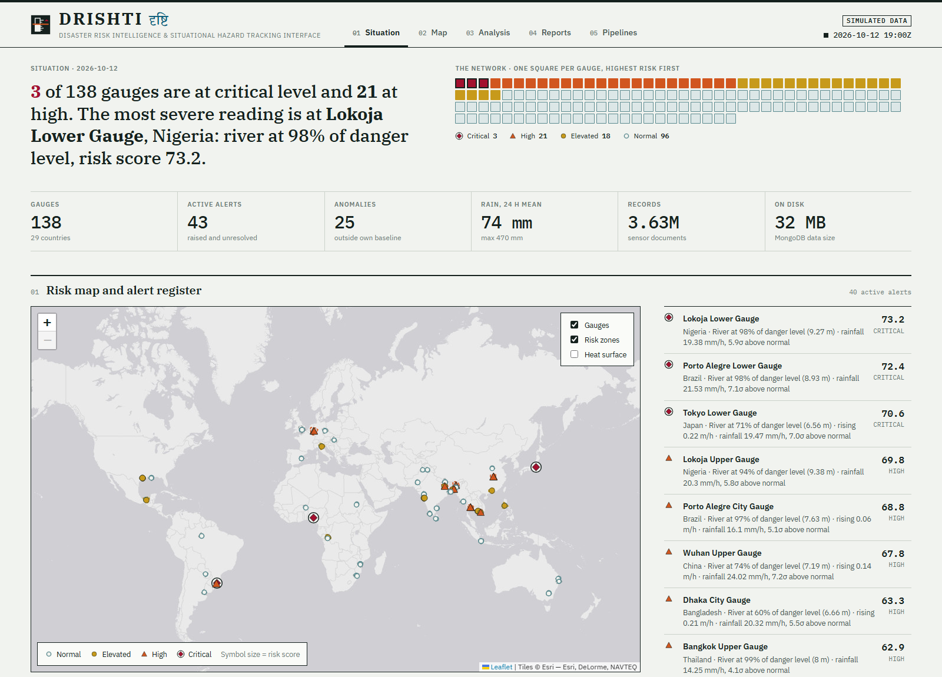
The solution: the DRISHTI situation room
World map of 138 river gauges in 29 countries
Risk score 0-100 per gauge, recomputed every live tick
Anomaly flags against each gauge's own baseline
Live alert feed that escalates and resolves
Drill-down hydrographs, weather and history
One-click situation reports
Notes:
This is the real application, running on a MongoDB with 3.6 million records. Left: key capabilities. Right: the Situation page: summary sentence, network at a glance, world risk map and live alert register.

Slide 6
System architecture
Data sources
Ingestion
MongoDB
Aggregation
Express API
React dashboard
Rainfall gauges
River levels
Weather stations
Risk-zone polygons
Historical events
Validate & clean
Normalise units
Synthetic sensor generator
Enrich with location
Time-series collections
2dsphere indexes
Flexible documents
Baselines via $merge
Risk scoring
Anomaly detection
Trends & rankings
Window functions
REST endpoints
Caching per tick
Alert lifecycle
Report generation
Risk map & heatmap
Charts & KPIs
Alert feed
Reports
▶
▶
▶
▶
▶
Client-server architecture: React.js frontend · Node.js + Express.js backend · MongoDB database (as proposed in the synopsis)
Notes:
Walk the flow left to right. Data enters, is validated and stored as documents in MongoDB, aggregation pipelines compute risk and anomalies inside the database, Express exposes REST APIs and React renders the map and charts.

Slide 7
MongoDB data model: 11 collections
Collection | Kind | Holds | Notable index
stations | standard | 138 gauges, thresholds, GeoJSON location | 2dsphere on location
rainfall_records | time-series | hourly rainfall mm, intensity class | meta stationId + ts
river_levels | time-series | level m, discharge, optional tide | meta stationId + ts
weather_data | time-series | temperature, humidity, wind, pressure | meta stationId + ts
risk_zones | standard | 46 flood-zone polygons + classification | 2dsphere on geometry
disaster_events | standard | 900 historical events with impact | 2dsphere + date
station_baselines | derived | mean, σ, p95, p99 per gauge ($merge) | _id = stationId
risk_snapshots / alerts / reports | derived | risk history, alert lifecycle, situation reports | simTime, status
Notes:
The first six are the collections named in the synopsis chapter 6.2. The rest support analytics: baselines, risk history, alerts and reports. Three sensor collections are MongoDB time-series collections.

Slide 8
Built for big data: measured on this system
3.6 M
138
~3 s
sensor documents
gauges · 29 countries
one year, 3 M docs
365 days of hourly rainfall, river and weather readings
Six continents, 46 flood-risk zones
Monthly continent trends via two-level $group + $lookup
< 50 ms
~3 ms
6 s
historical $facet
$geoNear query
live tick
900 events summarised by year, type, month, continent
Gauges within 400 km of a point, 2dsphere index
New readings stored, risk re-scored, alerts updated
Readings are synthetic (generated by a hydrological-style simulator) as permitted by the synopsis; gauge locations use real flood-prone cities.
Notes:
All numbers are measured on the running system on a single laptop. Be clear the readings are synthetic, as allowed by the synopsis, so we could demonstrate volume. Aggregation timings come from the Pipeline Lab.

Slide 9
Why MongoDB: capabilities we actually use
Time-series collections
Aggregation framework
Window functions
Hourly sensor readings bucketed by station and time for compact storage and fast range scans.
$group, $lookup, $facet, $dateTrunc and $merge run the analytics inside the database.
$setWindowFields with $derivative gives river rate-of-rise over a sliding 3-hour range.
Geospatial queries
Statistical accumulators
Flexible schema
2dsphere indexes with $geoNear and $geoWithin for nearest gauges and zone membership.
$stdDevPop and $percentile build per-gauge baselines of normal conditions.
Coastal gauges add tide height without any migration; documents vary by sensor type.
Notes:
Each card is a MongoDB feature used in the code, not a claim. Time-series collections for sensor data, the aggregation framework for analytics, window functions for rate of change, 2dsphere for geo queries, statistical accumulators for baselines, flexible schema for varied sensors.

Slide 10
Risk scoring and anomaly detection
score = 100 × ( 0.5 · level% + 0.3 · rain z + 0.2 · rise rate )
level% = (level − base) / (danger − base) · rain z = (6 h mean − μ) / σ ÷ 6 · rise = (m/h) ÷ 0.4 — each term capped to 0-1
CRITICAL
score ≥ 70
HIGH
score 50 - 70
ELEVATED
score 30 - 50
NORMAL
score < 30
Anomaly flag
Pipeline stages (one query)
Rainfall z ≥ 3σ above the gauge's normal
River-level z ≥ 3σ above its mean
River rising ≥ 0.25 m per hour
$match → $group → $lookup(river window)
→ $lookup(baseline) → $lookup(station)
→ $set(z-scores, score, severity) → $sort
Notes:
The score blends three normalised signals. Level percentage: how close the river is to its danger level. Rain z-score: how unusual the last six hours of rain are for this gauge. Rise rate: how fast the river is climbing. Severity bands map score to colours. An anomaly is flagged on statistical outliers independent of score.

Slide 11
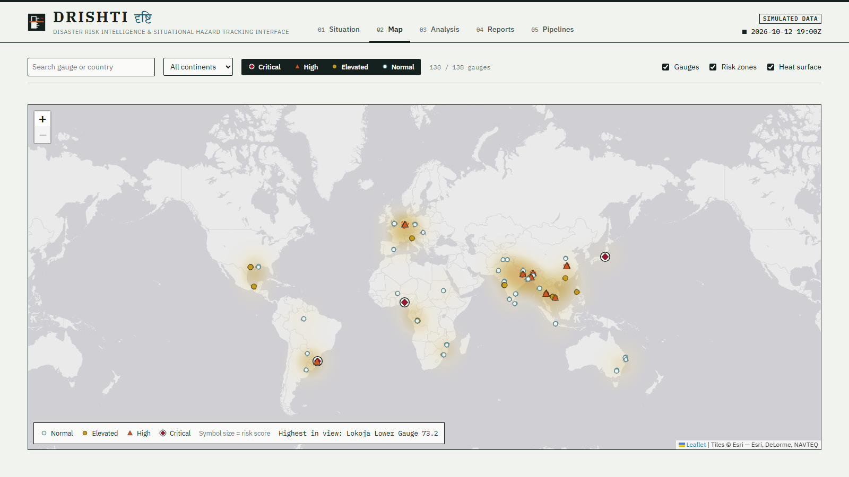
Live demo: interactive risk map
Hover for rainfall, river level and risk status
Click a gauge for full statistics
Zones coloured by worst gauge inside
Heatmap shows risk intensity across regions
Filter by severity, continent or name
Notes:
Show: hover a gauge for the tooltip, toggle heatmap, filter by severity or continent, risk zones coloured by worst gauge inside them. Pulsing rings mark CRITICAL and HIGH gauges.

Slide 12
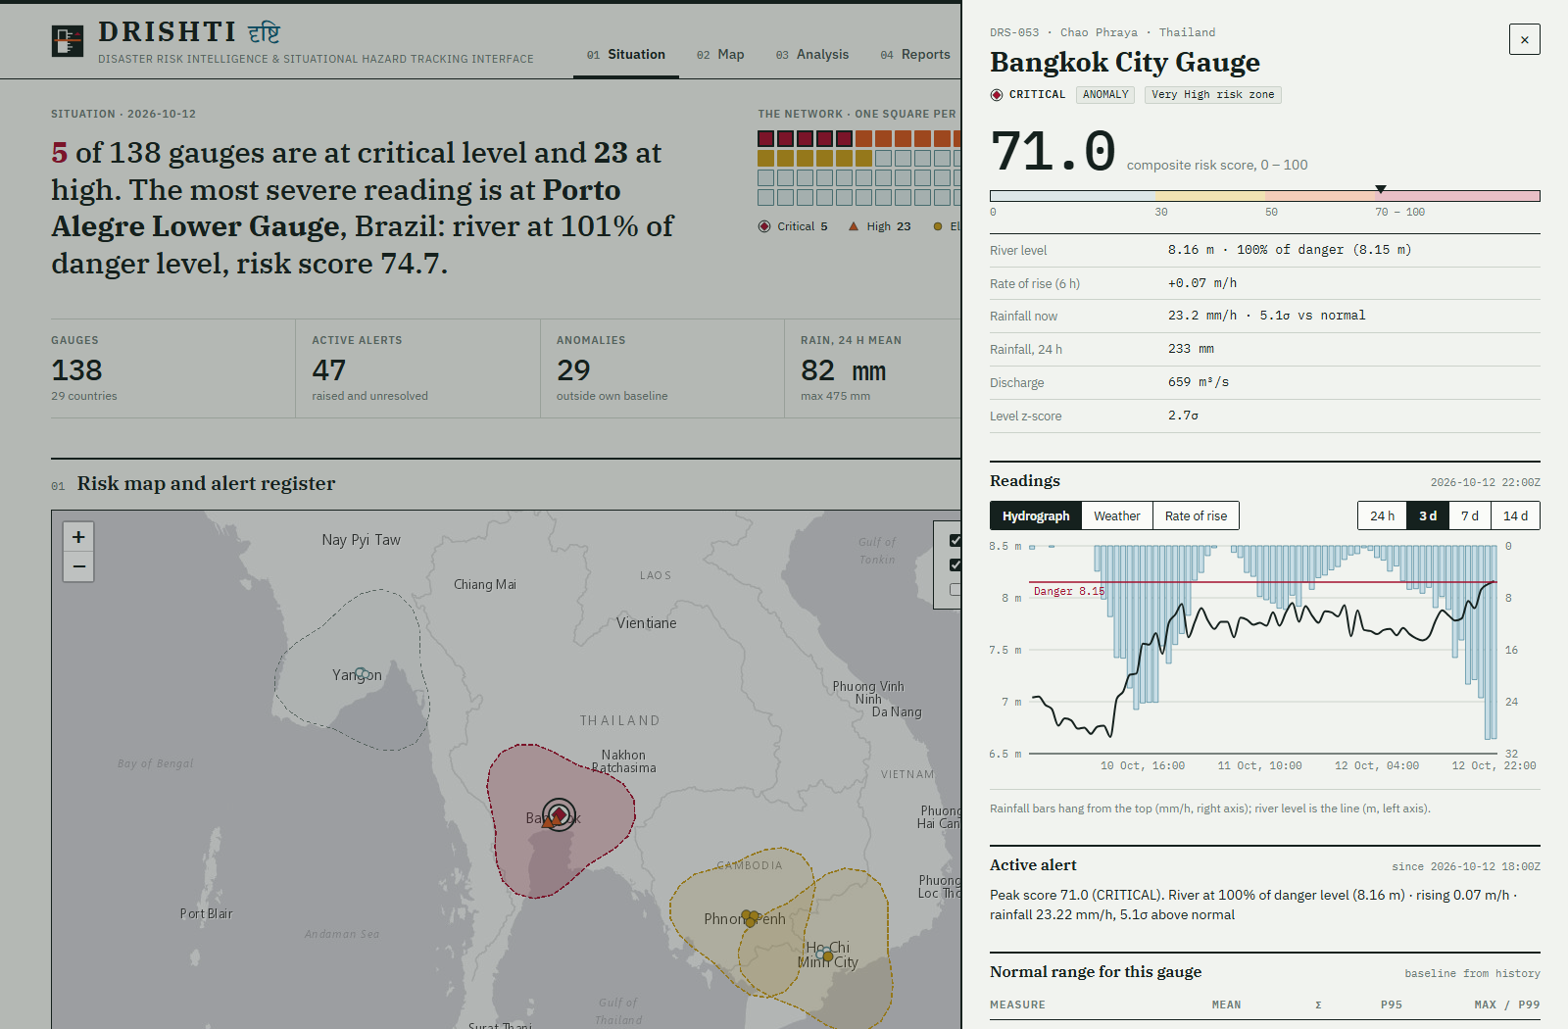
Station drill-down: from alert to evidence
Why this gauge?
Plain-language reasons: % of danger level, rise rate, rainfall σ.
Hydrograph
Rainfall bars with river level against warning and danger thresholds.
Local history
Past events within 250 km via $geoNear.
Notes:
Click any alert and the drill-down shows the reasoning: how close to danger level, how fast rising, how unusual the rainfall is. The hydrograph shows rainfall hyetograph inverted above the river level with warning and danger lines.

Slide 13
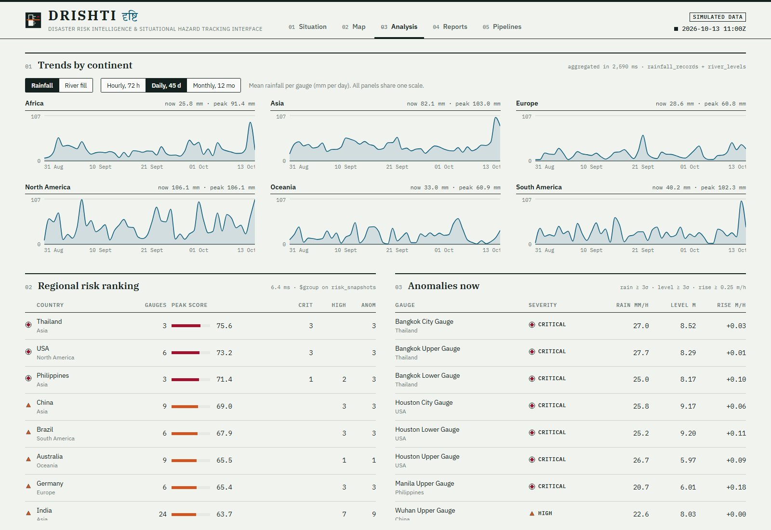
Analytics: trends, rankings and anomalies
Hourly, daily and monthly trends by continent
Regional risk ranking from latest snapshot
Live anomaly table with z-scores and rise rate
Historical events: year, type, season
Notes:
Everything here is computed on the fly by aggregation pipelines. Switch between hourly, daily and monthly granularity; the system reports how long the aggregation took.

Slide 14
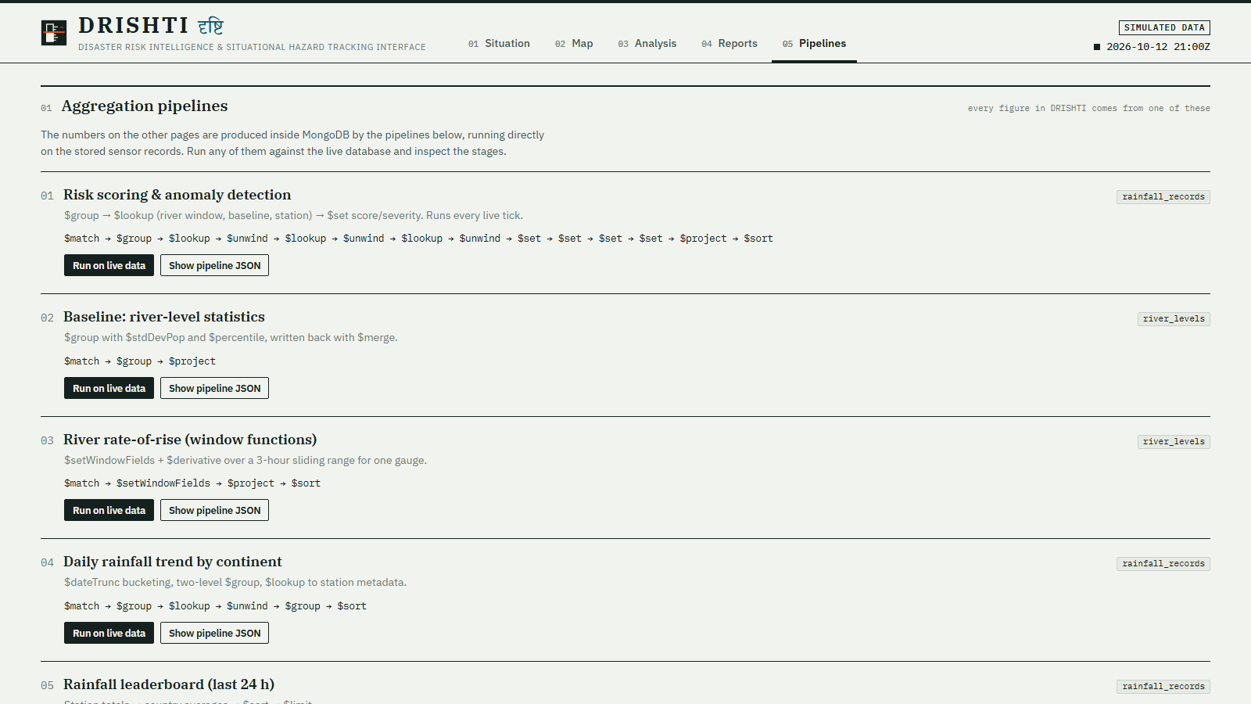
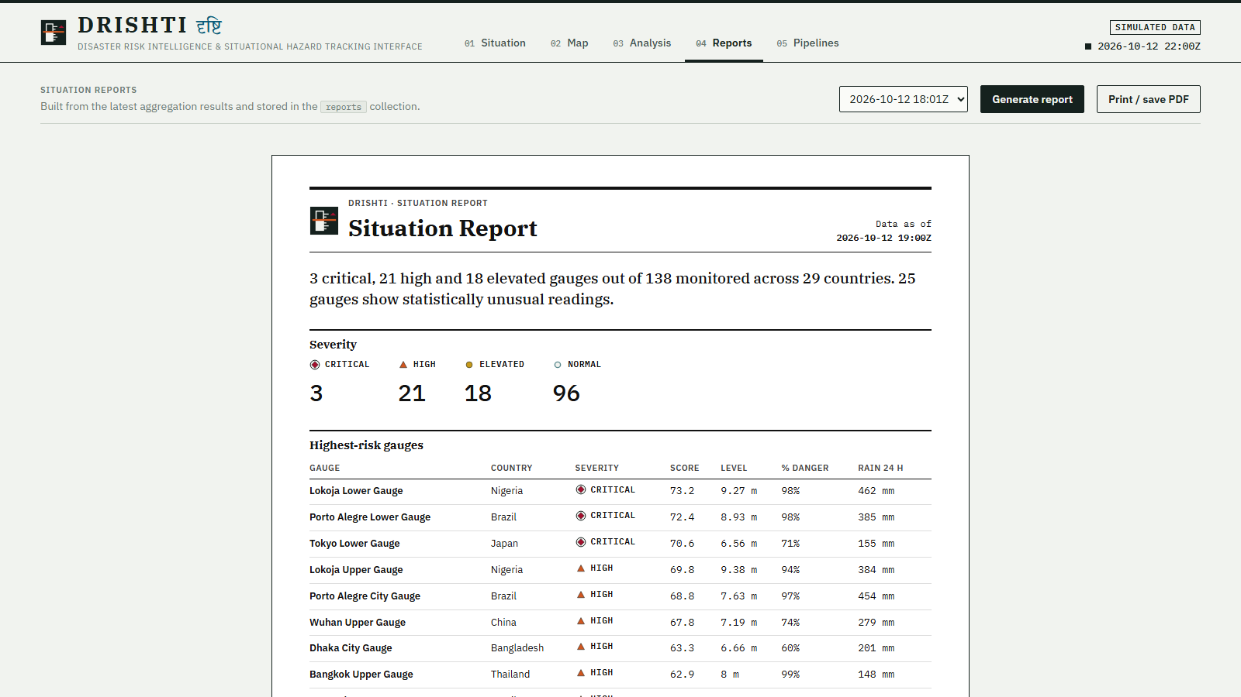
Pipelines page and situation reports
Pipelines: inspect and run every aggregation with timings
Situation report: severity summary, top gauges, regions of concern, recommended actions
Notes:
The Pipeline Lab exposes the exact aggregation pipelines and lets the audience run them against live data with timing. Reports are generated from the same results and stored in MongoDB.

Slide 15
Project modules and how they were built
Synopsis module | Implementation
6.1 Data collection & preprocessing | Seeder + simulator generate and validate station, rainfall, river and weather records
6.2 MongoDB data storage | Time-series and standard collections with 2dsphere indexes
6.3 Processing & aggregation | Pipelines for totals, trends, rankings, rate of change, baselines
6.4 Risk zone & anomaly detection | Risk score, severity bands, z-score and rise-rate anomaly flags, alerts
6.5 Interactive map & dashboard | React-Leaflet map, heatmap, KPI cards, Recharts, station drill-down
6.6 Analytics & reporting | Analysis page, stored situation reports, printable PDF view
Stack: React 19 + Vite · Recharts · React-Leaflet · Node.js + Express · MongoDB 7
Notes:
This maps the six synopsis modules onto the implementation.

Slide 16
Historical disaster patterns
900 events · 150,969 lives lost · 509 M people affected · computed in 42 ms with one $facet pass (synthetic data)
Notes:
Generated by a single $facet aggregation over the disaster_events collection. The data is synthetic, but the pipeline is the same one that would run on a real catalogue. Point out the monsoon-season peak July to September.

Slide 17
Outcomes and future scope
Delivered
Future scope
Centralised MongoDB with 3.6 M records
Database-driven interactive risk map and heatmap
Anomaly detection and risk scoring in aggregation pipelines
Hourly, daily and monthly trends
KPI dashboard, alerts and stored reports
Pipelines page showing every query
Real IoT and satellite feeds replacing the simulator
Predictive flood forecasting with ML
SMS and push alerting to authorities
Sharded MongoDB cluster for national scale
Integration with emergency-response systems
Notes:
Left: what was delivered versus the synopsis expected outcomes. Right: natural extensions.

Slide 18
Thank you
Questions?
Try the live system
https://windows.tailb18f6e.ts.net:8443
Served from the team laptop via Tailscale Funnel
DRISHTI · दृष्टि — Vichitra Attri · Vidhyashree S · Vidya Bai K · Vikram K
Notes:
Open the live link on the projector, or fall back to localhost:5055 if the network is down.

