Slide 1

Waste Management & Recycling in India
Machine Learning Project Report
Presented by: Mevina PD

Slide 2
Problem Statement
Rapid waste generation is a major environmental challenge.
Accurate prediction of waste generation helps improve planning and sustainability.

Slide 3
Project Objectives
- Analyze waste management data
-Identify key factors affecting waste generation
-Build ML models to predict waste generated (Tons/Day)

Slide 4
Dataset Overview
- Waste type
- Region
- Population
- Recycling rate
- Waste generated (Target Variable)

Slide 5
Data Preprocessing
- Handling missing values
- Encoding categorical variables
- Feature selection and scaling

Slide 6
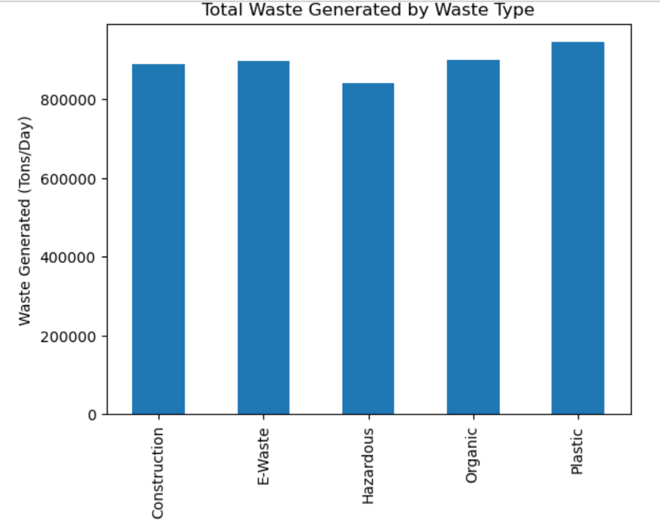

Slide 7
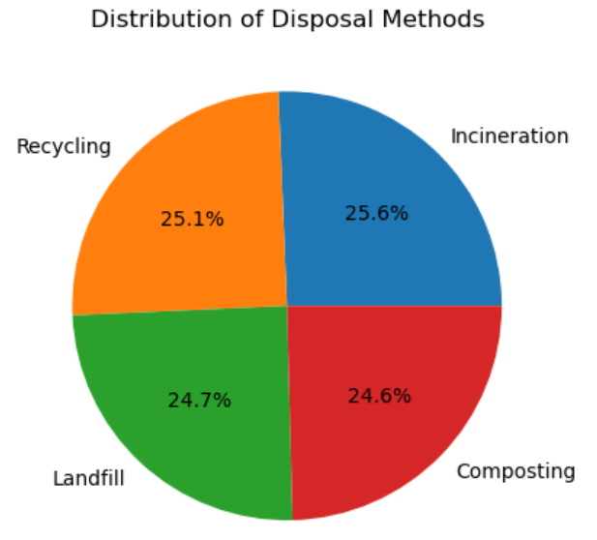

Slide 8
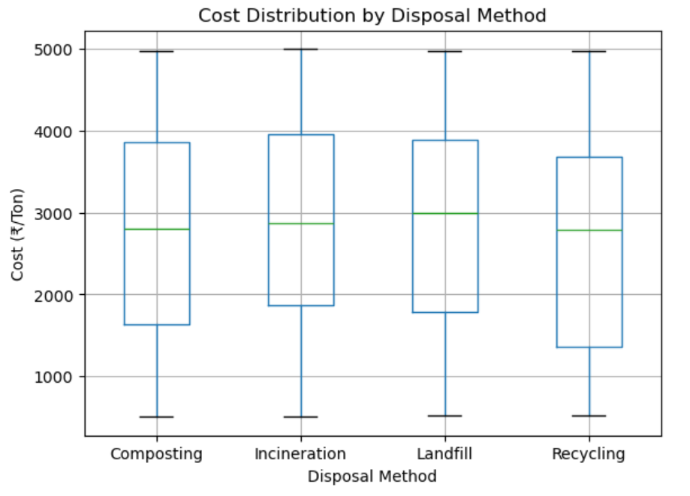

Slide 9
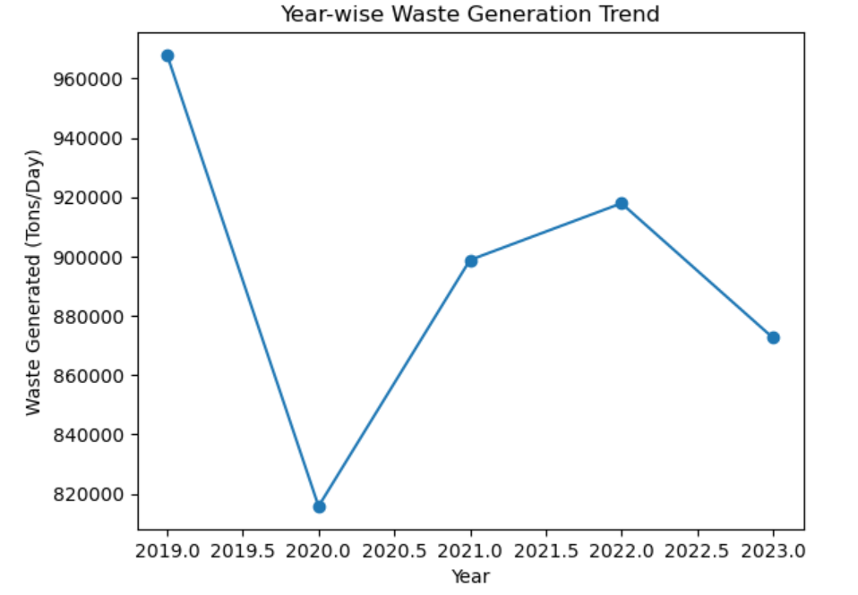

Slide 10
Machine Learning Models Used
- Linear Regression
- Decision Tree Regressor
- Random Forest Regressor

Slide 11
Model Evaluation
- Train-test split (80-20)
- Evaluation metric: R² Score
-Comparison of model performances

Slide 12
Best Model – Random Forest
- Highest accuracy
-Handles non-linear data effectively
- Robust to overfitting

Slide 13
Results & Insights
- Population and waste type strongly influence waste generation
- Ensemble models outperform basic regression models

Slide 14
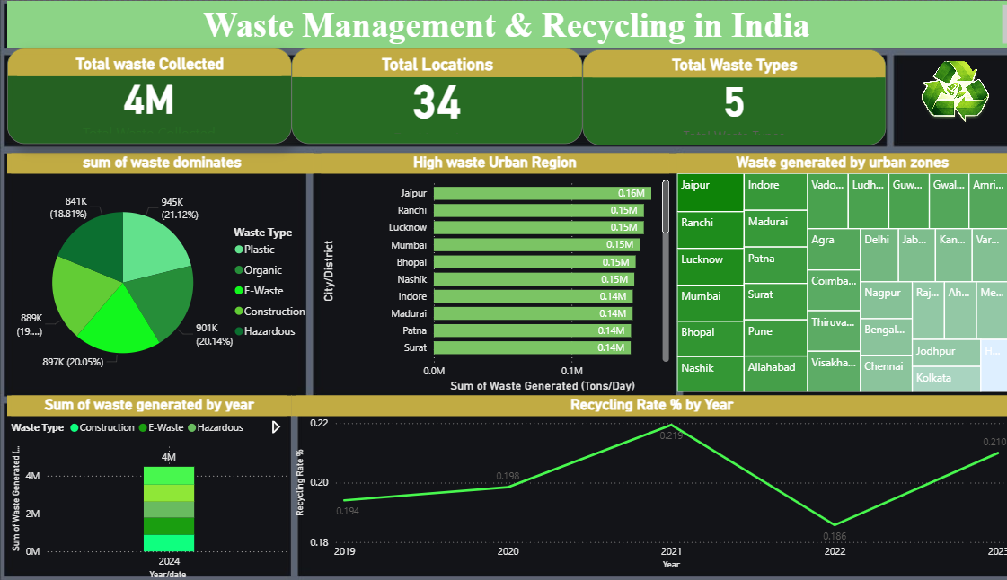
Dashboard Overview

Slide 15
Conclusion
Machine learning can effectively predict waste generation.
This project supports data-driven waste management planning.

Slide 16
Future Scope
- Time-series forecasting
- Real-time waste data
-Power BI dashboard integration

Slide 17
THANK YOU

