Slide 1
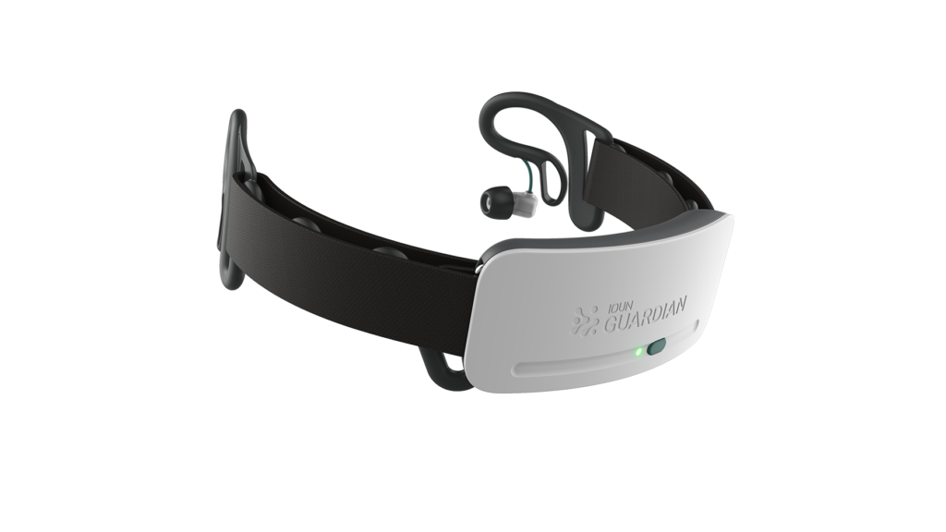


Determining mental state using brainwaves
The Happy Lie
Team 43: M Evonuk, S Volodin, H Hedjam
If you can’t tell it’s a lie, does it matter?
Notes:
Good afternoon, I am here to talk about brainwaves and associated mental states and how recognizable they may be. Our group is The Happy Lie and we ask: if you can’t tell that someone, or even yourself, is lying to you, does it matter?

Slide 2
State of mind based on their averaged brainwaves
IS IT POSSIBLE? HOW? LIMITS? CAN WE LIE?
Do your parents like your new partner?
Are you really happy with your new job?
Sometimes we say one thing but our mental state may not agree with that statement.
SO….IS IT POSSIBLE FOR US TO LIE ABOUT OUR MENTAL STATE?
TO OTHERS…AND TO OURSELVES?
Notes:
We propose determining the state of a mind based on the averaged brainwaves. In this exploratory presentation we look at various states to see if patterns in the brainwaves are recognizable to see if we can use brainwaves to determine if for example your parents actually do like your new partner, if you actually are happy with your new job, and in fact if we may say one thing but actually mean another (even unbeknownst to ourselves)

Slide 3
Brain Waves at different frequencies are associated with different mental states
Delta (0.5-4 Hz) – associated with deep sleep
Theta (4-7 Hz) – falling asleep
Alpha (8-12 Hz) – closing your eyes, calm state
Beta (12-30 Hz) – alert
Gamma (30-45 Hz) – may be associated with artifacts
Notes:
Before we look at any data, here is a brief summary of the frequencies that we will be looking at today. Delta waves are low frequency waves often associated with deep sleep. Theta waves, also low frequency are associated with falling asleep and both those and alpha waves, which pick up when you close your eyes, are associated with calmer states. Meanwhile beta and gamma are higher frequency waves that are associated with more alert states and the highest frequencies of such may be artifacts

Slide 4
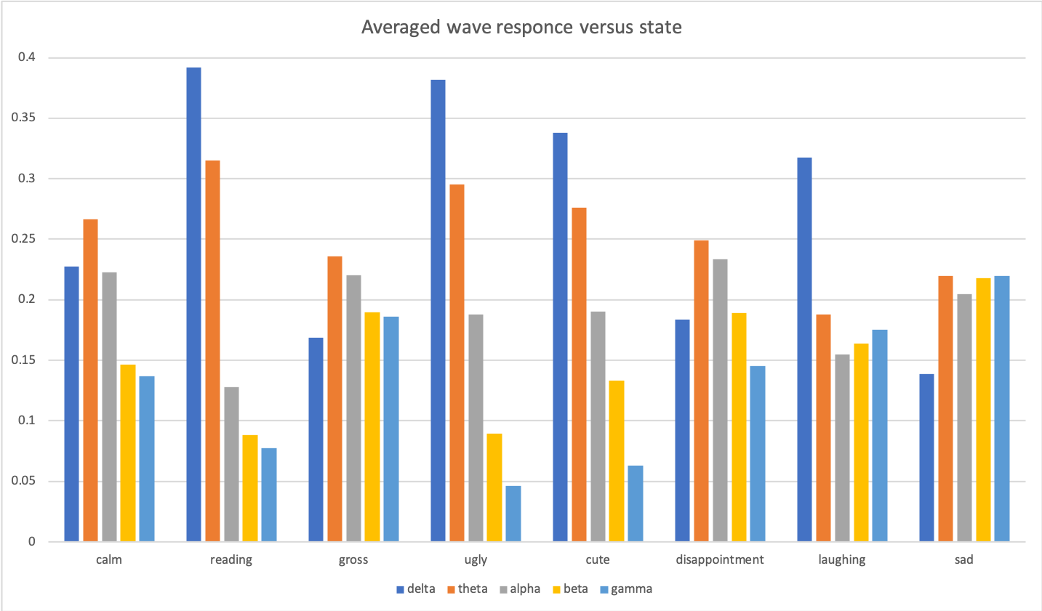
Various states
High beta (engagement)
Low beta (engagement)
Notes:
We measured various states as you can barely see here, including a calm state with eyes closed, a state in which text was read from the internet, a state observing a gruesome video online, a state looking at photos of ugly animals, another looking at cute animals, a state of disappointment, one in which the subject was laughing, and a sad state. As you can see higher beta and gamma proportions were observed for the gross, disappointment, laughing and sad states possibly indicating higher levels of attention and engagement. Meanwhile for the reading and viewing of photos, there were relatively low proportions of high frequency waves indicating lower engagement. However, can these data be used to postulate on an unknown state?

Slide 5
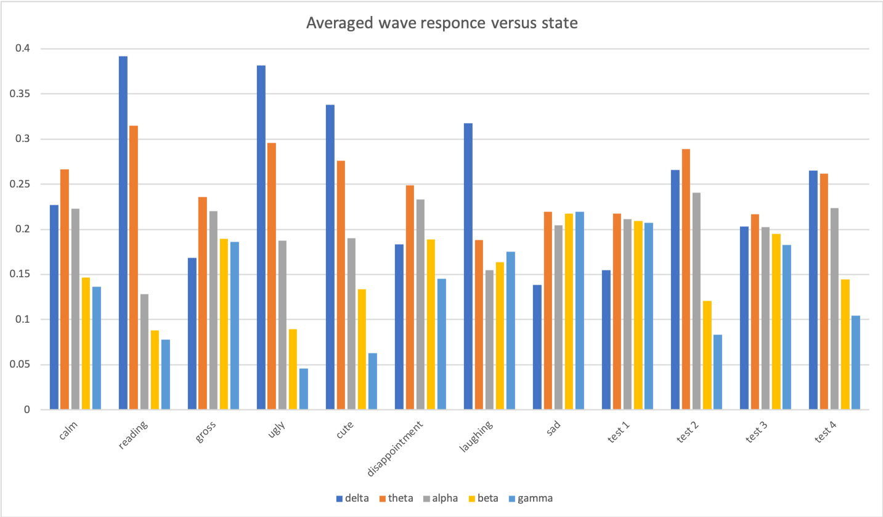
Test with “random” states
Test cases difficult to classify
Need more data
Notes:
Here we see the same data plus those for unlabeled test states. We can see that perhaps it is not so obvious what states they correspond to, two (1 and 3) look like they may have higher levels of engagement, while 2 and 4 may have lower levels of engagement

Slide 6
Possible applications
Notes:
One can imagine many possible applications if enough data are gathered to make more conclusive classifications

Slide 7
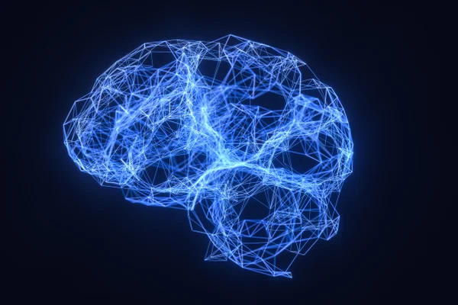

GATHER DATA
FIND PATTERNS CREATE TRENDS
Examine:
COGNITIVE DECLINE
DEPRESSION
ISOLATION
Notes:
For example, if we can find sufficient patterns, for instance by gather data using social media, we can examine problems such as cognitive decline, depression and isolation. We can also look then at the possibility of “lying” to our brains to alter such negative states.

Slide 8
WE CAN DECIDE TO BE HAPPY
THE BRAIN CAN BE TRICKED…
SO IF THE BRAIN CANNOT TELL, DOES IT MATTER?
Notes:
However, until then we can decide to be happy regardless of what our brainwaves indicate. And that is the Happy Lie.

