Slide 1
Use case Enedis
Sentient Coders:
Emma Blanchard (École 42)
Martha Evonuk (École 42)
Charles Herr (Telecom Paris)
Zakaria Kaddaoui (CentraleSupélec)

Slide 2
Problem: Classification of articles mentioning Enedis or Enedis-related topics based on tone and theme
Each month a large number of articles mentioning Enedis or aspects of the power grid are gathered from the media.
To manually evaluate these articles to determine the image of Enedis and its services being projected in the media is time-consuming.
A tool is needed to automate this process.

Slide 3
Data:
400+ article bodies collected concerning La Direction Régionale Nord-Pas de Calais
1000+ article titles
Desired output:
Tone: positive, negative, factual, positive factual, nuanced, …
Theme: Prevention, Clients, Network, Ecological transition, Climate hazards, Connection, HR, Miscellaneous, …

Slide 4
Solution
Supply a web-based frontend to enable users to upload articles.
Send the text to Amazon bedrock to be interpreted by an AI model (Mistral Large).
Give AI examples of article content with expected outcomes and have the AI roleplay as a Enedis analysist while interpreting the articles for their tone and theme.
Return the AI output to the frontend.

Slide 5
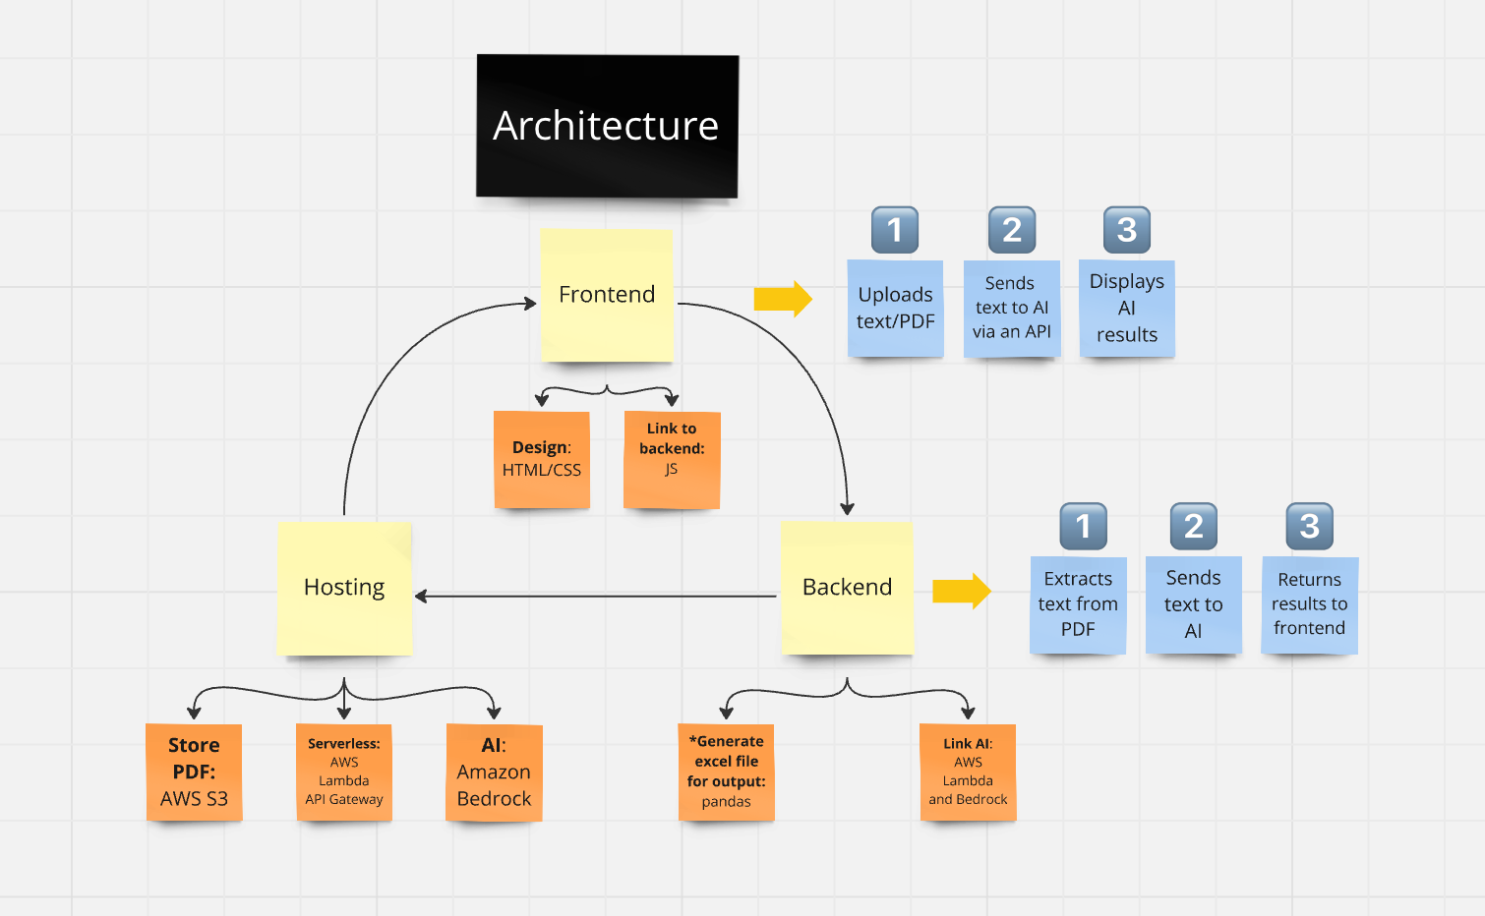

Slide 6
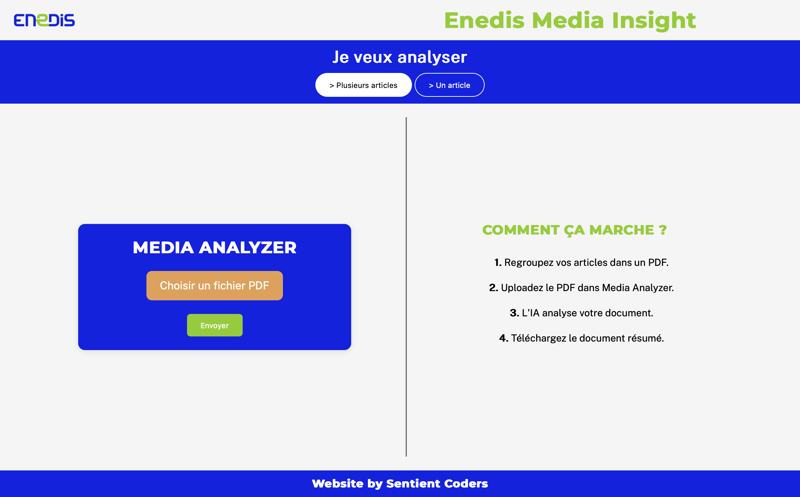

Slide 7
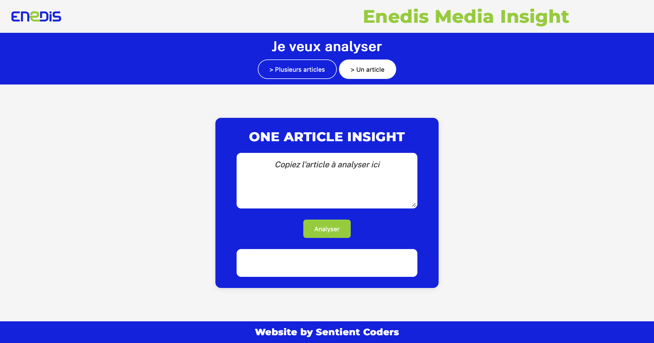

Slide 8
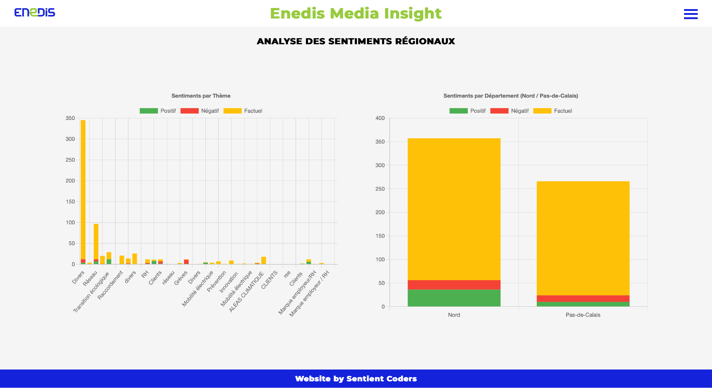

Slide 9
Results
Statistics for determining the tone:
Average random sample:
57.2% exact match
84.2% relative match (cost matrix)
1% mismatch

