Slide 1



ENEDIS USE CASE
SENTIENT CODERS

Slide 2

PROBLEM
Each month articles talking about Enedis go out in the press. Takes time to classify them and analyze the media image of the company.
OUR SOLUTION
ENEDIS
Supply a website that enables users to:
Analyze one or several articles
Have an IA classify the sentiment and theme of article
Have up-to-date data visualisation (see with one look media image of Enedis per region and per theme)
SENTIENT CODERS

Slide 3

LIVE DEMO

Slide 4

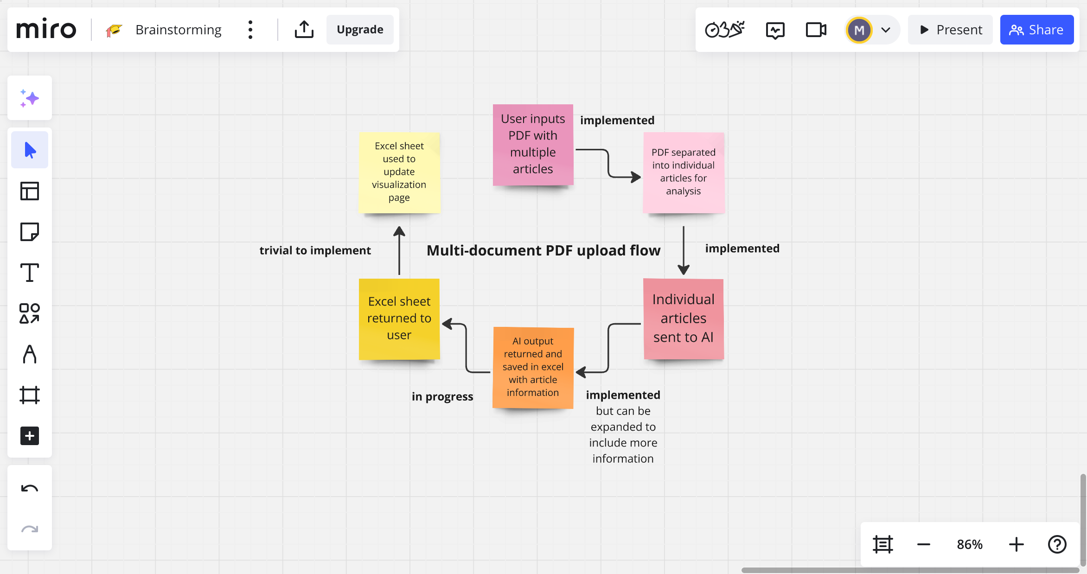
MULTI-ARTICLE UPLOAD

Slide 5

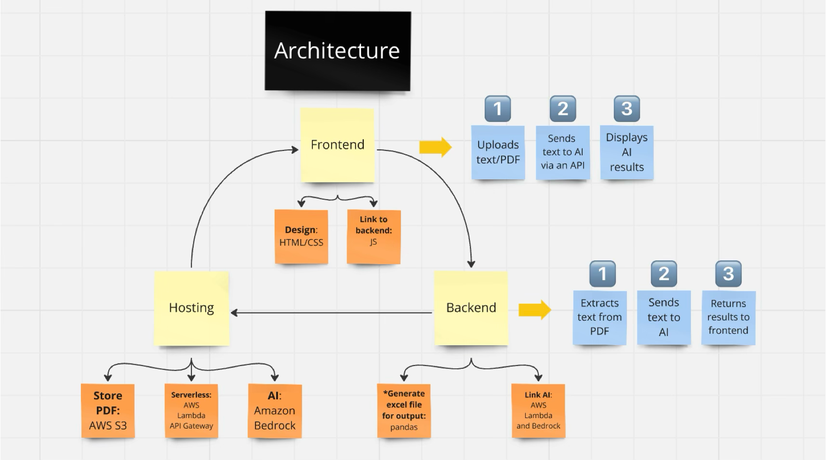
ARCHITECTURE

Slide 6
THANK YOU

