Slide 1
Use case Enedis
Sentient Coders:
Emma Blanchard (École 42)
Martha Evonuk (École 42)
Charles Herr (Telecom Paris)
Zakaria Kaddaoui (CentraleSupélec)

Slide 2
Problem: Classification of articles concerning Enedis based on tone and theme
Each month a large number of articles mentioning Enedis are gathered from the media
To manually evaluate these articles to determine the image of Enedis being projected in the media is time-consuming
A tool is needed to automate this process.

Slide 3
Data:
400+ article bodies collected concerning La Direction Régionale Nord-Pas de Calais
1000+ article titles
Desired output:
Tone: positive, negative, factual, positive factual, nuanced, …
Theme: Prevention, Clients, Network, Ecological transition, Climate hazards, Connection, HR, Miscellaneous, …

Slide 4
Solution
Use AI (Mistral Large) to extract information from uploaded articles
Give AI examples of “positive,” “negative,” “factual,” …
Other details…

Slide 5
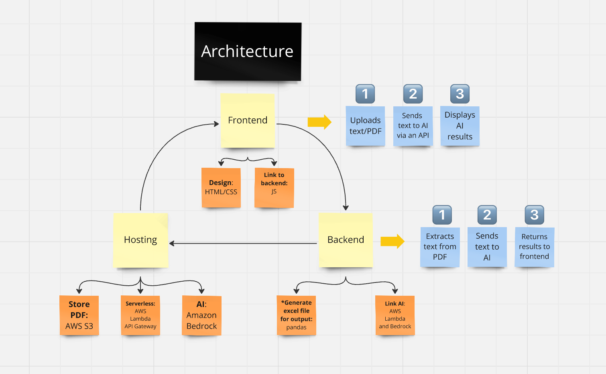

Slide 6
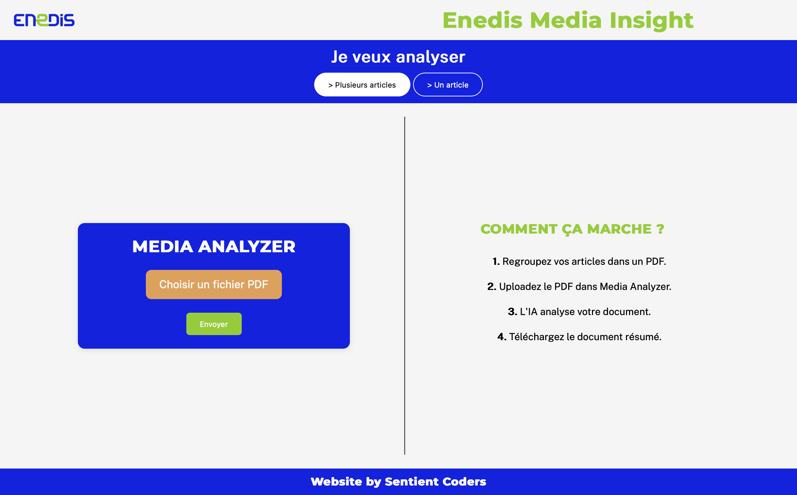

Slide 7
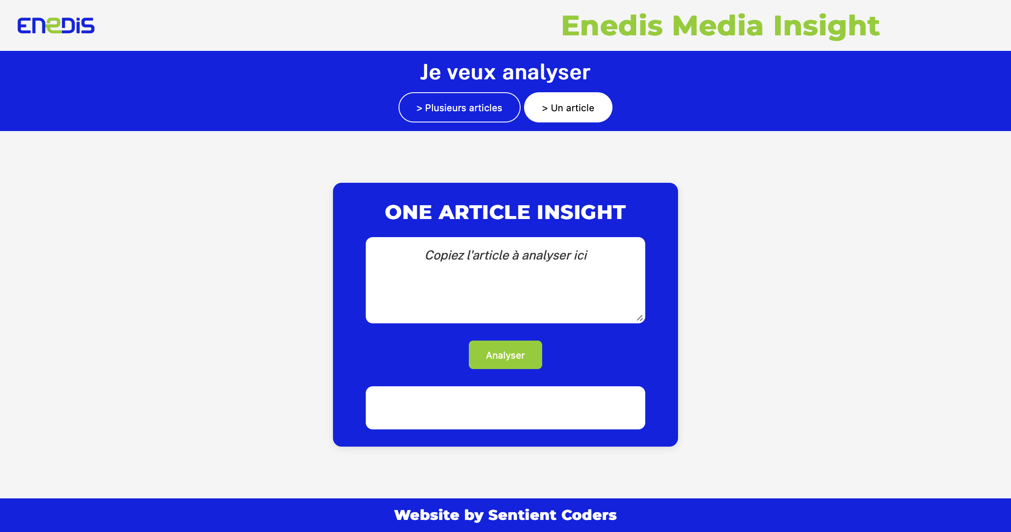

Slide 8
Results
Statistics for determining the tone:
Average random sample:
57.2% exact match
84.2% relative match (cost matrix)
1% mismatch

