Slide 1
To keep this simple, I wanted to be able to complete the following actions:
A customer wants to look at all of their previous orders
A customer wants to look at a specific order (details and line items)
A warehouse employee needs to see unfulfilled orders by precedence (oldest orders first)
What else should I add?

Slide 2
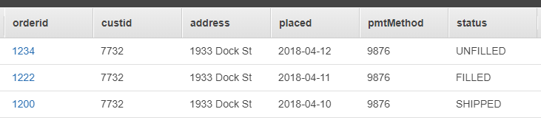
orders
Partition Key: orderid
Sort Key: custid
GSIs:
Partition Key: custid
Sort Key: orderid
Partition Key: status
Sort Key: placed
Fulfills: Customer wants to view specific order
(getOrder.js)
Fulfills: Customer wants to view all previous orders
(getAllOrdersByCust.js)
Fulfills: Employee wants to view unfilled orders
(getUnfilledOrders.js)

Slide 3
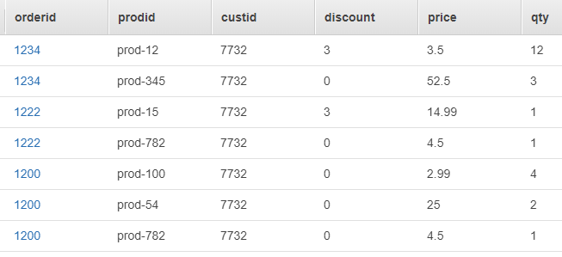
orderitems
Partition Key: orderid
Sort Key: prodid
GSIs:
Partition Key: custid
Sort Key: prodid
Fulfills: Customer wants to view items from specific order
(getOrderItemsByCustOrder.js)
Fulfills: Customer wants to view all previous order items (getAllOrdersByCust.js)

