Slide 1
Distributed Rate Control for Smart Solar Arrays and Battery

Slide 2
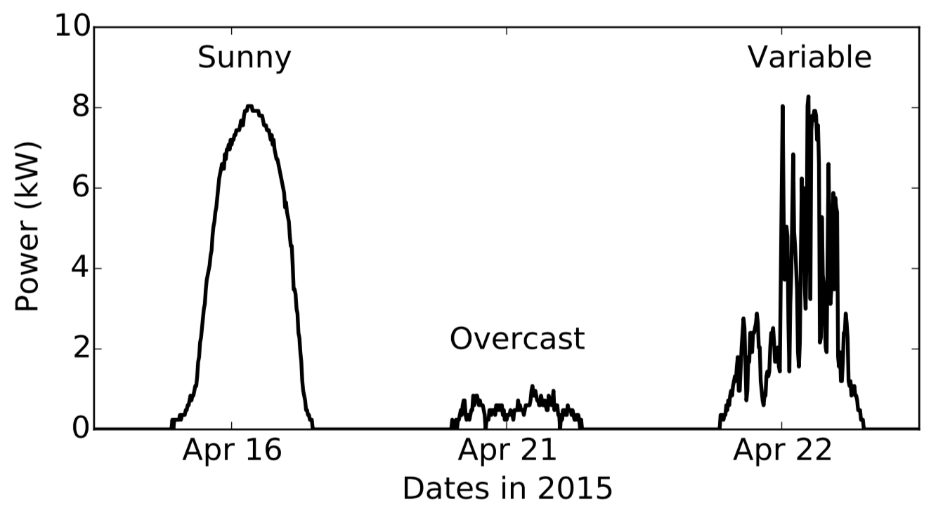
Background – Solar Generation
Productivity depends on weather condition

Slide 3
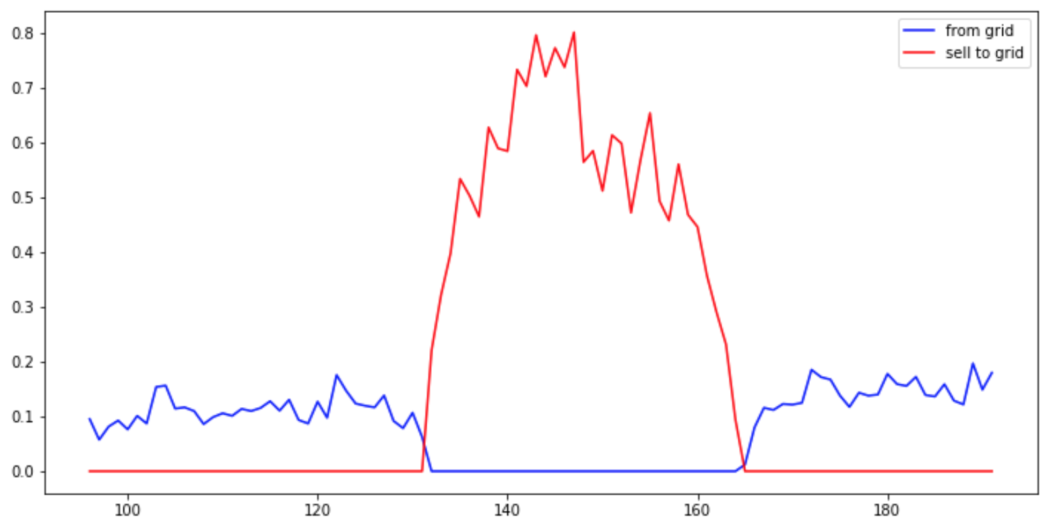
Solar Generation Distribution
Solar generation deeply depends on weather condition
more sunshine -> more solar generation
A spike during day time
What’s the problem?
More surplus -> more revenue

Slide 4
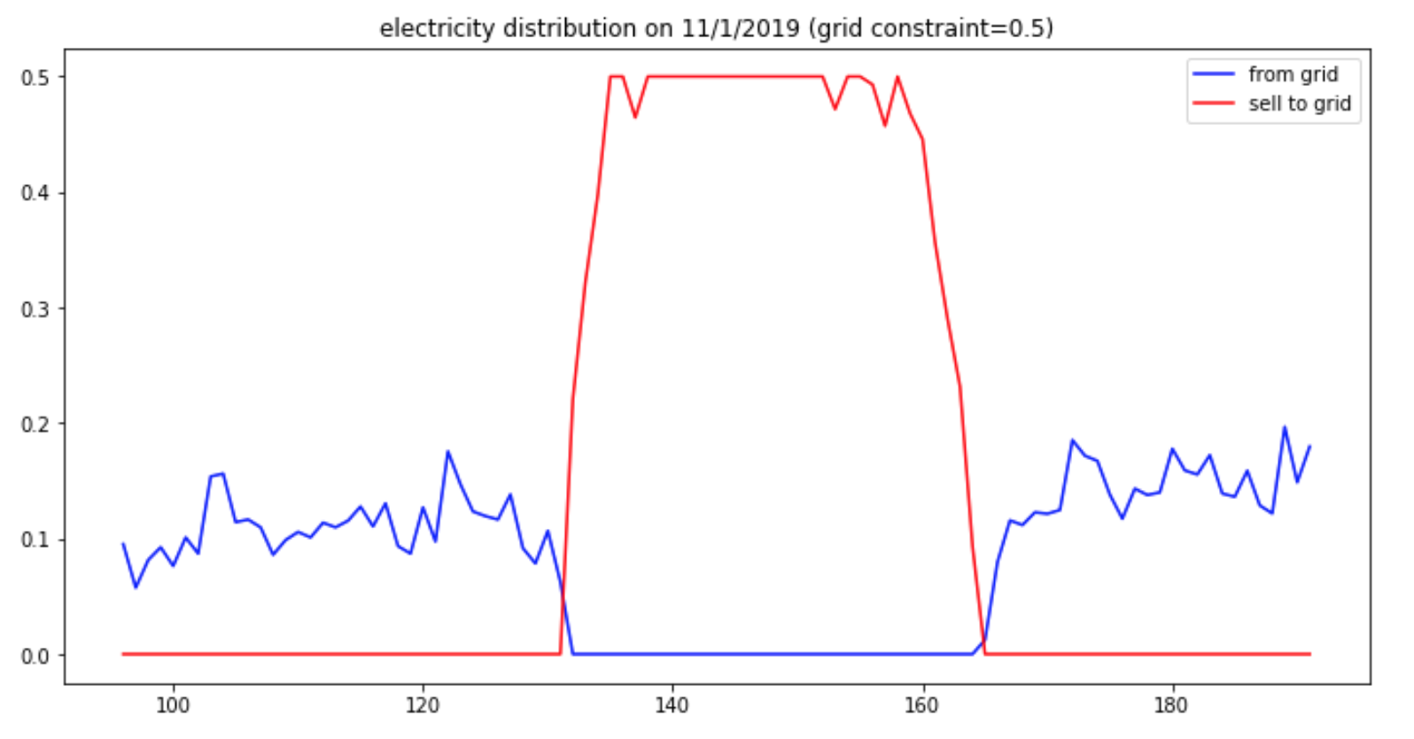
Grid Constraint
Grid cable has its physical limit
Not all solar generation fully sell to utility agent
Spike would be stopped due to constraint

Slide 5
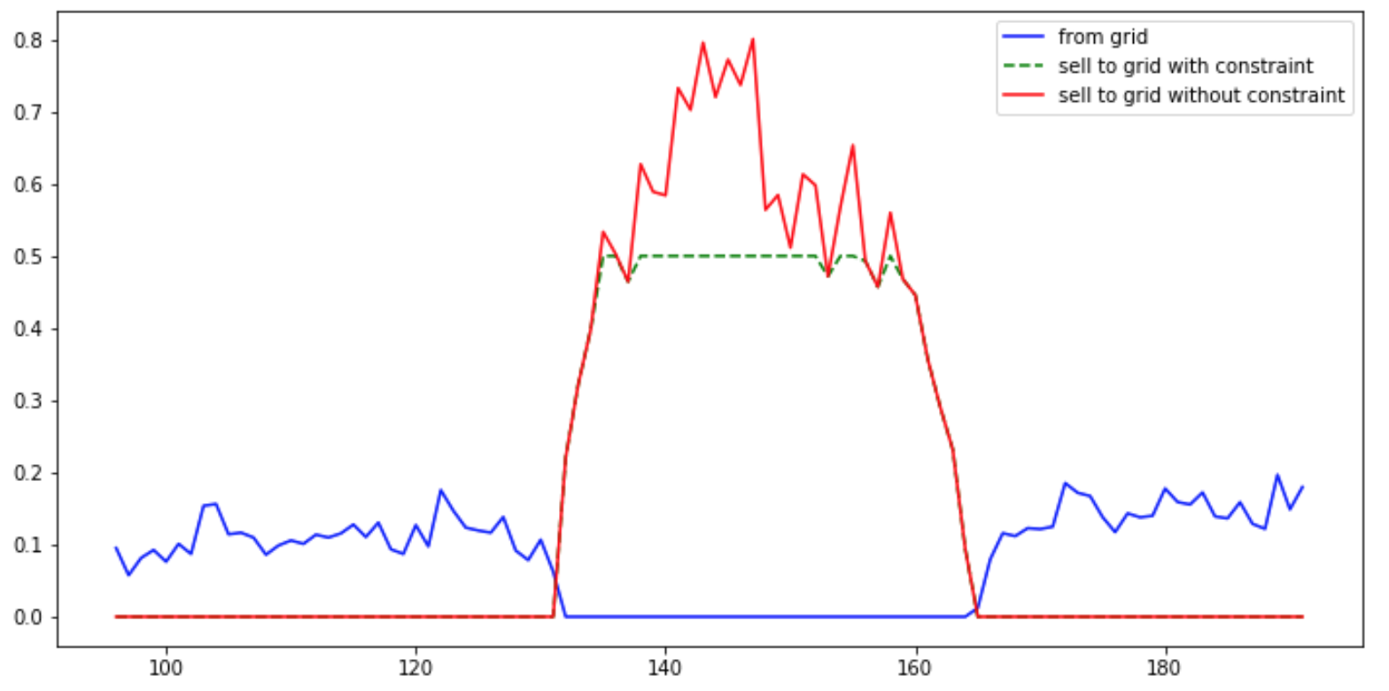
Waste of Solar Generation
waste solar generation
solar generation surplus sold to utility agent

Slide 6
Motivation
Technique of solar panel improved and become more popular these days
We’re able to control the producing rate of solar panel. Are we able to well use those surplus electricity rather than reducing them.

Slide 7
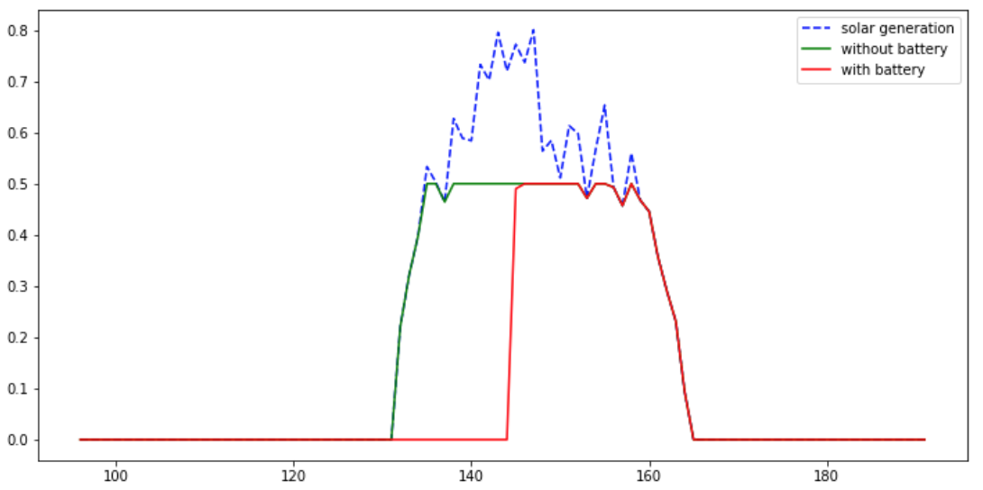
Solution - battery
A way of temporally storing power
Higher availability to power deployment
Delay the time of wasting solar power

Slide 8
Solution - battery
waste
Storing into battery
Sell to utility agent

Slide 9
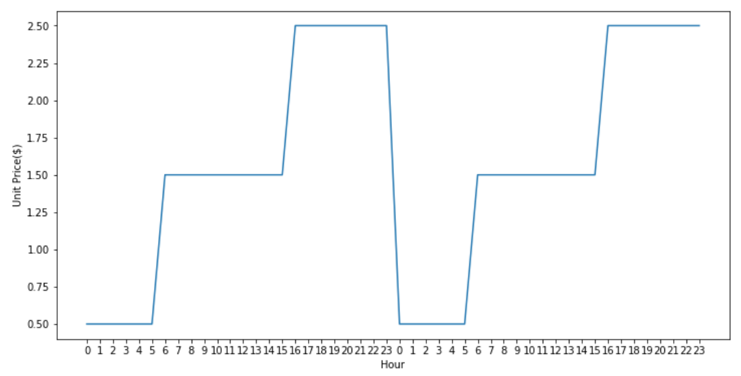
Utility Unit Price
Encourage people to consume electricity in off-peak hour
Cheaper Price

Slide 10
Charge with Grid Power
Take advantage from lower unit price
cheaper total cost
battery is idle from charging by solar panel during lower unit price period
Charging during lower unit price period
Consume battery power during high unit price period

Slide 11
Focusing Problem
How to reduce total bill if we could predict solar productivity and demand
How to well take advantage from different unit price period
How battery involves in deployment

Slide 12
System Component
1. Demand Predictor
Predict an approximate demand of a day
Input: Month, Day
Output: Demand
2. Solar Production Predictor
3. Charge-from-grid Calculator

Slide 13
System Component
1. Demand Predictor
2. Solar Production Predictor
Predict an approximate solar generation of a day
Input: Weather forecast
Output: Solar Production
3. Charge-from-grid Calculator

Slide 14
System Component
1. Demand Predictor
2. Solar Production Predictor
3. Charge-from-grid Calculator
Calculate an approximate extra electricity required from grid
Input: demand prediction, solar production prediction
Output: charge-from-grid estimation

Slide 15
System Structure
Utility
Agent

Slide 16
System Steps
1. Demand predictor predicts an approximate demand (d_pred)
2. Solar generation predictor receives weather forecast of one day
3. Predicts an approximate solar generation (pv_pred)
4. Calculate the estimation of charge-from-grid
5. If d_pred > pv_pred, charge battery every time slot until total charge reaches the charge-from-grid. (Do not charge during high unit price period)

Slide 17
Evaluation and Deployment
Training data
Weather data
Temperature, Dew Point, Wind Speed, Humidity
Texas, Austin from 11/1/2018 – 10/31/2019
Demand data
Texas, Austin from 11/1/2018 – 10/31/2019
Evaluate by data period of
11/1/2019 – 11/16/2019

Slide 18
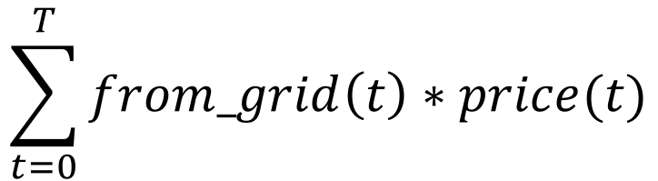
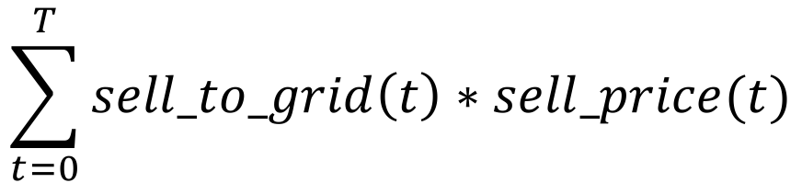
Evaluation
Let
T = total time slots in a day
t = each time slot
Cost =
Revenue =
Total Bill = Cost - Revenue
$$\sum_{t=0}^{T}{from_grid\left(t\right)∗price(t)}$$
$$\sum_{t=0}^{T}{sell_to_grid\left(t\right)∗sell_price(t)}$$

Slide 19
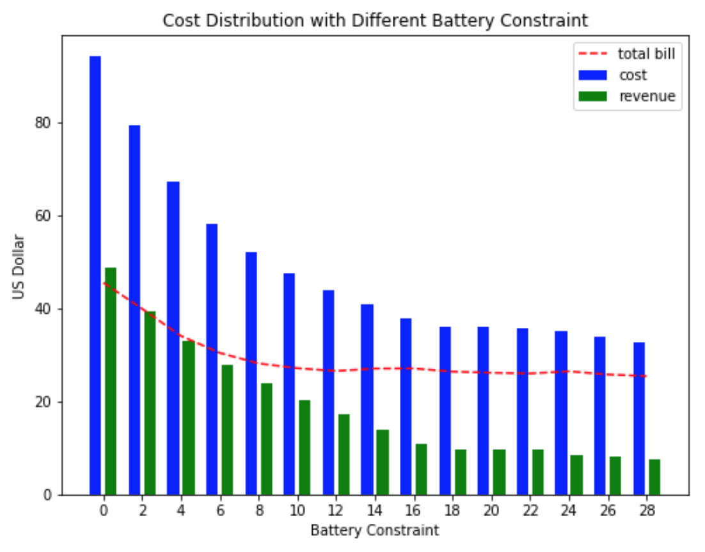
Experiment
Battery constraint = 0:
No battery involved
Total bill drops along with battery constraint increase, and stops decrease after bc=14
Battery actually help reducing total bill

Slide 20
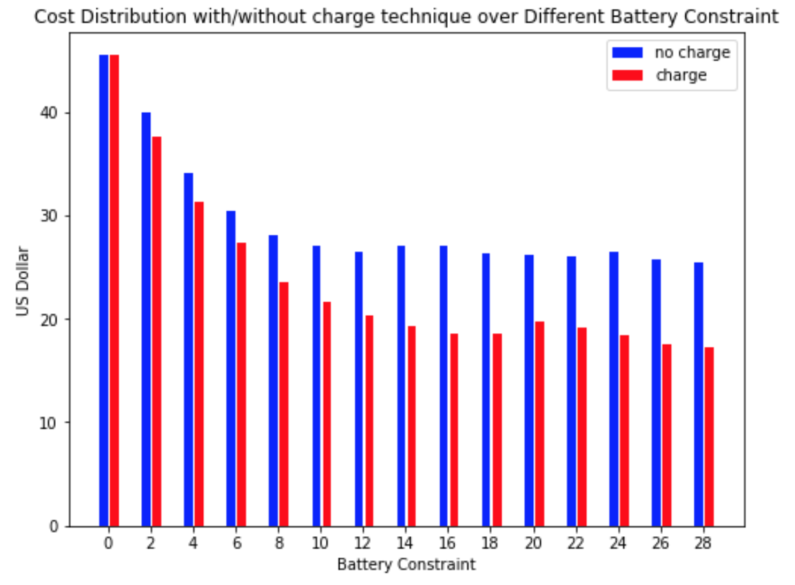
Experiment
The total bill actually decrease at most a certain amount
The decreasing trend also stops at around bc=14
Question?
Does bc actually affect the effectivity of these approach?

Slide 21
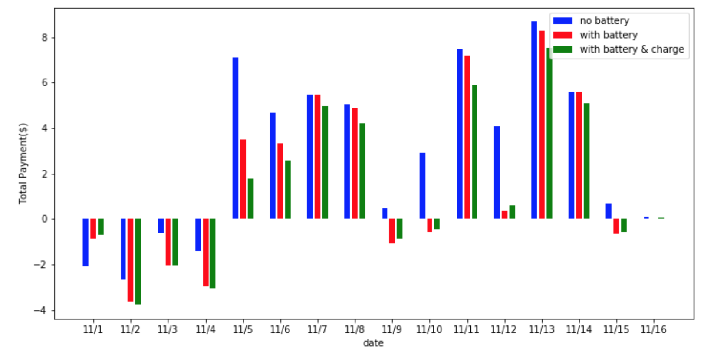
Deployment

Slide 22
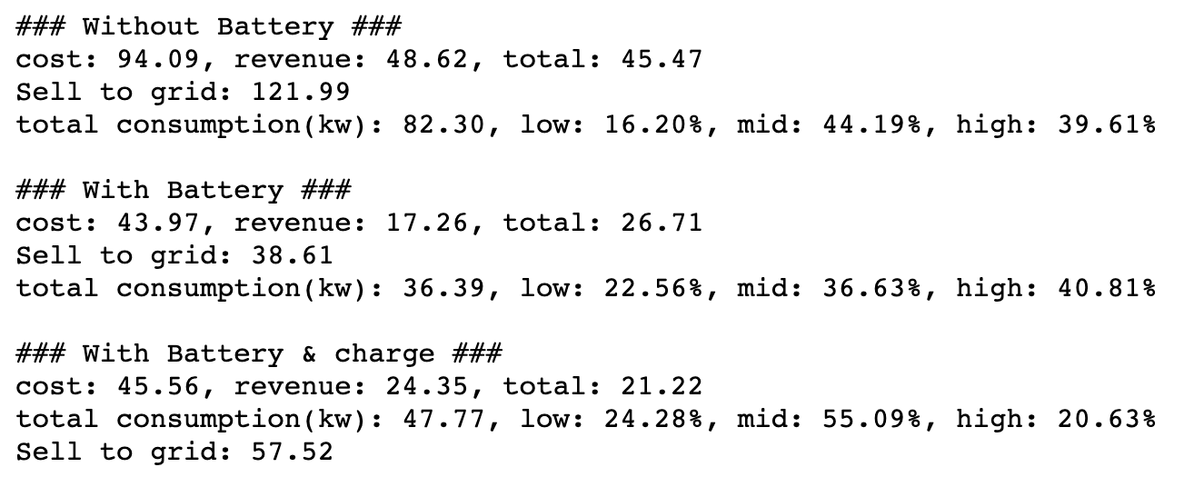
Deployment
With solely battery
good at reducing cost
With both battery and charge-with-grid
good at raising revenue from selling

Slide 23
Conclusion
Charge-with-grid and battery equipment actually help reducing total cost from utility agent
Battery constraint is a potential influence to how effectively the system would perform
There might be a perfect argument setting for different condition

Slide 24
Future Work
Demission during charging is not considered in these experiment
More experiments based on different home can verify the actual possibility of this system could work in real-life
Better predictors will definitely helps

