Slide 1


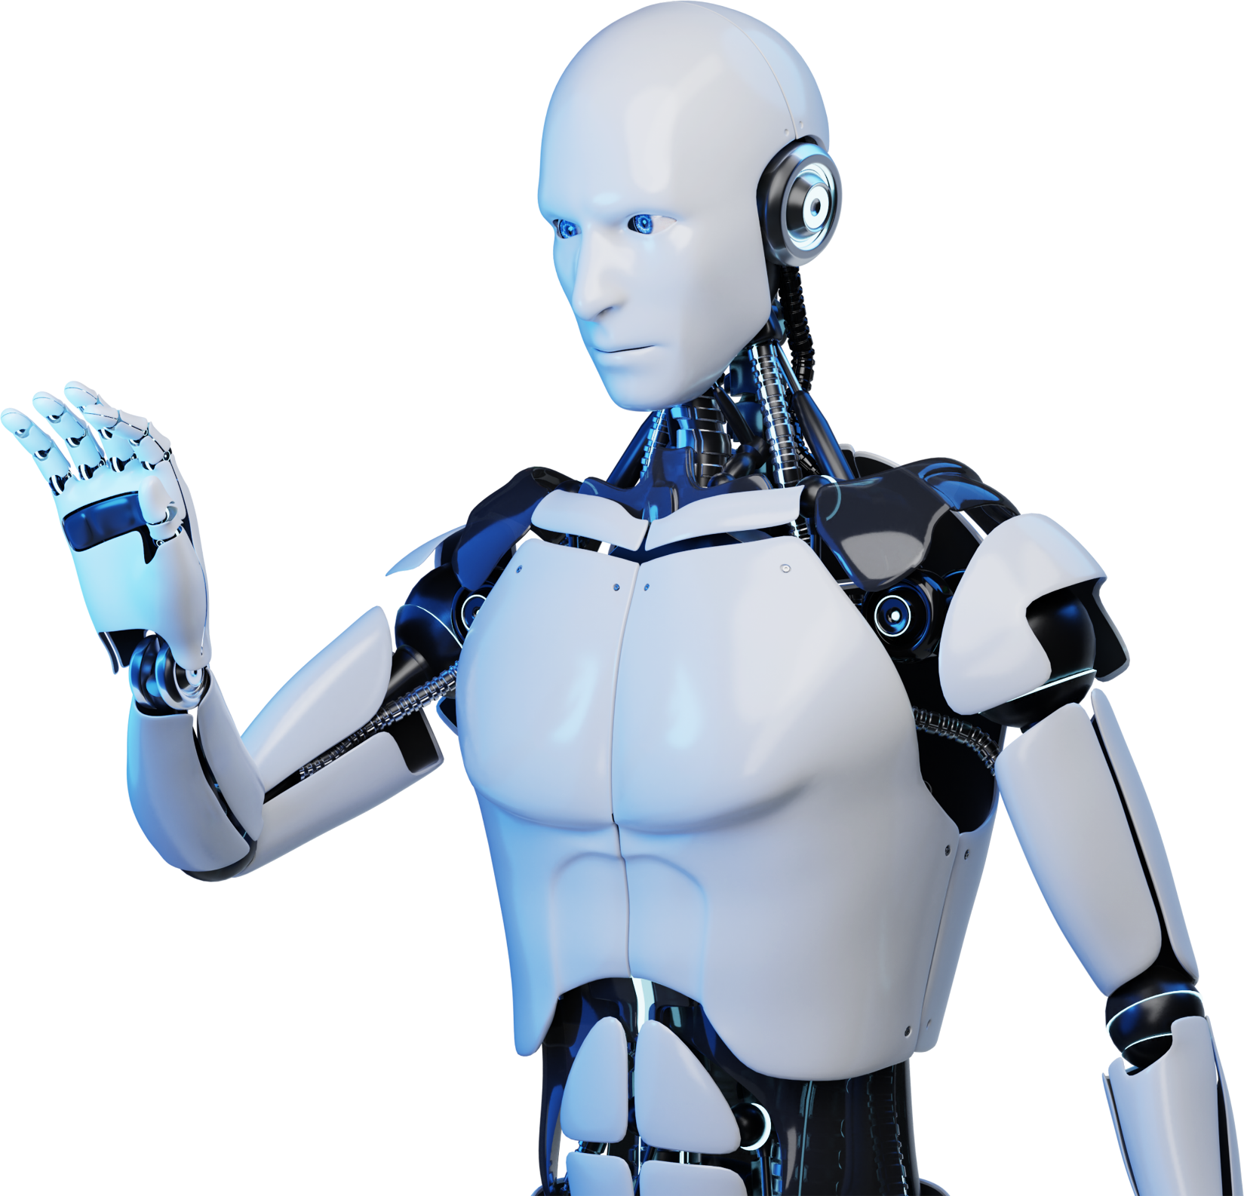
Bot Using Python
Presentation

Slide 2
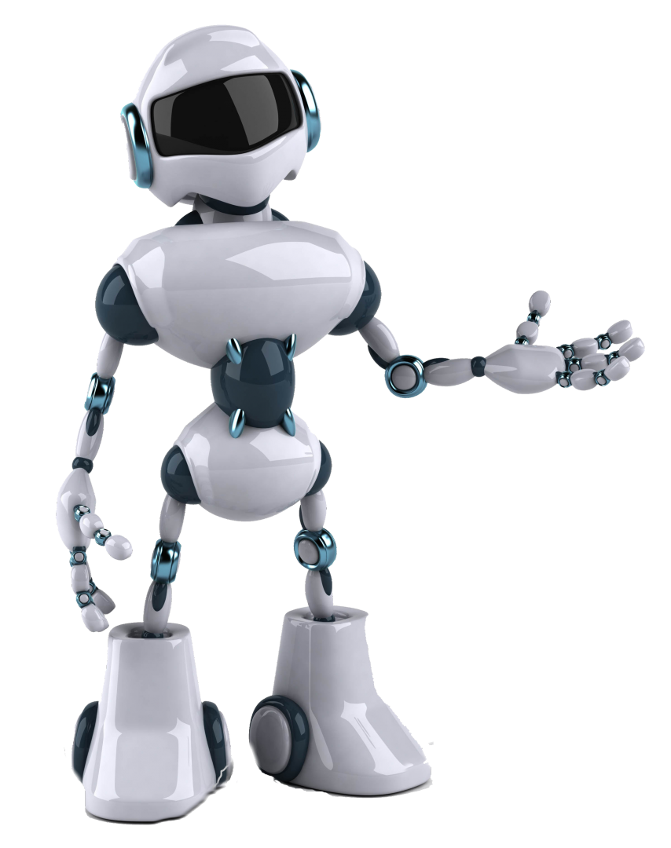
Introduction
A Bot is a type of automation attraction which interact with users and perform task accordindly.
Bot offers a wide range of benefits across various industries improving efficiency and productivity.

Slide 3
Libraries In Usage
1
Telegram-To connect with telegram
2
Random-To give random output
3
Re- To create list of wanted things for messaging
4
Json – For storing and retrieving data in form of list , dictionary etc.
5
Beautiful soup(bs4) – Scraping data from websites
6
Request – Making HTTP request to web server

Slide 4
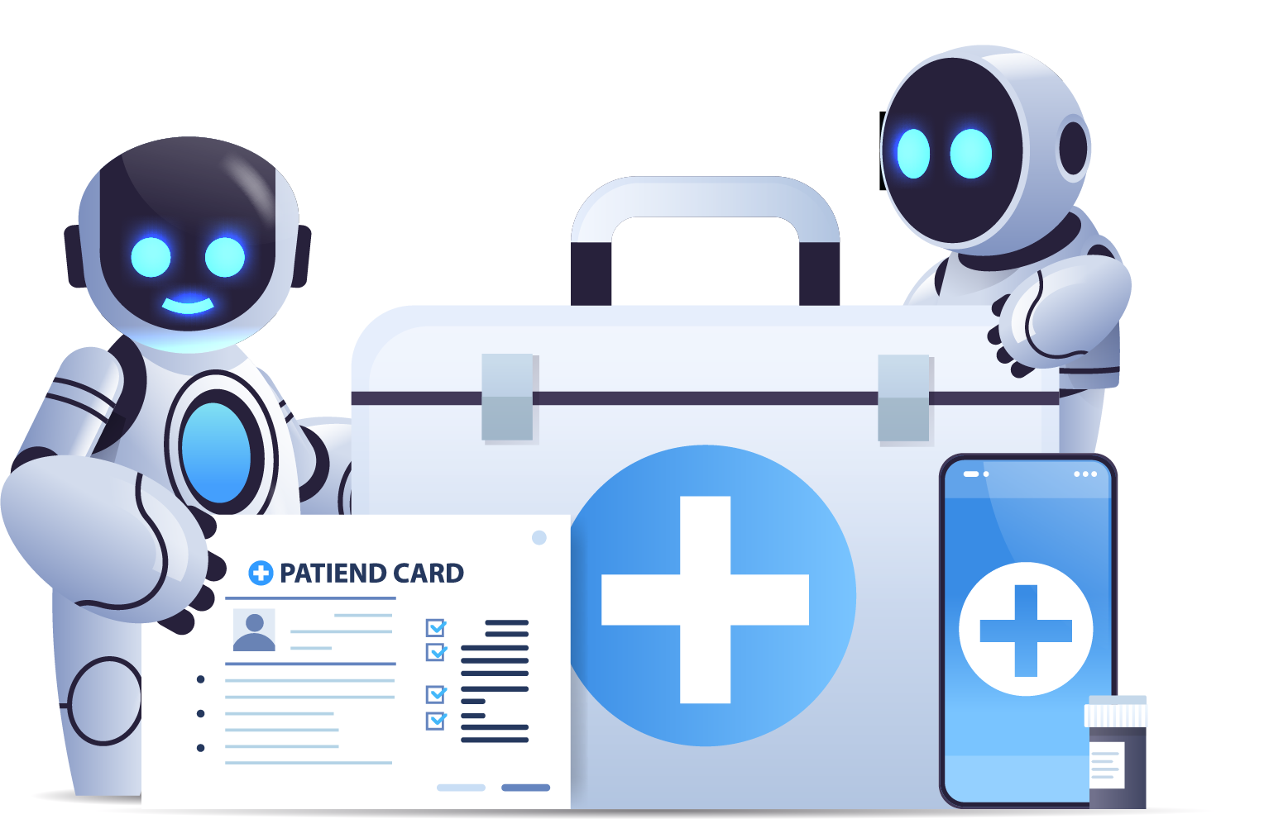
Advantages
24/7 Availability
Bot can be operate around the world without the need of break
Scalability
Bot can handle large volume of inquiries or task simultaneously, make them scalable solution for Businesses
Instantaneous Responses
Bot can provide immediate response to user queries or requests

Slide 5

Disadvantages
Lack of Human Touch
Bot lacks the empathy and emotional intelligence of human
limited Understanding and context
Bot sometimes struggle to answer or understand the queries
Maintenance
Needs to update the bot and maintain to ensure they effective over time

Slide 6
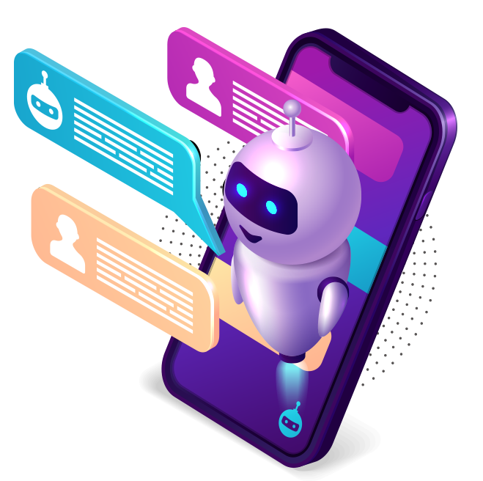
Future Scope
AI Implementation-AI assistants enhance their capabilities, enabling natural language interactions and seamless task automation.
Multi-channel response- Bots will expand beyond text-based to encompass voice-based , VR , AR and other emerging channel

Slide 7

THANK YOU

