Slide 1
Project Units and TE Units
Preliminary Analysis of MAE Transcript Data
14-June-2021

Slide 2
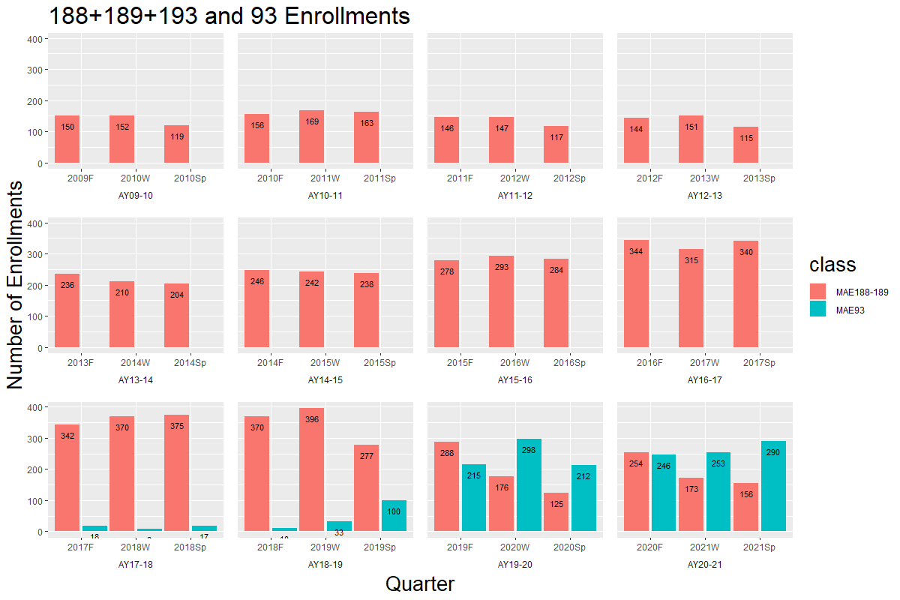
History of (189+188+193) and 93 enrollments. In AY18-19 we started Check-Ins. See next slide for information about summer project enrollments.

Slide 3
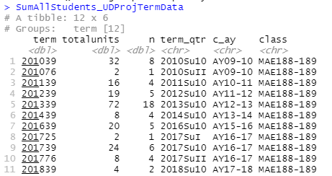
Some summer enrollments
Up to and including Summer of 2018, there were some summer enrollments.
They seemed to be mostly 188 with a few 189s.

Slide 4
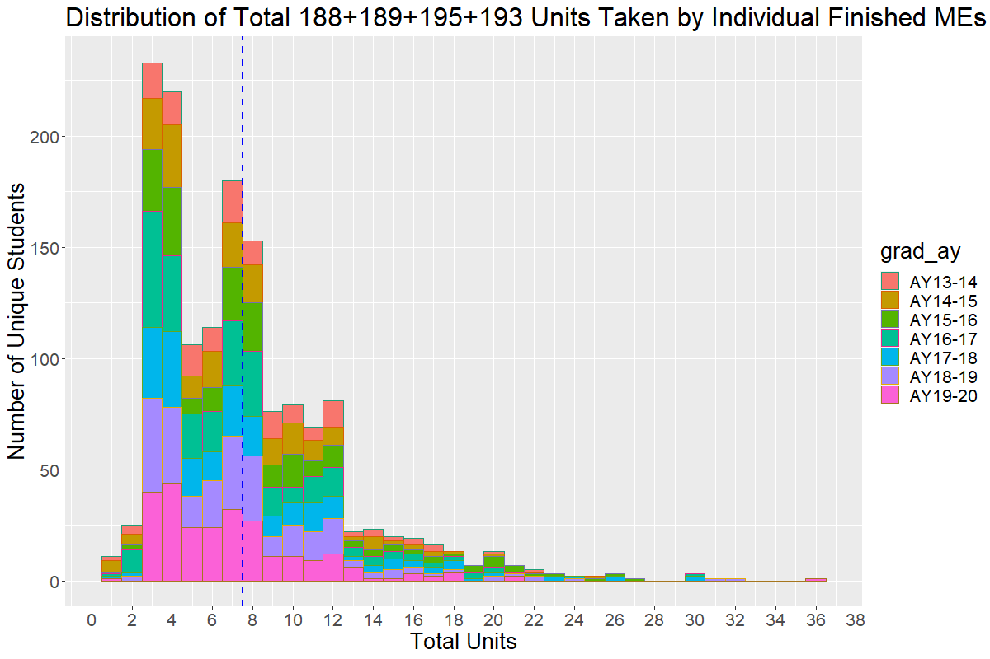
Including outliers, average is 7.5 units.
This includes required 3 units

Slide 5
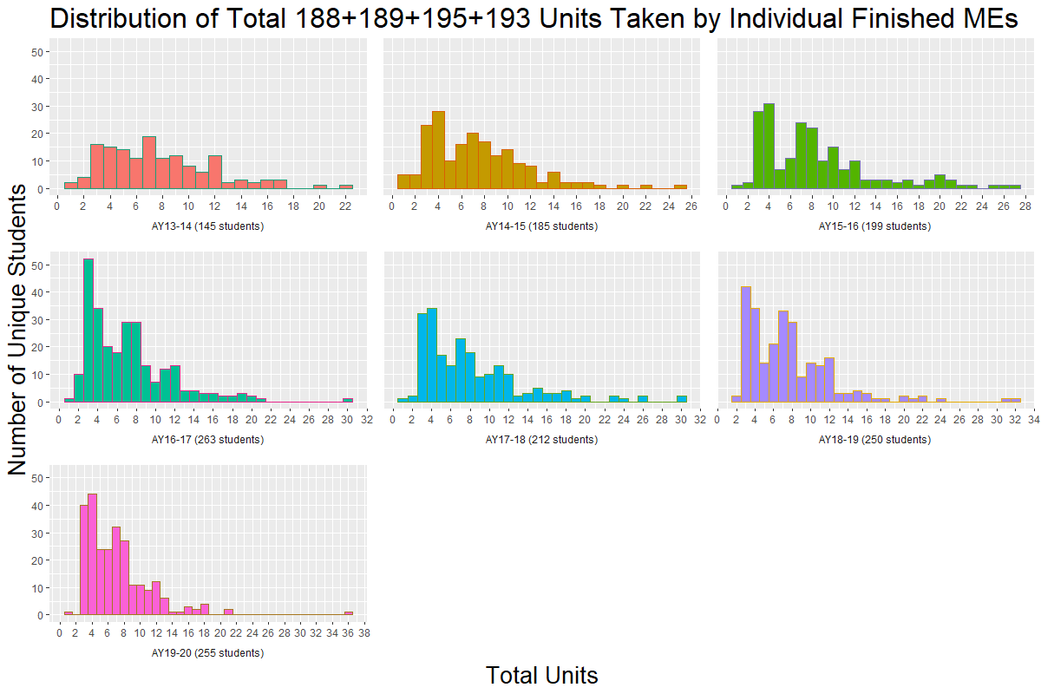
Faceted Distribution of all Upper Div project units taken by graduated MEs. Note that 3 units are required. They should not be taking more than 12

Slide 6
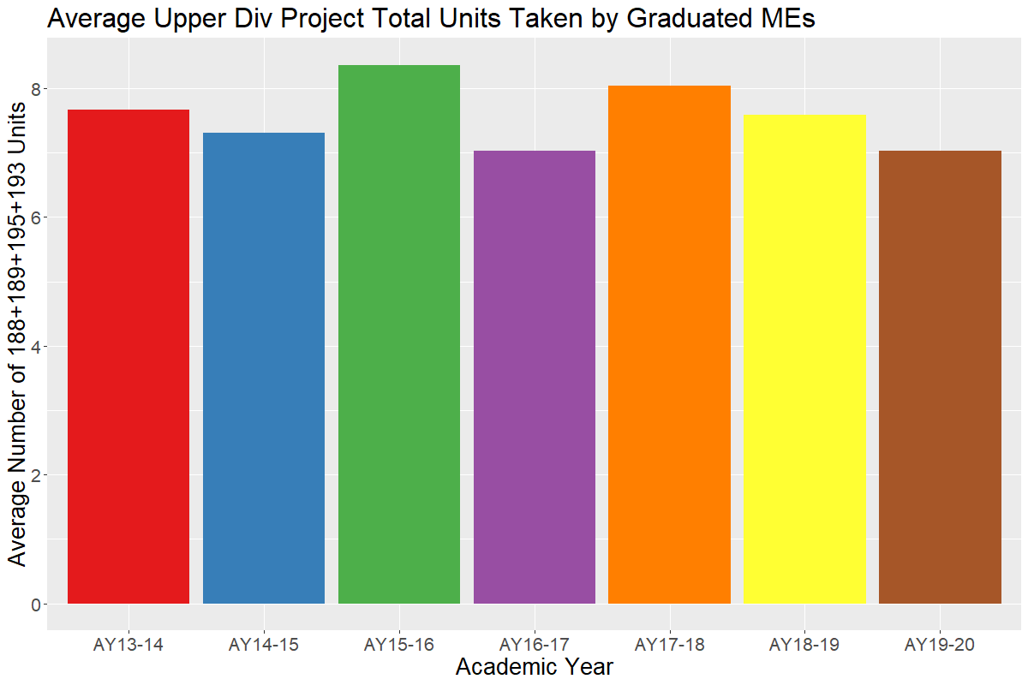
The AVERAGE total number of Upper Div Project units taken by graduated MEs

Slide 7
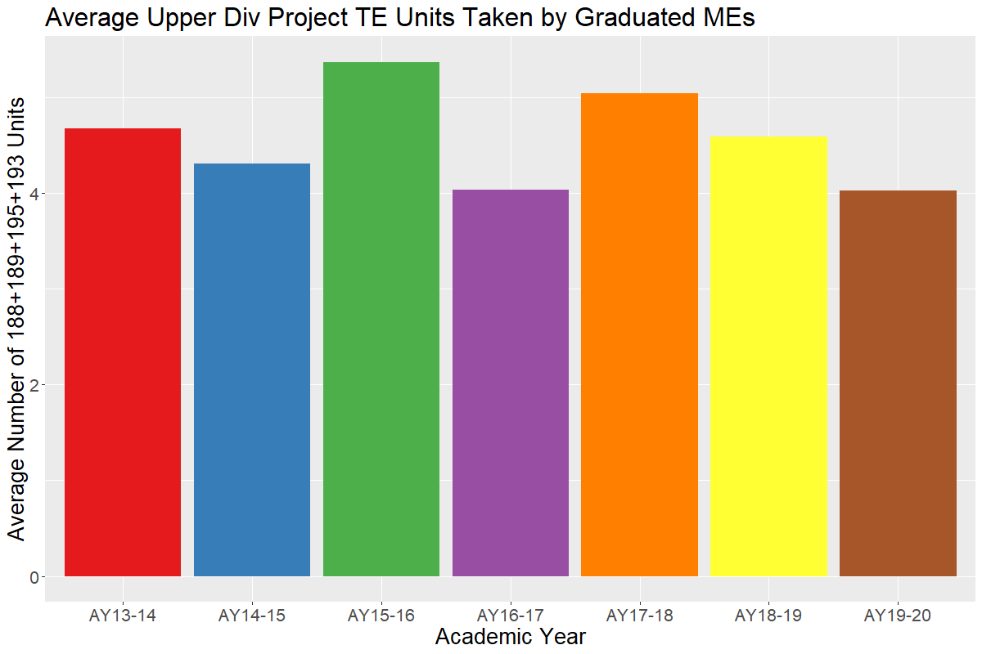
The AVERAGE number Upper Div Project units used by graduated MEs for Tech Electives … this is just the previous slide minus 3 units.

Slide 8
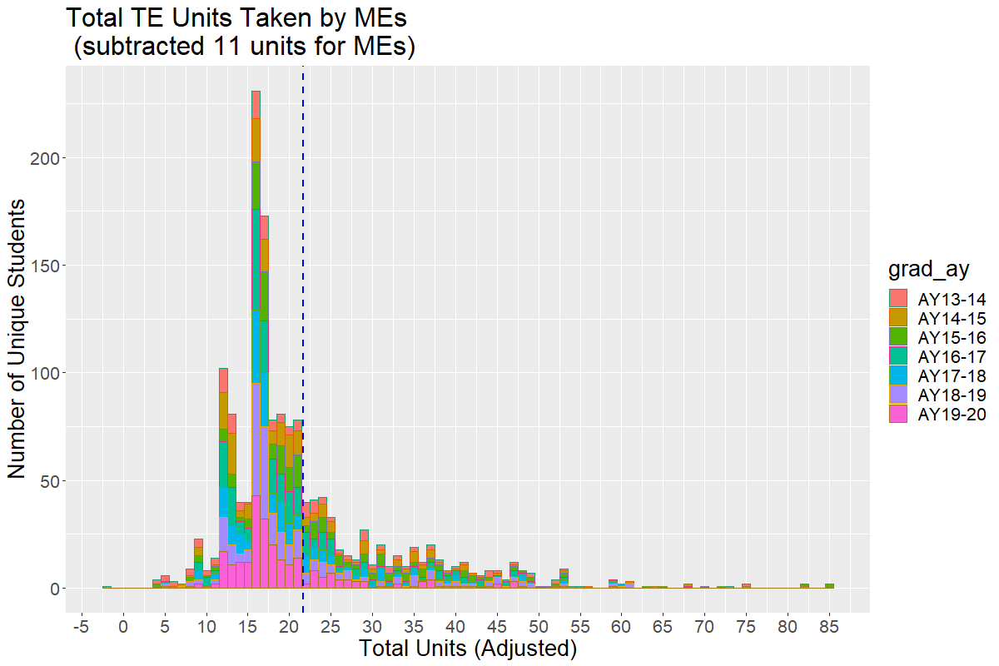
There are outliers, but
average number of TE units taken by MEs is 22 units

Slide 9
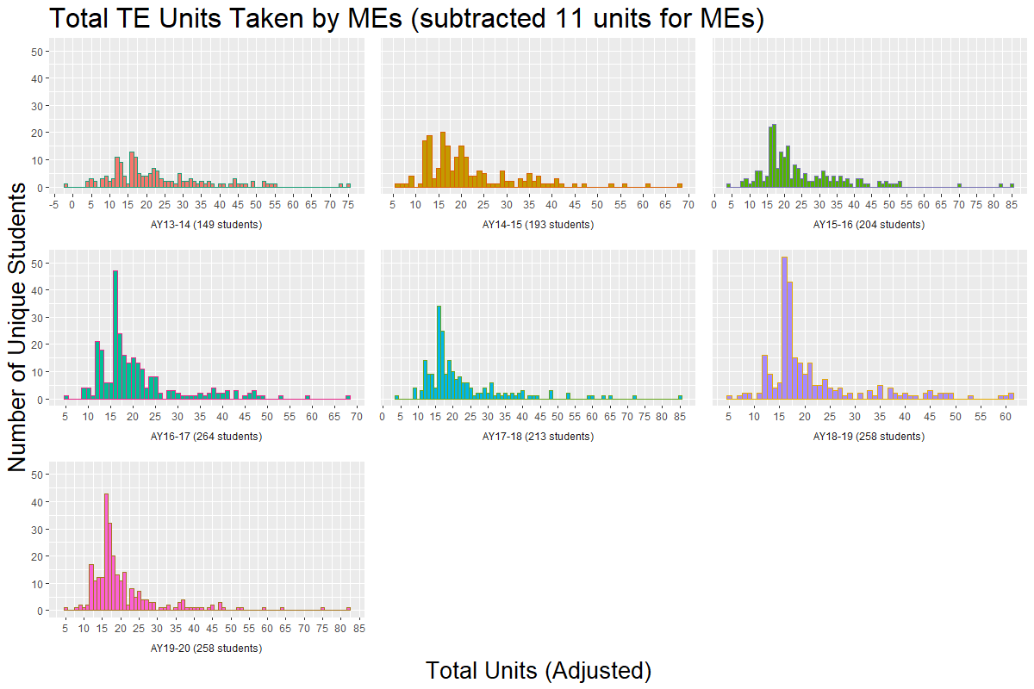
Evolution of total TE units taken my graduated MEs … should be >16

Slide 10
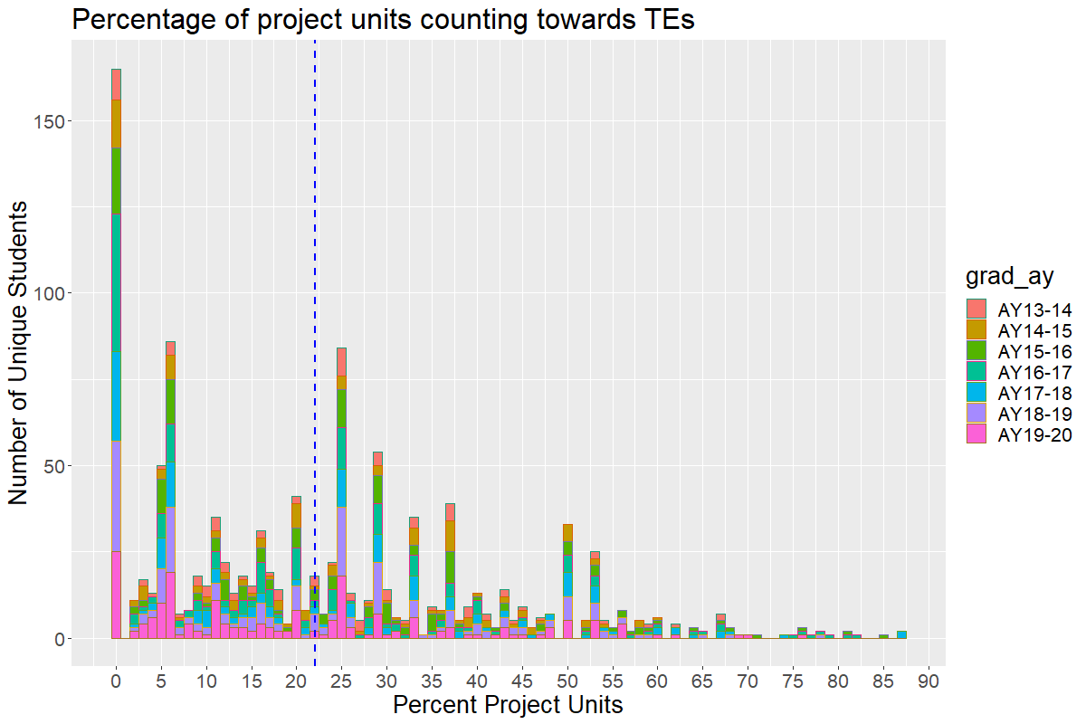
There are outliers, but
average is around 22% of TE from Project Units

Slide 11
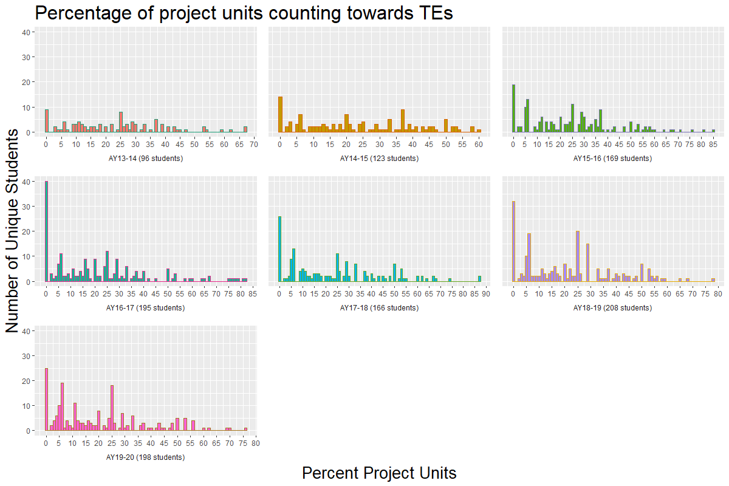
Evolution of the percentage of project units being used to satisfy Tes … cannot use more than 50%

