Slide 1
PoTSurveyAnalysis
Mark Walter

Slide 2
Introduction
This document currently has just 2 parts.
Year of hire by quarter and then by current rank.
Distribution of Actual, Preferred and Expected Workload by Activity
Hire Year Data
## Warning: Removed 3 rows containing non-finite values (stat_count).

Slide 3
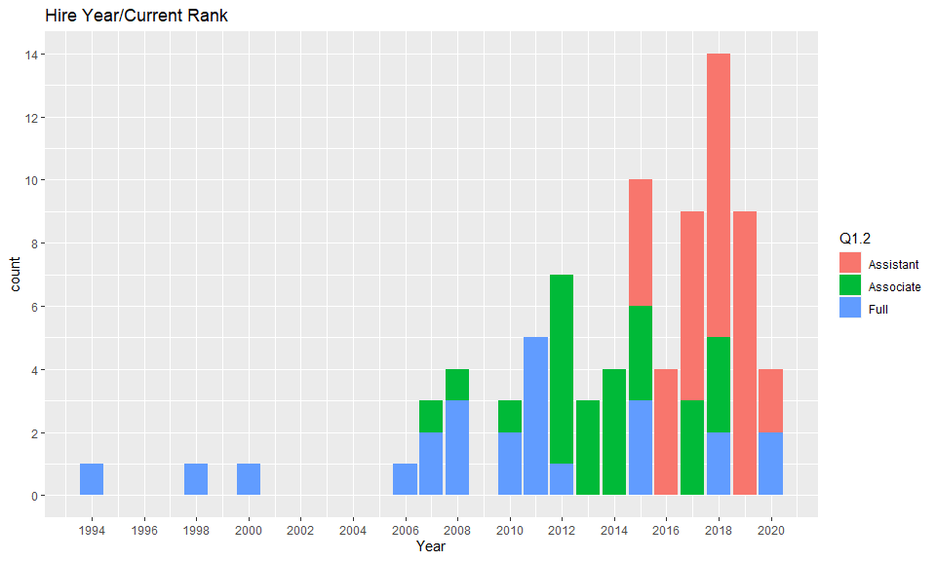

Slide 4
Workload Distribution Data
… # Plots …
subt <- "Workload Distribution: Expected, Desired, Actual" p <- ShowWorkMeans("1==1") p + scale_fill_brewer(palette="Greens") + labs(title=paste("All Pot (Count = ",count,")"), subtitle=subt)

Slide 5
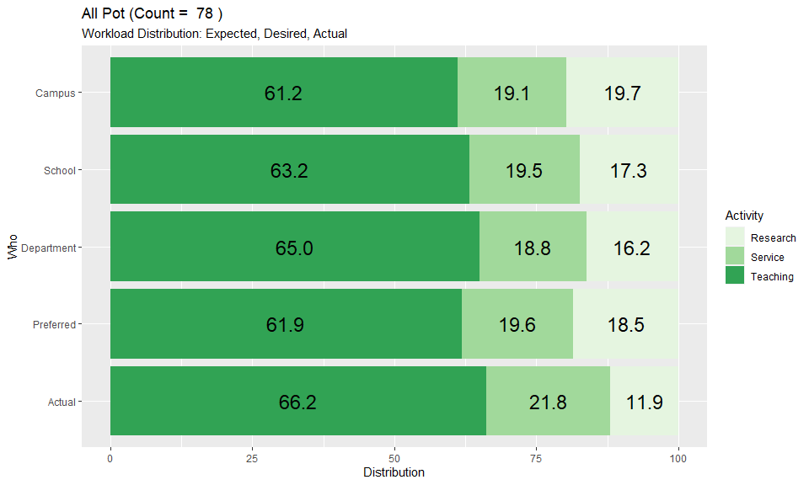

Slide 6
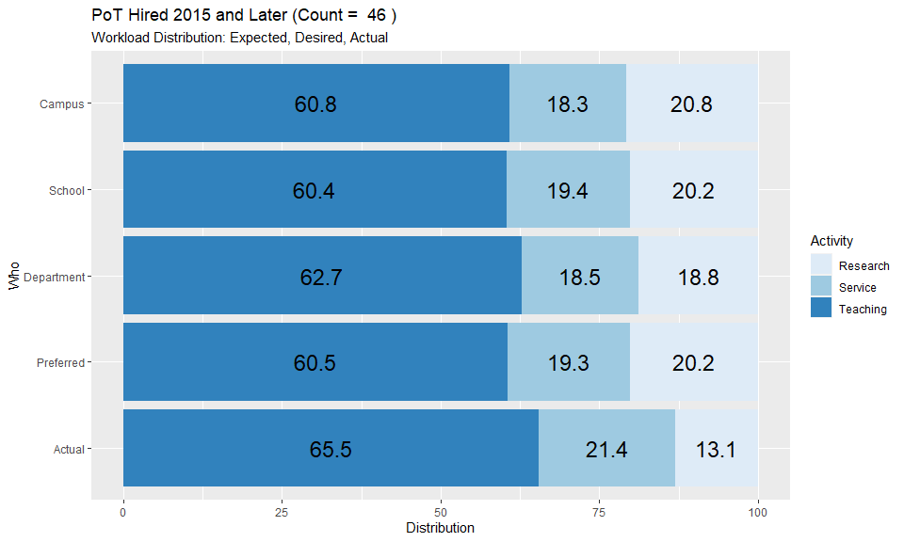

Slide 7
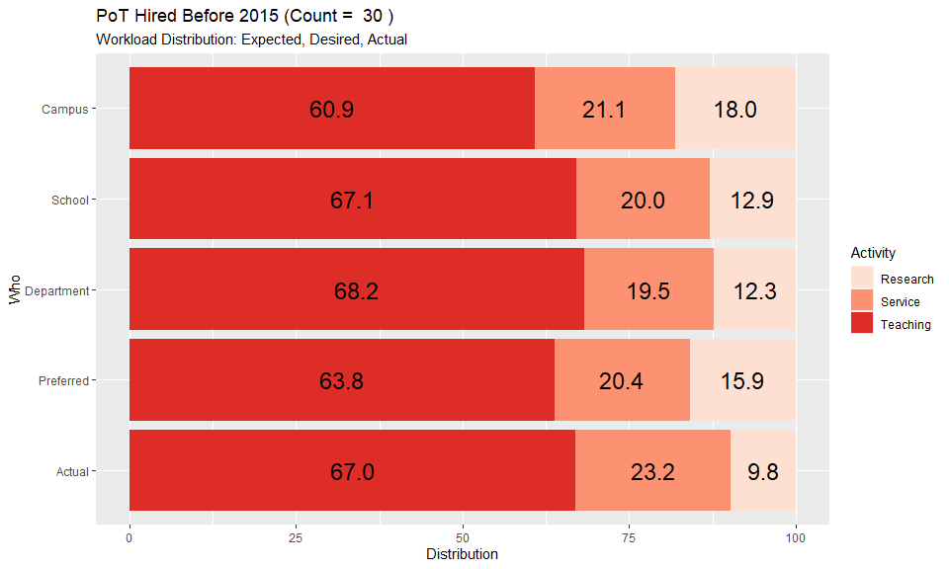

Slide 8
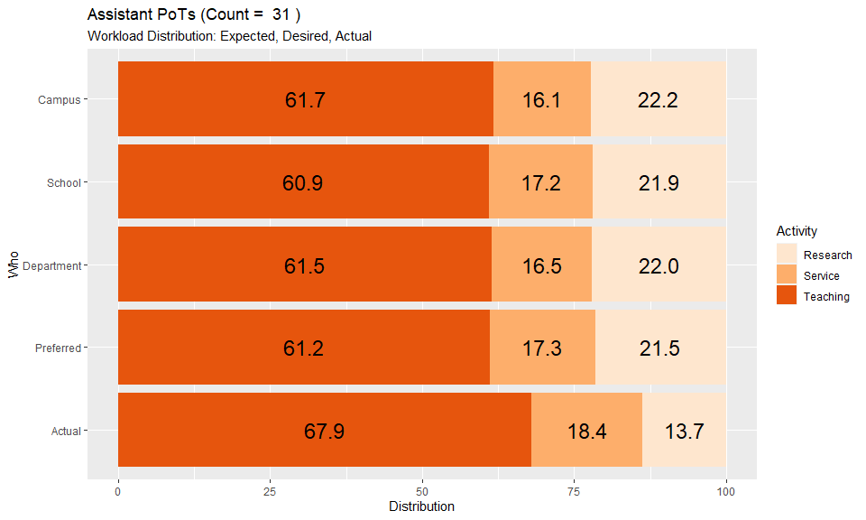

Slide 9
