Slide 1

Airline Sentiment Analysis
2021 Capstone project

Slide 2
Overview
Background
The Problem
Methodology
Solution
Next Steps

Slide 3

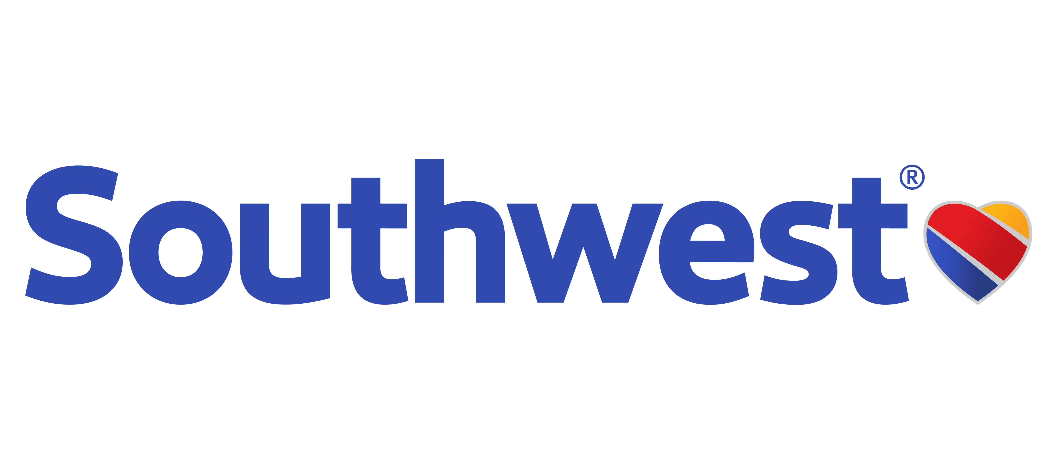





Background: What are customers tweeting?
192M Daily Active Users
500M Tweets per Day
2.5M Daily Passengers
42K Flights per Day

Slide 4
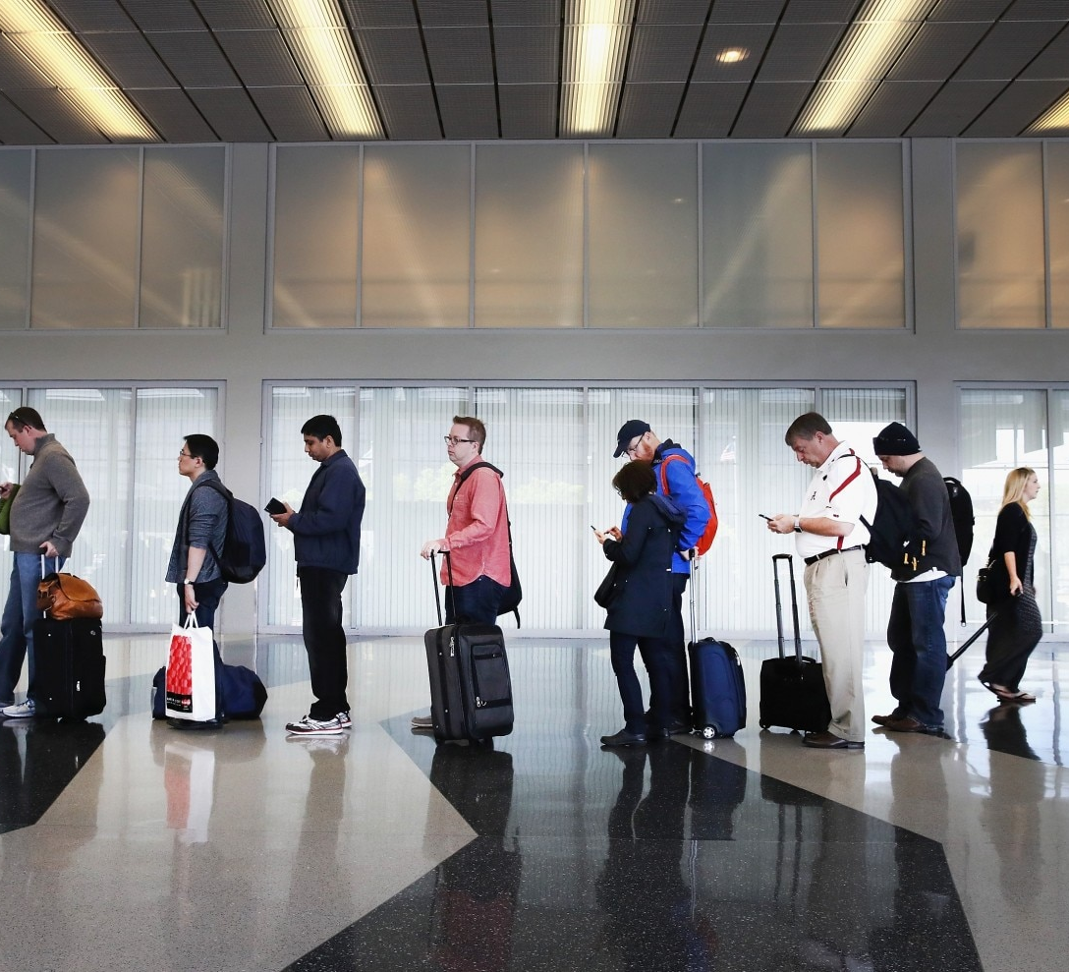
Problem Statement
US Airlines do not have real-time insight into their customers’ experience and brand impression.
Risks of Not Addressing this Problem:
  Negative social media left unchecked damages your reputation
  Missed opportunities for service recovery
  Misaligned improvements to operations without understanding the customer voice
  Lack trends* of customer sentiment over time
  *increasing, decreasing or maintaining

Slide 5
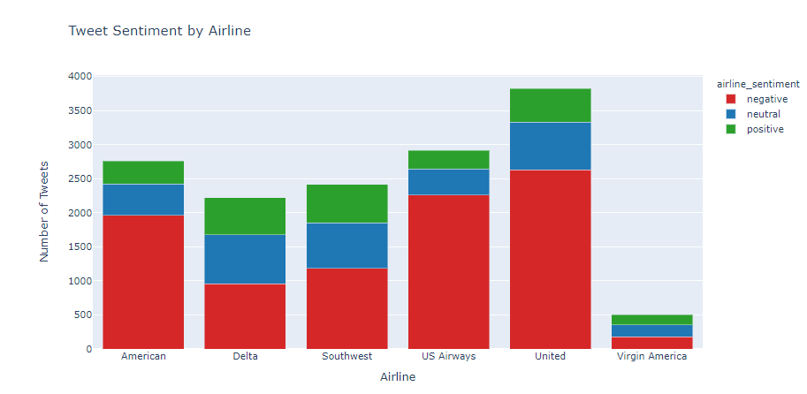
Airline tweets
14.5K Tweets scraped from Twitter in February 2015 referencing six of the major US Airlines and individually classified by sentiment.

Slide 6
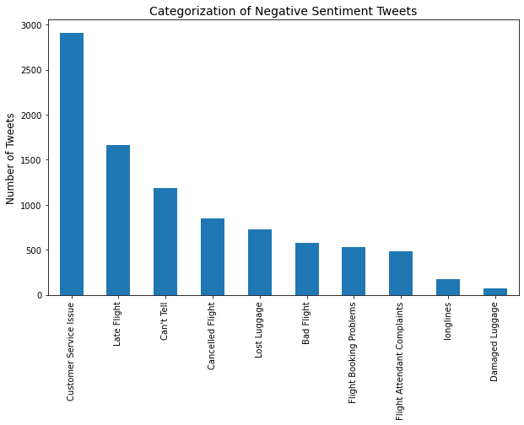
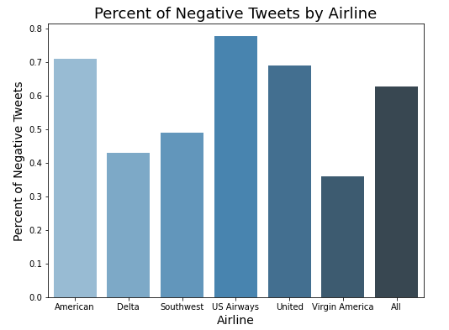
Negative sentiments

Slide 7
Methodology
Natural Language Processing and Sentiment Analysis

Slide 8
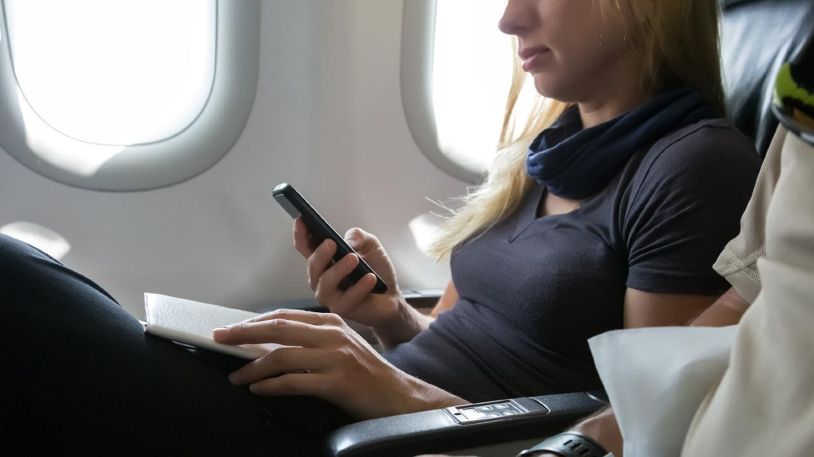
Goal:
Reliably predict the sentiment for tweets concerning US Airlines.
process:
Data Wrangling
Tweet Cleaning
Tokenization & Stemming
Exploratory Data Analysis
Word Clouds
Tweet Structure
Model Preprocessing
Bag of Words
Modeling
Additional Feature Creation
SentiWordNet
Evaluation
Model Selection

Slide 9
Natural language Processing & sentiment analysis
Natural Language Processing (NLP) is a subgroup of Artificial Intelligence (AI) that allows machines to dissect and interpret human language
  Used in Machine Learning to incorporate text or audio data
  NLP includes techniques, models, feature creation and extraction, etc.
Sentiment Analysis is a method to understand how customers feel about a brand, product or service using social media data
  NLP is the foundation of Sentiment Analysis, allowing for the processing of the huge volume of social media data
  Basic Sentiment Analysis categorizes the sentiment of social media streams as positive, negative or neutral

Slide 10
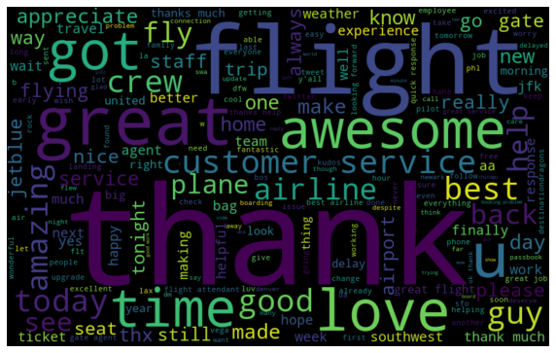
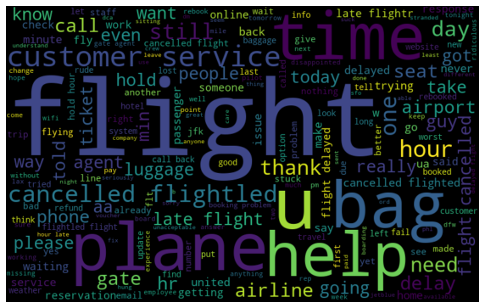
Sentiment Word Comparison
Positive Tweet Word Cloud
Negative Tweet Word Cloud

Slide 11
Solution & Next steps
Modeling conclusions

Slide 12
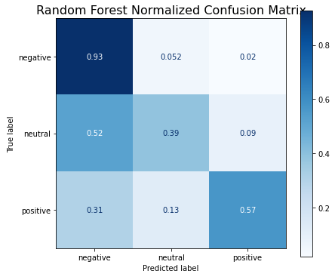
Best model: random forest
Modeling approach: Bag of Words
Top Features:
  Number of Words, Total Hashtags, words: experience, really, trip, said
Highest predictive power: Negative Tweets
Lowest predictive power: Neutral Tweets
76%
F1 – Score
30%
Increase over
Baseline

Slide 13
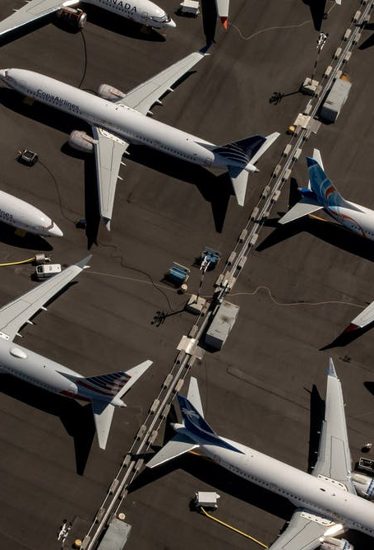
Next Steps
Create Customer Experience Dashboard
  Implement real-time version of sentiment analysis model with data visualization
  Include key words, tweet volume and trends over time
Model Enhancements
  TF-IDF (Term Frequency- Inverse Document Frequency) to improve word importance
  N-grams – include sequential context to model to improve predictive power
  Vader – rule-based analysis tool and dictionary for social media text

