Slide 1
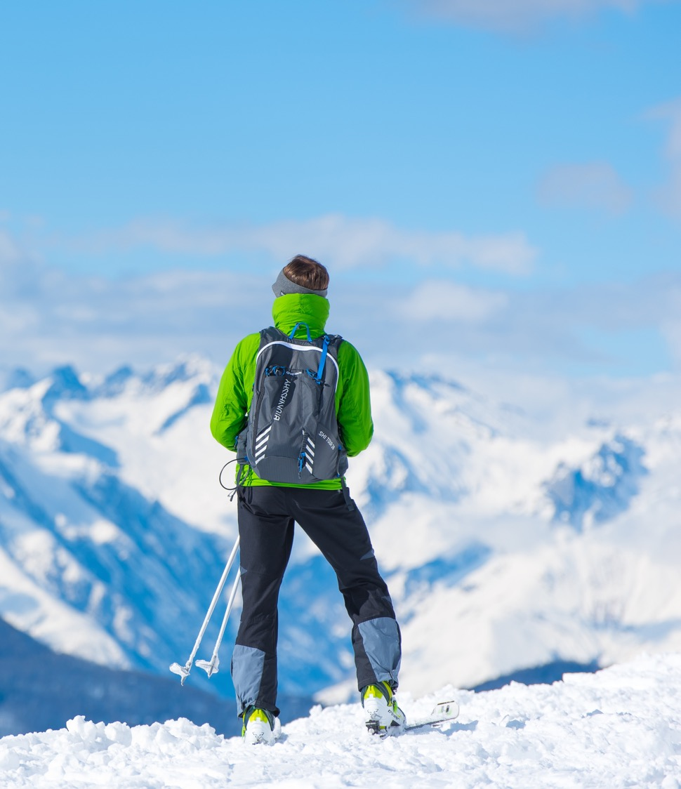
Big Mountain Resort
DATA DRIVEN PRICING STRATEGY JANUARY 2021

Slide 2
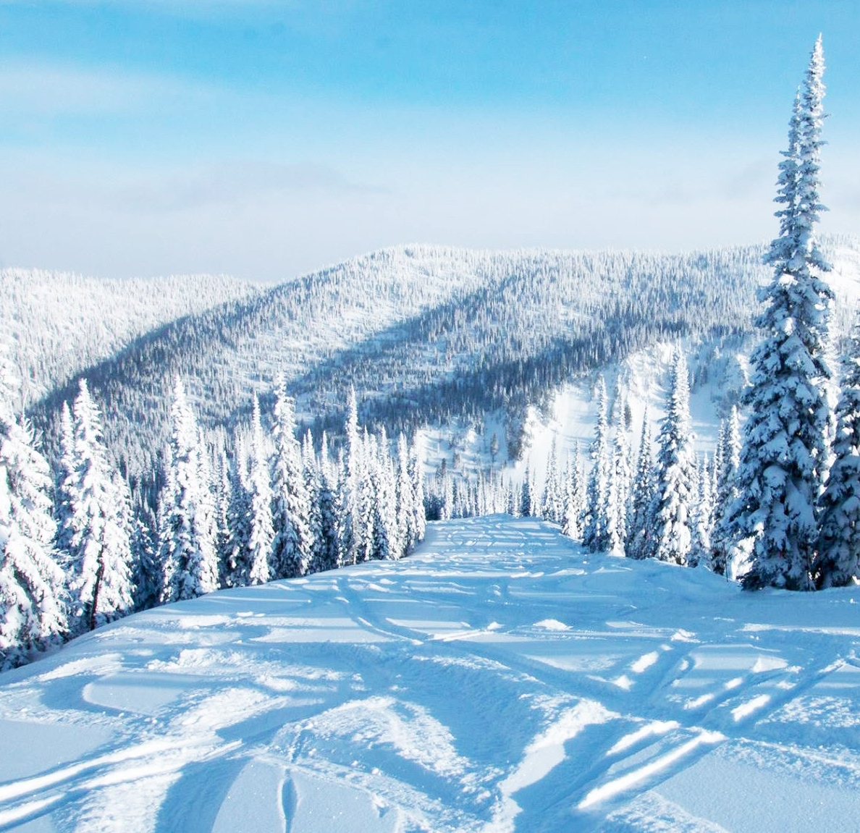
Problem statement
How can Big Mountain Resort restructure their ticket pricing model to offset their new and ongoing $1.54M lift operating cost by understanding and maximizing their facility investment strategy before the start of next ski season?

Slide 3
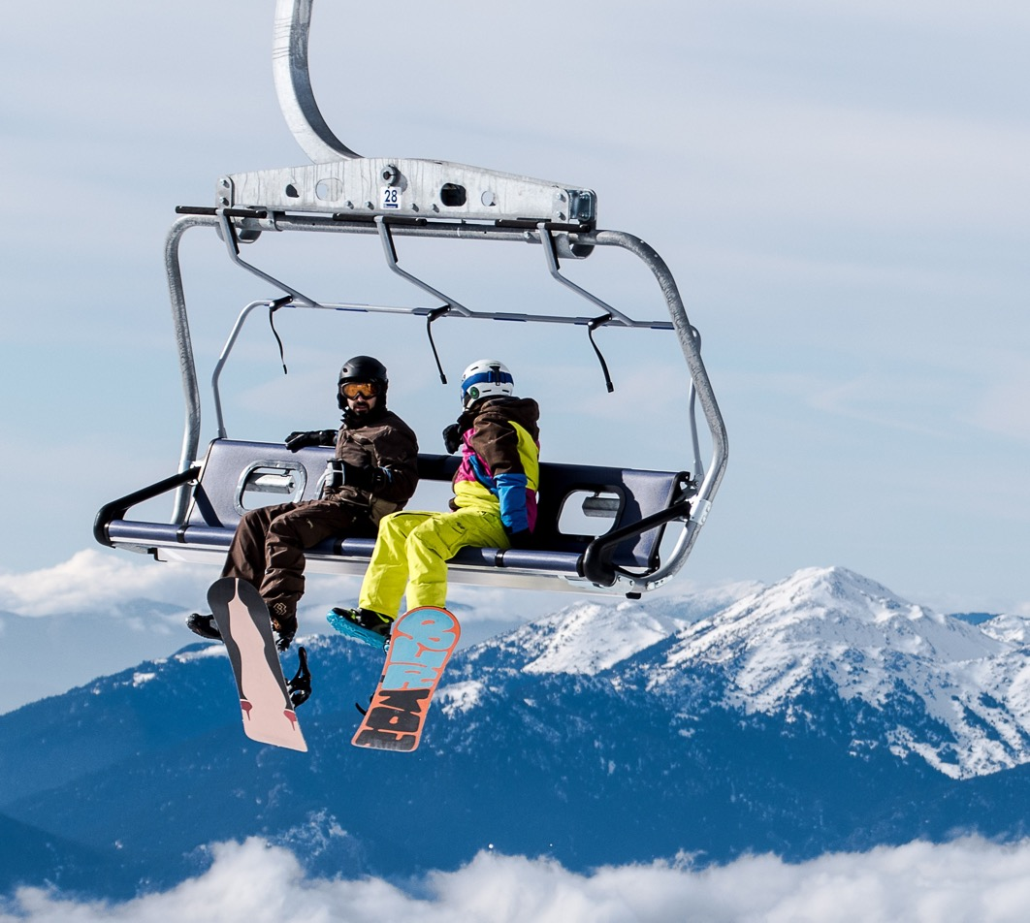
Recommendation
Increase base ticket price to $86/day
Align pricing with top resorts around the country
Capitalize on being in the 90th percentile for key resort features
Increase projected revenue by $8.75M
Offset the new lift operating cost
Notes:
© Copyright Showeet.com – Free PowerPoint Templates

Slide 4
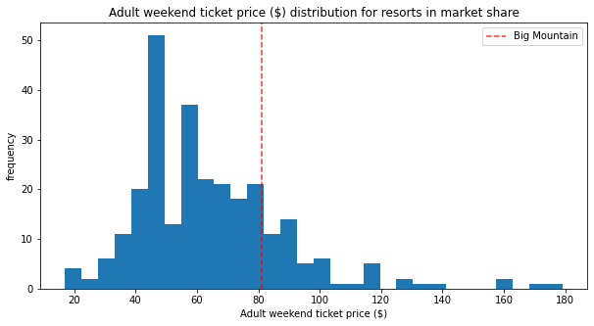
Modeling analysis
Current pricing for ski resorts around the country were predicted based on key features that draw customers
Key Features: Fast Quads, Vertical Drop, Snow Maker Coverage, Total Runs
Big Mountain current pricing of $81 puts it in the 80th percentile for ticket prices
The model predicted a market driven price for Big Mountain of $96 with an error of +/- $10

Slide 5
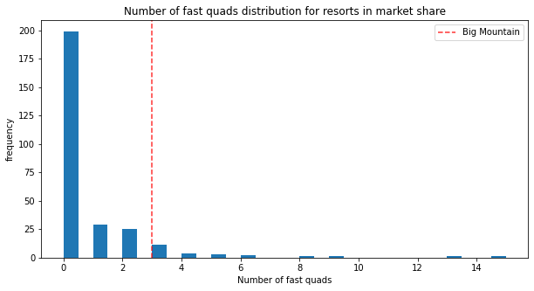
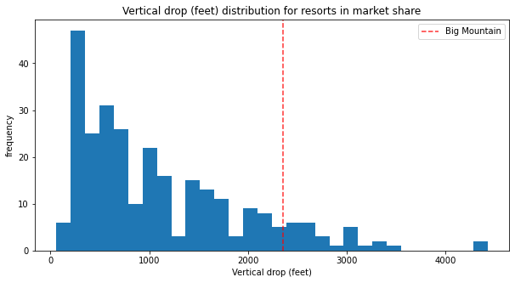
Key features
Fast Quads
Vertical Drop
Big Mountain Resort has more fast quads than 95% of resorts.
Big Mountain Resort has a bigger vertical drop than 90% of resorts.

Slide 6
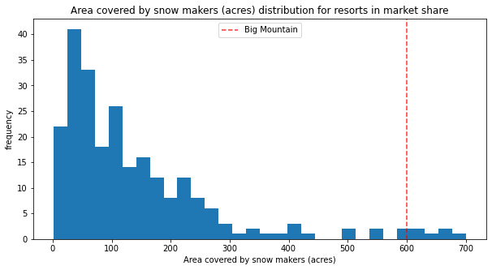
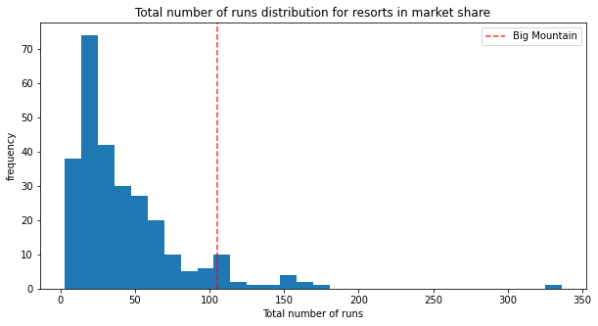
Key features
Snow Maker Coverage
Total Runs
Big Mountain has more snow making coverage than 97% of resorts.
Big Mountain Resort has more runs than 93% of resorts.

Slide 7
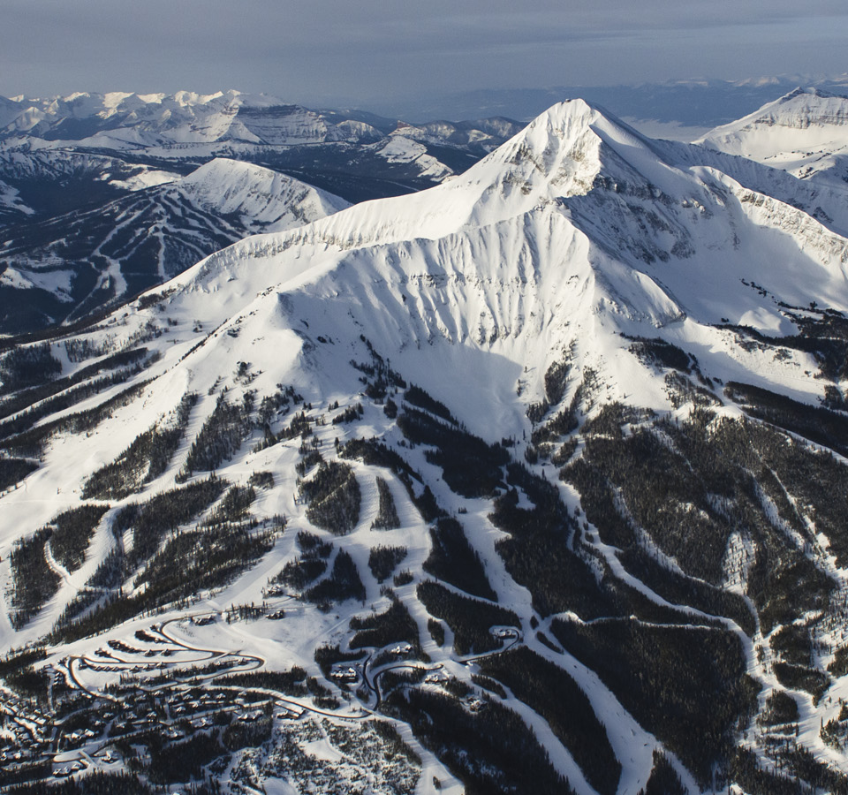
Strategic investment opportunities

Slide 8
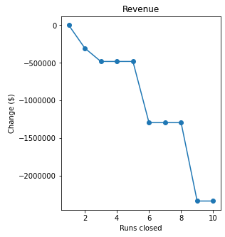
Least used runs
Scenario: permanently close up to 10 of the least used runs.
Close one run with no impact on revenue
Consider closing up to four additional runs depending on associated operational cost savings

Slide 9
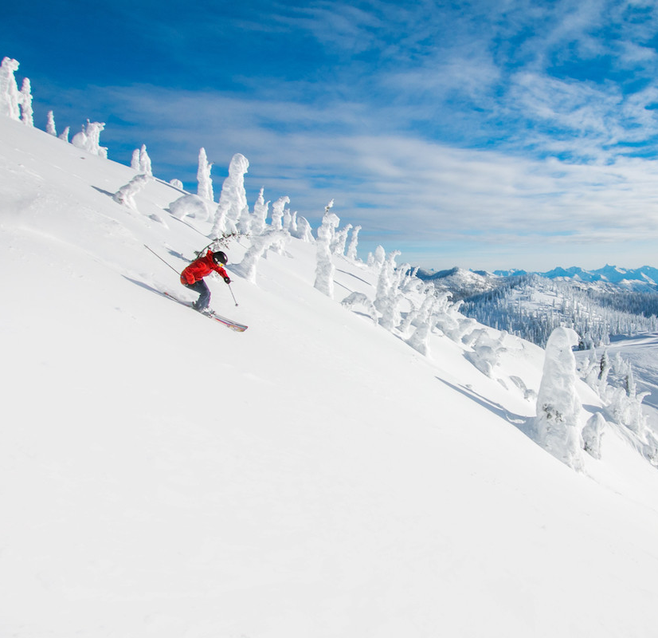
Vertical Drop
Scenario: Increase the vertical drop by adding a run to a point 150 feet lower down and install an additional chair lift
Increases ticket price by $1.60
Revenue increase of $2.8M offsetting the cost of another chair lift
Additional snow making coverage has no effect on increasing ticket prices

Slide 10
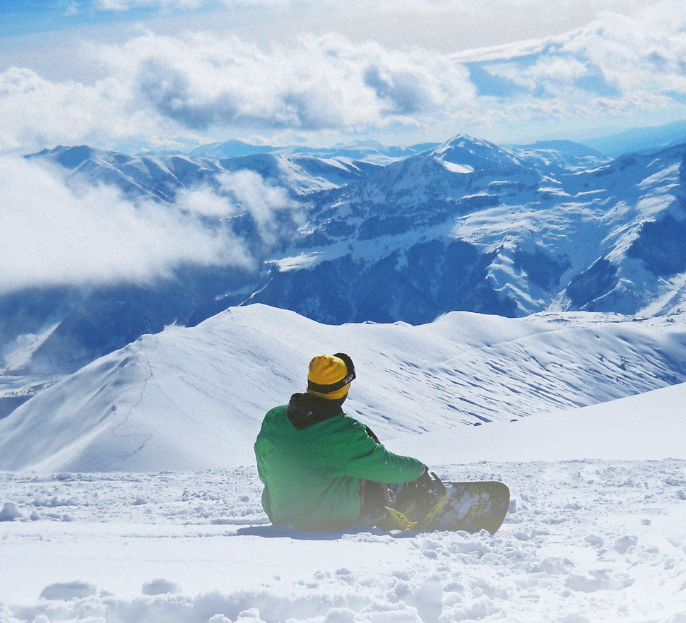
summary
Big Mountain facilities are in the top 10% of the country
Increase ticket price to a minimum of $86
Offset the cost of the new $1.54M lift
Up to 5 runs could be permanently closed as a cost savings measure
Adding the run to increase vertical drop increases revenue by $2.8M
Increase ticket price to $87.60

