Slide 1




Microfinance funding

Slide 2

agenda
Background
The Problem
Methodology
Solution
Next Steps

Slide 3
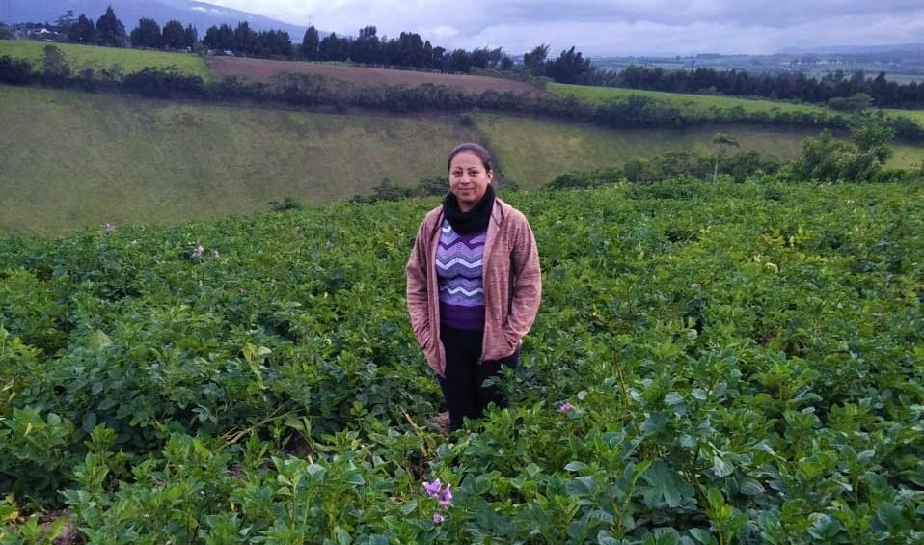
Sandra’s Story
“Sandra is twenty years old. She and her family are Columbian. They have been living in Ecuador for over ten years. Sandra is an enthusiastic, hard-working and responsible woman. She has been farming for two years. The work has allowed her to be a big support for her family because she generates her own income. Sandra's dream is to make progress and to improve their standard of living. Sandra needs to purchase farm supplies for her potato crop so she can care for it and keep it productive. Doing so will give her the opportunity to earn a good income and allow her to meet her personal expenses as well as those of her household. She wants to continue increasing her working capital, to be able to keep planting more and to create stability in her farm work.”
#Refugee | #Vegan | #Woman-Owned Business
To purchase farm supplies for growing potatoes | Farm Supplies
Country: | San Gabriel, Ecuador
Total Loan: | $1500 for 17 months
Loan Partner: | VisionFund
Notes:
This is Sandra. She is a typical borrower for Kiva. Kiva provides services to enable micro loans to borrowers around the world empowering them to improve their quality of life.
How it works:
Borrower works with a partner organization to outline the needs for their loan
Partner connects with Kiva to facilitate securing funding for the loan
Kiva posts the loan for 30 days on their online platform for lenders around the world to provide funds**
The borrower makes repayments to the Field partner who sends funds to Kiva to repay the lenders
**Loan is disbursed to the borrower prior to the loan going through the funding period
Sandra has been farming potatoes

Slide 4
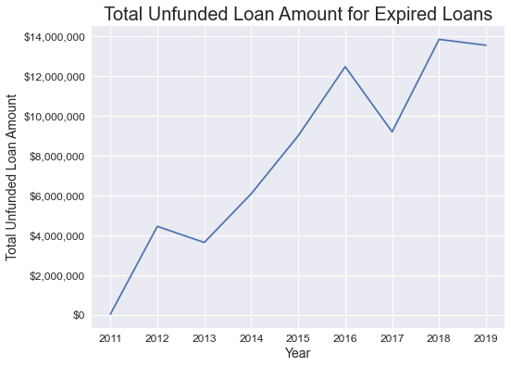
The problem
In Kiva’s current model they assume the financial risk for all underfunded or unfunded loans on their platform. Since 2011 this has grown from $0 to almost $14M. Kiva needs to minimize their financial risk to expand micro loans to new populations of borrowers.

Slide 5
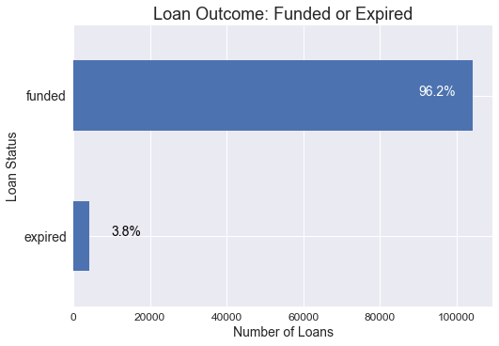
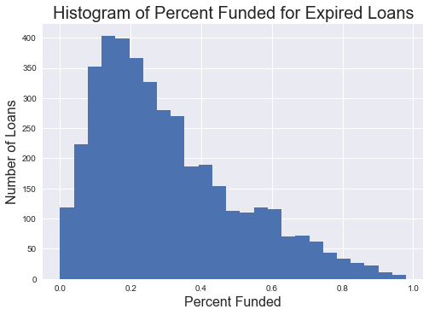
What does the data say?
A small amount of loans expire
3.8% in 2019
Average expired loan is less than 30% funded when it expires
Average expired loan is underfunded by $932

Slide 6
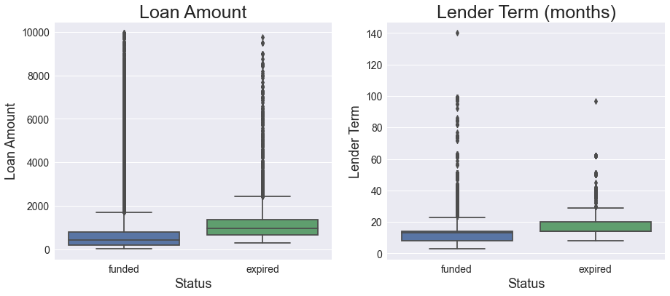
What does the data say?
Expired loans tend to be for larger amounts with longer terms

Slide 7
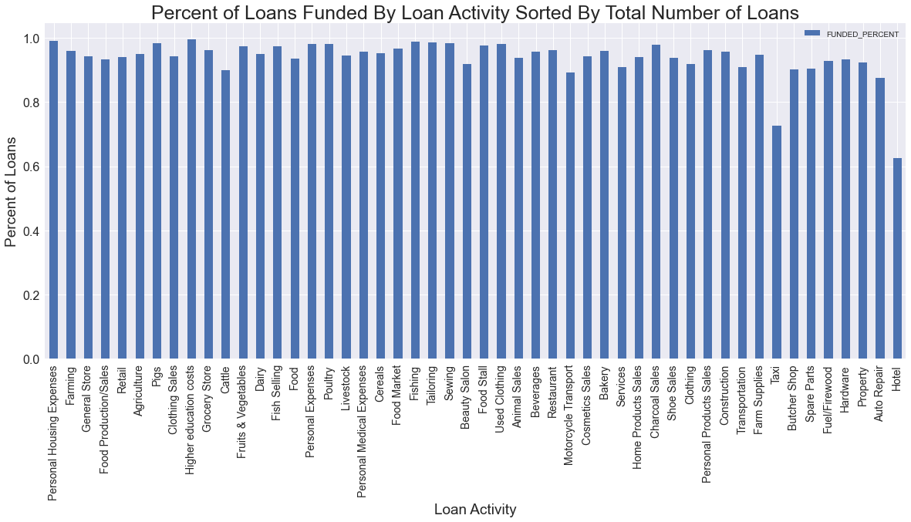
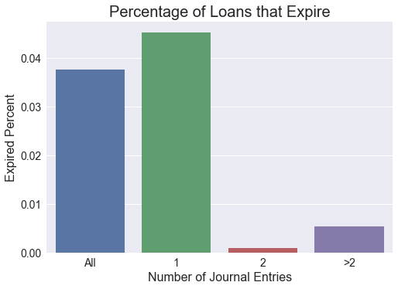
What does the data say?
Borrowers & their Stories Matter
Profiles with more updates had a lower rate of expired loans
Female loans expired 5% less often than male or mixed loans
Loan Purpose Matter
Percentage of Loans Funded by activity varied from 60% - 100%

Slide 8
Methodology

Slide 9
Approach
Develop a predictive model
Class imbalanced data
Classification prediction
Highly dimensioned dataset
Model Evaluation
Minority class F1 score
Identify Recommendations
Short-Term & Long-Term
Notes:
to proactively identify loans that will expire during the funding period
(majority to minority: 96/4)

Slide 10
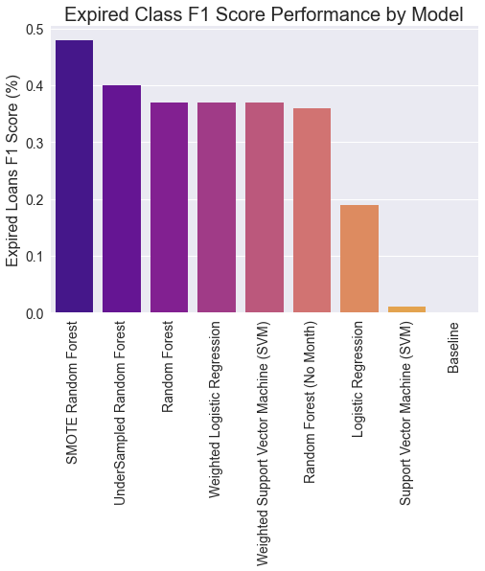
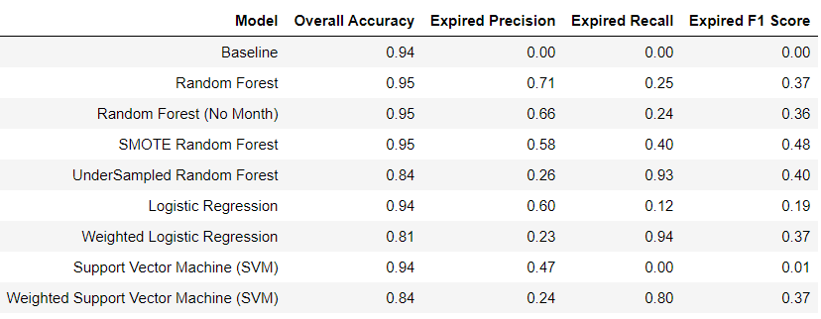
Model selection & Comparison
Random Forest
Logistics Regression
Support Vector Machine

Slide 11
Solution & next steps

Slide 12
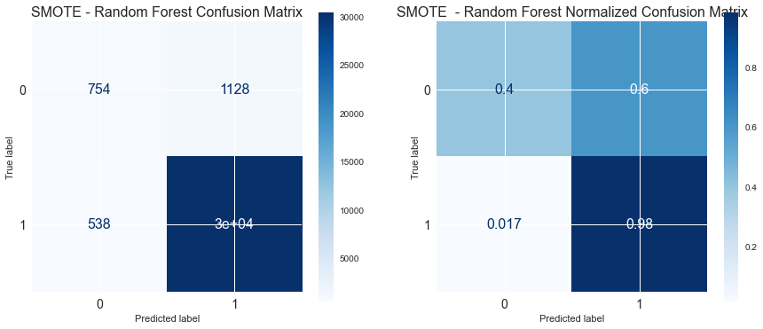
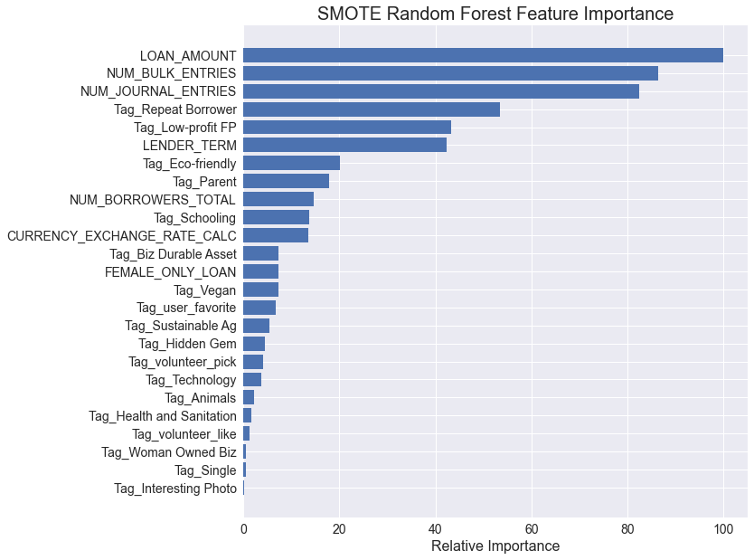
Best model: Random forest (SMOTE)
Most balanced model for precision and recall of the minority (expired) class
Key features: Loan amount, bulk entries, journal entries, loan “tags”, lender terms and total borrowers

Slide 13
Next steps
Reduce Kiva’s financial risk
Predict loans that will not fully fund
Proactively adjust loan terms
Use targeted marketing
Tag loans for better visibility
Problem
Analysis
Tactics
Notes:
Problem: In Kiva’s current model they assume the financial risk for all underfunded or unfunded loans on their platform. Since 2011 this has grown from $0 to almost $14M. Kiva needs to minimize their financial risk to expand micro loans to new populations of borrowers.
The intent of this project was to identify which loans would not be fully funded during the time that the loan was posted on the Kiva platform to allow for proactive interventions before posting the loan. The SMOTE model would allow for a little less than half of these loans to be identified while keeping the false positive rate relatively low.
Loans: Counsel borrowers or set standards to align the technical aspects of the loan to align better with loans that are successfully funded in each sector
Platform: Feature loans that are predicted to underfund to attract more lenders. Encourage borrowers to write journal entries about their journeys. Work with partners to understand which types of loans are successful and feature those stories with similar loans that might not fully fund.
Tags: Use tags to allow for underfunded loans to be searched more easily

